Slide 1
Introduction to PCBs

Slide 2
Preliminaries
Units
We will use mm in this class.
Lots of tutorials, documents, etc. use mils (1/1000 of an inch) or inches.
1mm is about 40mils (39.3700787, actually)
Keep an eye on your units.
Video that explains PCB manufacturing
https://www.youtube.com/watch?v=59Io2Moz8G4

Slide 3
PCBs are Made of Layers
Silkscreen – documentation labels
Metal – for making wires
Dialectric – insulation and structure
Solder mask – protective outer coating

Slide 4
Metal Layers
The Metal layers for several components
Conductive “traces” to connect components
Pads for attaching/connecting components
N-layer boards have N metal layers
N usually is 2,4,...
Fewer layers → cheaper
Top and bottom layers are for mounting components and routing traces
Internal layers can serve several purposes
Ground and power planes
Other signal planes
Internal routing layers

Slide 5
Metal Layers (cont.)
Thickness is measured in oz per square foot.
Standard copper is 1oz
About 0.034 mm
Thicker metal layers can carry more current

Slide 6
Dialectric
The dialectric in the insulator between metal layers
Most PCBs use FR4
“glass reinforced epoxy laminate”
i.e., fancy fiberglass
“FR” means flame retardant
Other specialized dialectrics are are available
To support high speed circuits
To manage thermal expansion

Slide 7
Solder Mask
The solder masking is a polymer (plastic) coating on the top and bottom of the board
Solder does not adhere to it.
It serves several needs
Protects the top and bottom metal from oxidation.
Helps prevent solder bridges

Slide 8
Silkscreen
It’s an opaque (usually) white epoxy
It provides documentation and markings
References designators
Part outlines
Logos
Serial numbers etc.

Slide 9
Connecting Layers
Plated holes connect metal layers.
Drill a hole
Electroplate it with copper
The plating attaches to metal that the hole passes through

Slide 10
Pads and Vias
Vias are electrical connections
Usually very small.
Through hole pads accommodate through-hole parts
Even larger, mounting holes are possible

Slide 11
Designing Through-hole Pads
The diameter of the hole is smaller than the drilled hole
You need to add about 0.3 mm to the desired, plated internal diameter to get the drill diameter
More here: http://goo.gl/NzcY2W

Slide 12
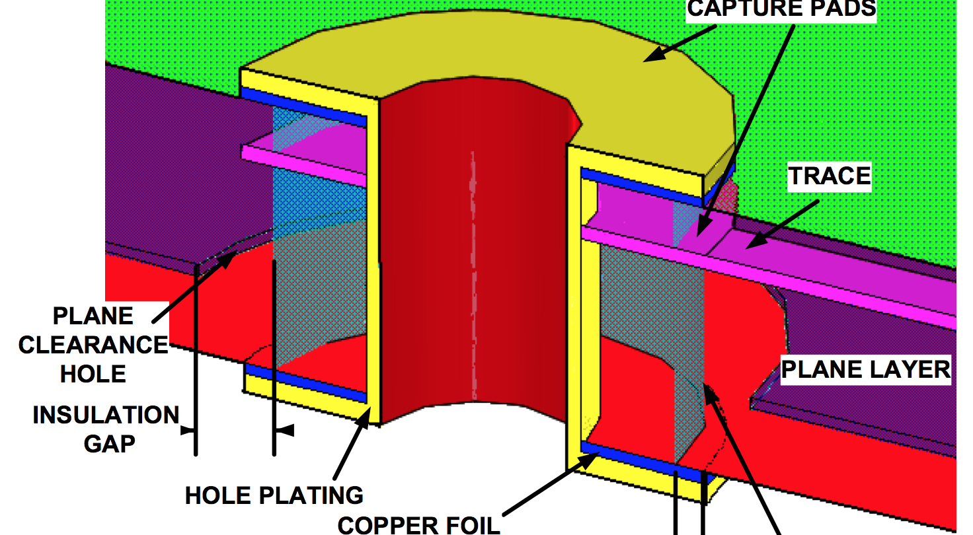
Holes and Vias

Slide 13
Lots of Choices, in Theory
There are clearly many, many choices when designing a PCB
We will get to make very few of them
Cheap, quickturn PCB manufacturers provide a standard setup. E.g.:
FR4
1oz copper
2 or four layers

Slide 14
Resources
White paper about board stackups
www.icd.com.au/articles/Stackup_Planning_AN2011_2.pdf
Videos of PCB Manufacturing
https://www.youtube.com/playlist?list=PL8zP8UuDk8a0ZNWiteC-7PHx1HCeBY0qB
Original version with text: http://www.eurocircuits.com/Making-a-PCB-PCB-Manufacture-step-by-step

Slide 15
Decoupling Caps
http://www.vagrearg.org/content/decoupling
http://www.analog.com/static/imported-files/tutorials/MT-101.pdf

