Slide 1

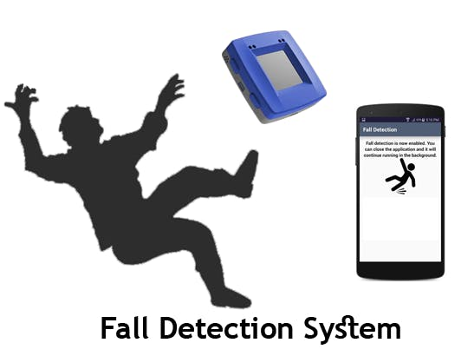
FALL DETECTION USING COMPUTER VISION
BY
NVS PAVAN KARTHIK

Slide 2
TOPICS TO BE DISCUSSED
Problem statement
Application of Fall Detection
Previous work in this field using sensors
Disadvantages of wearable type sensor fall detection
Fall detection using computer (camera based) vision
Our Projects Flow chart
Results with test images and
Conclusion

Slide 3
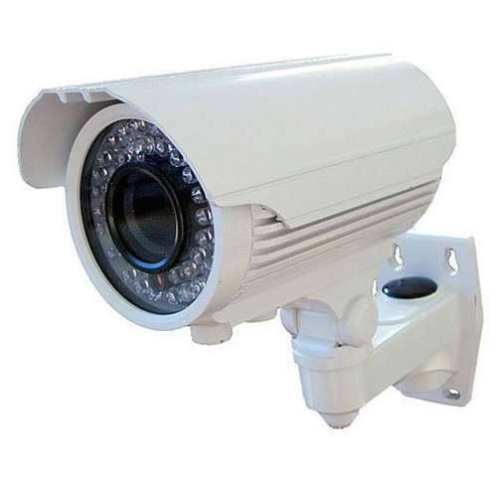
PROBLEM STATEMENT
Fall detection is a major problem in the healthcare department. Elderly people are more prone to fall than others. There are more than 50% of injury-related hospitalizations in people aged over 65.
A more affordable and adaptable system is necessary for retirement homes and clinics to build a smart city powered by IoT and artificial intelligence. An effective fall detection system would detect a fall and send an alarm to the appropriate authorities.
PROJECT AIM :
Fall detection using camera vision i.e by using videos
Find the location of Fall
Find time of fall
Provide efficient fall detection model

Slide 4
APPLICATIONS OF FALL DETECTION
A fall detection system can be defined as an assistive device whose main objective is to alert when a fall event has occurred.
In a real-life scenario, they have the potential to mitigate some of the adverse consequences of a fall. Specifically, fall detectors can have a direct impact on the reduction in the fear of falling and the rapid provision of assistance after a fall.
The important aspect that fall detectors help is to reduce the time the elderly remain lying on the floor after falling (long lie). This time is one of the key factors that determine the severity of a fall. Many older fallers are unable to get up again without assistance and any subsequent long lie can lead to hypothermia, dehydration, bronchopneumonia and pressure sores.
They provide great potential to improve their security and safety in home for elderly people
For these and many more reasons, the number of studies on fall detection has increased dramatically over recent years.

Slide 5
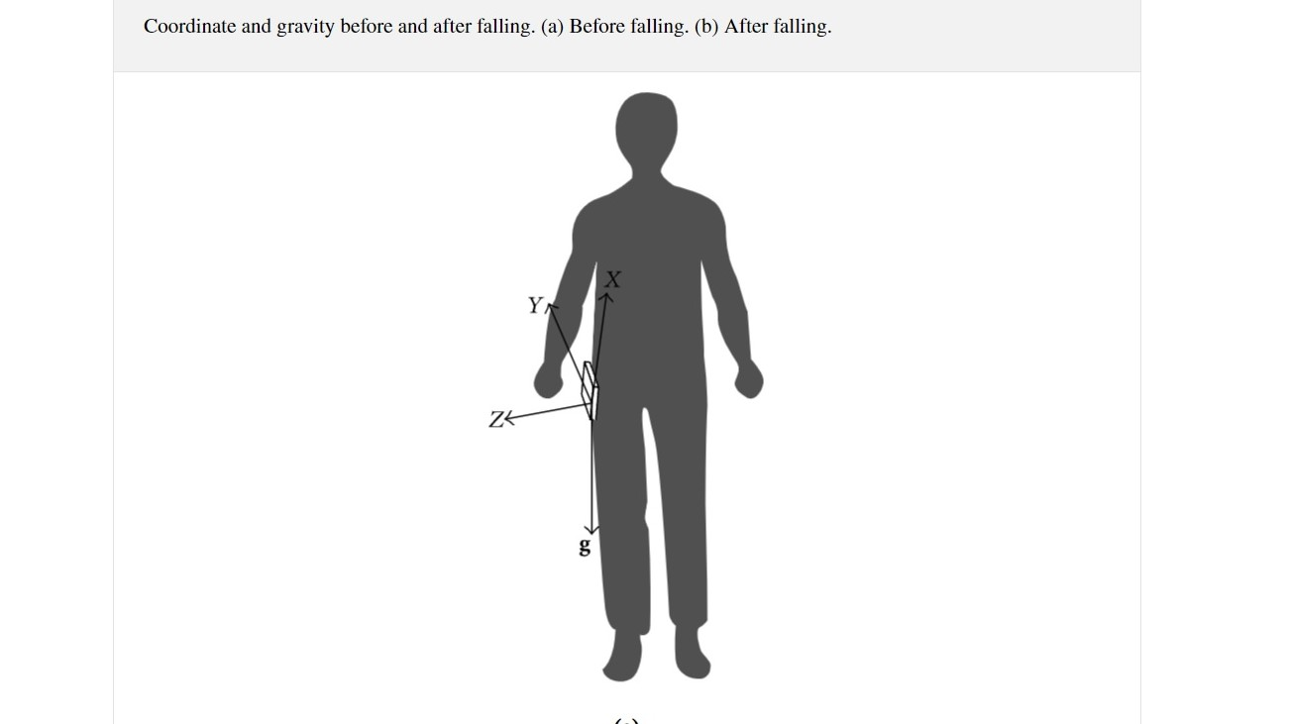
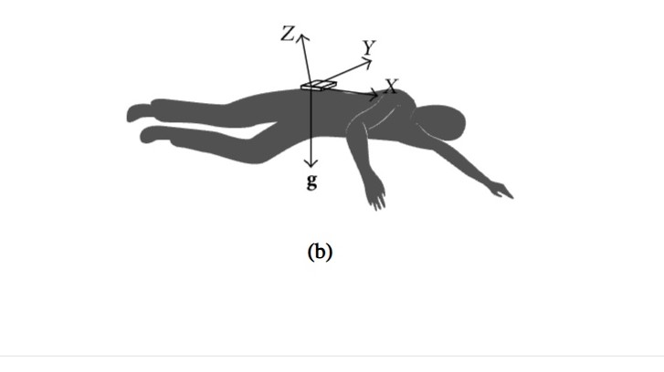
PREVIOUS WORKS ON FALL DETECTION USING WEARABLE SENSORS

Slide 6
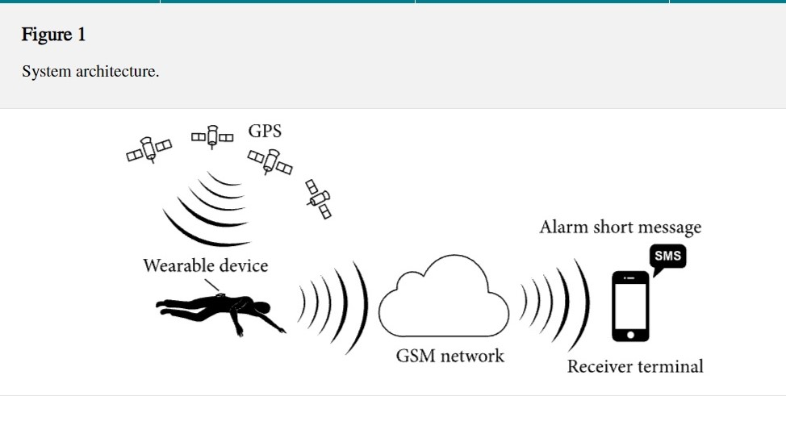
WORKING PRINCIPLE OF SENSORS
The architecture of the developed system is described in Figure 1. A wearable device is placed on human’s waist.
The system can detect the elderly’s falling by acceleration analysis. Then it will get the elderly’s geographic position and send fall alarm short message to caregivers. So the elderly who has fallen can get timely help to minimize the negative influence.

Slide 7
DRAWBACKS OF USING SENSORS
Inconvenience due to wearing/attaching the sensor on a part of the body.
Difficult to wear continuously due to the nature of the elderly, the primary users, and battery life is limited.
Less detection accuracy when compared to camera based
Detection.
Must be charged by a third party on site.

Slide 8
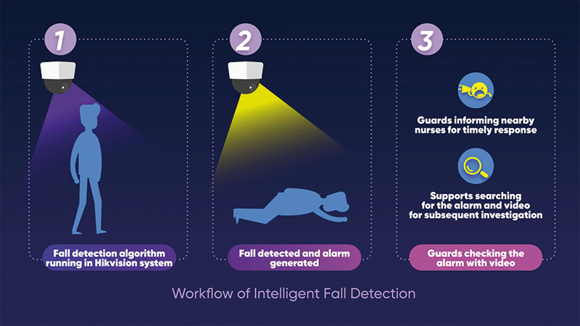
CAMERA BASED FALL DETECTION

Slide 9
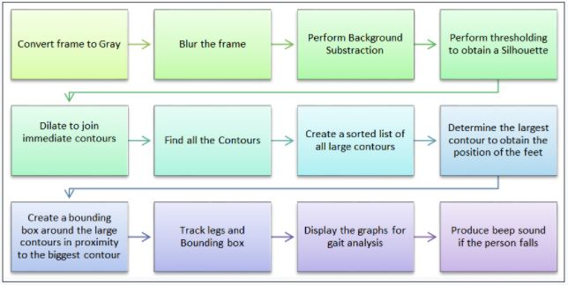
OUR PROJECT’S MODEL FLOWCHART
READING VIDEO FRAMES FROM CAMERA VIDEO
SEND INFORMATION TO EMERGENCY SERVICES

Slide 10
APPROACH
Gait analysis is a method for identifying biomechanical abnormalities in the gait cycle, i.e. the way a person walks. Abnormal gait, if gone undetected can be aggrevated by injury and lead to major musculoskeletal and cardiovascular problems.
If we observe abnormal gait , we immediately detect the fall and report to emergency services which makes fall detection much fasterand can provide fast recovery services before it become severe.

Slide 11
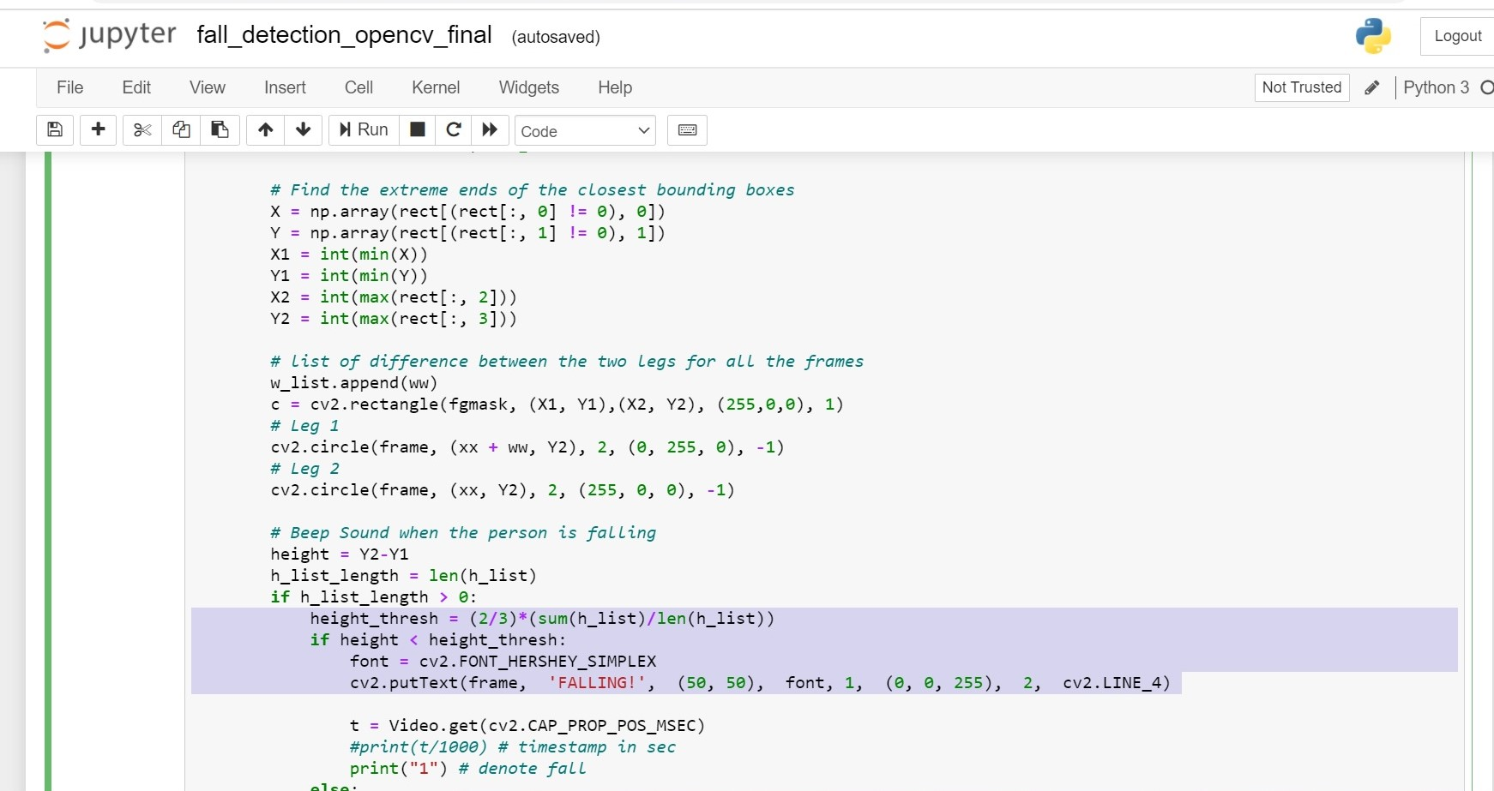
CODE FOR FALLING CONDITION:

Slide 12
MODEL RESULTS
FALL DETECTION MODEL USED IN PROJECT , achieved following results:
ACCURACY OBSERVED : 93.15%
OUT OF 160 FRAMES OF A TEST VIDEO :
CORRECT DETECTION : 149
FALSE RESULTS : 11

Slide 13
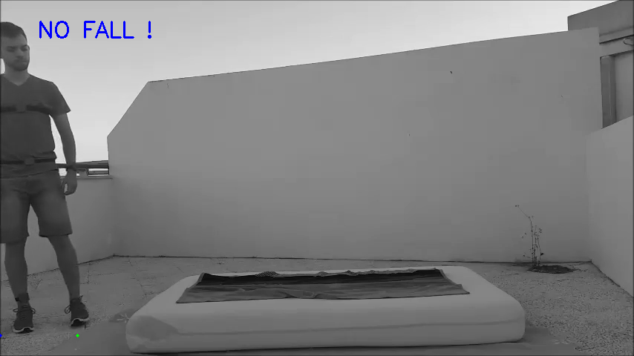
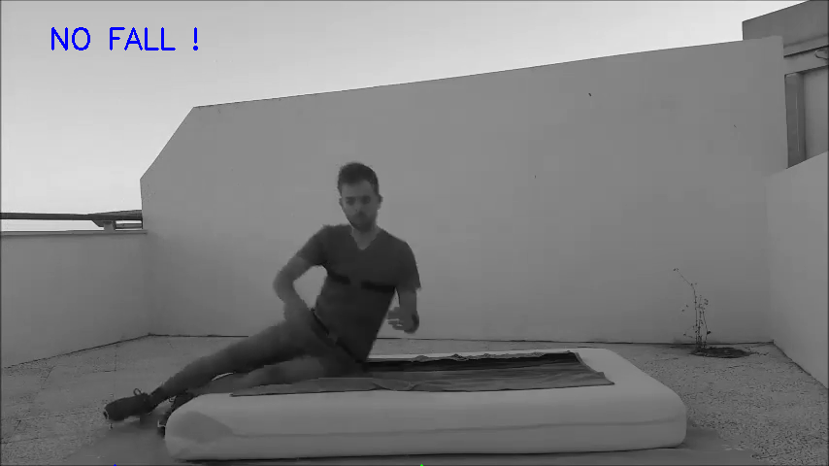
IMAGES OF FALL DETECTION USING OPENCV IN PROJECT
CORRECT PREDICTION IMAGES:

Slide 14
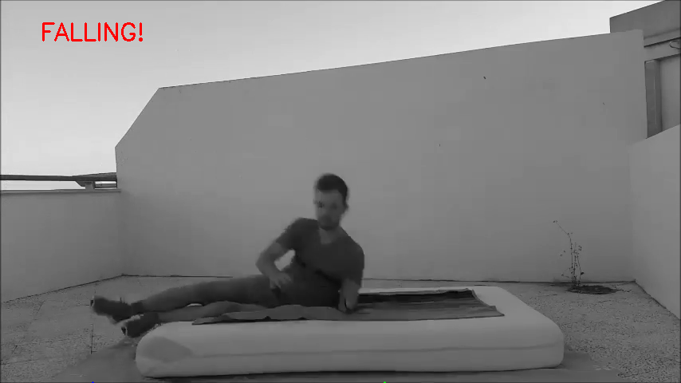
IMAGES OF FALL DETECTION USING OPENCV IN PROJECT
CORRECT PREDICTION IMAGES:

Slide 15
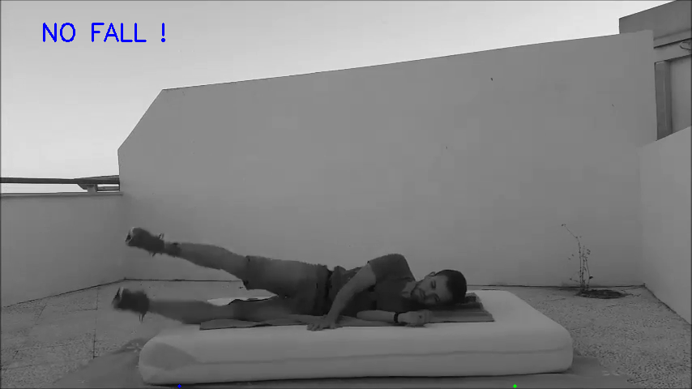
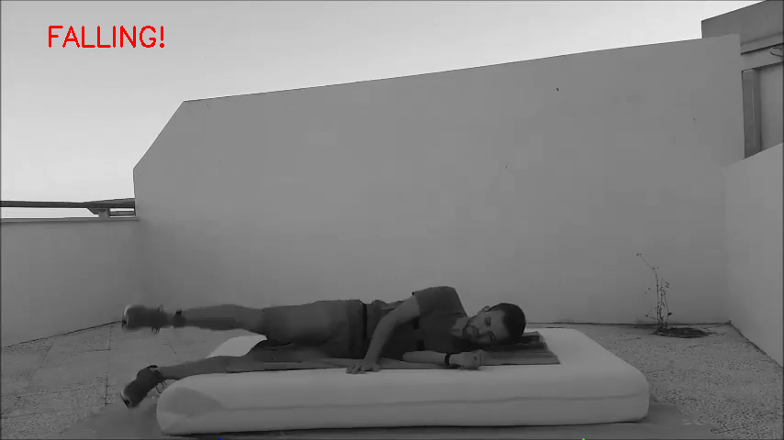
IMAGES OF FALL DETECTION USING OPENCV IN PROJECT
WRONG PREDICTION ALONG WITH CORRECT PREDICTION OF NEXT FRAME:

Slide 16
CONCLUSION
Hence , we can conclude from our results that Computer vision provides more accuracy for fall detection when compared to Wearable sensors .
It is cost effective and more reliable .
Easy to monitor .
Fast emergency services can be provided in case of fall and help
many elderly people who are having fear of falling .

Slide 17


