Slide 1
RELEASE BRIEFING · 27 OCTOBER 2026
CURRENT STATUS
Release gate open
Literate AI 1.3.1
Release, evolution and readiness
Specification to verified artifact, with evidence at every boundary
Notes:
Sources:
README.md
docs/roadmap/release-goals.json
GitHub Actions run 40460869302

Slide 2
EXECUTIVE SUMMARY
What 1.3.1 represents
The product
The release
The decision
A specification-led SDLC harness that treats generated source as replaceable and verification authority as durable.
A patch that joins a rebuilt onboarding film with stricter action custody, release governance and native Windows evidence.
Exact-main CI is green. Publication waits on the seventeen remaining goals covering all thirteen open milestone issues, discoverable symposium documentation and this deck.
Release quality is defined by completed authority and retained evidence, not by elapsed schedule pressure.
Literate AI 1.3.1
02
Notes:
Sources:
README.md: product definition
CHANGELOG.md: Unreleased
docs/roadmap/release-goals.json
GitHub milestone 1.3.1 snapshot on 2026-10-26

Slide 3
CORE CONCEPTS
The Literate AI execution model
Authority
Plan
Generate
Prove
Retain
Specifications
Flavors
Skills
Assets
Exact DAG
Bounded tasks
Model routes
Source
Tests
CycloneDX SBOM
Build
Run
Independent acceptance
Artifact
Provenance
Test receipt
Cache removal changes cost, not meaning. A changed authority input changes identity.
Literate AI 1.3.1
03
Notes:
Sources:
README.md sections 'From specification to binary' and 'What is first class'

Slide 4
CORE CONCEPTS
What remains first class
Components
Behavior, contracts, composition and acceptance criteria
Assets
Exact required bytes, referenced without surrendering custody
Flavors
Replaceable language, OS, build, runtime and packaging choices
Skills
Bounded agent behavior for planning, generation and verification
Provenance and SBOM
Exact inputs and dependency closure for each accepted artifact
Independent acceptance
Verifier-owned proof outside model-generated tests
Literate AI 1.3.1
04
Notes:
Sources:
README.md section 'What is first class'

Slide 5
RELEASE EVOLUTION
From bounded self-hosting to release-governed native proof
0.1.1
0.6
0.9
1.0
1.1
1.2
1.3.1
2 Aug
25 Aug
4 Sep
8 Sep
4 Oct
12 Oct
Now
Typed contracts
and cutover
Cross-host
evidence
Installed
qualification
Lifecycle
locking
Repository move
and adoption
Native Mix and
release policy
Film, custody
and explicit goals
The through-line: each release moved trust away from implicit environment state and into explicit, replayable evidence.
05
Notes:
Sources:
CHANGELOG.md release sections v0.1.1 through v1.2.0
Git tags v0.1.1 through v1.3.0

Slide 6
LEARNING
What the release history taught us
1
Green is too broad
2
Identity must be exact
A passing suite can miss installed, native, cross-host or exact-commit defects.
Specs, skills, models, dependencies and wire bytes belong in the accepted identity.
3
The verifier owns truth
4
Failure needs custody
Model-authored tests help, while independent acceptance decides whether an artifact is usable.
Unknown ownership, partial publication and post-actuation transport loss must fail closed.
5
Usability is release scope
6
Deferral needs consent
Onboarding, status, diagnosis and clear evidence determine whether rigor is practical.
A roadmap move changes the release promise and therefore requires explicit user approval.
Literate AI 1.3.1
06
Notes:
Sources:
CHANGELOG.md
docs/roadmap/active-work.md
docs/architecture/project-releases.md

Slide 7
RELEASE SCOPE
The 1.3.1 release package
01
Onboarding film
12:04 animated episode, 86 voice turns, captions, poster, rebuildable sources and exact hashes
02
Custody and re-admission
Bounded action ownership plus separate policy-controlled paths for semantic payloads and prior signed binaries
03
HTML repository explorer
Interactive authority graph, provenance metadata and exact Markdown/JSON excerpts with an explicit code-navigation boundary
04
Release governance
Machine-checked goals, completion before publication and user-approved deferral only
05
Windows evidence
Real PE dependency closure runs without xdist contention while retaining the 300-second observation bound
Literate AI 1.3.1
07
Notes:
Sources:
CHANGELOG.md Unreleased
README.md onboarding and HTML explorer sections
docs/user/html-repository-explorer.md
verification/onboarding-1.3.1-approval.json

Slide 8
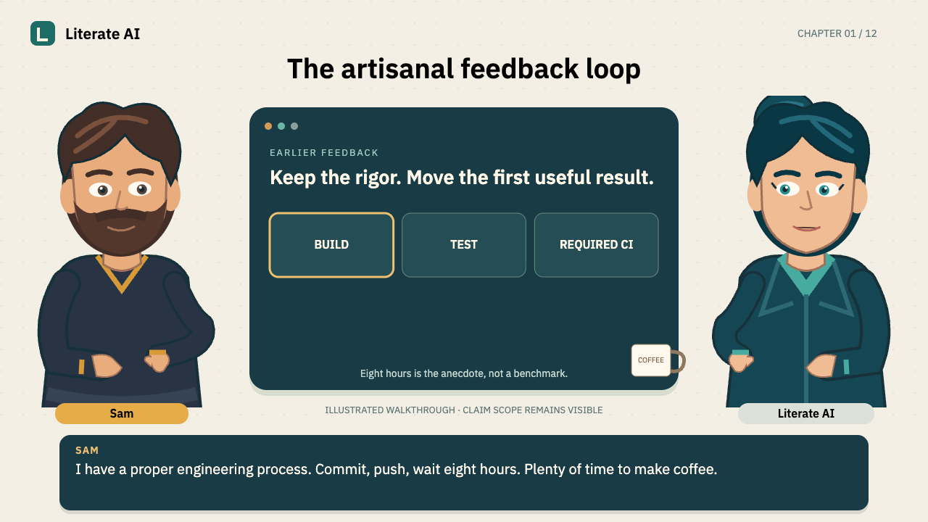
ONBOARDING
Eight Hours to Make Coffee
The story keeps CI rigor while moving useful feedback earlier through reviewed plans, selected targets, aligned workers and independent evidence.
12:04 runtime
86 NVIDIA Magpie voice turns
SRT and WebVTT captions
Exact approval and media hashes
08
Notes:
Sources:
README.md onboarding section
docs/courses/full-onboarding/README.md
verification/onboarding-1.3.1-approval.json
Local poster: media/courses/eight-hours-to-make-coffee/poster.png

Slide 9
RELEASE METHOD
The publication contract
1
2
3
4
5
6
7
Roadmap
Completion
Exact head
Exact main
Release CLI
Publish
Verify
Every goal named
No open goal
PR and full CI
Post-merge CI
Plan, prepare, check
Tag and assets
Hashes and links
A proposed deferral is a release change. The user must approve the future milestone before the move occurs.
Literate AI 1.3.1
09
Notes:
Sources:
CHANGELOG.md Unreleased release-goal policy
docs/roadmap/release-goals.json
skills/agent/release-project/SKILL.md

Slide 10
CURRENT EVIDENCE
Release readiness at 27 October 2026
Exact-main CI
26 OF 26 GREEN
Merge commit 3b606d42c; run 40460869302 completed successfully
Formal release goals
1 OF 18 COMPLETE
Seventeen declared goals remain blocking until their recorded acceptance is complete
Milestone issues
0 OF 13 CLOSED
Every issue in GitHub milestone 1.3.1 remains open
Contribution sweep
NOT READY
Unresolved issue and branch dispositions remain
Exact-main success closes the Windows observation goal. It does not close the other roadmap goals or milestone scope.
Literate AI 1.3.1
10
Notes:
Sources:
litai release contributions sweep --project . --version 1.3.1
docs/roadmap/release-goals.json
GitHub milestone 1.3.1
GitHub Actions run 40460869302

Slide 11
DELIVERY OUTLOOK
ETA for a compliant 1.3.1 release
27 OCT
28 OCT
30 OCT
Business deadline
Best case
Working ETA
Not supportable under the current release policy while goals and milestone issues remain open.
Possible only if the seventeen remaining goals close through existing evidence and require no additional implementation or CI restart.
Friday end of day PT, assuming evidence reconciliation and native qualification complete without a new product defect.
Risk range: 3 November if any open milestone item needs code, review and another exact-main matrix.
11
Notes:
Sources:
Roadmap and milestone snapshot on 2026-10-26
ETA is an inference from current open scope and required release gates

Slide 12
NEXT ACTIONS
Critical path to publication
COMPLETE
Qualify release policy
All 26 exact-main jobs pass on 3b606d42c, including isolated Windows receiver proof
NOW
Land the enforced scope
Merge the 18-goal milestone reconciliation, scoped documentation CI and this exact release briefing on green CI
THEN
Close seventeen goals
Run missing native qualifications, update roadmap evidence and obtain issue-closure authority
FINALLY
Cut and verify 1.3.1
Plan, prepare, check, publish, verify links and hashes, then mark the milestone complete
Release when the evidence closes the promise.
Literate AI 1.3.1
12
Notes:
Sources:
docs/roadmap/active-work.md
docs/roadmap/release-goals.json
literate.release.json
skills/agent/release-project/SKILL.md

