Slide 1
LITERATE-AI
From readable intent
to executable evidence
How a specification-led harness grew into a component system for governed software creation.
CONFERENCE EDITION · 28 OCTOBER 2026
Editable deck · repository-backed claims
Notes:
Open with the distinction between generation and confidence.
Literate AI makes readable intent durable and requires generated implementation to earn acceptance.
Sources: PROJECT.md; README.md.

Slide 2
LITERATE-AI
CONFERENCE 2026
02
Code generation made code abundant. Confidence stayed scarce.
The bottleneck moved from typing implementation to proving that an exact candidate deserves trust.
?
PROMPT
SOURCE
TESTS
→
→
plausible intent
plausible implementation
plausible self-assessment
release
confidence
A candidate can be coherent, tested, and still be wrong about the authority it was meant to implement.
source-notes.md
Notes:
Do not frame models as the problem. The missing piece is an independently checkable custody and acceptance boundary.
Source: docs/user/models-and-generation.md.

Slide 3
LITERATE-AI
CONFERENCE 2026
03
Invert the product: intent is durable; implementation is renewable.
Three different things must remain different.
INTENT
IMPLEMENTATION
EVIDENCE
Readable behavior
and constraints
Replaceable source
and native artifacts
Independent checks
and current receipts
AUTHORITY
CANDIDATE
ADMISSION
source-notes.md
Notes:
This is the core thesis. A model can help regenerate implementation, but cannot grant itself authority or acceptance.
Source: PROJECT.md goals 2 and 4.

Slide 4
LITERATE-AI
CONFERENCE 2026
04
A Component DAG keeps authority factored—and still makes art.
Behavior composes without flattening every concern into one prompt or one source tree.
Component
music
math
physics
3D
video
Each node owns a readable boundary.
Edges express composition, not copy-and-paste.
source-notes.md
Notes:
The DAG is both a technical boundary and a creative palette. Components can be small enough to review and rich enough to collaborate.
Sources: docs/architecture/repository-inheritance.md; labs/05-component-cathedral.

Slide 5
LITERATE-AI
CONFERENCE 2026
05
The lifecycle is a chain of custody, not a single generate button.
Every transition has an owner, an identity, and a reason to refuse.
RESOLVE
→
GENERATE
→
BUILD
→
VERIFY
→
RECEIPT
→
RELEASE
exact DAG
bounded context
native tools
independent oracle
current evidence
exact commit
A changed specification, Flavor, skill, route, dependency, toolchain, or artifact changes what must be proved.
source-notes.md
Notes:
The exact recipe is broader than source. Reuse is allowed only when the relevant identities remain current.
Sources: docs/user/framework-flow.md; docs/user/caches-packages-publication.md.

Slide 6
LITERATE-AI
CONFERENCE 2026
06
Evolution I · make readable authority executable.
The 0.x line built the grammar, the lifecycle, and the operator front door.
0.1–0.4
0.5–0.8
0.9
0.10
1.0
Components
+ readable specs
locks, receipts
+ release protocol
evidence-gated
framework
create + adopt
operator journey
stable product
boundary
source-notes.md
Notes:
This is a capability narrative, not a claim that every present feature existed at each tag.
Sources: repository tags, CHANGELOG.md, historical roadmap records.

Slide 7
LITERATE-AI
CONFERENCE 2026
07
Evolution II · make evidence compose at production scale.
The 1.x line broadens native custody, observability, scheduling, and release governance.
1.1
1.2
1.3
1.3.1
1.4 dev
native + multi-language
integration + document pairs
action DAG + HTML explorer
separate patch closure
retained native + public paths
Published
Patch program
Development
source-notes.md
Notes:
Be explicit: v1.3.0 is the latest published tag. 1.3.1 is a separate patch program. main carries 1.4.0 development authority.
Sources: tags; src/literate_ai/version.py; docs/roadmap/release-goals.json.

Slide 8
LITERATE-AI
CONFERENCE 2026
08
Exact identities turn explanation into an executable contract.
The recipe is inspectable before model egress and re-checkable after native execution.
Component revision
candidate + evidence
selected Flavors
EXACT
RECIPE
source · build · tests
acceptance · receipt
pinned skills
workflow + routing
repository sources
source-notes.md
Notes:
The receipt is compact because it binds larger retained evidence by exact identity. It does not replace that evidence.
Sources: docs/architecture/design-traceability.md; docs/user/framework-flow.md.

Slide 9
LITERATE-AI
CONFERENCE 2026
09
Failure is evidence, too—if ownership stays explicit.
A timeout or transport loss after actuation cannot be wished into a clean retry.
MODEL OUTPUT
FAILED ATTEMPT
TRUSTED RESOLUTION
Useful proposal
No acceptance authority
Retain diagnostics
Preserve ownership uncertainty
Owned terminal evidence
or admitted fenced lease
Retry policy must follow side effects—not optimism.
source-notes.md
Notes:
This is why the action DAG distinguishes immutable production from mutable package or signing operations.
Sources: CHANGELOG.md action ownership entries; ADR 0044.

Slide 10
LITERATE-AI
CONFERENCE 2026
10
Observability became a product surface, not a debug afterthought.
The HTML explorer renders effective authority and provenance as one portable file.
IT IS
repositories
Components
Flavors
skills
A provenance-bound authority graph
with filters, focus, and source excerpts
IT IS NOT
A general IDE, symbol index,
or go-to-definition engine
source-notes.md
Notes:
The boundary matters: calling it a source browser would overstate the implementation.
Source: docs/user/html-repository-explorer.md.

Slide 11
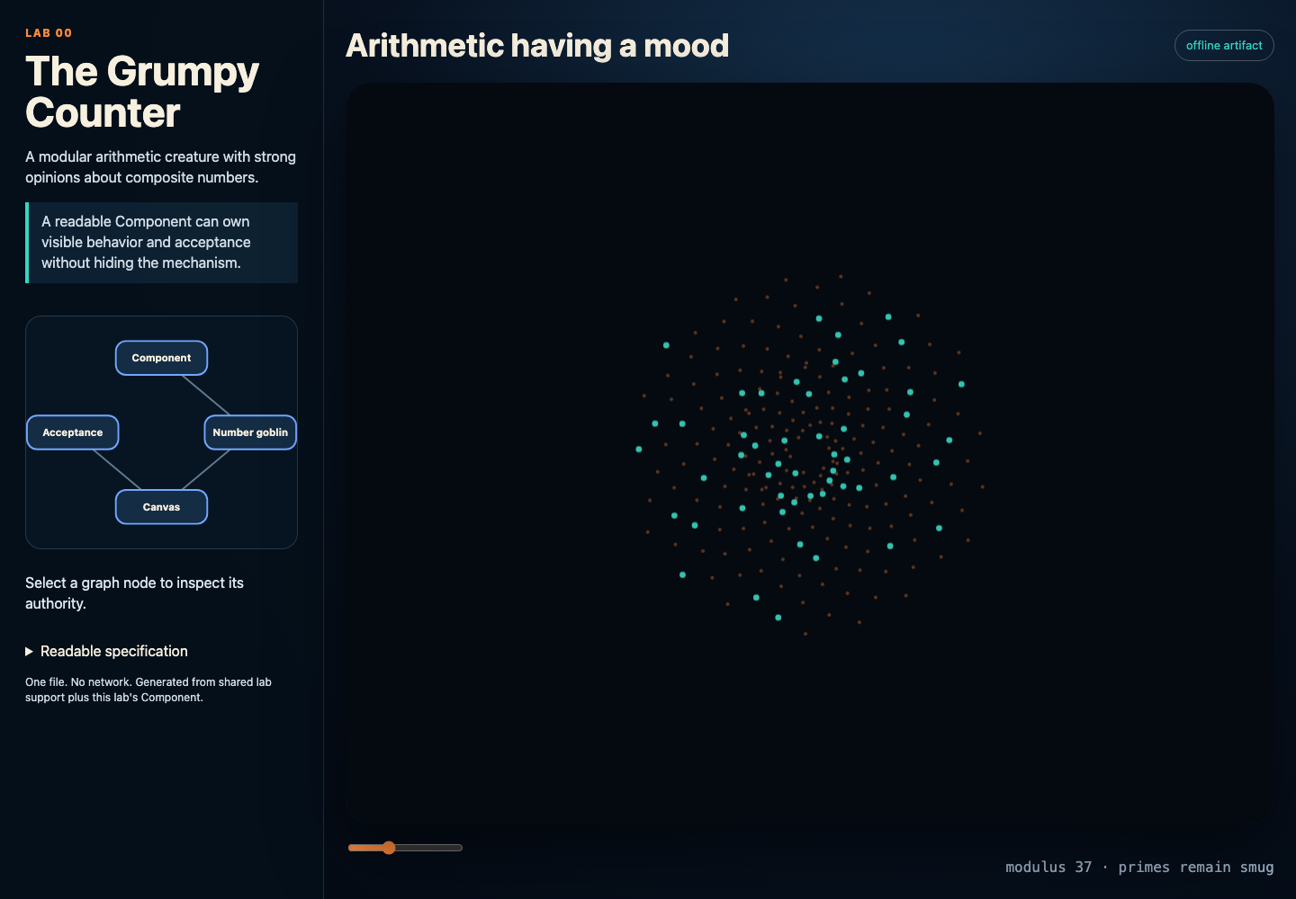
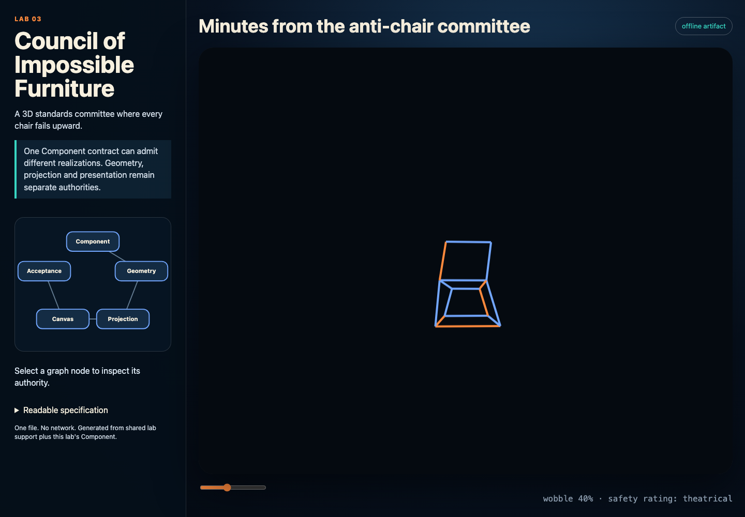
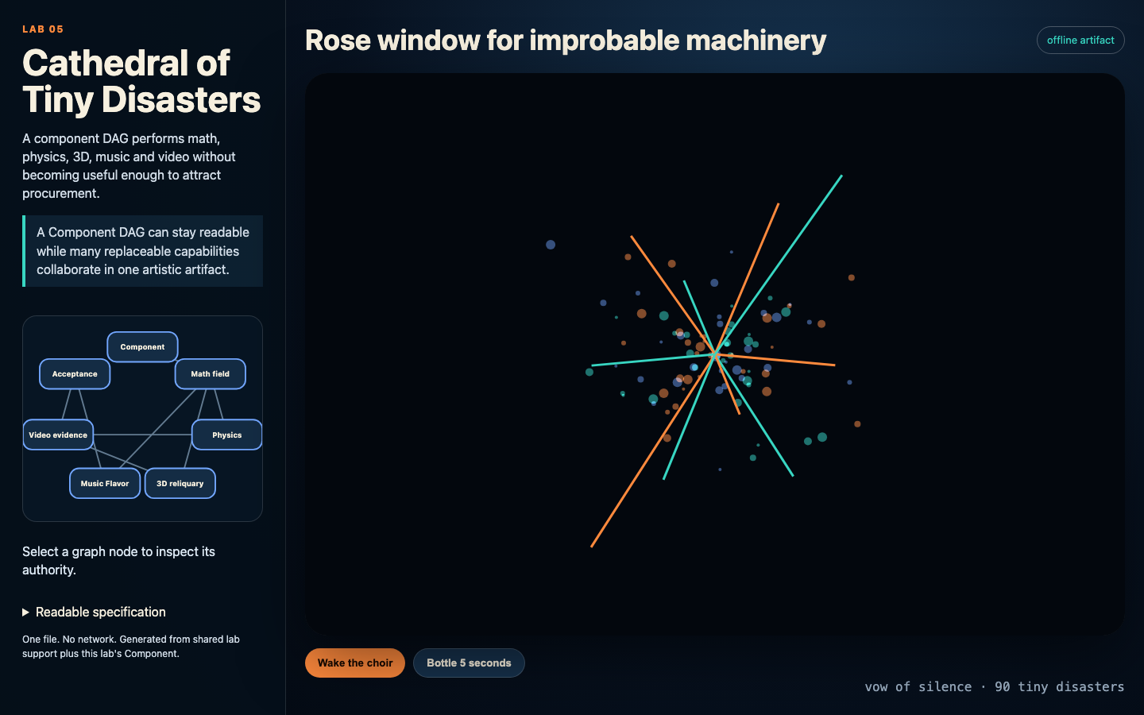
LITERATE-AI
CONFERENCE 2026
11
Six labs teach composition by becoming progressively less sensible.
Every lab is one offline HTML artifact with its specification and interactive DAG in view.
00
grumpy math
03
impossible 3D
05
multimedia cathedral
math → physics → audio/music → 3D → video → composed component art
source-notes.md
Notes:
The source is DRY, but each generated index.html is free-standing and works without a server or network.
Source: labs/README.md and labs/scripts/verify_labs.py.

Slide 12
LITERATE-AI
CONFERENCE 2026
12
The cathedral is the argument: rigor does not have to look corporate.
Math, physics, 3D, music, audio, and video become replaceable capabilities in one readable DAG.
READABLE
Select a node and inspect the authority it owns.
REPLACEABLE
Change one capability without rewriting the whole artifact.
PROVABLE
Capture a bounded video artifact; keep audio opt-in.
source-notes.md
Notes:
This is intentionally cheeky. The point is that component boundaries can support expressive work, not only business workflows.
Source: labs/05-component-cathedral.

Slide 13
LITERATE-AI
CONFERENCE 2026
13
Release posture is part of the feature—not a footnote.
Literate AI distinguishes published evidence, patch closure, current development, and open qualification.
PUBLISHED
1.3.0 exact tag
PATCH
1.3.1 explicit goal ledger
DEVELOPMENT
1.4.0 on main
OPEN
FreeBSD + complete retained/public paths
An unchecked roadmap item is not a release claim. A catalog entry is not universal native qualification.
source-notes.md
Notes:
This is the credibility slide. It prevents the evolution story from erasing current boundaries.
Sources: docs/user/current-features.md; release-goals.json; PROJECT.md.

Slide 14
LITERATE-AI
Readable systems can be
rigorous, renewable—and strange.
Keep intent human-readable.
Keep implementation replaceable.
Make evidence earn the release.
Start with the visual labs. Then inspect the authority graph.
github.com/jordanhubbard/literate-ai
Notes:
Close on the three imperatives: readable intent, renewable implementation, earned evidence.
Invite attendees to open labs/ and the generated HTML authority graph.

