Slide 1
ADIDAS
Sales Report
Business Intelligence and Business Analytics

Slide 2
Team Members :
Kruthika Surendrakumar - x22241965.student.ncirl.ie
Alan Babu Manuel - x23157143@student.ncirl.ie
Melin Mary Lalu - x23185104@student.ncirl.ie
Vishnunath Nharekkat - x22234217@student.ncirl.ie

Slide 3
Table of contents
01
02
03
History of Brand
Database
CRM Tool
04
05
06
Visualisation
Business Strategy
Conclusion
Detailed explanation about the brand and how they boomed in this era
Used PostgreSQL as a database platform
Hubspot
PowerBI

Slide 4
01
History of Brand

Slide 5

History of Brand
Adidas journey to fame is a fascinating story that intertwined innovation, strategic marketing and cultural relevance.
Adidas was founded in 1949 by Adolf "Adi" Dassler in Germany.
He started creating innovative shoes particularly athletic shoes.

Slide 6
02
Database

Slide 7
PostgreSQL And ER Diagram
It is necessary to understand the important entities and relationships in the business to implement the CRM and dashboards of our project.
Here we are using ‘PostgreSQL’ as our Database.
We also used docker to install PostgreSQL.
The cleaned data is stored in a csv file and then load that cleaned data to the PostgreSQL DB and connect it to CRM with DB using API.
ER Diagram is presented to understand about the relationships.

Slide 8
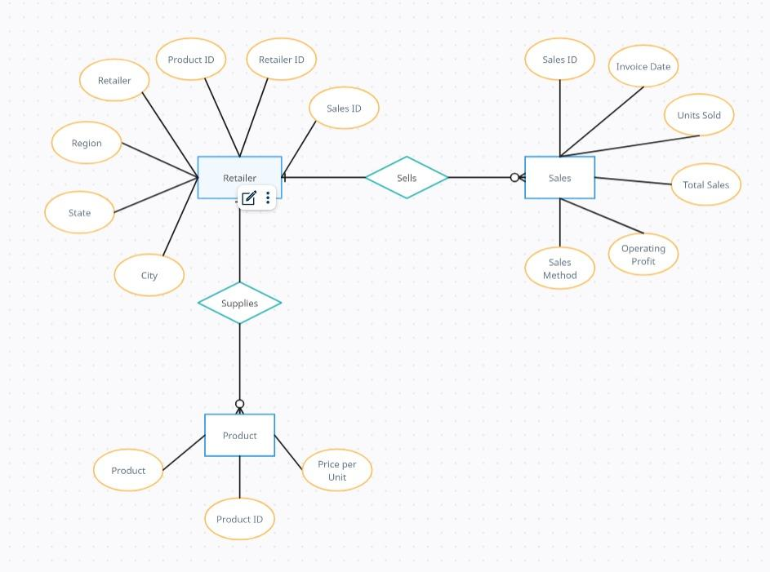

Slide 9
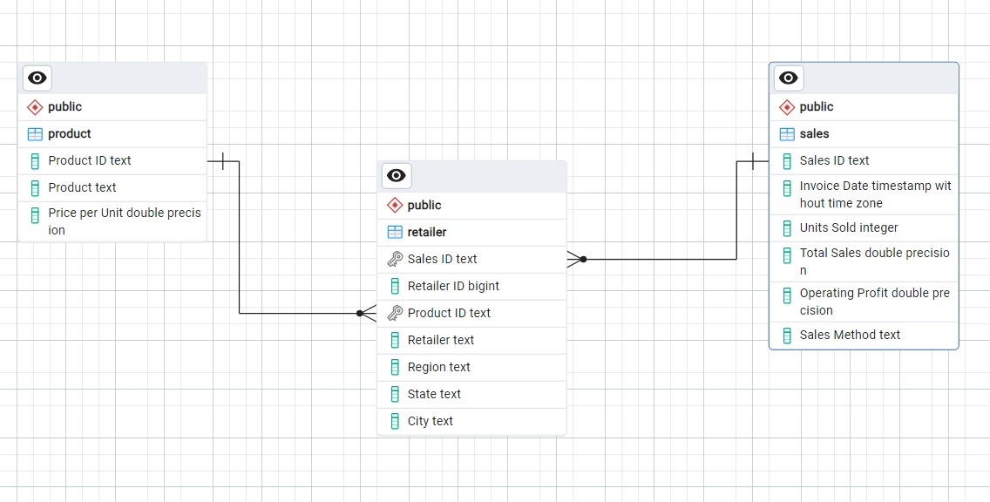

Slide 10
03
CRM Tool

Slide 11
Hubspot
CRM software helps businesses keep track of their customers and improve relationships.
It also helps streamline sales and marketing tasks, making teams more efficient and effective in reaching customers and growing the business.
HubSpot’s customer relationship management (CRM) software, provides a wide range of capabilities for sales, marketing, and customer support.

Slide 12
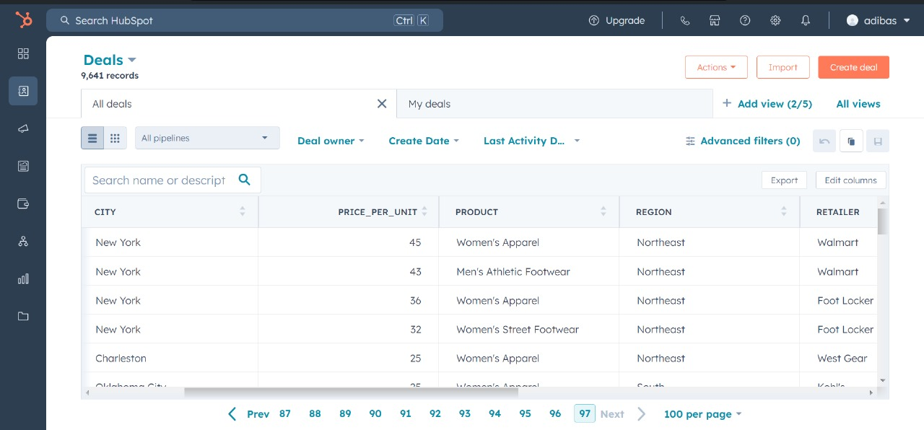

Slide 13
04
Visualisation

Slide 14
Coupler
Coupler.io is used to connect the CRM to Power BI.
Coupler.io is an integration tool that periodically synchronises data between different services.
Consolidating data from several sources into a single location is made simpler by the ability for users to set up automatic information synchronisation across apps and services.

Slide 15
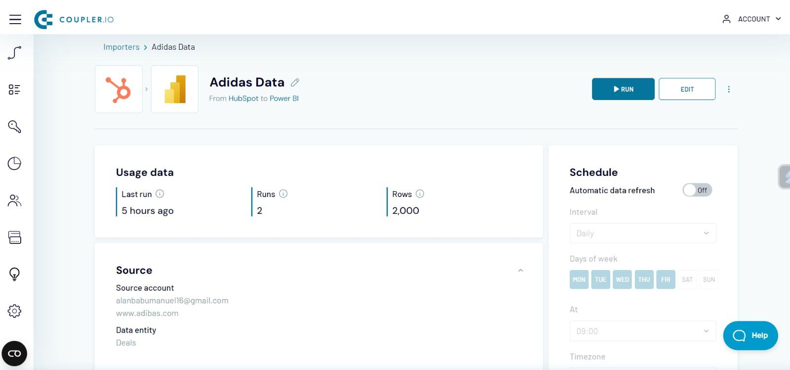

Slide 16
PowerBI
A dashboard is a type of visualisation tool that combines several tables and charts to give the user a 360-degree perspective of the phenomenon under study.
Here, we have used PowerBI tool for our visualisation.
PowerBI is a business analytics tool by Microsoft, visualizing data and sharing insights for informed decision-making.

Slide 17
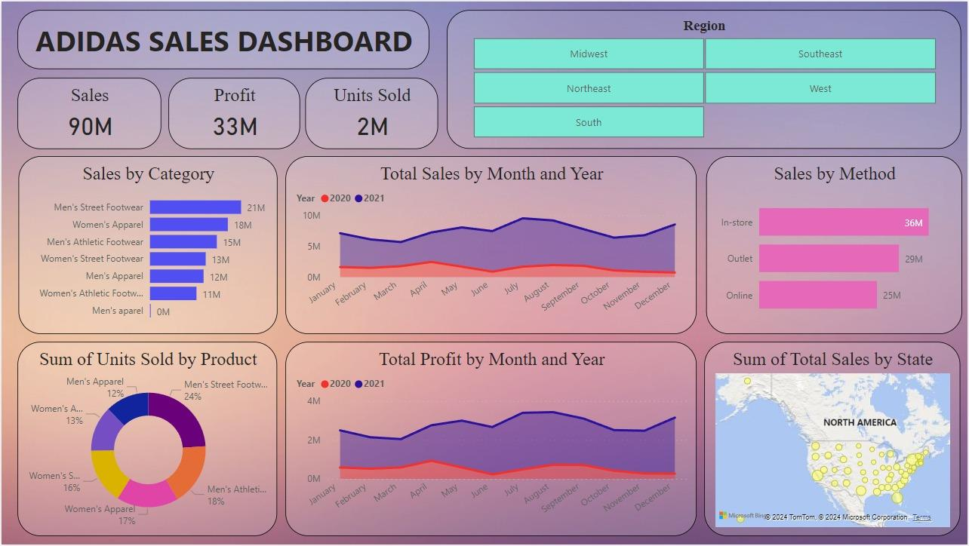

Slide 18
05
Business Strategy

Slide 19
Adidas may improve its business strategy by implementing two innovative techniques:
Product Recycling
Customisation of Product

Slide 20
Product Recycling
Adidas may attract environmentally conscious customers by promoting sustainability through recycling programmes and the use of eco-friendly materials by implementing a recycling product strategy.
And also the customers will exchange their old shoes and buy a new shoes in reasonable price.
It will also decrease the company’s production cost by using the recycled material and make a better profit from it.

Slide 21
Customisation of Product
Adidas can offer their customers a customised options by improving their buying experience and creating a sense of brand loyalty.
Adidas is positioned as a forward-thinking and customer-centric brand in the competitive footwear and clothing business thanks to these strategies, which are in line with current market trends towards sustainability and customisation.
This will increase the sale of direct to customer [DTC] of the company.

Slide 22
06
Conclusion

Slide 23
Based on our business strategies for expanding the adidas sales worldwide, we have effectively implemented them using business intelligence and business analytics solutions.
We used Power BI to understand and demonstrate the sales through visualization.
HubSpot CRM is used for centralizing the customer information, managing the meetings, and handling the other functions inside the company.
Implementing new ideas into action that will complement current market developments towards customisation and sustainability, Adidas will be positioned as a customer-focused and forward-thinking brand in the competitive clothing and footwear sector, which will ultimately boost sales and customer engagement.

Slide 24
THANK YOU !!

