Slide 1
From Traditional to Advanced Machine Learning: A Comparative Study of Political Tweet Sentiment Analysis
Presented by: Vishnunath Nharekkat
Date: 12 December 2024

Slide 2
Research Background
Social Media’s Role:
Social media platforms, especially X (formerly Twitter), have revolutionized the way public opinion is expressed and analyzed.
These platforms provide real-time insights into public sentiment during key political events like elections.
Indian Context:
With its vast and diverse population, India exhibits multilingual political discourse online.
Tweets serve as a valuable resource for understanding public sentiment towards political figures and parties.

Slide 3
Research Objective and Question
Objective:
Analyze and compare traditional machine learning and advanced machine learning techniques for sentiment classification on political tweets.
Research Question:
How do Support Vector Machine (SVM) and Long Short-Term Memory (LSTM) compare in terms of accuracy, efficiency, and scalability when analyzing political tweet sentiments?

Slide 4
Importance of Sentiment Analysis
Definition and Applications:
Sentiment analysis involves extracting emotional tones from text to gauge opinions about people, products, or events.
It is crucial for political campaigns, policy analysis, and real-time public opinion tracking.
Challenges in Political Sentiment Analysis:
Informal Language, multilingual tweets, and domain-specific technical language.
Need for tools that balance computational efficiency with contextual understanding.

Slide 5
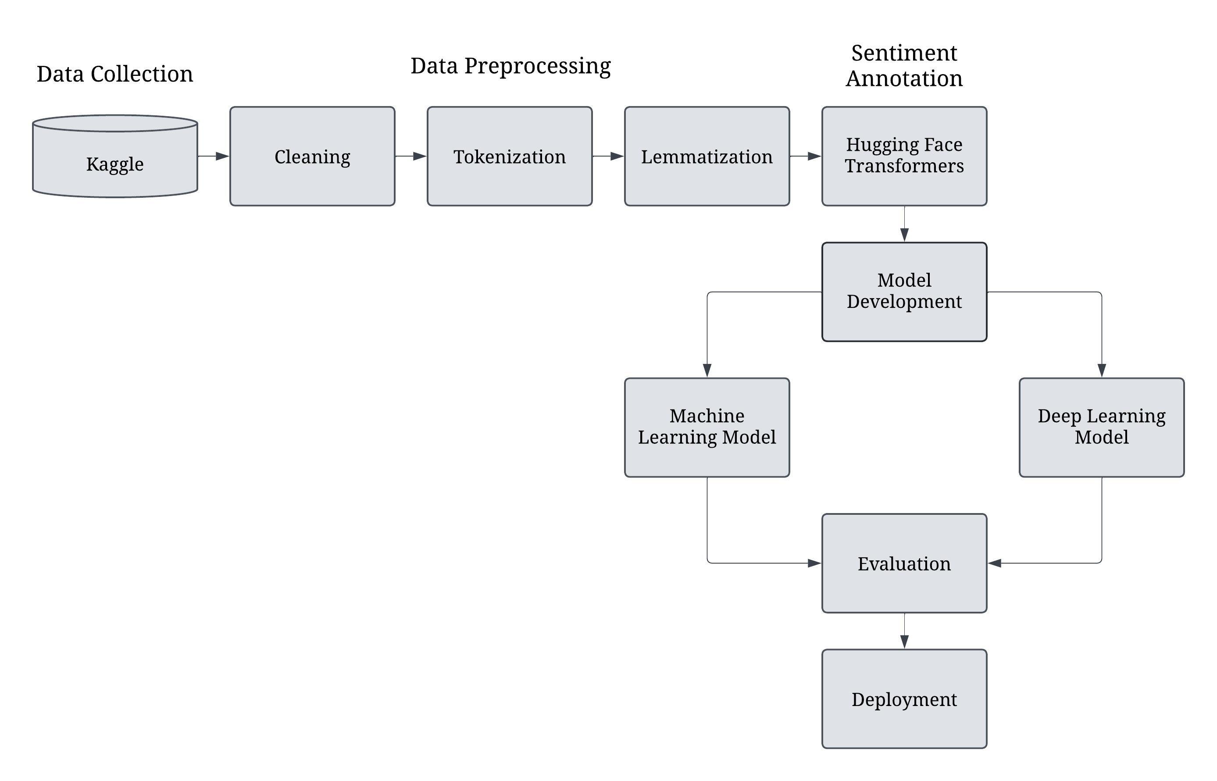
Methodology Overview
Framework: CRISP-DM (Cross-Industry Standard Process for Data Mining).

Slide 6
Preprocessing and Data Preparation
Steps in Preprocessing
Cleaning: Remove URLs, mentions, hashtags, punctuation, and emojis.
Text Standardization: Convert text to lowercase, remove stop words, and apply lemmatization for consistency.
Tokenization: Breaking text into individual words or phrases.
Truncation and Padding: Ensuring uniform input lengths for LSTM
Sentiment and Party Labeling:
Sentiment labeling using BERT from the Hugging Face Transformers library.
Party affiliation: BJP, INC, or Unknown, based on keywords.

Slide 7
Data Balancing with SMOTE
Challenges in Preprocessing
Challenge: Imbalanced dataset with BJL tweets dominating the data and fewer tweets for INC and Unknown classes.
Solution: Applied SMOTE (Synthetic Minority Oversampling Technique) to handle class imbalance.

Slide 8
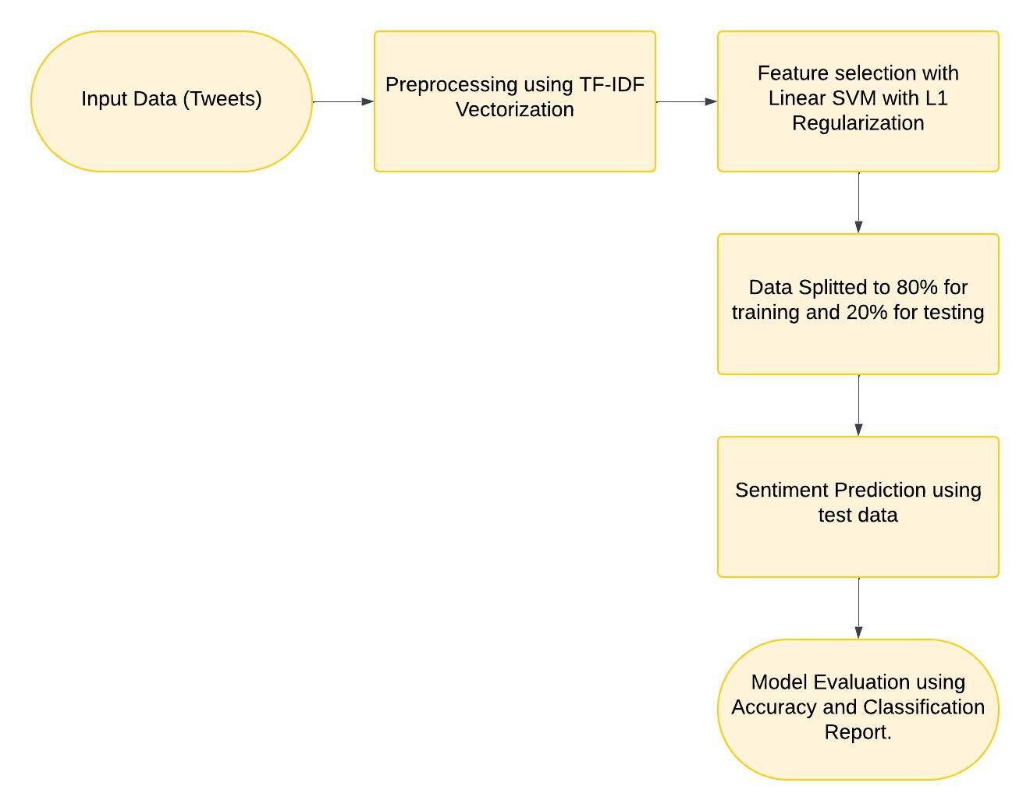
Model Architectures
Support Vector Machine (SVM):
Converts text to numerical vectors using TF-IDF.
Implements linear classification with L1 regularization for feature selection.
Suitable for structured datasets with defined features.

Slide 9
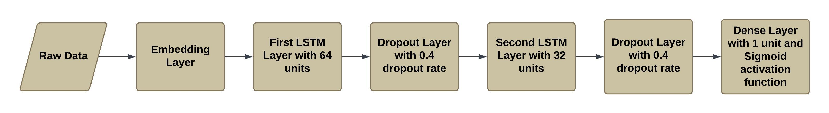
Model Architectures
Long Short-Term Memory (LSTM):
Embedding layer map words to dense vector representations.
LSTM layers capture sequential patterns and contextual dependencies in text.
Dropout layers prevent overfitting, ensuring better generalization.

Slide 10
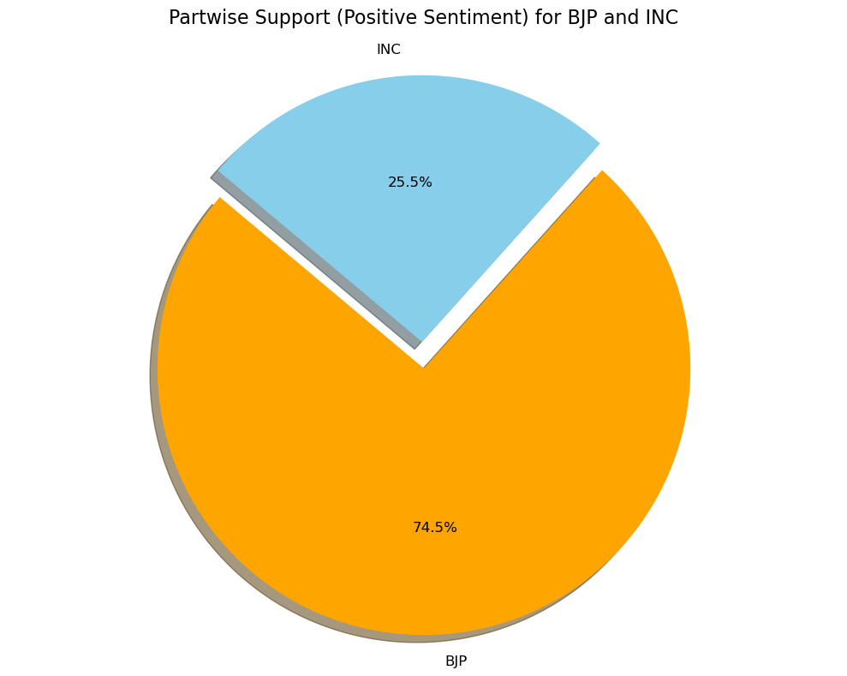
Results
Dataset Insight:
BJP (Bharatiya Janata Party) got a higher positive sentiment of 74.5% compared to INC (Indian National Congress) 25.5 %.

Slide 11
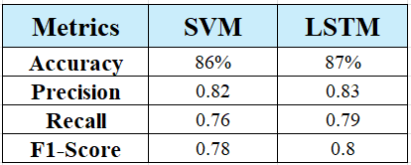
Results
Performance Metrics:
LSTM got 87% of accuracy compared to SVM’s accuracy 86%.
From the outcome of model’s performance, we can say that LSTM is performing better.

Slide 12
Conclusion and Future Works
Conclusion:
Both SVM and LSTM perform well, but LSTM proves more effective for large, complex datasets.
The use of SMOTE for data balancing significantly improved the model performance.
The study demonstrates that LSTM scales well with larger datasets.
Future Work:
Implement transformer-based models like ROBERTa for enhanced context and multilingual support.
Expand the dataset to cover diverse periods and linguistic variations.
Develop real-time sentiment analysis tools for political events.

Slide 13
Thank You

