Slide 1
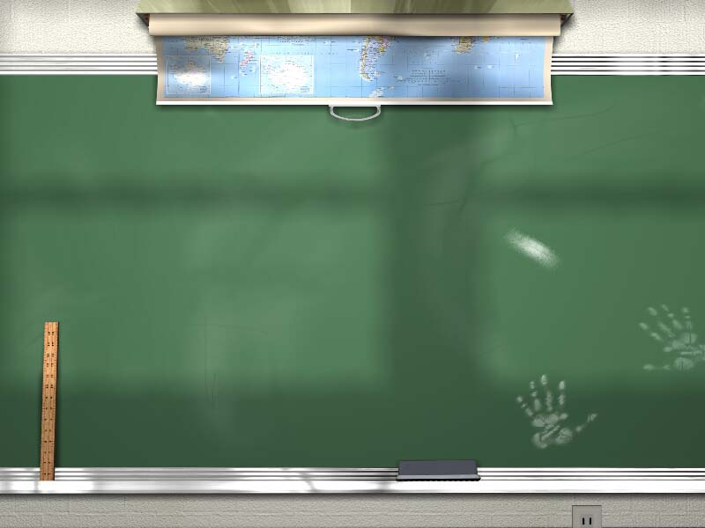
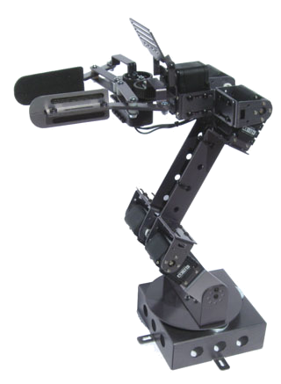
Robot Arm 2012
Division C
Presented by
Jim Boyd - State Event Supervisor
jboyd@newyorkscioly.org

Slide 2
Basic Information
Description: Prior to the competition teams must design, build, document and test one robotic device to move scoreable items.
How many students on a team: 2
Impound: Check with tournament - there will be an impound for the State Tournament.
Eye Protection: #5 HIGH IMPACT PROTECTION (ANSI Z87+)
Similar to Robot Ramble except that the robot remains stationary while picking up objects and depositing them into designated goal boxes.

Slide 3
Event Parameters
One device only per team
Must have eye protection to compete
Teams that cannot obtain proper eye protection will be scored as “no shows”
Supervisor provides competition area and items

Slide 4
Construction Parameters
The “Device” includes the Arm(s), an optional permanently attached Base, and remote control boxes
The Arm(s) may be attached to a Base. The entire robot (excluding the control boxes and any connections) must fit in a 30 cm x 30 cm box. The arm may be pointed up in the air to meet this size requirement. The bot must be held down by gravity only (no sticky substance on the bottom, no fastening devices)
The device may use modified kit parts and may have any number of arms and joints.

Slide 5
Construction Parameters (Page 2)
All movement of the arm must be powered by stored energy in the device components
Commercial batteries with a maximum of 14.4 volts may be used to power each of the Device’s electrical circuits. Multiple batteries may be connected in any manner so long as the total voltage delivered to a circuit does not exceed 14.4 volts.
Each arm function may have its own electrical circuit, sources of electrical energy and/or control mechanisms.

Slide 6
Construction Parameters (Page 3)
Radio controls used to run the device must use one of the following frequencies:
  75 MHz
  27 MHz
  49 MHz
  2.4 GHz
Devices using other frequencies will not be allowed to compete (ie: 72 MHz may only be used for air vehicles, so it cannot be used in this event).

Slide 7
Documents
Teams must submit three technical documents:
Engineering Drawings: either as three views or projected views of the basic structure of the device showing:
  All motors and actuators on the Arm(s)
  All energy sources
  All Arm(s) and parts that interact with the objects in the playing field
  Controls the competitors are using to control the arm

Slide 8
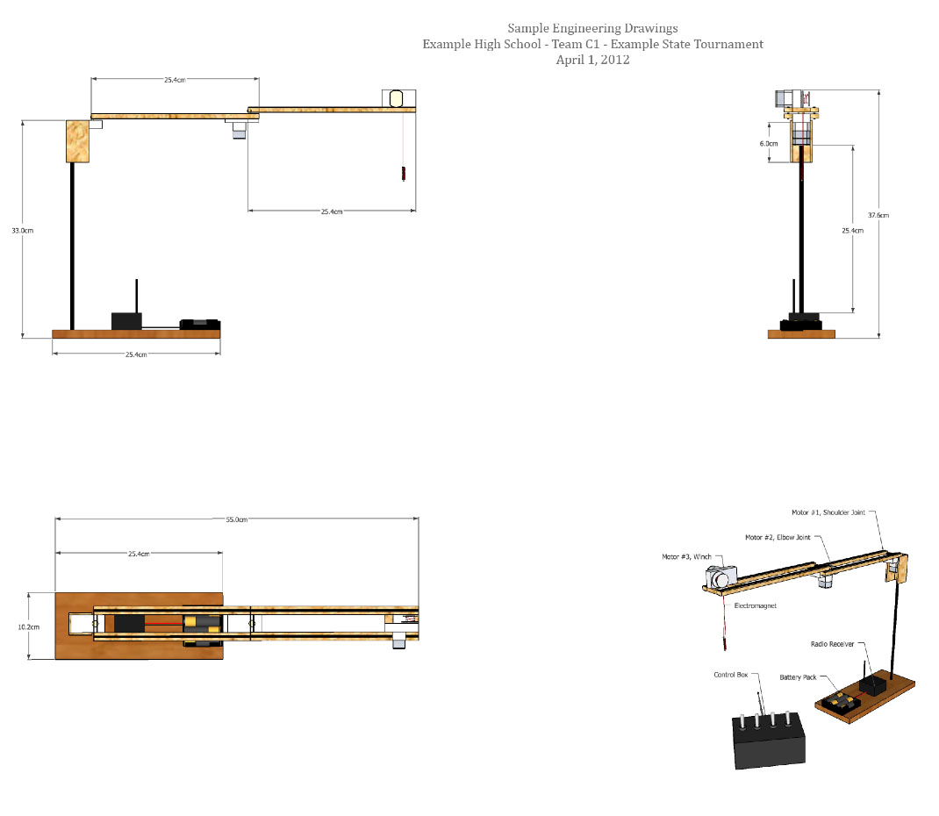
Engineering Document
Original of this file can be downloaded from http://www.soinc.org/sites/default/files/Sample%20Robot%20Arm%20Engineering%20Drawings.pdf

Slide 9
Documents - #2
Individual Component List: A list of all of the parts (except fasteners) of the arm. A pre-assembled part (one not assembled by the team) counts as one component. This list should include the following:
The name of each component
The location/vendor from which the component can be obtained
Two or more properties of the component (ie: weight, dimensions, voltage rating, etc.)
The energy source of the component (n/a is acceptable if the component is an energy source or if the component is not energized)

Slide 10
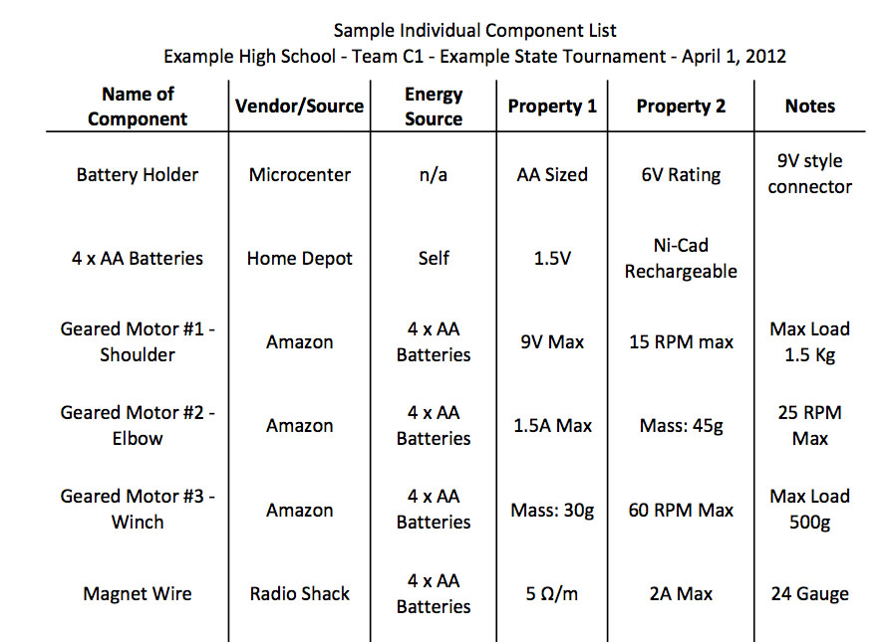
Individual Component List
This is a partial list - original of this file can be downloaded from http://www.soinc.org/sites/default/files/Sample%20Robot%20Arm%20List%20of%20Components.pdf

Slide 11
Documents - #3
Operating Description: This is a list similar to the lists submitted for Mission Possible. The list should include the following information:
The reaction of the Device to each control input (ie: what happens to the device when you move toggle switch one forward, backward, left, and right)
The tentative plan of movement - the order in which you plan to move the items and how you plan on moving them.
For the State Tournament, these three documents must be submitted to the State Event Supervisor by March 21 (see the Clarifications page on the web site for specifics)

Slide 12
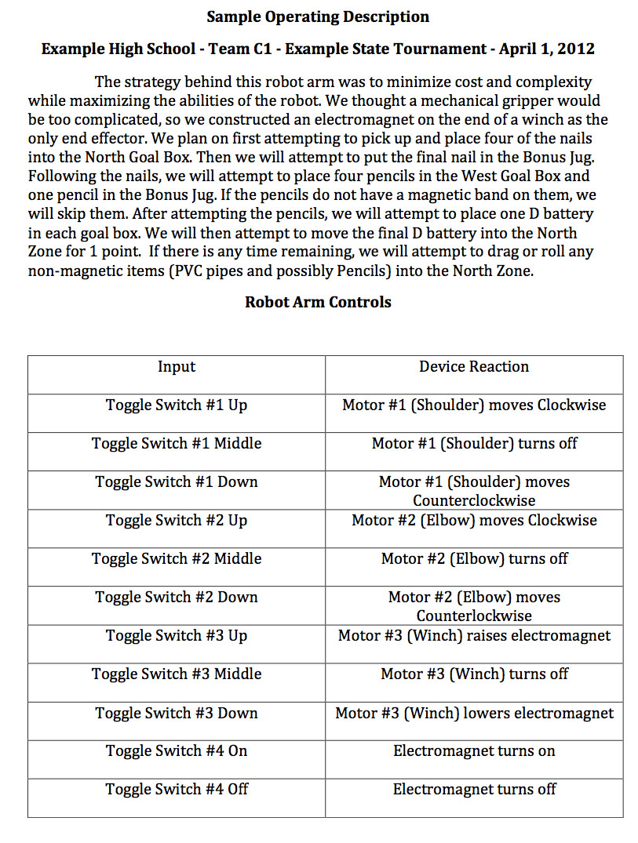
Operating Description
Original of this file can be downloaded from http://www.soinc.org/sites/default/files/Sample%20Robot%20Arm%20Operating%20Description.pdf

Slide 13
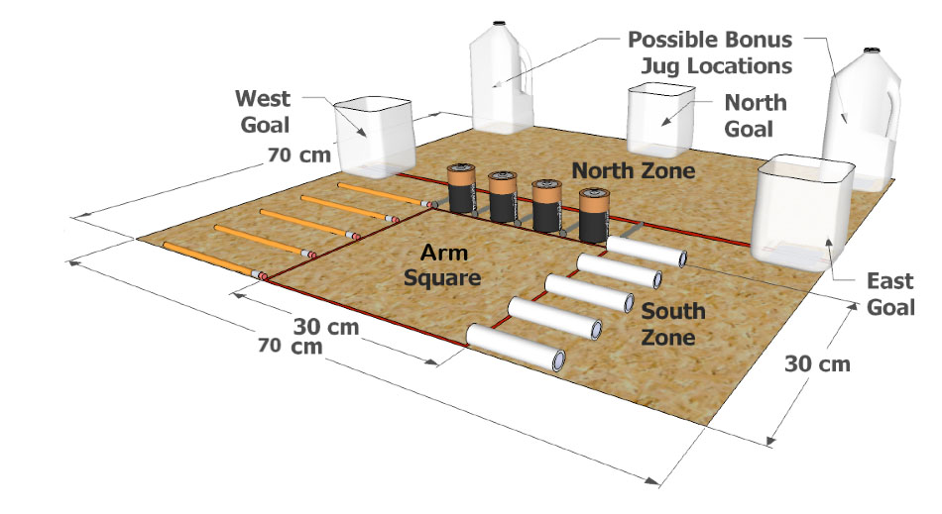
Competition Area
70 cm x 70 cm area, divided into North and South by a center line at 35 cm
30 cm x 30 cm box for Device (Arm Square)
Goal boxes at the W, N, and E sides (centered), with one unmodified 1/2 gallon jug placed at either the north-west or the north-east corner
5 .5” PVC pipes (9.5-10.5cm long), 5 ferromagnetic nails (same length), 5 unsharpened #2 pencils, 4 D Cell batteries are placed around the Arm Square as pictured

Slide 14
Competition
At check-in, judge will check the device for size and electrical circuit power, then will ask the team to point out 4 items from their technical documents.
After inspection by the judge, teams will have 5 minutes to set up and test their Device in the competition area.
Teams will have 3 minutes (starting when they begin moving their arm) to move the items into scoring position.
Time will stop when any of the following occurs:
  3 minutes has elapsed
  The team says “Stop”
  A member of the team steps into the Competition Area after the team has been warned once
  Any part of the Arm is moved by anything other than stored energy
  Any part of the device touching the surface of the Arm Square moves out of that square
  The device is physically moved by the connections to the control boxes
  The Arm becomes detached from the optional Base

Slide 15
Scoring
High Score wins
If connections between the control box and the arm move any of the items, or if any of the items touches the floor outside the playing area, those items are out of play and will not receive a score
Items completely supported by a Goal Box will be scored as below. Items must be placed in the Goal Box while the Box is upright:
West Goal Box North Goal Box East Goal Box
Pencil 3 2 2
Nail 2 3 2
PVC 2 2 3
4 points for each Goal Box that supports 1 or more batteries (12 points max)
Any item completely in the North Zone but not completely supported by a Goal Box receives 1 point
10 points for each item type (except batteries) completely in the Bonus Box (30 points max)
If at least 1 item is either fully in the North Zone or fully supported by a Goal Box when time ends, 5 points are awarded for each Goal Box that did not lie completely on its side at any time during the competition (15 points max)

Slide 16
Scoring (page 2)
Maximum number of points is 94
Teams with complete documentation will receive their full score. For each complete document missing, teams will receive a 10% penalty off of their score (maximum of 30% penalty). For each incomplete document submitted (eg: a drawing that doesn’t show all of the motors on the Device), teams will receive a 5% penalty (15% maximum penalty)
1 point for each missing or incorrectly identified item during the check-in inspection
Ties are broken by:
  Least number of electrical, hydraulic or pneumatic motors used
  Quality of technical documentation
Tiers:
  Tier 1: Devices that meet all requirements
  Tier 2: Devices that fail to meet a spec under “Construction Parameters”
  Tier 3: Devices with Competition violations
  Participation points only for teams with devices that violate the Frequency rules; that have no capability (either by design or by construction) to score points via moving items; or are unable to compete.

Slide 17
Hints and Tips
You don’t have to invest in a kit: just Google “how to build a robot arm” and you will get over 900,000 links, including:
http://www.pathfindersdesignandtechnology.com/worksheets/build_a_robotic_arm.pdf
where you can get instructions for building a robot arm from wood that is powered hydraulically using syringes.
Look for items that can be used from previous robot competitions (controllers from Sumo Bots, Robot Ramble, Robo Cross, etc.)
Remember that building the robot is only half the battle - you need to finish the robot early enough to give you plenty of time to practice for competitions
Add weights to the base to hold things down - the arm will be stretching up to 40 cm from the base while holding items

Slide 18
Sherman notes:
ROBOT WILL BE IMPOUNDED – even though not on rules
Must have Z87+ goggles – Z87+ is stamped on side of goggles
  No goggles is considered a no show
Can have 3 arms if want – can have 2 arms doing something at
the same time – but more motors can have points taken away if
someone did everything with one arm
Vex kit can be used to make an arm or use an erector set
2.4 GHz should not have interference if bound to a receiver
Must have the 3 documents mailed early to him – info to be put on
state website (possibility to have them emailed)
– get some info now on national website
Points for submitting on time – will need to show judge different
things at the event that corresponds with documents sent;
ex. Motor matches documents sent
Will also be asked if you brought anything and what is modified if
so- Ex. Robot arm kit
Anything with 2 megahertz cannot compete

Slide 19
½ gallon jugs – 3 of them cut; bonus container not cut – no rule for where handle is
Use the entire 3 minutes since time is not a factor
Take parts from Sumo, etc for this
No liquid restrictions
MUST PRACTICE THIS – THOSE ARE THE WINNERS!
2nd person can go around to see where things are and tell operator
Autonomous – program robot = problems – hard to get precise – if hit other objects, it will look at the spot and they may not be there
Scioly.org for ideas – link to a device using a vacuum that picks up stuff
Last item – can let claw drop in and stay in and say “time” – no rule that says it needs to be out

