Slide 1
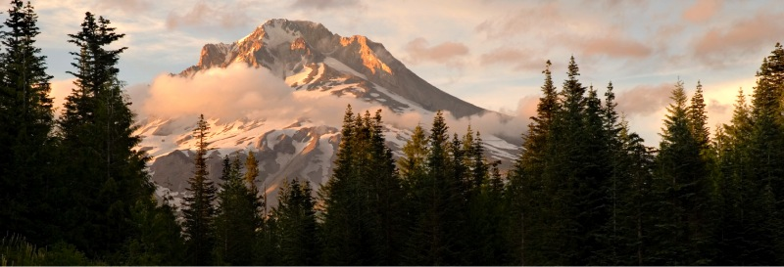

The Energy Challenge
Margaret Strong
Interim Energy Manager - Oregon Military Department
Josh Manders
Northwest Energy & Water Education Institute

Slide 2

Have you seen our newsletters?

Slide 3

QUESTION:
In a typical Oregon Government building, how much energy is wasted?
50%
18%
24%
30%

Slide 4

Answer = 30%
Every building, from the smallest school to the tallest skyscraper, uses energy most often generated by the burning of fossil fuels.
5 million buildings in the U.S. where we work, play, and learn are responsible for nearly 20 percent of both the nation’s energy use and greenhouse gas emissions at a cost of over $100 billion per year.

Slide 5
QUESTION:
Joining the Energy Challenge will
cost me money
generate electricity
increase awareness about our buildings energy use
help you lose 10 pounds in a week

Slide 6
Answer = Awareness & Action
Our goal is to:
Help increase everyone's awareness of the amount of energy used within this facility and where it goes.
Take Action to Reduce Energy Waste.
This includes providing specific actions individuals can take in addition to a whole-building operational tune up.

Slide 7

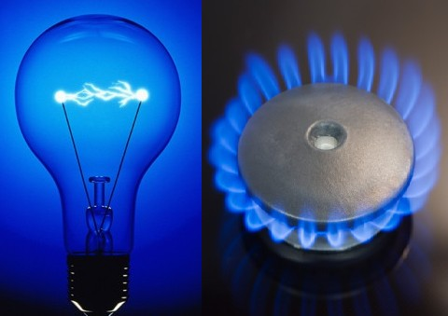
QUESTION:
Name one benefit of reducing energy usage.

Slide 8

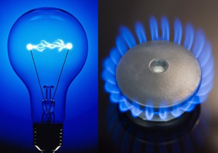
Answer
While there are many benefits for reducing energy waste, a vast majority of people agree.
Reducing Energy Waste:
Decreases the cost of operating the building allows better financial flexibility and stability.
Decreases the energy consumed within the building.
Decreases air & water pollution
that is a direct result of energy generation.

Slide 9

QUESTION:
If everyone continues to significantly reduce their building energy consumption, we can reverse.....?

Slide 10
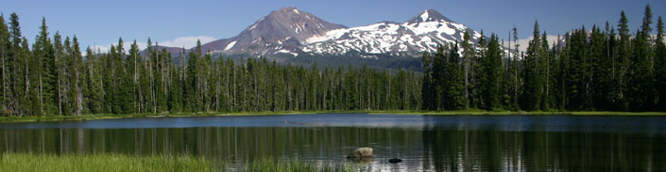
Answer: Climate Change!
Energy Efficiency is a Renewable Energy Resource.
When we increase our efficiency we don’t need to generate additional energy by building new fossil fuel power plants.
Source: http://en.wikipedia.org/wiki/Climate_change_mitigation

Slide 11
Why? – Federal Mandates
Energy Policy Act (EPACT) 2005
Independence and Security Act (EISA), 2007
EO 13423, Strengthening Federal Environmental, Energy and Transportation Management , 2007
EO 13514: Federal Leadership in Environmental, Energy and Economic Performance, 2009
Guiding Principals for Federal Leadership in High Performance & Sustainable Buildings, 2011
All federal agencies need to address energy performance and use resources effectively.

Slide 12
Energy is the ability to do work.

Slide 13
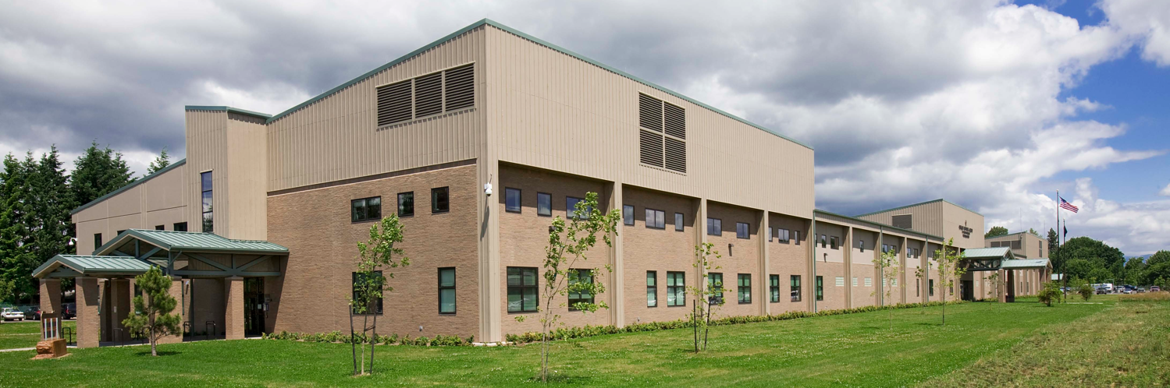
High Performance Buildings for High Performance People.
Q: What are some characteristics of a high performing building?

Slide 14
High Performance Buildings for High Performance People
Insulated Exterior, Efficient Lighting, Occupancy sensors (lights), CO2 sensors (demand ventilation), Day lighting, Air Quality, Efficient HVAC, Exterior Shading, Operable Windows, Proper Site Orientation, Smart Architecture, Automation & Controls, Non-toxic construction materials … + more!
But it's also about...
Enhancing everyday work lifestyles
Accommodating changes in the use and function of space
Reducing operating & maintenance costs
Taking the long-term view of the building lifecycle.

Slide 15
We are Working as a Team.

Slide 16
What Actions Are We Taking?
We are benchmarking our building’s energy use and improving operating performance through equipment tune-ups and or changes to operations and maintenance routines.
EXAMPLES:
Calibrating temperature sensors for a more accurate temperature reading. (less HOT & COLD)
Adjusting airflow so you get the air when you need it
Locating and fixing equipment not working as designed.
Updating daily schedules ensuring equipment shuts down when people aren’t in the building.
Improve controls to reduce energy consumption

Slide 17
What Can YOU Do?
Unplug entire cubicles not in regular use - including PHONES!
WHY?: A typical workstation consists of 2 monitors, computer and a phone using ~75-100 watts. If it glows, it’s using energy!
Turn off your monitors at the end of the day.
WHY?: While IT currently requires the machines to be left on for software updates and maintenance (we’re looking to change this), each monitor is using ~6 watts on ‘standby’. By making this small change, IT staff can supply the services everyone depends on without impacting the quality.
Turn off & UNPLUG AV equipment when not in use.
WHY?: Projectors are high energy users (some upwards of 200 watts) and plasma or large LCD's can consume even more with upwards of 400 watts.
Use the laptop when possible.
WHY?: A typical laptop can use less than half the energy of a desktop computer. Make your laptop the preferred device
and save!

Slide 18
What Else Can YOU Do?
Don't be the last one/first one in the office.
WHY?: Entire sections of lights are waiting for you to turn off and go home. It means your 1 extra hour of work *could* actually cost the agency money.
Need more air? Why not open a window?
WHY?: Your high performance building features beautiful windows that YOU can control. Windows are best left open when the outside air temperature is just right.
(not too hot/not too cold)
Wear light clothing for summer & warm clothing in winter.
WHY?: By dressing appropriately, you can remain comfortable without the shock of the outdoor temperature when leaving the office and help save energy.
(Perhaps its time to enact summer casual Fridays)

Slide 19
Upcoming Events
Green Bag Lunch Seminars
LEED Gold Plaque Unveiling
Ice Cream / Dessert Social

Slide 20

Thank You
&

