Slide 1
NWEN304
Group project Progress Presentation
GitHub: https://github.com/NWEN304Group/GroupProject

Slide 2
User Management
Registration (SK)
Security issue (Password encryption)
Email verification
Login / logout (SK)
Cookie & Session
OAuth / OpenID (SK)
Facebook Login
Support a timeout function (SK)

Slide 3
Products Management
Browsing of the product catalog(WZ)
Shopping cart (WZ)
Product recommendation (SK)
Get user location information
Server sent http request to other service

Slide 4
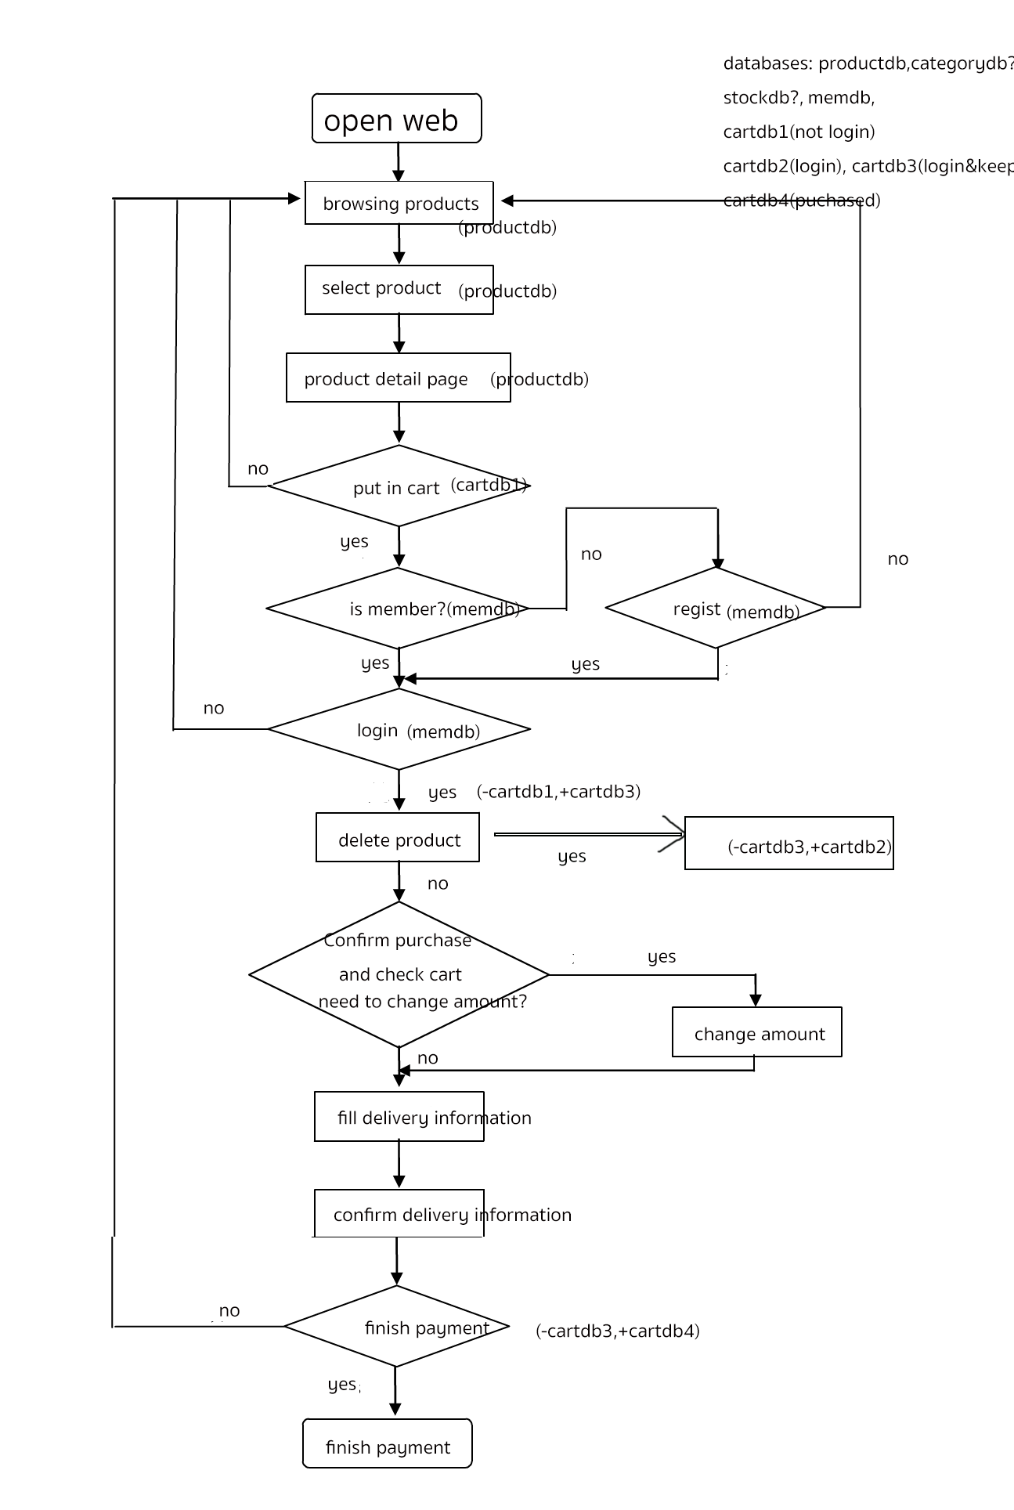

Slide 5
Server Development
Host the server application on cloud service(CV)
HTTPS (CV)
Caching(CV)
Evaluate and measure the performance(CV)
RESTful API interface design(CV)

Slide 6
Database Management
Set up a database at the server (WZ)
Query design(WZ)

