Slide 1
Krill size

Slide 2
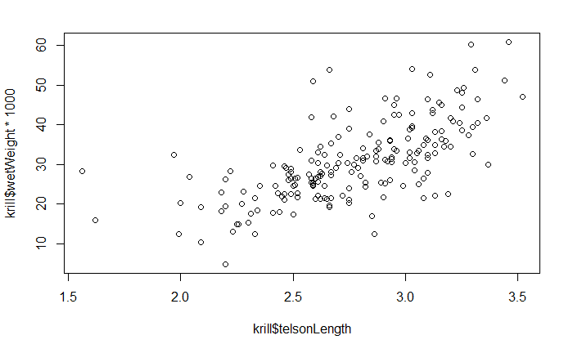
Basic scatter plot of telson length vs. wet weight

Slide 3
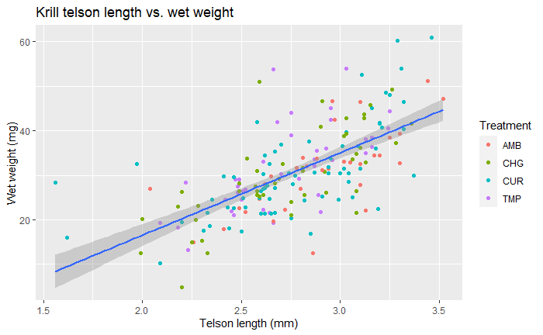
ggplot scatter + treatment

Slide 4
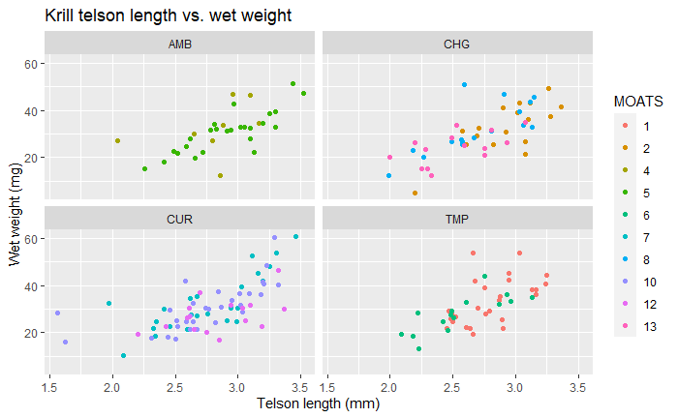
Faceted by treatment

Slide 5
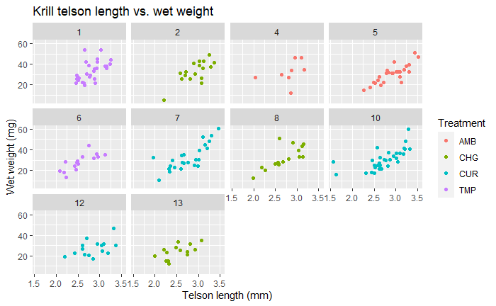
Faceted by MOATS

Slide 6
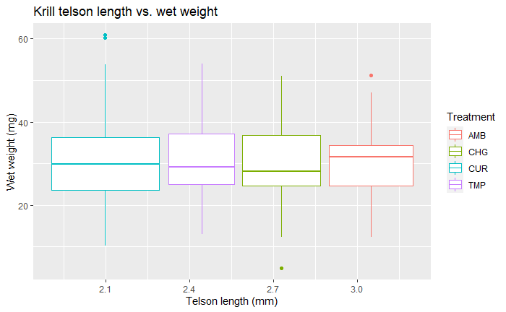
Boxplot by treatment

Slide 7
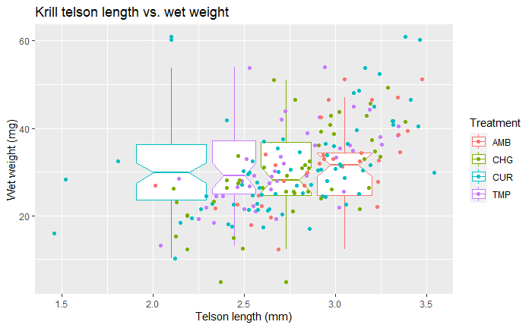
Boxplot by treatment + points

Slide 8
Basic stats

Slide 9
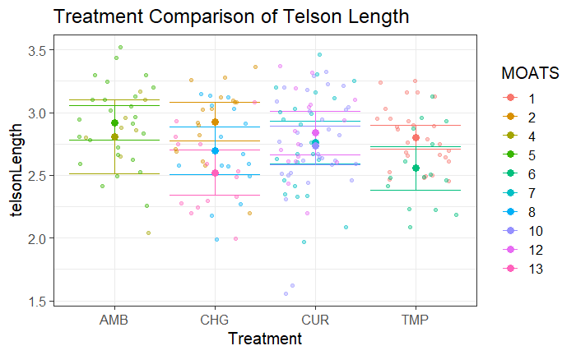
Treatment comparison of TL

Slide 10
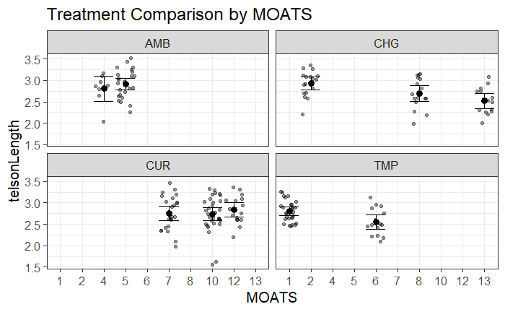
Telson length comparison by MOATS

Slide 11
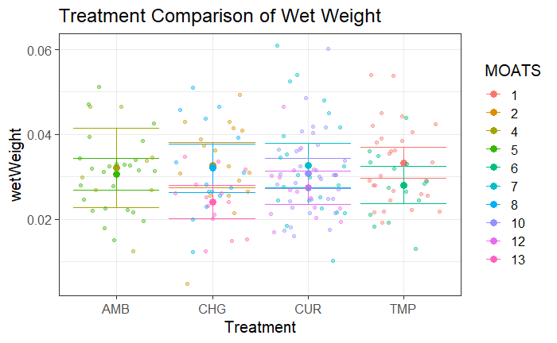
Treatment comparison of weight

Slide 12
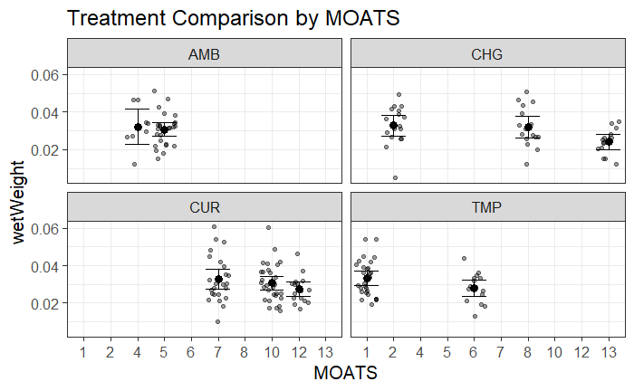
Wet weight comparison by MOATS

Slide 13
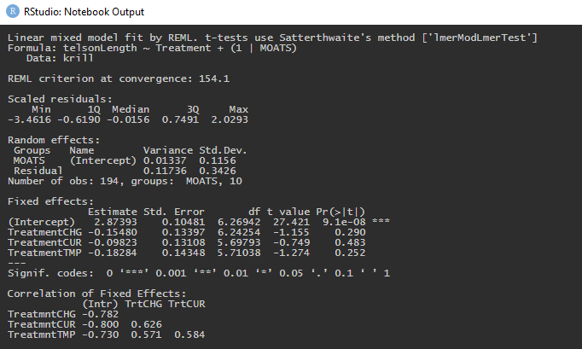
Linear mixed model for telson length

Slide 14
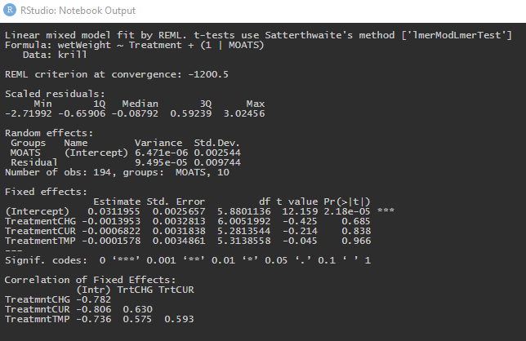
Linear mixed model for wet weight

