Slide 1
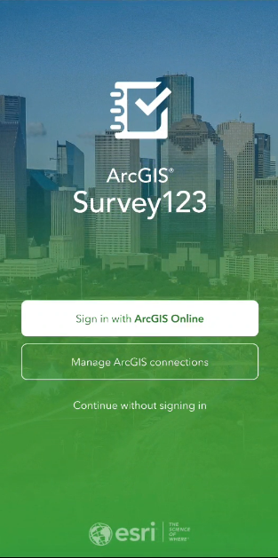
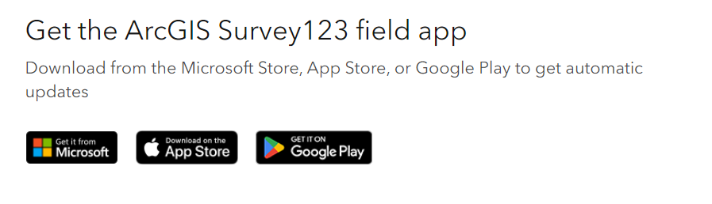
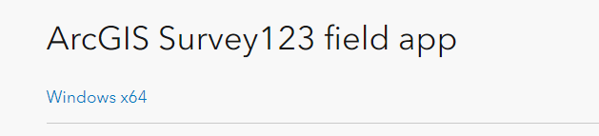
How to Download Survey123
Download the Survey123 Field App via the URL
Choose between downloading on from an App Store or with
Microsoft Store
Using the Windows x64 file

Slide 2
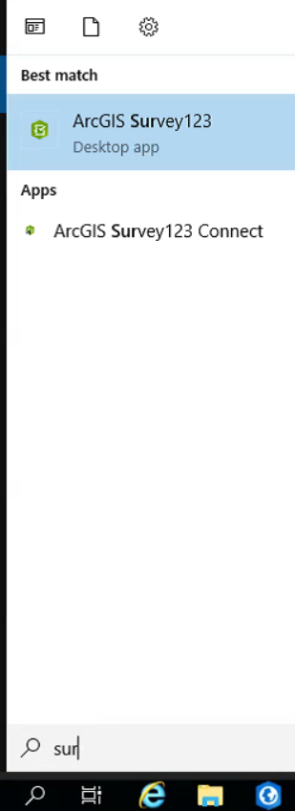
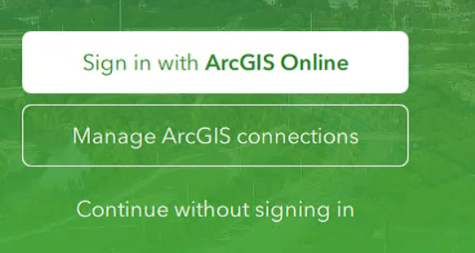
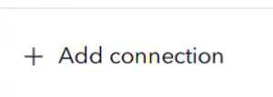
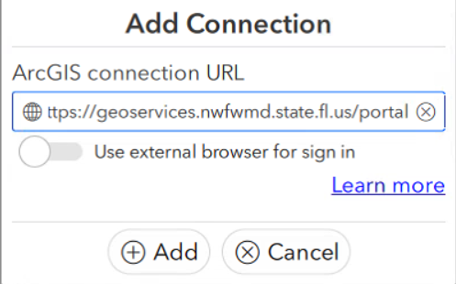
How to Add Portal Connection
Launch ArcGIS Survey123
Select ‘Manage ArcGIS connections’ then ‘Add connection’
Enter ‘https://geoservices.nwfwmd.state.fl.us/portal’ and click ‘Add’

Slide 3
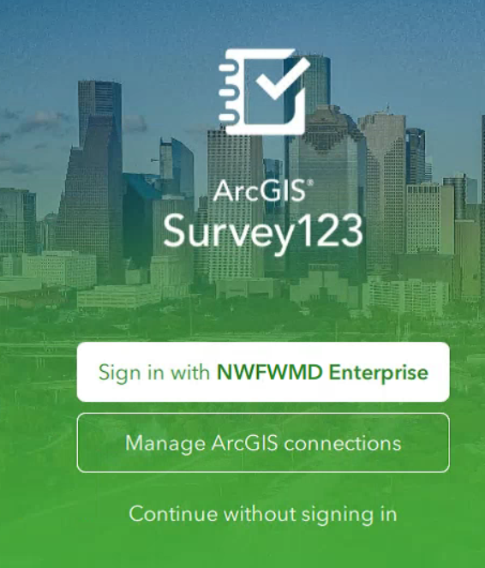
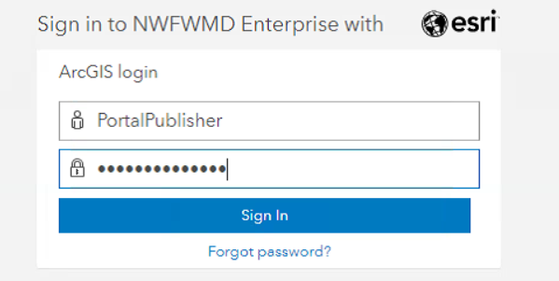
How to Login
On the Survey123 homepage click ‘Sign in with NWFWMD Enterprise’
Use your Portal credentials to sign in

Slide 4
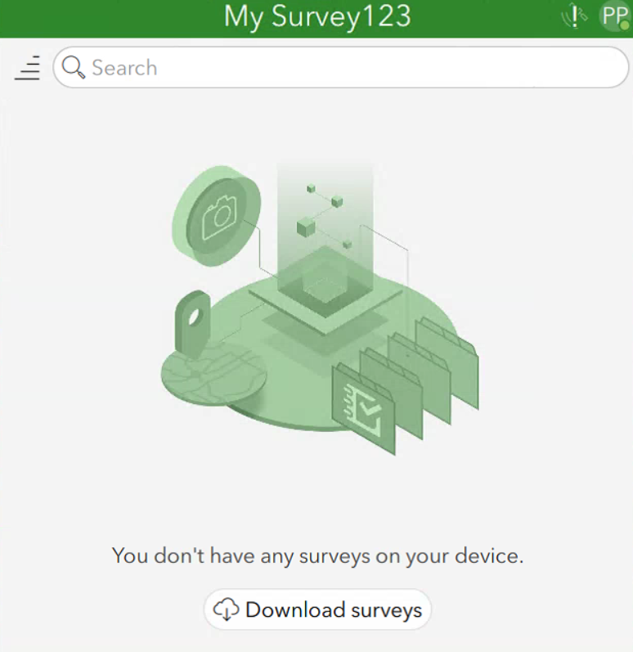
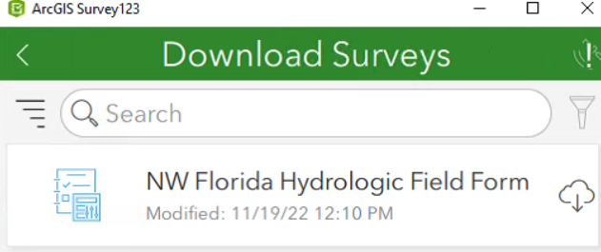
How to Download Survey
Select ‘Download survey’s’
Download the ‘NW Florida Hydrologic Field Form’

Slide 5
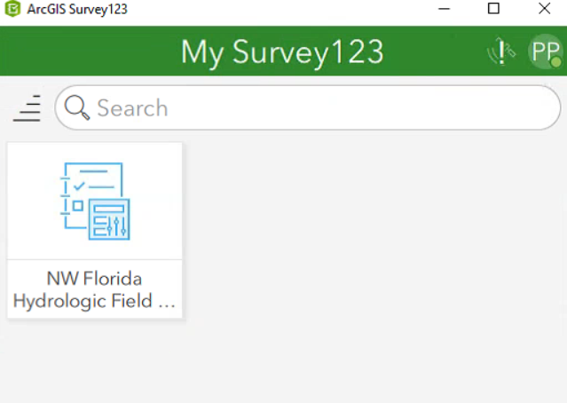
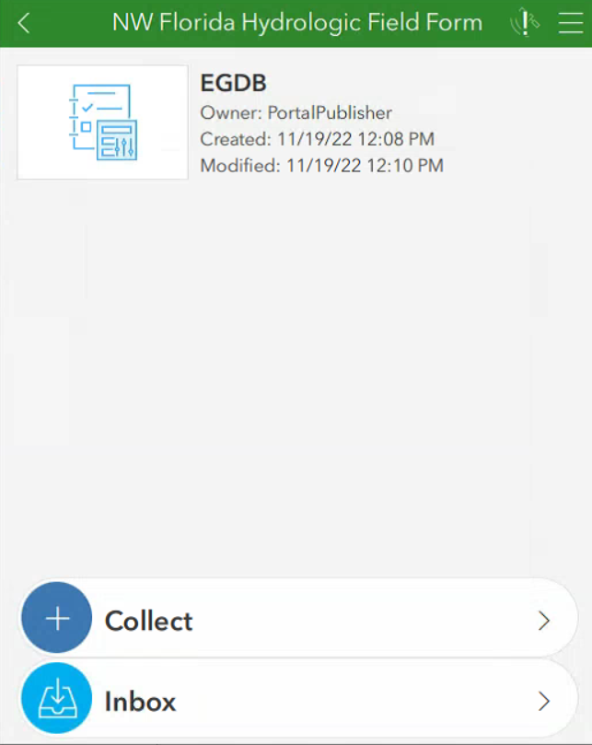
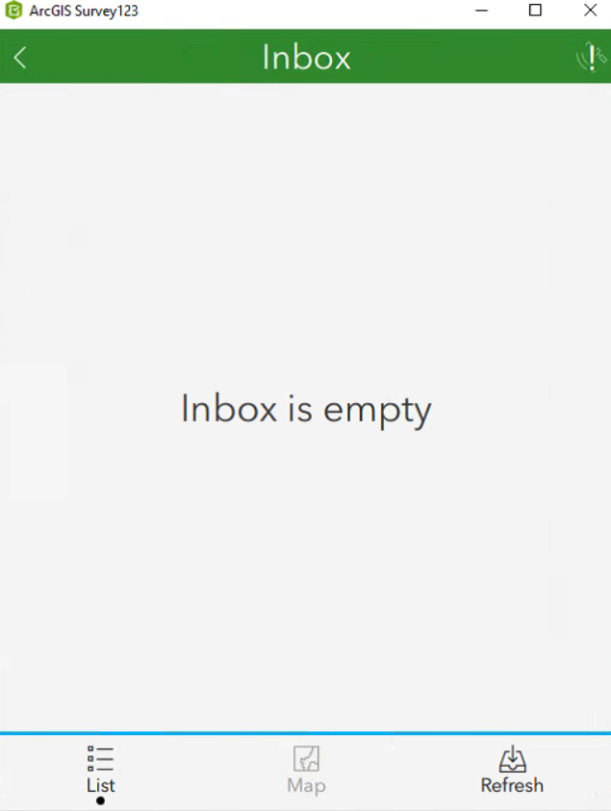
How to Load Locations
Click on the ‘NW Florida Hydrologic Field Form’
Click on ‘Inbox’
Select ‘Refresh’

Slide 6
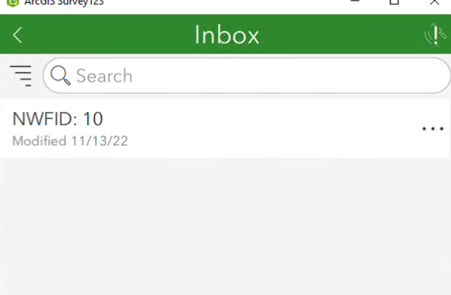
Testing: Create a Location Visit
Click on the Location in the Inbox to open
Scroll through the form and complete the sections
Are there questions missing which you would normally investigate when visiting a site?
Are there questions that should or should not be mandatory?
Are there questions that should be hidden or shown based on a previous answer?
Is navigation challenging? Would it be helpful to split the survey up into separate pages?

