Slide 1
Hydrologic Monitoring Fieldwork Instructions
Purpose of this document is to help prepare staff before going out into the field to collect data at monitoring wells

Slide 2


Summary
Field Maps Application: Map Based. Used to locate well, ability to view historical information, ability to view photos, launch Survey123.
Survey123: Form Based. Used to collect current site visit information.

Slide 3
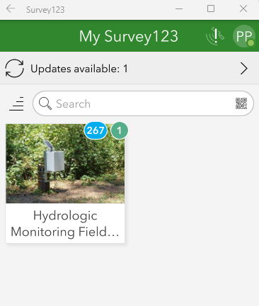
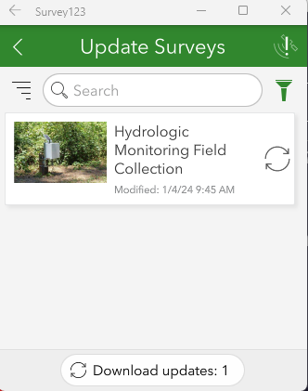
Update Survey123 (Prior to Fieldwork)
While you still have internet connection in the office the fieldworker will be required to update the Survey123 to the l
Open Survey123 application via your task bar or search bar
Click on ‘Updates available’
Click on refresh button or ‘Download updates’ to get the latest version of the survey
2
3

Slide 4
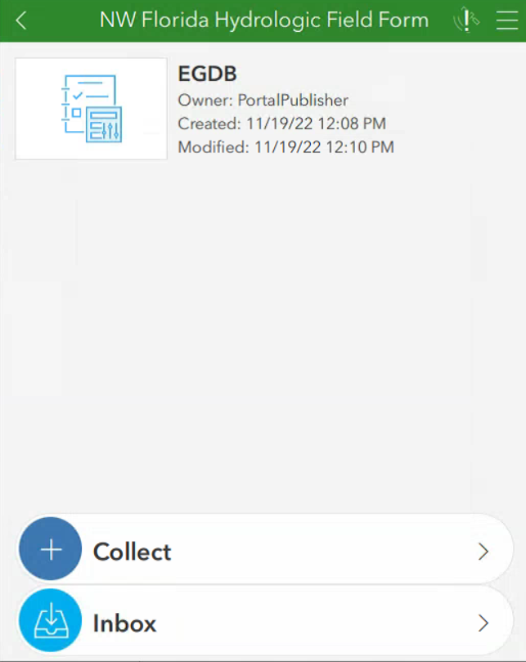
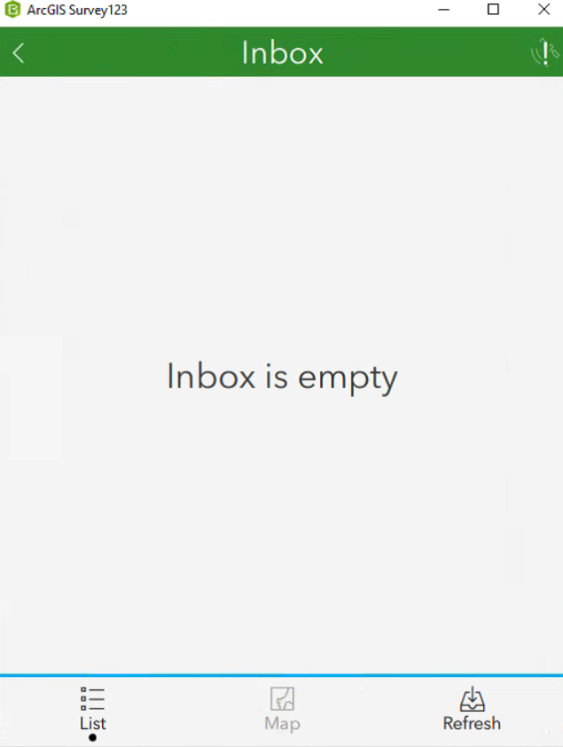
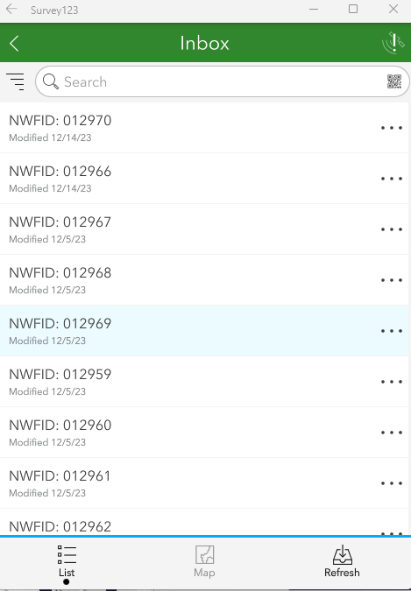
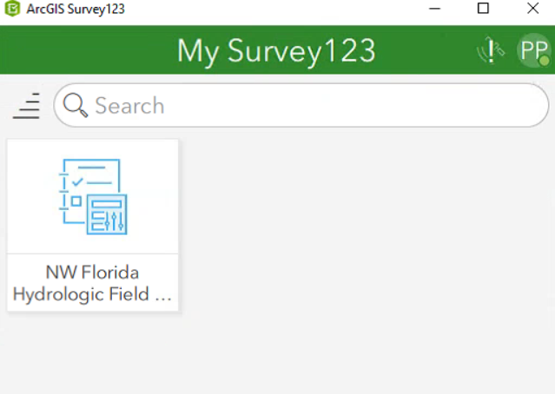
Load Locations (Prior to Fieldwork)
While you still have internet connection in the office the fieldworker will be required to load the locations in Survey123
Open Survey123 application via your task bar or search bar
Click on the ‘NW Florida Hydrologic Field Form’
Click on ‘Inbox’
Select ‘Refresh’
3
4
2

Slide 5
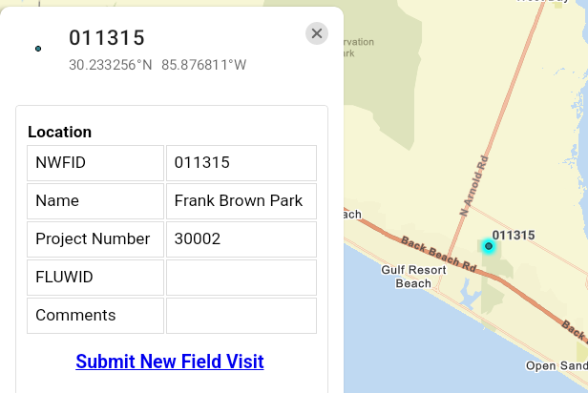
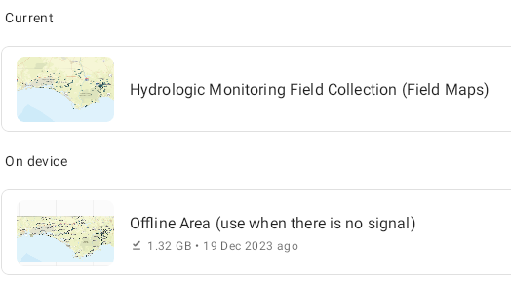
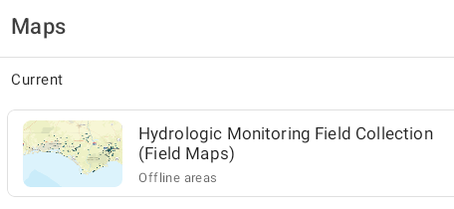
How to Use Field Maps (In the Field)
This workflow will be completed while the fieldworker is in the field
Open the Field Maps application via your task bar
Open the map called ‘Hydrologic Monitoring Field Collection (Field Maps)’
Select the offline basemap called ‘Offline Area’ if no signal is available
Once the map opens, zoom into the location of interest on the map and select the point
View any historical field visits, Measuring Point photos etc.
Select ‘Submit New Field Visit’ (Survey123 will launch)
4
3
2
6

Slide 6
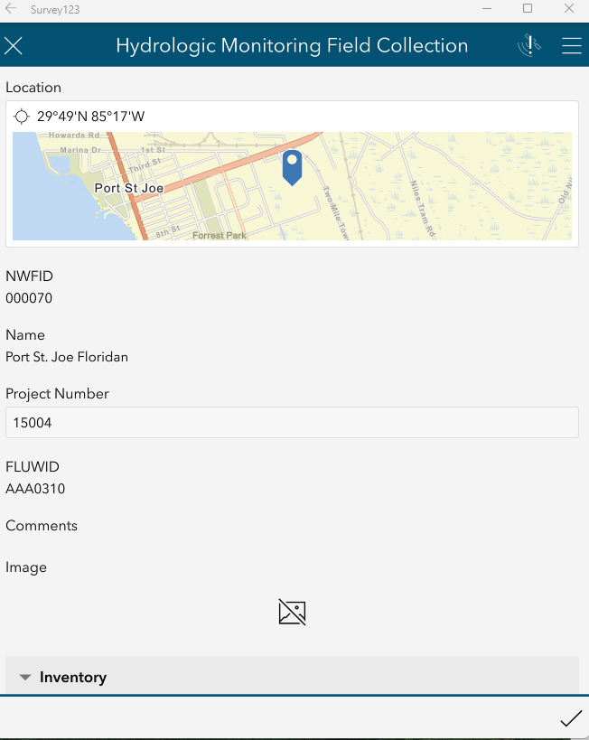
How to Use Survey123 (In the Field)
This workflow will be completed while the fieldworker is in the field
From Step 6 on previous slide, Survey for location will automatically open
Scroll through the form and complete the sections. Make sure to fill in all required questions marked with an *
Submit the form via the checkmark on the lower right
1
3

Slide 7
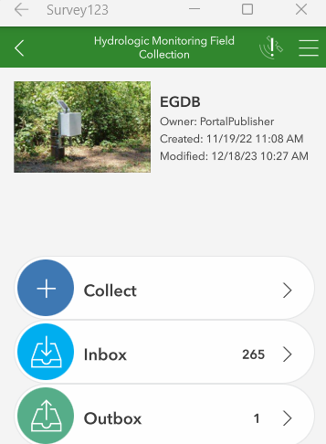
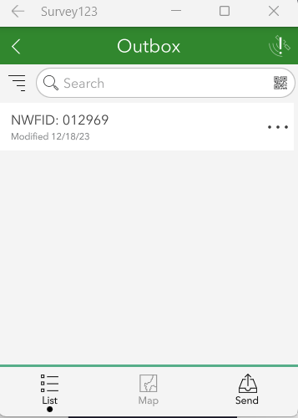
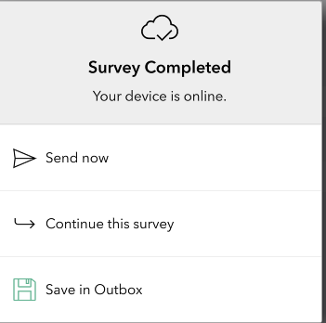
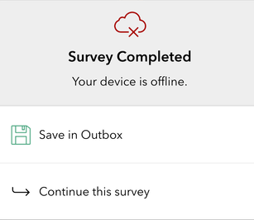
Options for Saving Survey123 (In the Field)
Upon clicking the submit checkmark in Survey123 there are a few options
If the device is online, you have two options
Send Now – which will send all collected data directly into the database
Save in Outbox – which saves the data locally on the device and allows you to reopen it on the device later
If the device is offline, you have one option
Choose Save in Outbox - then once the device is back online send the data to the database.
1
2

