Slide 1
Hydrologic Monitoring Fieldwork Instructions
Purpose of this document is to help prepare staff before going out into the field to collect data at monitoring wells

Slide 2


Survey123 Workflow
Survey123
Form based
Available on laptop
Used to collect current site visit information
Required

Slide 3
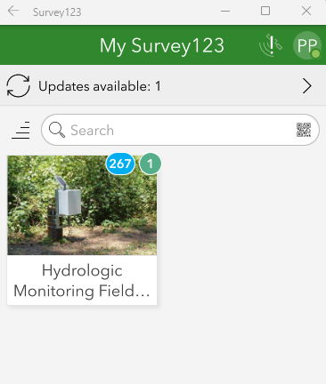
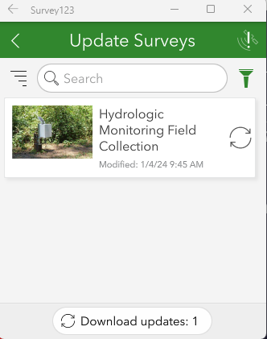
Update Survey123 (Prior to Fieldwork)
While you still have internet connection in the office the fieldworker will be required to update the Survey123 to the latest version.
Open Survey123 application via your task bar or search bar
Click on ‘Updates available’
Click on refresh button or ‘Download updates’ to get the latest version of the survey
2
3

Slide 4
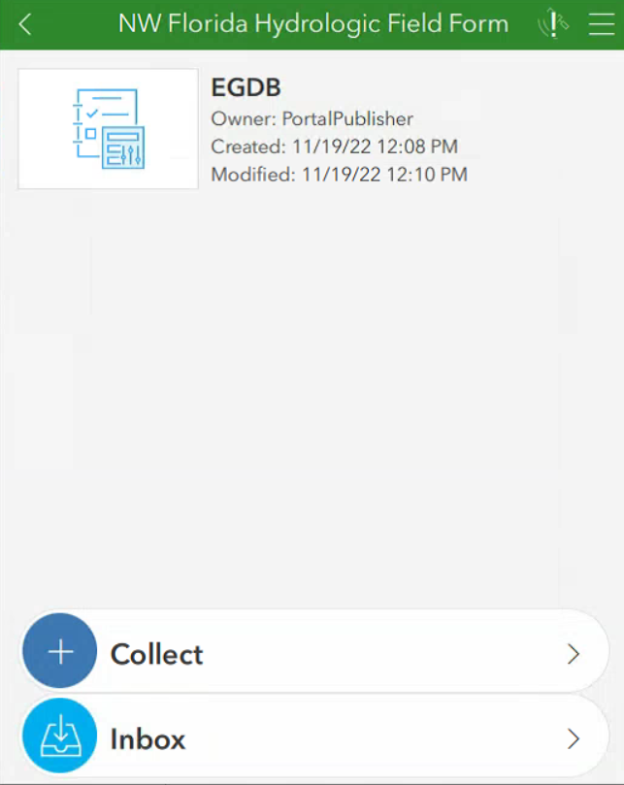
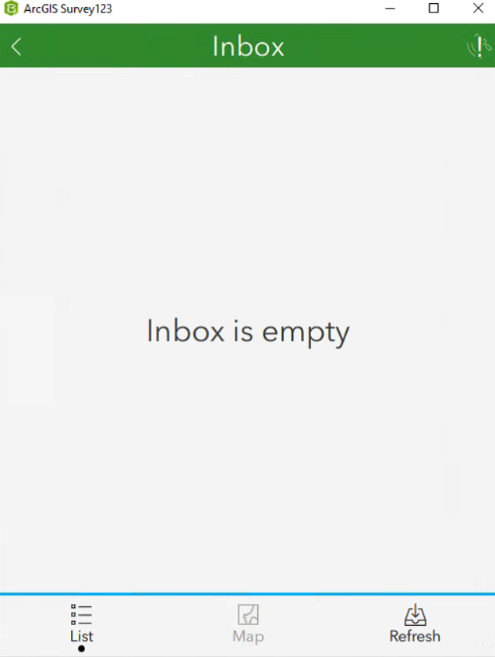
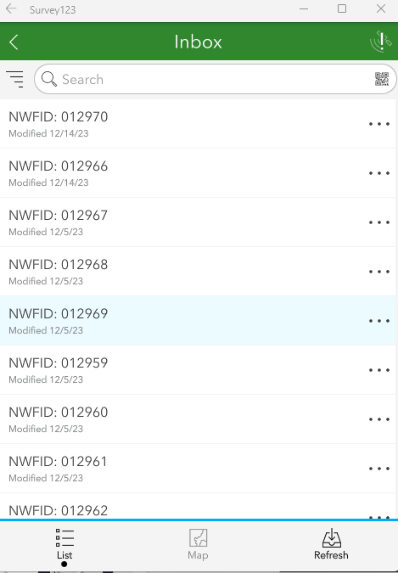
Load Locations (Prior to Fieldwork)
While you still have internet connection in the office the fieldworker will be required to load the locations in Survey123.
Open Survey123 application via your task bar or search bar
Click on the ‘Hydrologic Monitoring Field Collection’
Click on ‘Inbox’
Select ‘Refresh’
3
4
2

Slide 5
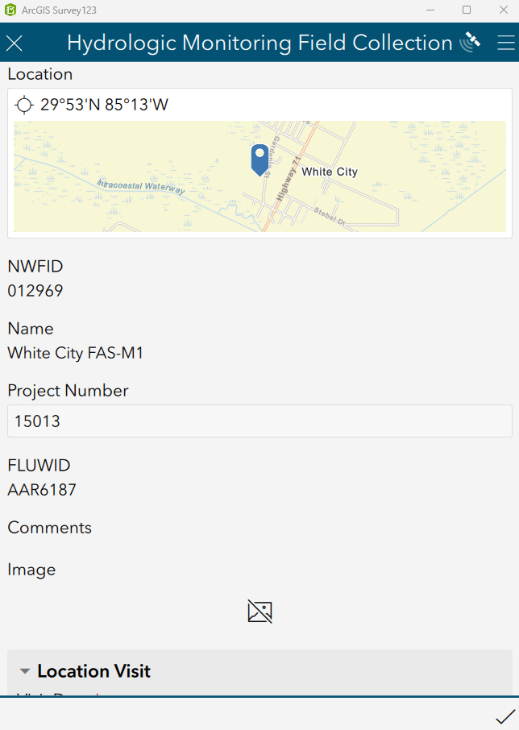
Starting a Location Visit (In the Field)
This workflow will be completed while the fieldworker is in the field.
Open Survey123 application via your task bar or search bar
Click on the ‘Hydrologic Monitoring Field Collection’
Click on ‘Inbox’
Use the Search bar or scroll to the location and select it
Fill in the form
3
4
5
2

Slide 6

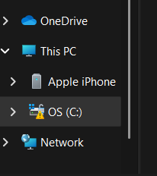
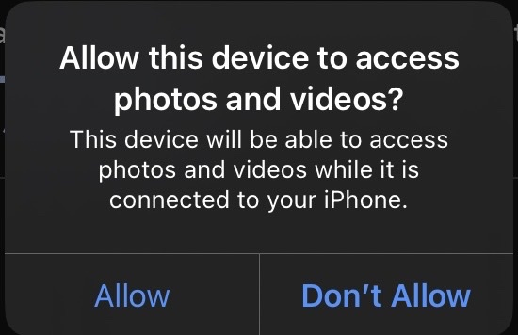
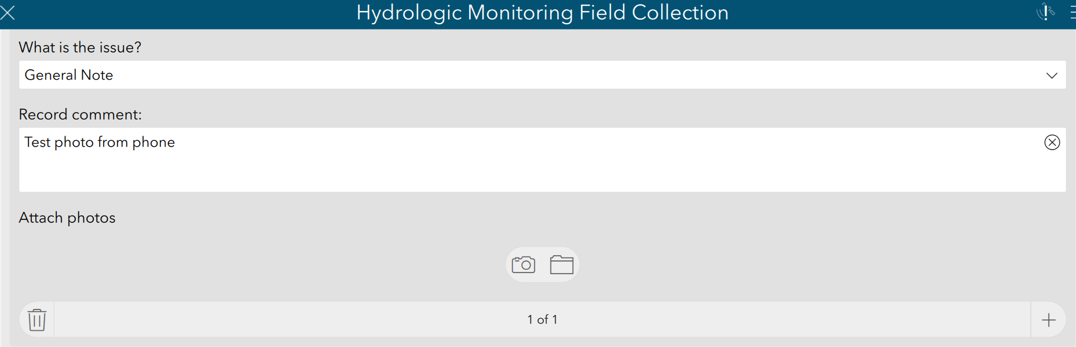
Upload Photos (In the Field)
This workflow will be completed while the fieldworker is in the field.
Photos taken using an external device such as a smart phone.
Upload via physical connection (iPhone)
After taking a photo, connect your phone to the laptop via USB. Allow device to access photos and videos.
Click on the folder icon in the survey.
Navigate to the photo – the iPhone will be accessible under My PC in the file explorer window.
Photo will be seen in the survey when it has been successfully uploaded.
iPhone Instructions (Android instructions on next slide)
3
1
2

Slide 7

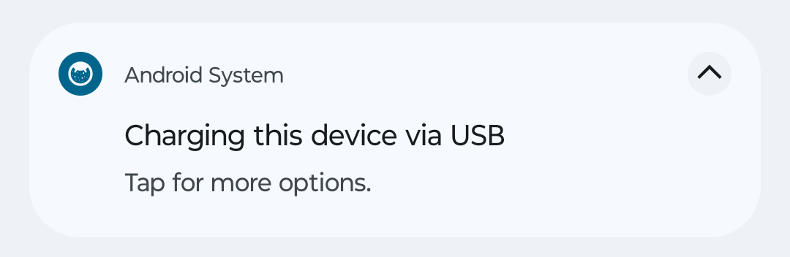
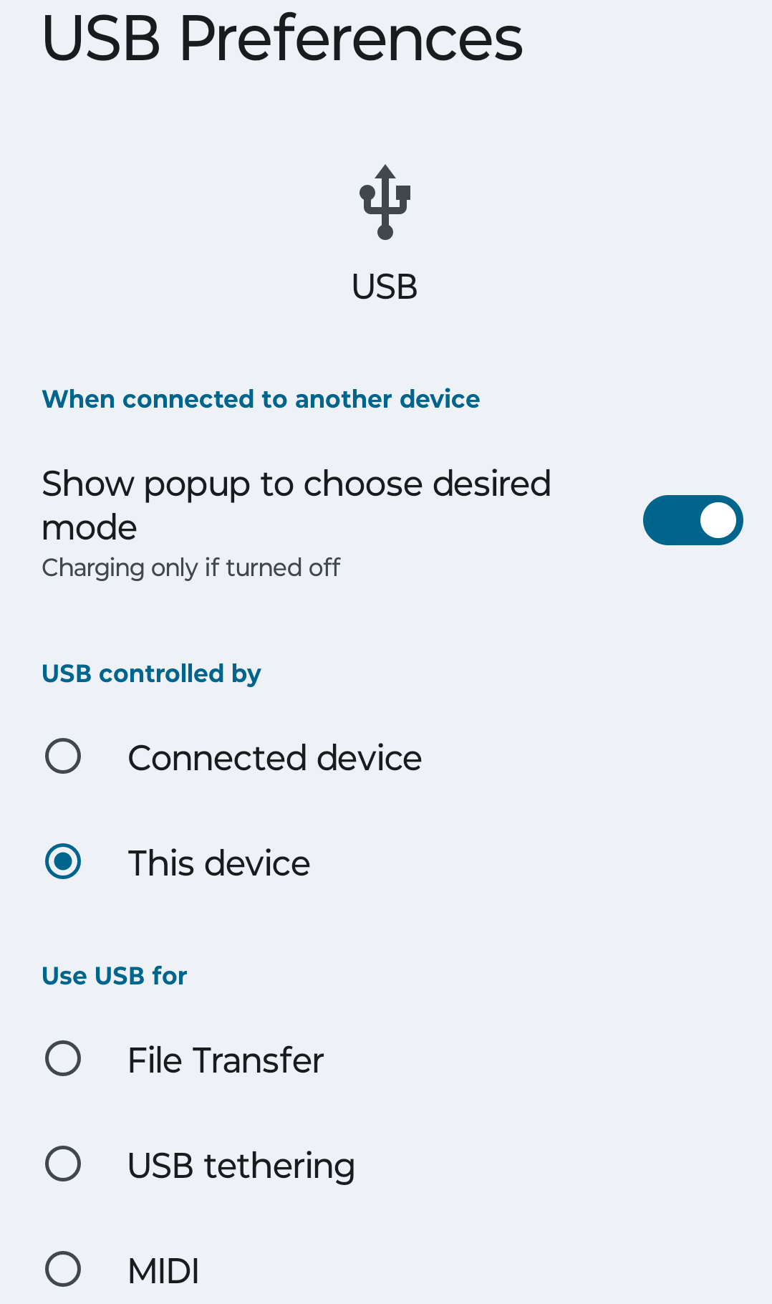
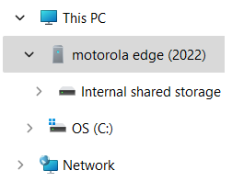
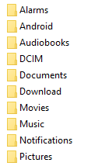

Upload Photos (In the Field)
1
Android Instructions
This workflow will be completed while the fieldworker is in the field.
Photos taken using an external device such as a smart phone.
Upload via physical connection (Android)
After taking a photo, connect your phone to the laptop via USB. Pull down the notification bar from the top of the screen and tap for more options.
Select “File Transfer”.
Click on the folder icon in the survey.
Navigate to the photo
Select Internal shared storage underneath the name of your phone.
Open DCIM folder
Open Camera folder and Select photo
2
3
a
b
c

Slide 8
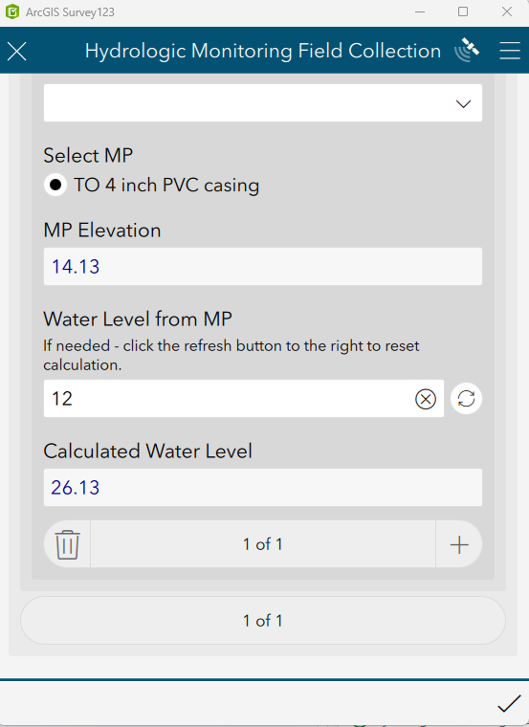
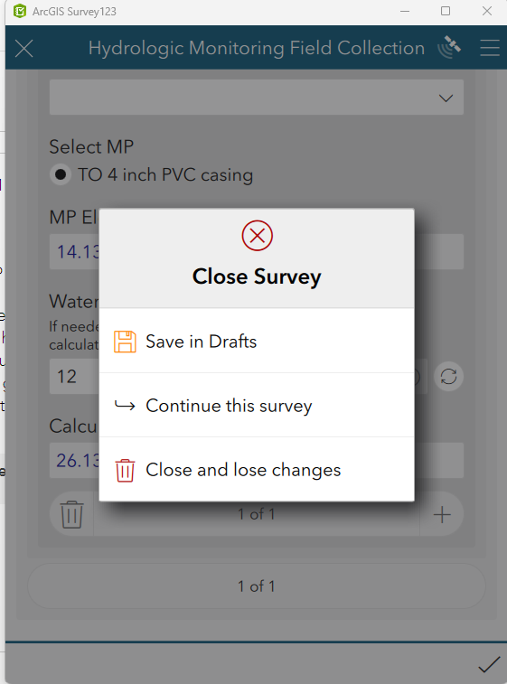
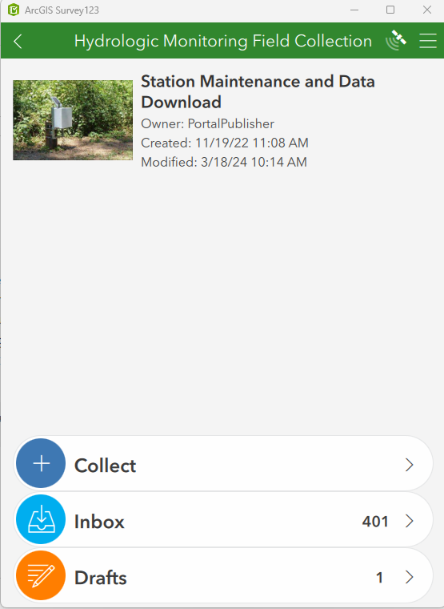
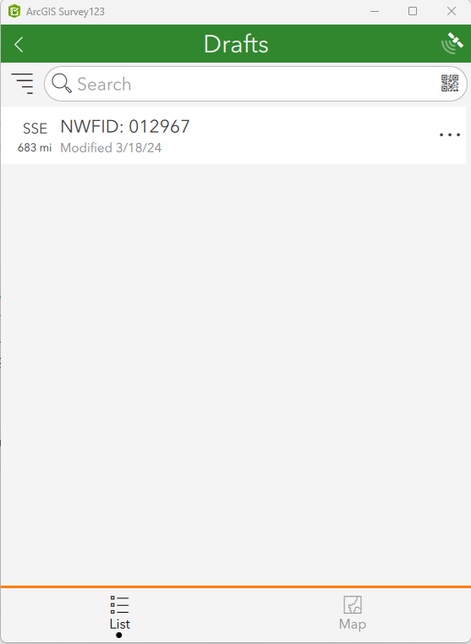
Saving a Partially Completed Visit (In the Field)
If a situation arises where the form can’t be completed, the information can be saved to the device as a draft.
Click the ‘X’ in the upper left to leave the form
Select the Option to ‘Save in Drafts’
Reopen the survey via the ‘Drafts’ and then selecting the location
1
2
3

Slide 9
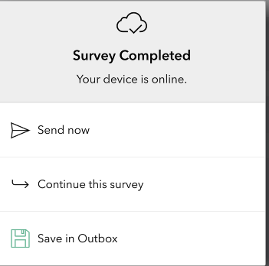
Submitting a Completed Visit - Online (In the Field)
After all information is collected in the form, the fieldworker will submit the form.
Click the checkmark to submit the form
When the device is online, you have two options:
Send Now – which will send all collected data directly into the database (recommended)
Save in Outbox – which saves the data locally on the device and allows you to reopen it on the device later (recommended to use ‘Save as Draft’ if the form is partially completed)
1
2

Slide 10
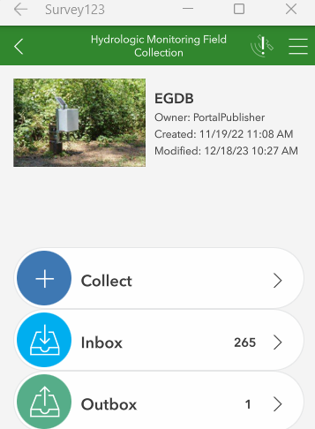
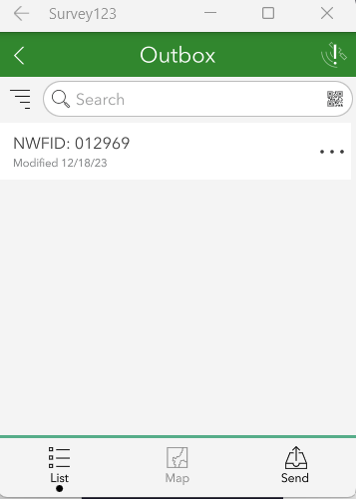
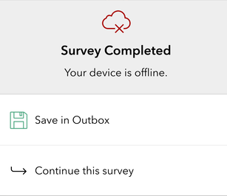
Submitting a Completed Visit - Offline (In the Field)
After all information is collected in the form, the fieldworker will submit the form.
Click the checkmark to submit the form
If the device is offline, you have one option
Choose Save in Outbox - then once the device is back online send the data to the database
1
2

Slide 11

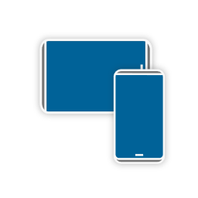
Field Maps
Field Maps Application
Map based
Available on mobile device
Used to locate well, ability to view historical information, ability to view photos
Optional

Slide 12
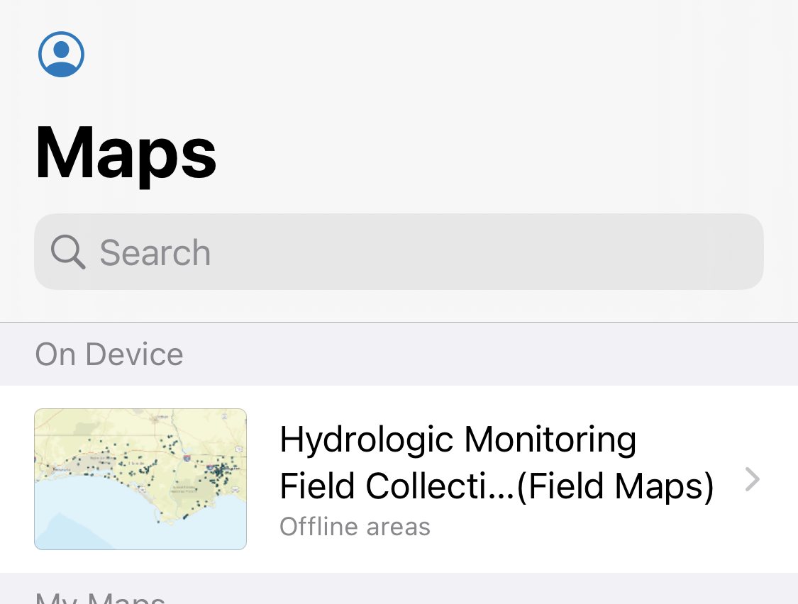
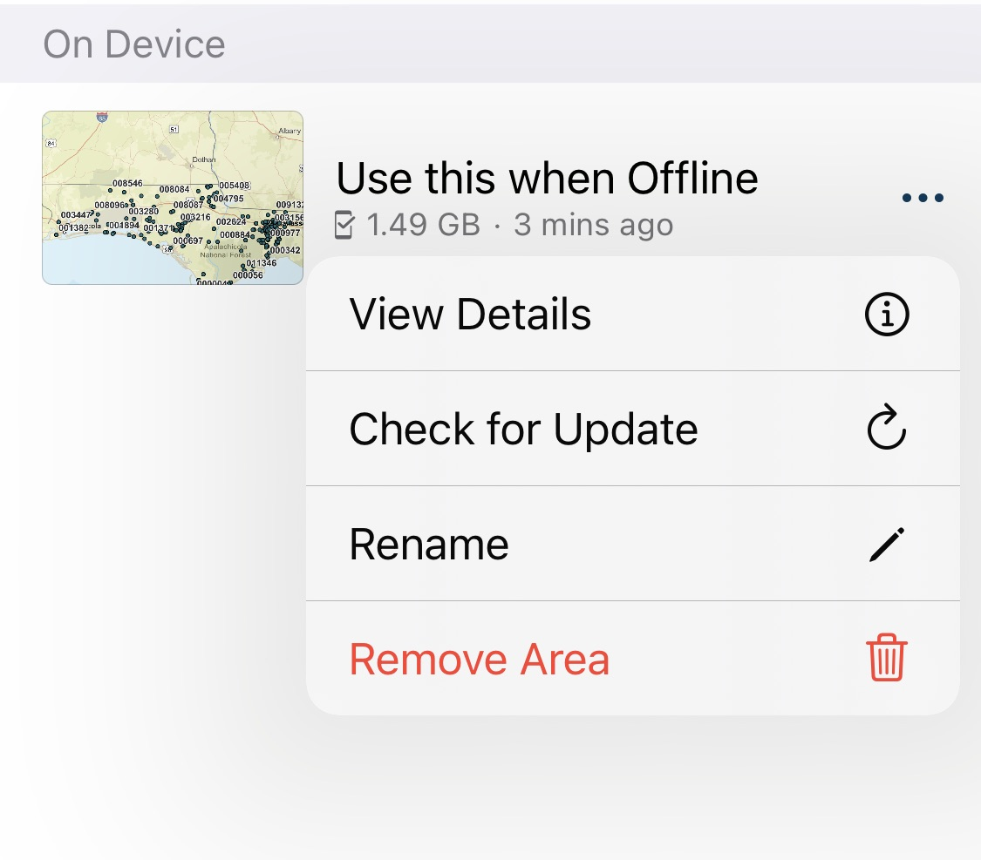
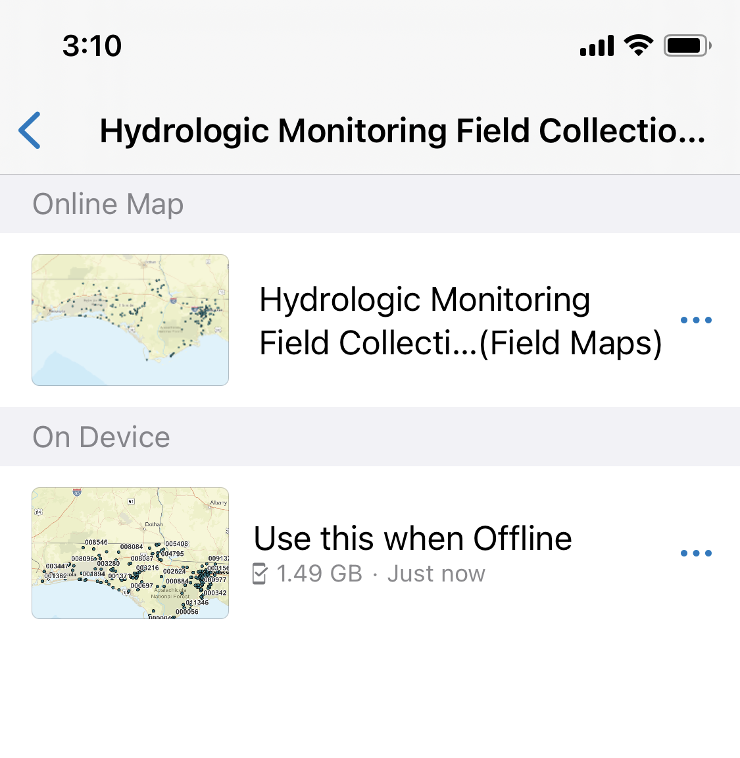
Check for Updates (Prior to Fieldwork)
While you still have internet connection in the office the fieldworker will be required to update the offline map area to incorporate any recent changes.
Open the Field Maps application on your mobile device
Open the map called ‘Hydrologic Monitoring Field Collection (Field Maps)’
Select the three dots next to the offline map area called ‘Use this when Offline’ and select ‘Check for Update’
Offline area will be updated to show all Location Visits available
2
3
4

Slide 13
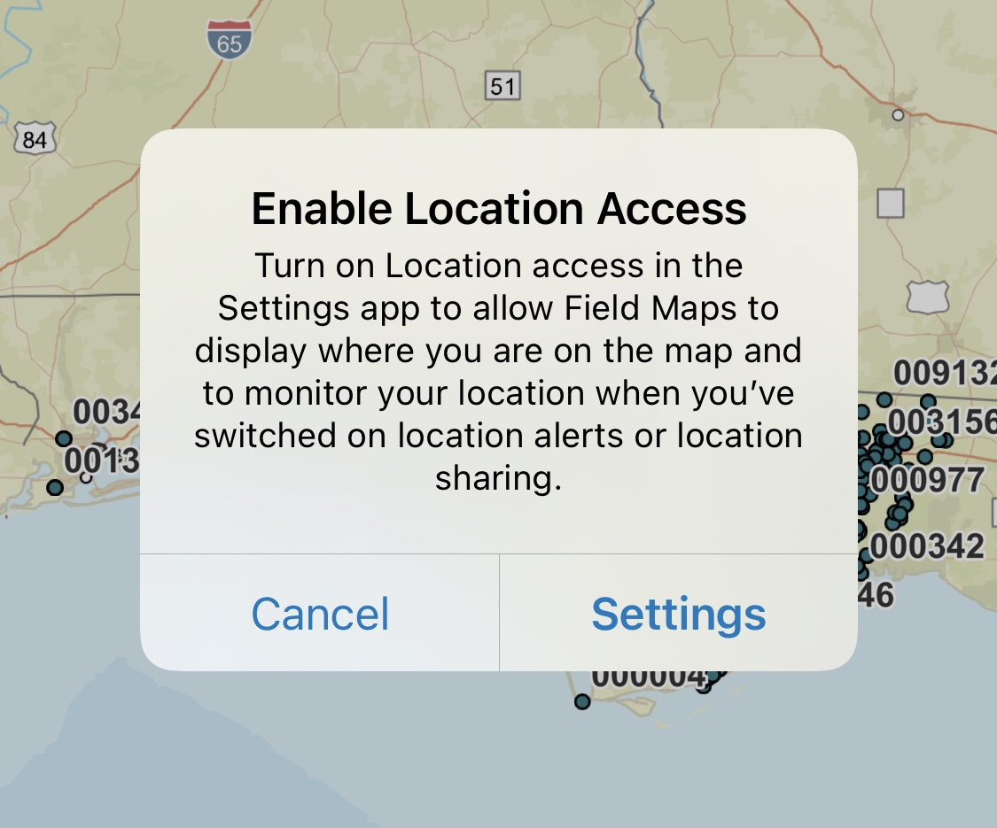
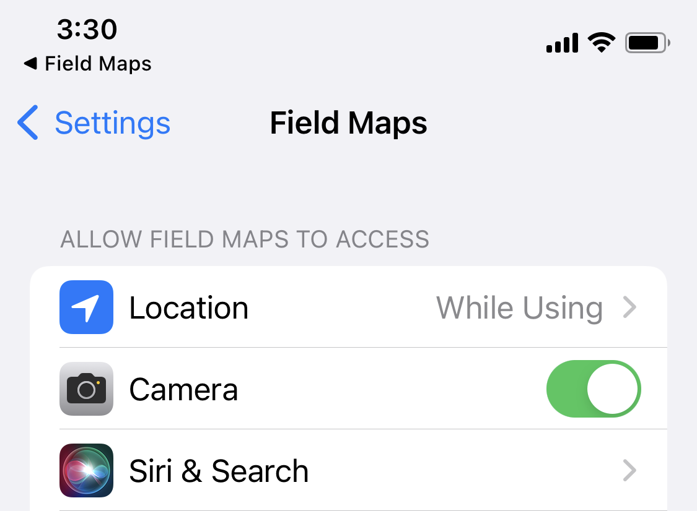
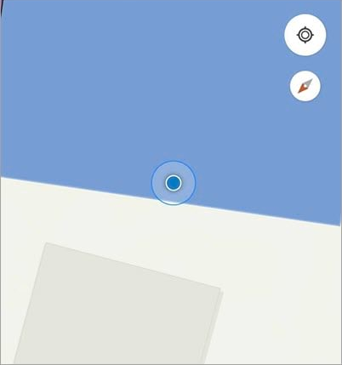
Enabling Location (Optional Setting)
This is an optional settings for Field Maps. By turning on Location access in your phones settings the application will monitor your location and show your proximity to the well.
Setting configuration will vary depending on device (iOS/Android)
Once the ‘Online Map’ is opened a dialog box will appear to update the setting. Alternative you may go directly to the settings app on your device
Change the Location setting to ‘While Using’ or ‘Always’
View your location on the map via the blue dot
1
2
3

Slide 14
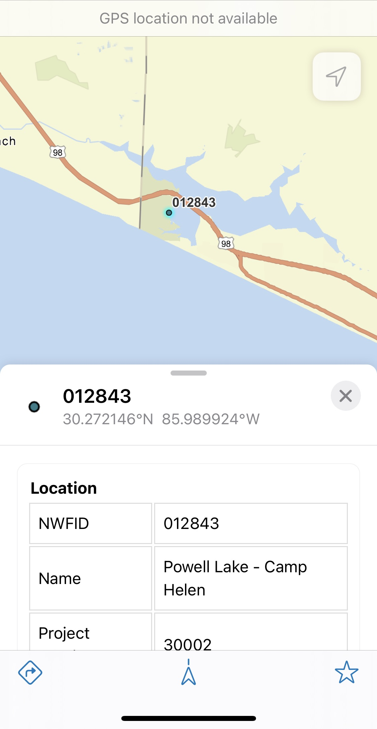
How to Use Field Maps (In the Field)
This workflow will be completed while the fieldworker is in the field.
Open the Field Maps application on your mobile device
Open the map called ‘Hydrologic Monitoring Field Collection (Field Maps)’
Select the ‘Online Map’ if you have signal connection, otherwise if your device is offline use the option ‘On Device’
Once the map opens, zoom into the location of interest on the map and select the point
View any historical field visits, Measuring Point photos etc
4
2
3

