Slide 1

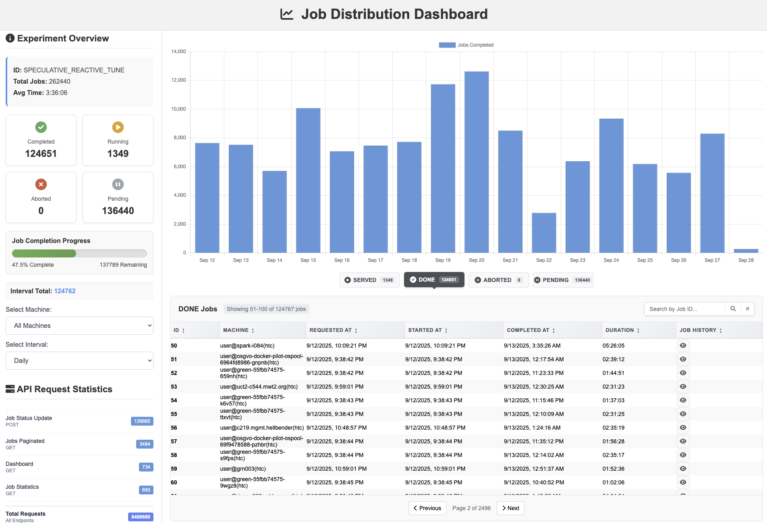
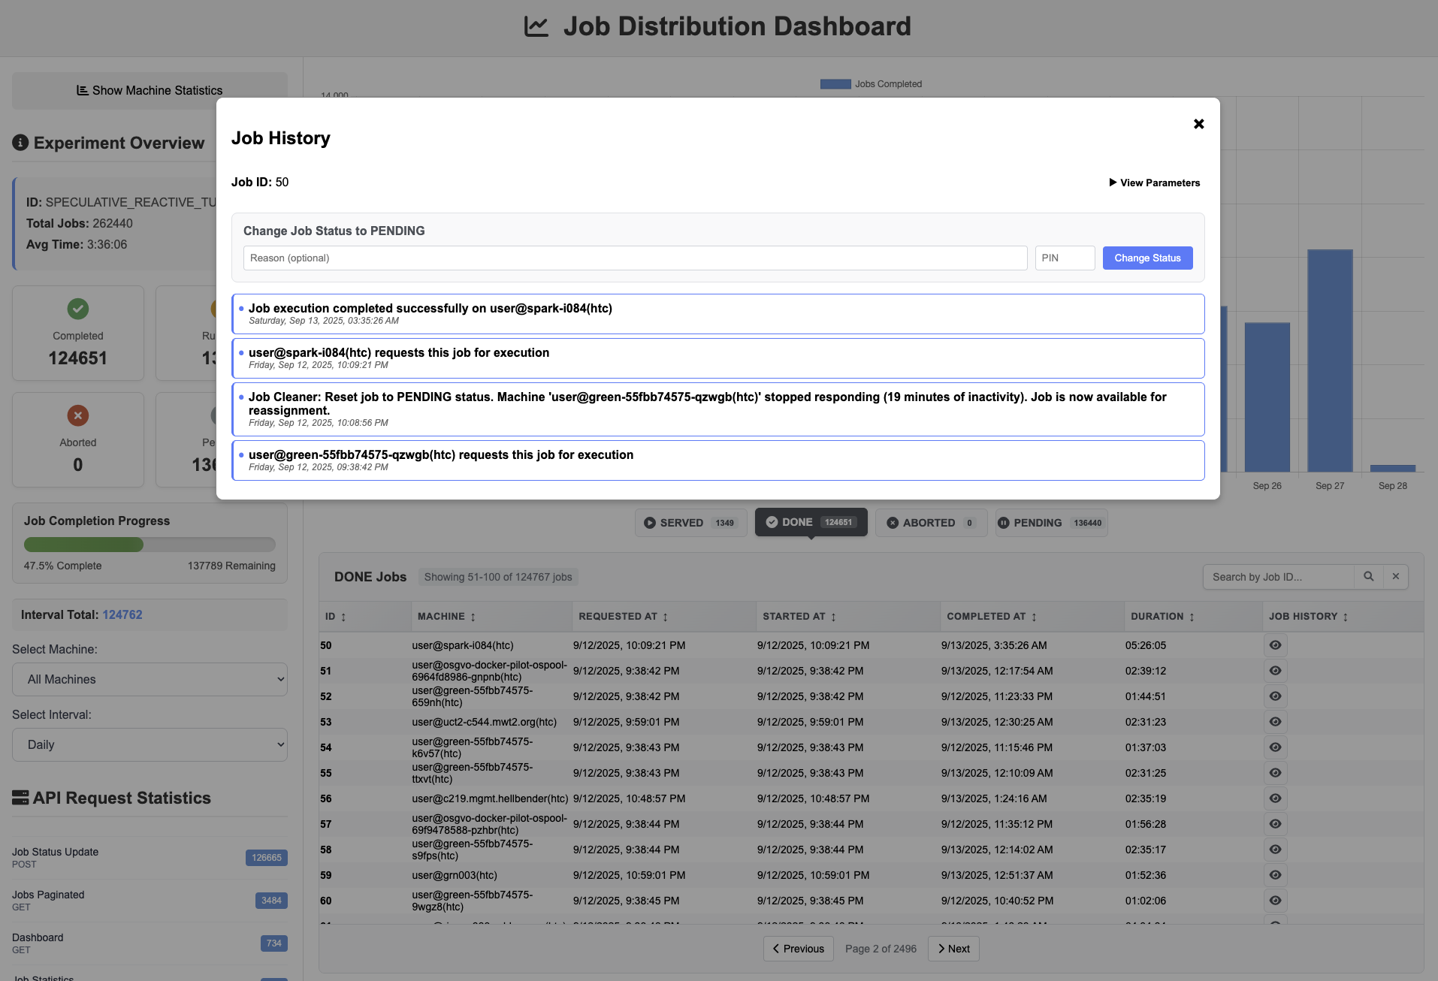


DART: Distributed Assignment of Research Tasks for Heterogeneous Compute Environments
Abdur Rouf, Fahad Ahmad Khan, Benjamin Keene, Shafaq Chaudhry, and Murat Yuksel
Networking and Wireless Systems Lab (NWSL), Department of Computer Engineering, University of Central Florida
INTRODUCTION
DART WORKFLOW
JOB LIFECYCLE
STATIC vs DYNAMIC ALLOCATION
Modern research increasingly relies on diverse computing resources ranging from personal laptops and cloud VMs to institutional HPC clusters. Managing jobs across such heterogeneous systems is often complex, requiring significant setup and expertise. To address this challenge, we present DART, a lightweight, platform-agnostic job distributor designed for academic research.
DART emphasizes simplicity, portability, and minimal configuration, enabling seamless job submission, monitoring, and fault-tolerant rescheduling without the overhead of traditional orchestration frameworks. Unlike tools such as Dask or HTCondor, DART provides an intuitive interface and quick deployment using simple JSON configurations, making it especially suitable for researchers handling evolving workflows.
In large-scale experiments with 37,720 jobs distributed over 68 heterogeneous machines, DART’s dynamic allocation achieved up to a 35× speedup compared to static strategies, reducing turnaround from months to days. These results highlight DART as an efficient solution for managing distributed computational tasks in today’s research.
A job moves from UNASSIGNED to RUNNING when a worker requests it.
While RUNNING, three things can happen: 2.1) It finishes successfully → goes to DONE. 2.2) It fails (e.g., OOM or runtime error) → goes to ABORTED. 2.3) The worker shuts down; after a timeout → job returns to UNASSIGNED.
ABORTED jobs wait a short grace period, then move back to UNASSIGNED so the distributor can reassign them to another worker.
KEY CONTRIBUTIONS
Figure: Performance comparison of static and dynamic scheduling. The figure shows the vast performance difference between the two approaches.
Flexible Resources: Add or remove worker machines anytime during workflow.
On-Demand Scheduling: Jobs assigned when requested, not pre-allocated.
Load-Aware Distribution: Fast machines handle more jobs, slow ones handle fewer.
Failure Resilience: Detects failed machines and reassigns jobs to healthy nodes.
Reduced Tail Latency: Minimizes straggler effect → faster experiment completion.
Heterogeneous Friendly: Efficiently utilizes mixed compute environments.
LEVERAGING RESOURCE HETEROGENEITY
Machines have different speeds — faster ones complete jobs in less time.
DART dynamically assigns more jobs to faster machines, reducing overall makespan.
Observation: Clear inverse correlation between machine runtime and number of jobs assigned.
Real-world factors (e.g., job failures, task variability, node availability) cause small deviations but overall trend is strong.
DART DASHBOARD
CONVENTIONAL RESEARCH WORKFLOW
ARCHITECTURE AND COMPONENTS
Stokes → 20 Compute Nodes
Newton → 10 Compute Nodes
Desktop → 1 Compute Node
Laptop → 1 Compute Node
Figure: Task count vs. average task runtime, illustrating the inverse correlation between machine speed and job count and demonstrating how DART leverages resource heterogeneity.
We want to run the same code/software across different research configurations by utilizing all available compute nodes
Interested in using DART to
streamline your experiments?
Figure: System architecture and job flow of the DART frame-
work. Flows: (a.x) is the main job assignment and execution
flow throughout the system; (b.x) is the information flow
between database and dashboard; (c.x) is the handles fault
tolerance of system between job cleaner and database.

