Slide 1

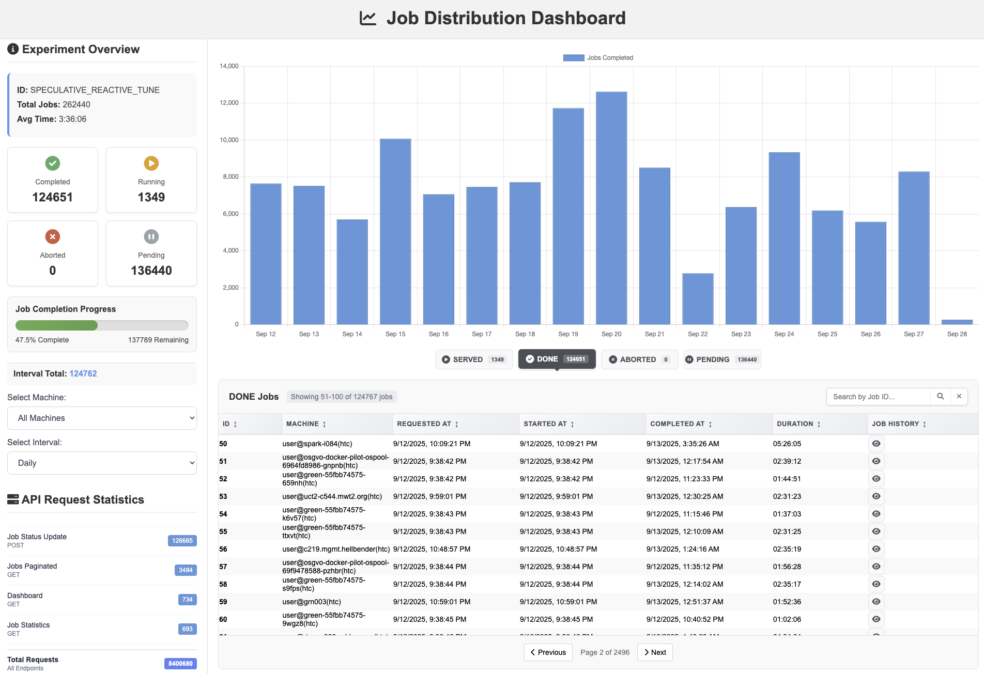
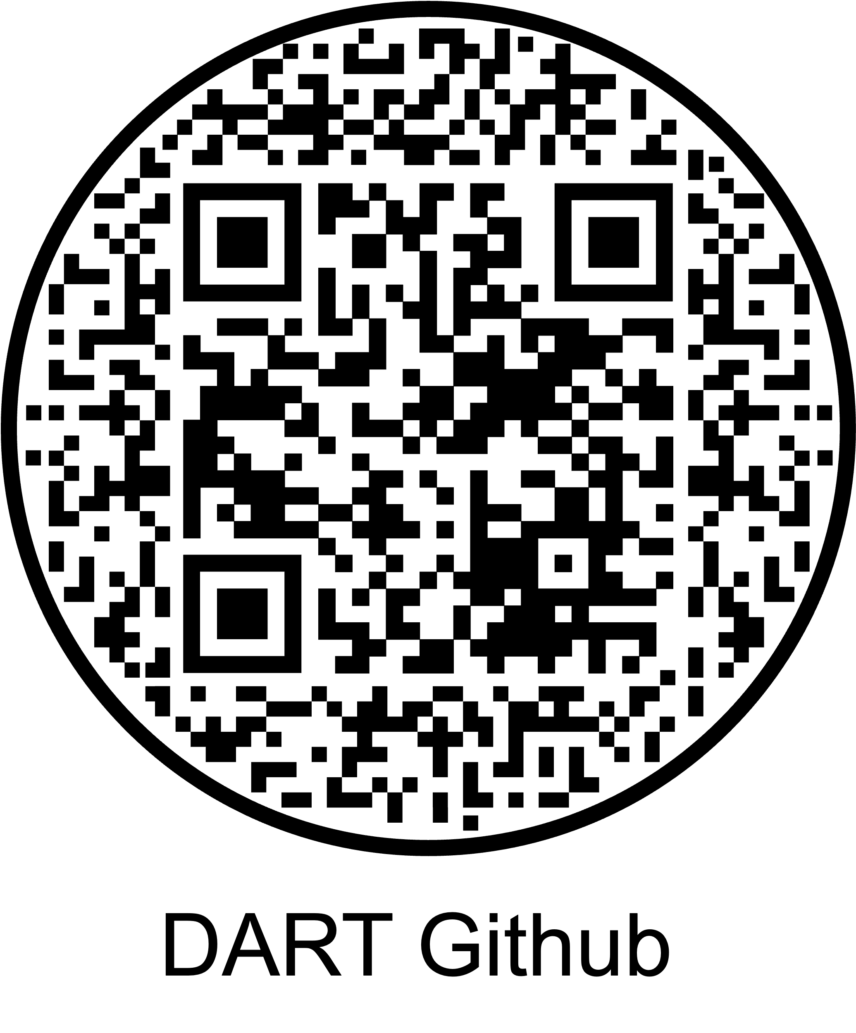



DART: Distributed Assignment of Research Tasks for Heterogeneous Compute Environments
Abdur Rouf
Abdur.rouf@ucf.edu
Fahad Ahmad Khan
Fahad.Khan@ucf.edu
Benjamin Keene
Keene@ucf.edu
Shafaq Chaudhry
Shafaq.Chaudhry@ucf.edu
Murat Yuksel
Murat.Yuksel@ucf.edu
Introduction
Key Contributions
DART Dashboard
Modern research increasingly relies on diverse computing resources ranging from personal laptops and cloud VMs to institutional HPC clusters. Managing jobs across such heterogeneous systems is often complex, requiring significant setup and expertise. To address this challenge, we present DART, a lightweight, platform-agnostic job distributor designed for academic research.
DART emphasizes simplicity, portability, and minimal configuration, enabling seamless job submission, monitoring, and fault-tolerant rescheduling without the overhead of traditional orchestration frameworks. Unlike tools such as Dask or HTCondor, DART provides an intuitive interface and quick deployment using simple JSON configurations, making it especially suitable for researchers handling evolving workflows.
In large-scale experiments with 37,720 jobs distributed over 68 heterogeneous machines, DART’s dynamic allocation achieved up to a 35× speedup compared to static strategies, reducing turnaround from months to days. These results highlight DART as an efficient solution for managing distributed computational tasks in today’s research.
Flexible Resources: Add or remove worker machines anytime during workflow.
On-Demand Scheduling: Jobs assigned when requested, not pre-allocated.
Load-Aware Distribution: Fast machines handle more, slow ones handle fewer.
Failure Resilience: Detects failed machines and reassigns jobs to healthy nodes.
Reduced Tail Latency: Minimizes straggler effect → faster experiment completion.
Heterogeneous Friendly: Efficiently utilizes mixed compute environments.
Architecture & Components
Conventional Research Workflow
Stokes → 20 Compute Nodes
Newton → 10 Compute Nodes
Desktop → 1 Compute Node
Laptop → 1 Compute Node
Leveraging Resource Heterogeneity
We want to run the same code/software across different research configurations by utilizing all available compute nodes
Machine have different speeds --- faster ones complete jobs in less time
DART dynamically assigns more jobs to faster machines, reducing overall makespan.
Observation: Clear inverse correlation between machine runtime and number of jobs assigned.
Real-world factors (e.g., job failures, task variability, node availability) cause small deviations but overall trend is strong.
Figure: System architecture and job flow of the DART framework. Flows: (a.x) is the main job assignment and execution flow throughout the system; (b.x) is the information flow between database and dashboard; (c.x) is the handles fault tolerance of system between job cleaner and database.
Job Lifecycle
DART Workflow
Figure: Task count vs. average task runtime, illustrating the inverse correlation between machine speed and job count and demonstrating how DART leverages resource heterogeneity.
Interested in Using DART in Your Research Workflow?
A job moves from UNASSIGNED to RUNNING when a worker requests it, and while running it may either finish successfully (→ DONE), fail due to errors like OOM or runtime issues (→ ABORTED, then after a short grace period return to UNASSIGNED), or be interrupted if the worker shuts down (→ after a timeout the job goes back to UNASSIGNED).
https://github.com/NWSL-UCF/job-distributor.git
https://jobdistributor.abdur-rouf.com

