Slide 1
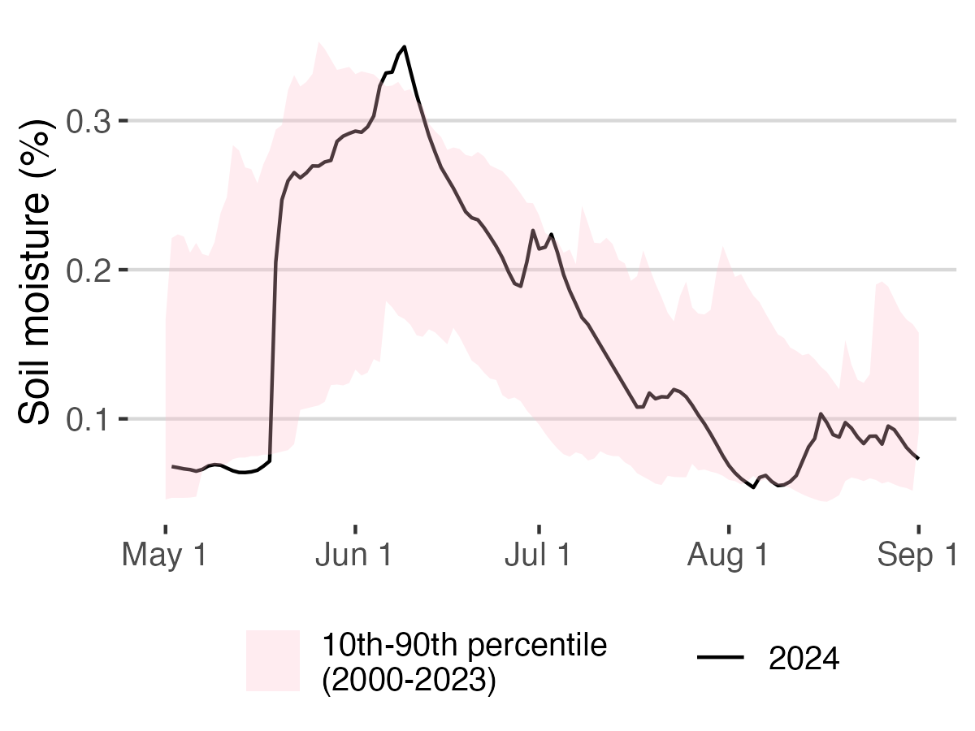
Saddle (SDL) Data: Morse, J. and M. Losleben. 2025. Climate data for saddle data loggers (CR23X and CR1000), 2000 - ongoing, daily. ver 10. Environmental Data Initiative. https://doi.org/10.6073/pasta/b01aea637f7608f0a1b2895ae474d571. Accessed 2025-08-11.
Notes:
Current year soil moisture compared to historical patterns. The ribbon shows the 10th-90th percentile range of historical data (2000-2023), providing context for evaluating whether conditions in 2024 are within normal ranges.

