Slide 1
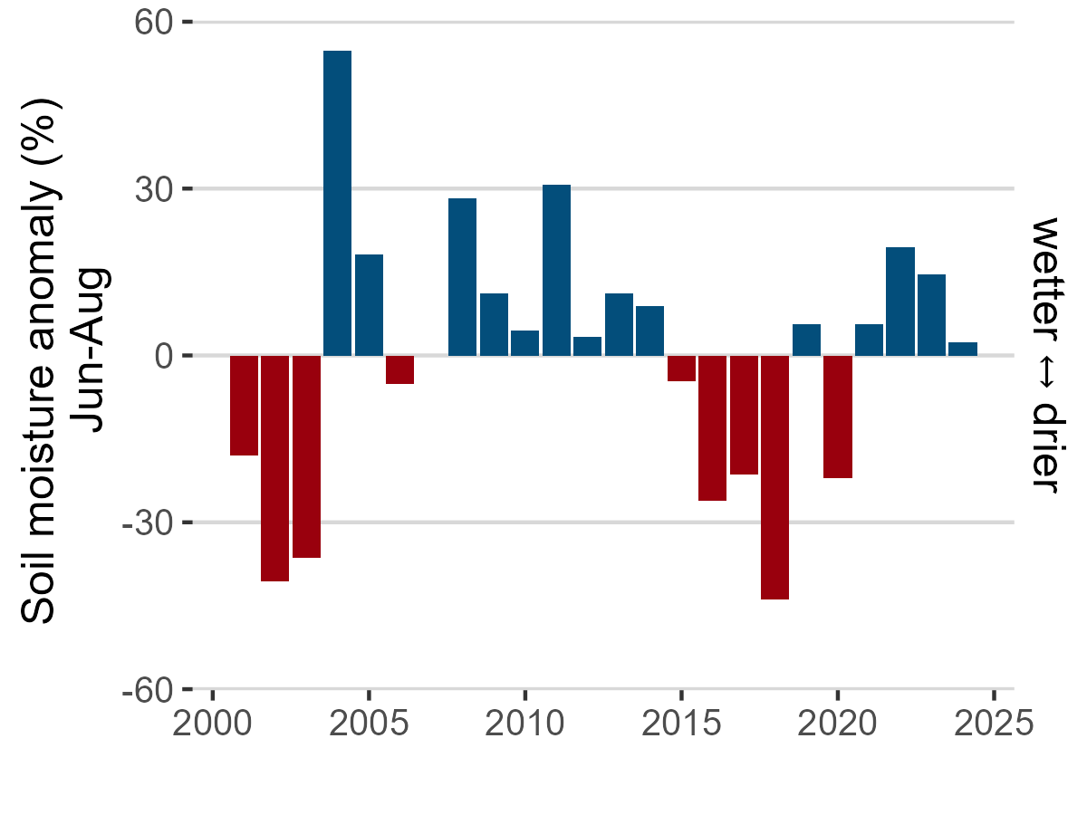
Saddle (SDL) Data: Morse, J. and M. Losleben. 2025. Climate data for saddle data loggers (CR23X and CR1000), 2000 - ongoing, daily. ver 10. Environmental Data Initiative. https://doi.org/10.6073/pasta/b01aea637f7608f0a1b2895ae474d571. Accessed 2025-08-11.
Notes:
This figure below illustrates how summer soil moisture (June-August) deviates from average across the Niwot Ridge alpine tundra soil moisture record. Data are from an alpine dry meadow located on the Saddle of Niwot Ridge.

