Slide 1

Introduction to Lists
Lists are used to store multiple items in a single variable.
Lists are one of Python's most flexible data structures.

Slide 2
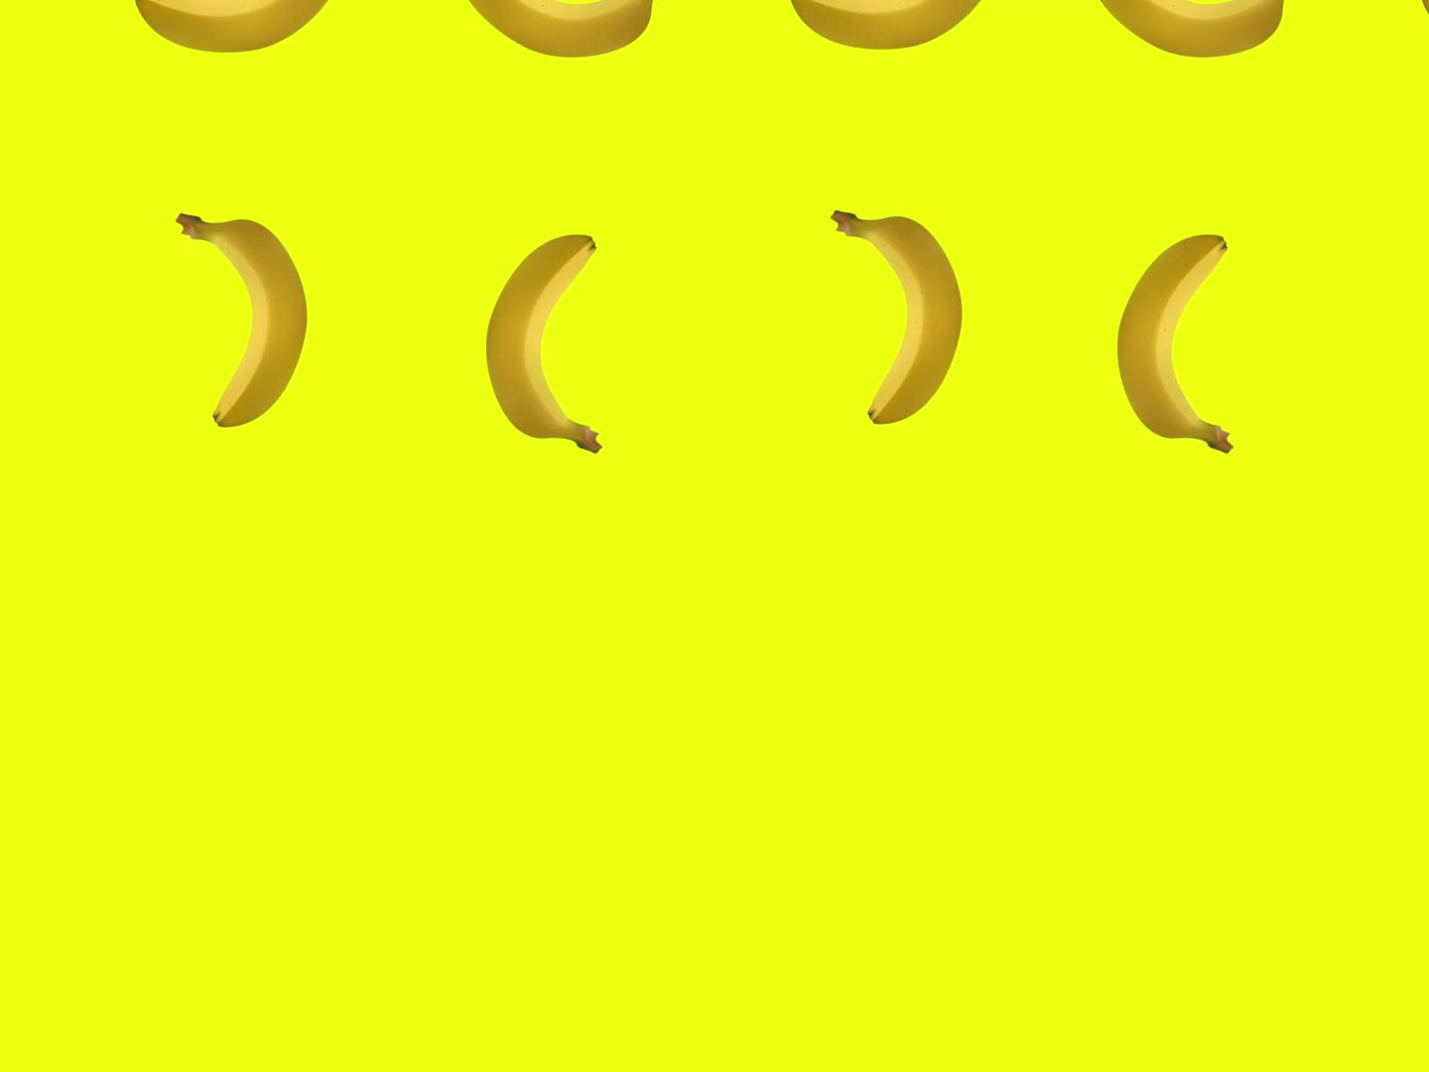
Creating a List
We create lists using square brackets.
Example:
fruits = ["apple", "banana", "cherry"]
print(fruits)

Slide 3
Accessing List Items
We use indexes to access items in a list.
Example:
fruits = ["apple", "banana", "cherry"]
print(fruits[0]) # apple
print(fruits[2]) # cherry

Slide 4
Negative Indexing
Negative indexes start from the end.
Example:
fruits = ["apple", "banana", "cherry"]
print(fruits[-1]) # cherry

Slide 5
Changing List Items
We can change values in a list using their index.
Example:
fruits = ["apple", "banana", "cherry"]
fruits[1] = "blueberry"
print(fruits)

Slide 6
Adding Items to a List
We use append() and insert() to add items.
Example:
fruits = ["apple", "banana"]
fruits.append("cherry")
fruits.insert(1, "orange")
print(fruits)

Slide 7
Removing Items from a List
We use remove() or pop() to delete items.
Example:
fruits = ["apple", "banana", "cherry"]
fruits.remove("banana")
fruits.pop(0)
print(fruits)

Slide 8
Looping Through a List
We can loop through items in a list with a for loop.
Example:
fruits = ["apple", "banana", "cherry"]
for fruit in fruits:
print(fruit)

Slide 9
Other Data Structures
Besides lists, Python has:
- Tuples: ordered, unchangeable
- Sets: unordered, no duplicates
- Dictionaries: key-value pairs

Slide 10
Summary
Lists store multiple items in one variable.
We can access, modify, add, and remove items.
Lists, tuples, sets, and dictionaries are core Python data structures.

