Slide 1


CODEFEST 2023 - School Category
Welcome to the introduction of the cutting edge School Management System developed for the Walisinghe Harischandra Maha Vidyalaya. The primary objective of this software is to simplify responsibilities and improve the educational journey, for both educators and learners.
by Ashen Nirmal Wadugodapitiya

Slide 2

Introduction
1
Competition Category: Senior
The School Management System is categorized under the Senior division, emphasizing advanced functionality and utilization.
2
Teacher in Charge:
Name: Prasanna Sumudu Chandrasekara
Contact Number: 0777350000
Email: nbitsyp@gmail.com
3
Students:
Name: Ashen Nirmal Wadugodapitiya
Contact Number: 0703620555
Email: anirmalwadugodapitiya@gmail.com

Slide 3
Main Components
Brief Overview
Key Features
System Benefits
The school management system helps with tasks conducting online classes managing the library and enabling smooth communication, between teachers and students.
The core features of the system include automated grading, managing student profiles, accessing classes and a messaging platform, for collaboration.
Enhances students ability to conveniently access information fosters communication, between teachers and students and enhances overall administrative effectiveness.

Slide 4

Student Benefits
Academic Management
Students are able to check and print their grades make changes, to their information and view records of books available, in the library.
Enhanced Learning
Our platform offers the opportunity for students to attend classes and gain access, to a range of educational materials creating an engaging and interactive learning atmosphere.
Communication
Enables teachers to interact and facilitates communication, within the school community.

Slide 5
Demonstration

Slide 6
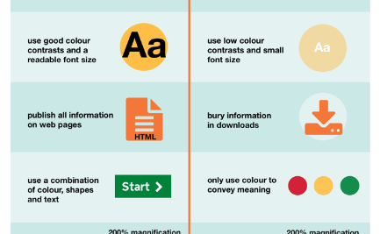


Visual Impressions
User Interface
Student-Teacher Interaction
Academic Progress
Intuitive and user-friendly interface for seamless navigation and system interaction.
Illustration of the system's impact on academic growth and student accomplishments.
Visual representation of the collaborative environment encouraged by the system.

