Slide 1

Data Analysis
Notes:
Hello welcome to my Spotify data analysis presentation

Slide 2
Background
Created 2006
Largest music streaming service
178 countries by end of 2021
Over $23 billion in royalties paid
Notes:
Spotify is a Swedish audio streaming and media services provider founded in 2006. It is the world's largest music streaming service providers, with over 381 million monthly active user, including 172 million paying subscribers, as of September 2021
Spotify offers digital copyright restricted recorded music and podcasts, including more than 70 million songs, from record labels and media companies. As a freemium service, basic features are free with advertisements and limited control, while additional features, such as offline listening and commercial-free listening, are offered via paid subscriptions. Users can search for music based on artist, album, or genre, and can create, edit, and share playlists
Spotify is available in most of Europe and the Americas, Oceania and more than 40 countries in Africa as of July 2021. (including South Africa and Mauritius) and Asia. By the end of 2021, Spotify is expected to operate in a total of 178 countries. The service is available on most modern devices including Windows, macOS, and Linux computers, iOS and Android smartphones and tablets and AI enabled smart speakers such as Amazon Echo and Google Home
Unlike physical or download sales, which pay artists a fixed price per song or album sold, Spotify pays royalties based on the number of artist streams as a proportion of total songs streamed. It distributes approximately 70% of its total revenue to rights holders (often record labels), who then pay artists based on individual agreements. Approximately 13,000 of seven million artists on Spotify generated $50,000 or more in payments in 2020.
Spotify generates more money for rights holders than any other streaming service: As of 2020, Spotify has paid over $23 billion in royalties to rights holders — including over $5 billion in 2020 alone, up from $3.3 billion in 2017

Slide 3
Objective
Understand influence of song features on popularity
Value for artists and record labels
Notes:
Our objective for this analysis was to understand the influence of different song features on popularity.
The value in this can be seen for artists and record labels who seek to put out popular music to generate revenue.

Slide 4
Methodology
Used hypothesis tests to examine mean differences
Feature samples separated into 2 groups
Groups separated into High/Low
Notes:
To determine what features of a song have an influence on popularity we used hypothesis tests (or t-tests) to see if there were significant differences in the population mean using the sample means from the data.
Basically, we are looking to see the likelihood that the differences in our samples is due to random chance.
These groups were separated into high low categories that were split on 0.50 since all the values were rate on a 0 to 1 scale.
Meaning for example a song with less than 0.50 energy rating would be considered Low and more than 0.50 would be high.

Slide 5



Features Explored
Energy
Danceability
Valence
Intensity and activity
Tempo, rhythm stability, beat strength, regularity
Musical positiveness
Notes:
The three features we explored are: energy, danceability, and valence
Energy is a measure from 0.0 to 1.0 and represents a perceptual measure of intensity and activity. Typically, energetic tracks feel fast, loud, and noisy.
Describes how suitable a track is for dancing based on a combination of musical elements including tempo, rhythm stability, beat strength, and overall regularity. A value of 0.0 is least danceable and 1.0 is most danceable.
A measure from 0.0 to 1.0 describing the musical positiveness conveyed by a track. Tracks with high valence sound more positive (e.g. happy, cheerful, euphoric), while tracks with low valence sound more negative (e.g. sad, depressed, angry).
*Give example of high energy vs low energy songs

Slide 6
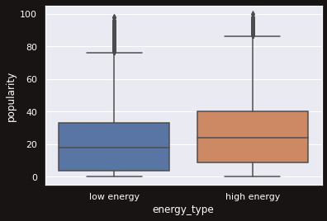
Energy
p < 0.05
Significant difference
Notes:
With our test on energy we found a p-value far less than 0.05 which suggests that there is a statistically significant difference in the means for low and high energy songs.
Here we can see that songs rated as high energy tend to be more popular
*Add difference in means and confidence interval
*Add examples of songs

Slide 7
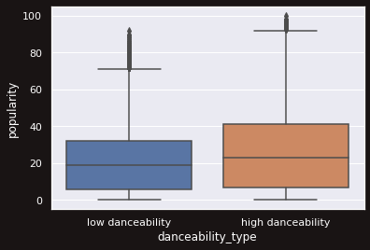
Danceability
p < 0.05
Significant difference
Notes:
Testing danceability we also found a p-value much lower than 0.05 showing a statistically significant difference.
More danceable songs tend to be more popular which makes sense when thinking about the prevalence of dance in pop music.
*Add difference in means and confidence interval
*Add examples of songs

Slide 8
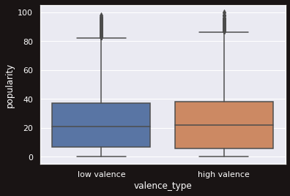
Valence
p > 0.05
No significant difference
Notes:
For our test on valence we found a p value greater than 0.05 meaning there was not a significant difference in means.
As you can see from the visualization songs from both low and high valence groups seem to be similar in popularity
*Add difference in means and confidence interval
*Add examples of songs

Slide 9
Conclusion
High energy
Highly danceable
Any valence
Notes:
In conclusion an artist or label seeking to put out popular music should consider making music that is
High energy
Highly danceable
And have any valence

Slide 10
Questions?
Notes:
I’ll now take any questions

