Slide 1
Traffic lights
Author: Nguyen xuan chu

Slide 2
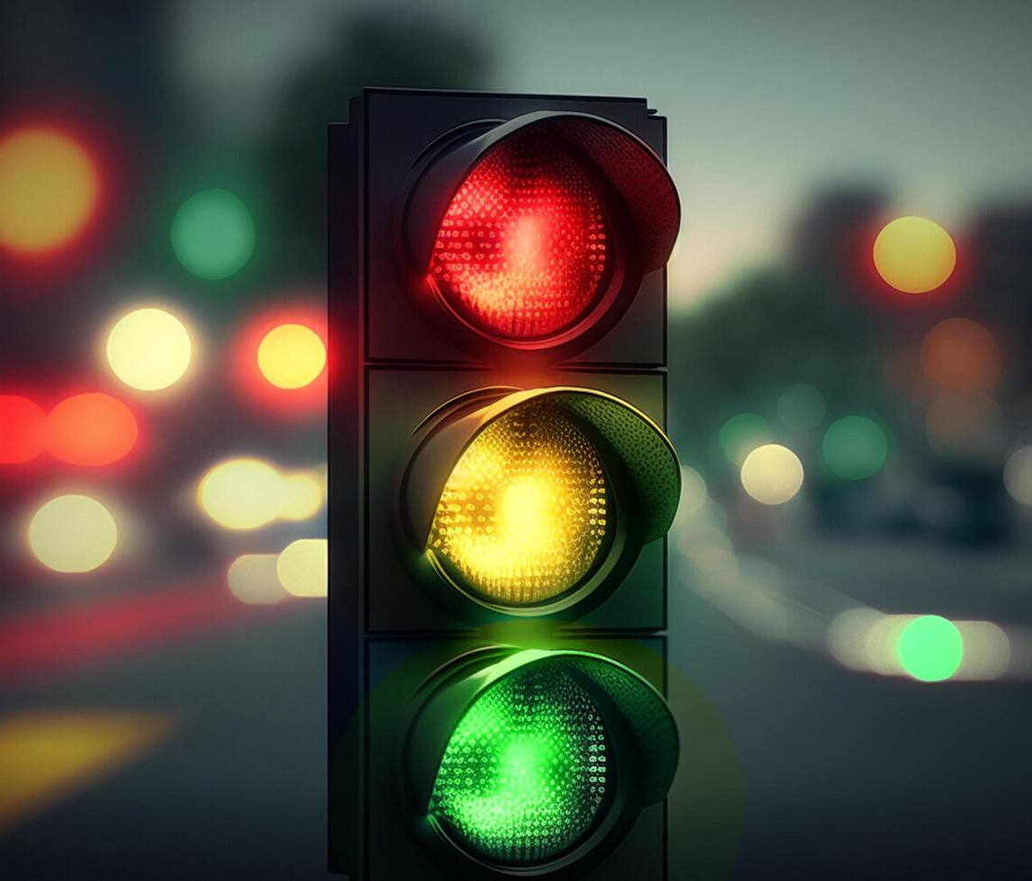
All Sections
What are traffic lights?
How to control the traffic lights?
Simulation on Proteus

Slide 3
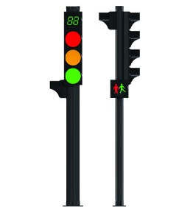
What are traffic lights?
Timer
RED On → STOP
YELLOW On → SLOW DOWN
GREEN On → GO

Slide 4
How to control the traffic lights?
Several types of traffic lights
Control the timing of traffic lights
All functions to regulate traffic flow

Slide 5
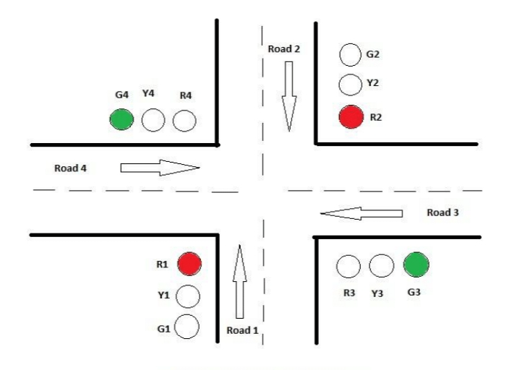
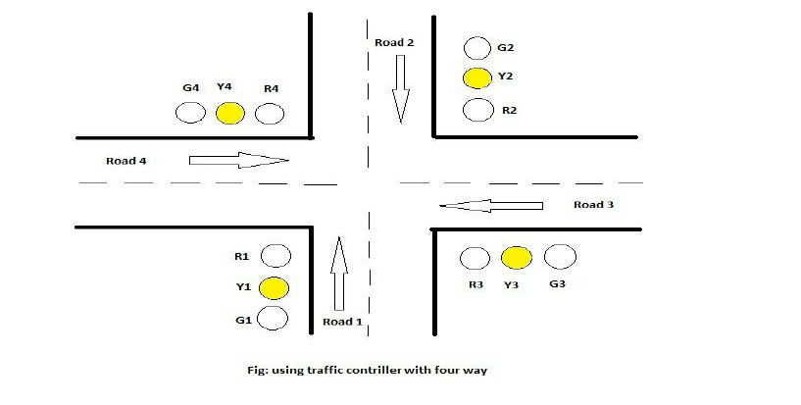


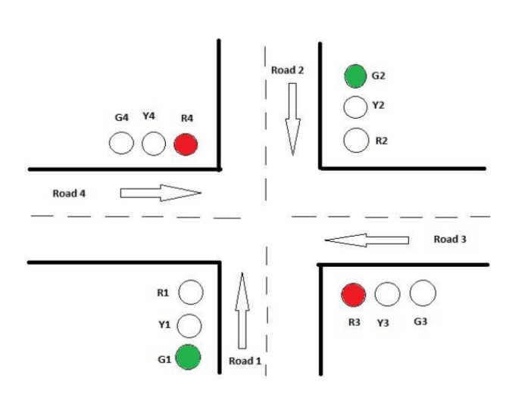
How to control the traffic lights?
1
2
3
4

Slide 6
HOW Traffic lights timing WORK?
h_red time = v_green time + v_yellow time
Vertical Side
3 secs
Horizontal Side
_{t_start}
_{t_end}
time

Slide 7
Traffic light timing
h_red time = v_green time + v_yellow time
Vertical Side
3 secs
Horizontal Side
_{t_start}
_{t_end}
time

Slide 8
ALL Functions
Swap traffic light
All red lights
Increase delay by 5 seconds
Decrease delay by 5 seconds

Slide 9
ALL Functions
Swap traffic light

Slide 10
ALL Functions
Swap traffic light
All red lights
Increase delay by 5 seconds
Decrease delay by 5 seconds

Slide 11
ALL Functions
All red lights

Slide 12
ALL Functions
Swap traffic light
All red lights
Increase delay by 5 seconds
Decrease delay by 5 seconds

Slide 13

ALL Functions
Increase delay by 5 seconds
Decrease delay by 5 seconds

Slide 14
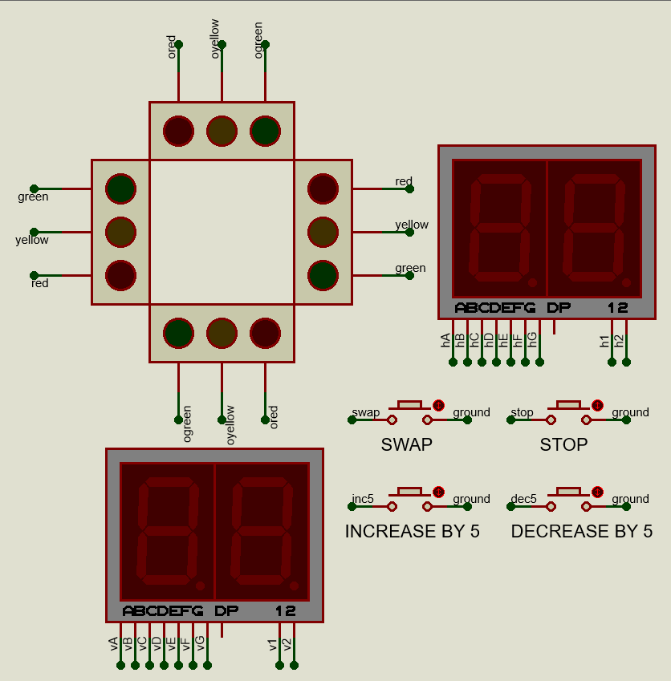
Simulation on Proteus
MCU: STM32F401RET6
Using internal timer 2.
Port A [0:8] used to display timer.
Port C [0:8] used to display timer.
Port B [0:3] used to receive input signal.
Port B [8:10] and [13:15] used to send signal to traffic lights.

Slide 15

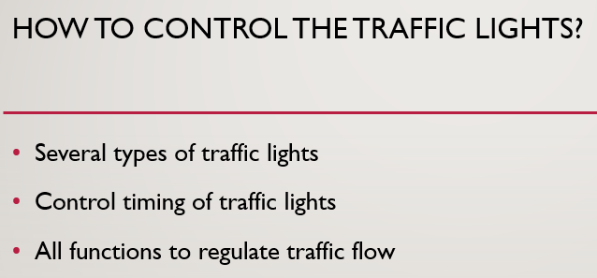


Conclusion

Slide 16

Q&A

Slide 17

Thank you for your listening

