Slide 1
MCX A34X Inductive Encoder
MCU SE & CAS Team, BL SCE

Slide 2
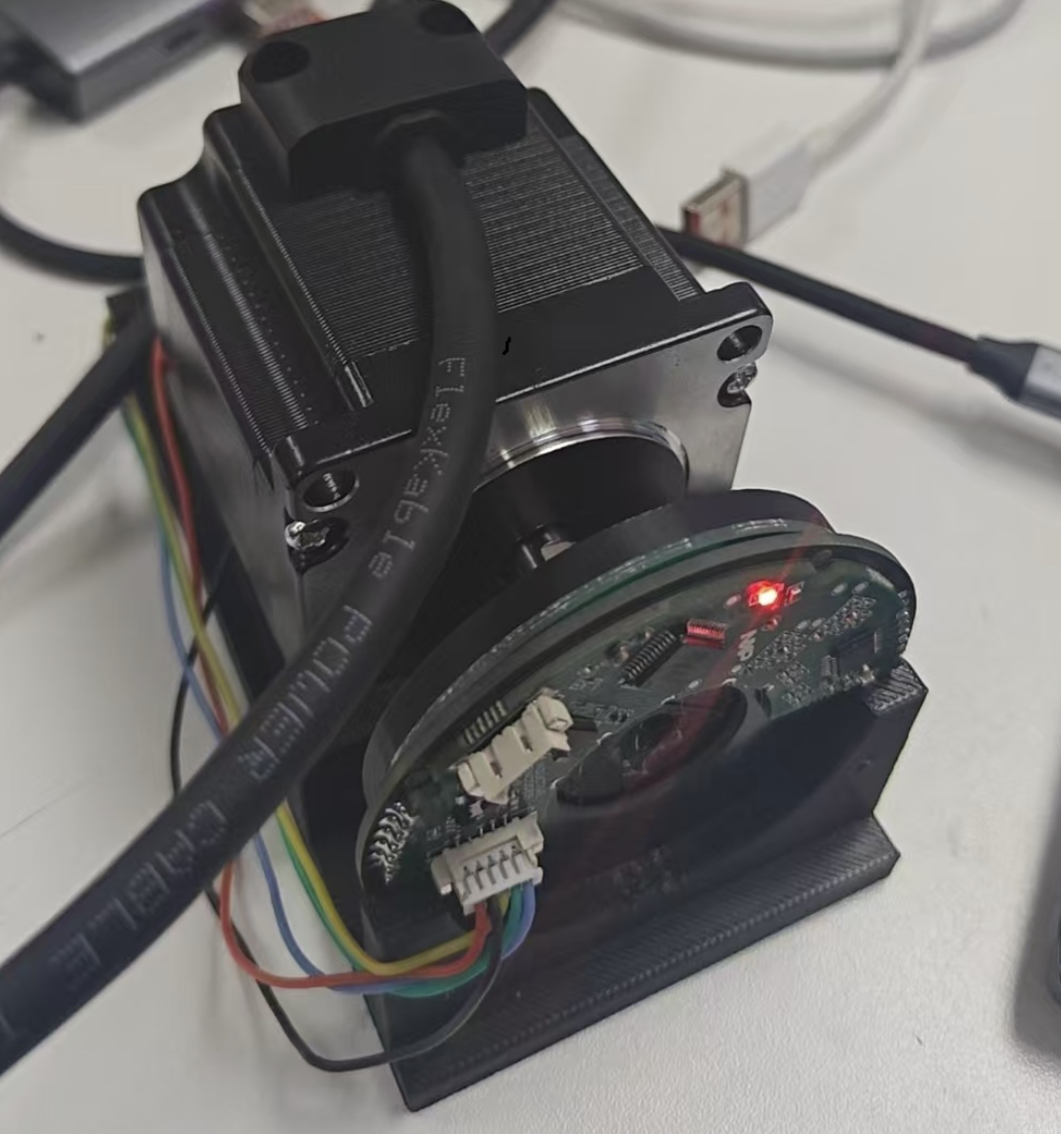
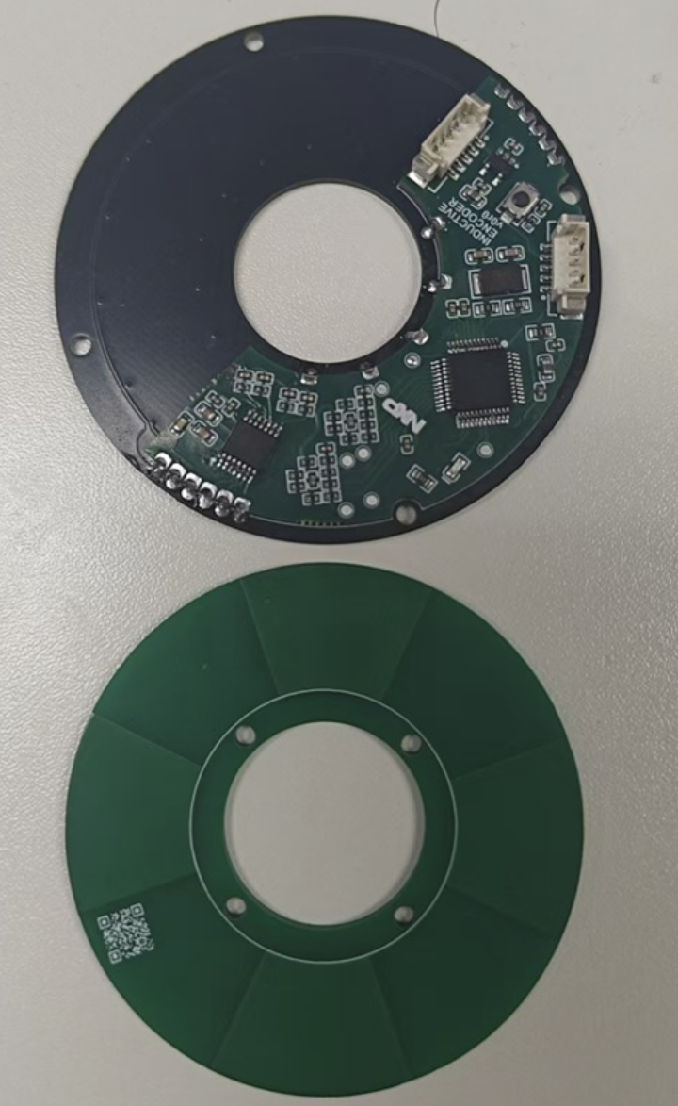
MCXA34x-based Inductive Encoder
MCXA343VLH
180MHz CM33
Inductive Sensor
(AS5715R)
LPUART0
ADC0
OP0
Sin+
Debug
Sin-
Hardware
MCU: MCXA343VLH/MCXA173VFM 128K Flash, 32K RAM
Integrated internal dual Op-Amps with internal ADC connection
Dual 16-bit ADC converters
1× UART for RS485 communication (supports Tamagawa protocol) or BissC(using SmartDMA)
FRO180M accuracy: ±1.5% over full temperature range
MAU(Math Accelerator Unit) support fast atan2 calculation
Software
Complete inductive encoder software implementation with Tamagawa T-Format protocol communication support
Integrated ellipse correction, phase unwrapping, single-turn/multi-turn counting, temperature measurement, etc.
Outputs — 16-bit angle, angular velocity, status/quality gate; angle output supports filtering, dead zone, and other common features
Tamagawa/
BissC
LPUART1 or SmartDMA
EEPROM
I2C
Cos+
ADC1
OP1
SPI Master
SPI
Cos-
Crystal
SOSC
Notes:
Thanks to Chao Zhuang, Alex Yang,

Slide 3
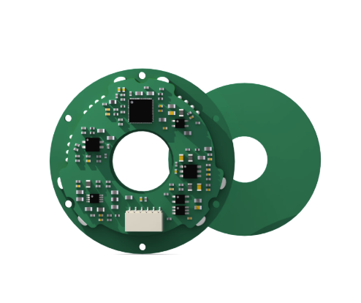
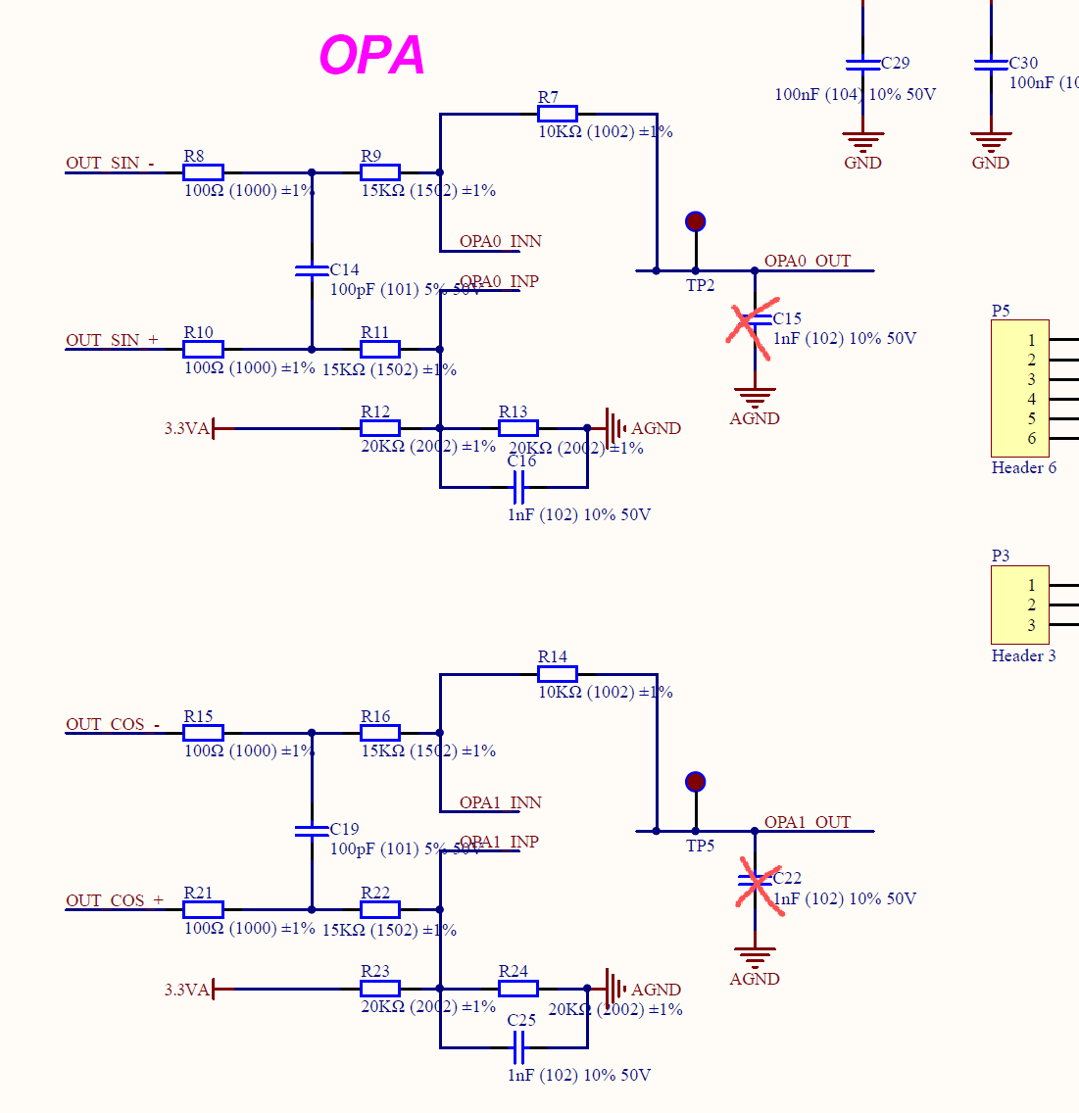
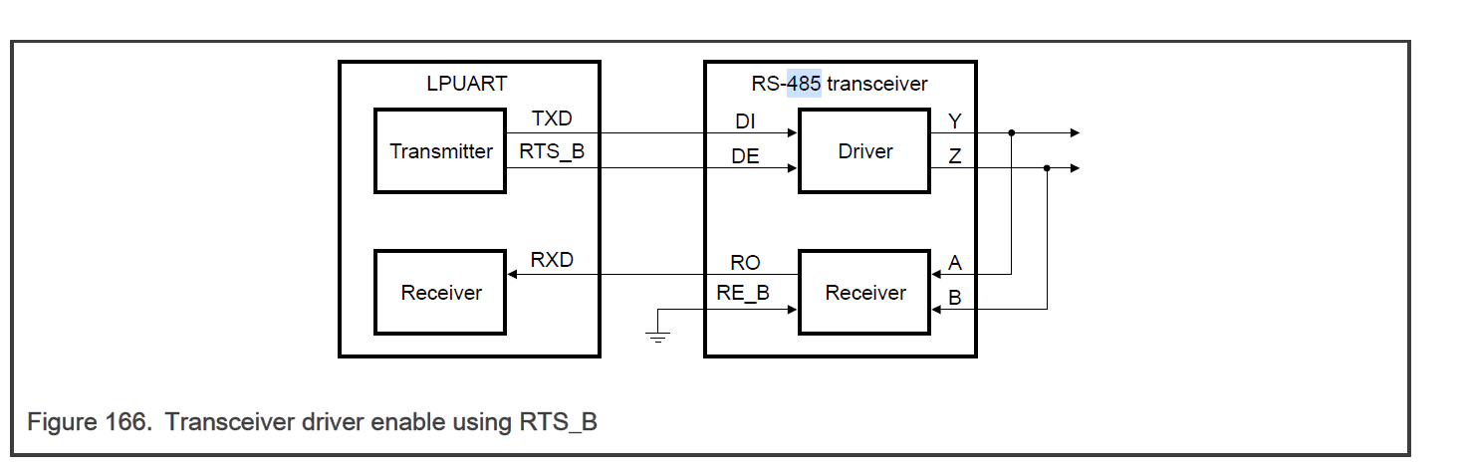
硬件修改建议:
PCB外形可以设计成圆环式(右图为参考),要考虑可连接电机或者其他编码器(做对比使用)
建议用QFN32/48封装, ISP/RST引脚拉出测试点
OPAMP的 D/N/O 拉测试点
Debug口 采用 SWDIO/CLK/GND/3V3/TX/RX 6线制, TX/RX可以和485的串口共用一个串口,如果可能的话最好单拉另外一路串口(SDK默认串口用于debug/前期固件升级用).
2xGPIO: 1 for LED, 1 for test pin.
(optional): RST 加一个小按键
DNP C15/C22, 加上这两个电容会使OPAMP自激振荡. 暂不考虑放外部运放了
485电路目前板子没有贴RS485,所以目前还无法验证功能.(当前原理图和RM给的参考似乎不太一样, 见右图)
之前HW BUG修复: 孔径问题, 前端模拟线接错问题.
BISS-C BISS-C无法通过UART/SPI模拟, 直接接到FlexIO上实现,所以建议对外通讯接口 做成solder bridge, 可以选择FlexIO 或者 UART

