Slide 1

Innovation World Tour 2025 Poster Template
Guidelines for use:
Use only Poppins font or Poppins SemiBold font.
Do not alter the font sizing & placement defined in this template.
Use Poppins Semibold within copy text for paragraph headlines or highlights.
Place your Innovation Board title name in the space allotted at top left side of the poster.
To keep the audience in mind, it is preferred to:
Make sure to highlight the innovation solution
Use more graphics than text on the poster

Slide 2
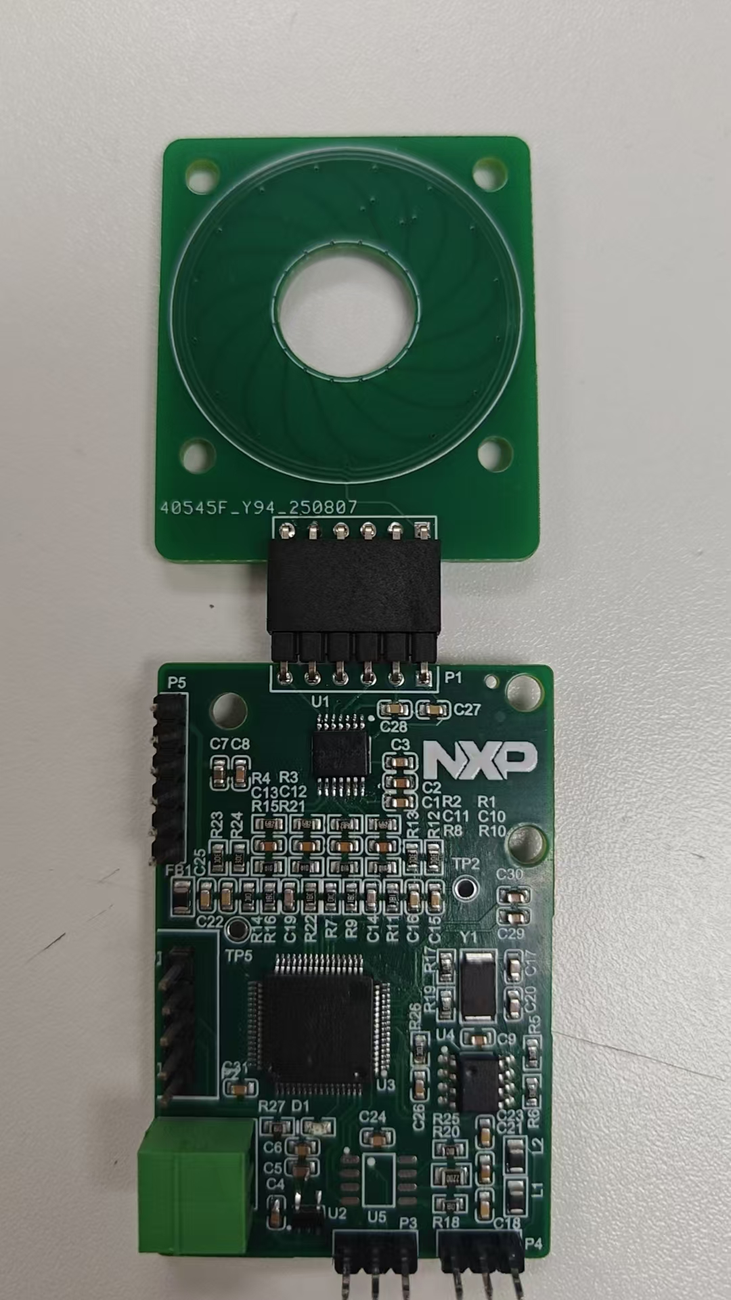
MCXA34x-based Inductive Encoder
Hardware
MCU: MCXA343VLH/MCXA173VFM 128K Flash, 32K RAM
Integrated internal dual Op-Amps with internal ADC connection
Dual 16-bit ADC converters
1× UART for RS485 communication (supports Tamagawa protocol)
FRO180M accuracy: ±1.5% over full temperature range
MAU(Math Accelerator Unit) support fast atan2 calculation
MCXA343VLH
180MHz CM33
Sin+
Magnetic Sensor
ADC0
OP0
Debug
LPUART0
Sin-
RS485
LPUART1
EEPROM
I2C
Cos+
ADC1
OP1
Software
Crystal
Complete inductive encoder software implementation with Tamagawa T-Format protocol communication support
Integrated ellipse correction, phase unwrapping, single-turn/multi-turn counting, temperature measurement, etc.
Outputs — 16-bit angle, angular velocity, status/quality gate; angle output supports filtering, dead zone, and other common features
Future expansion: Tamagawa A-Format and BiSS-C protocol support (implemented via Smart DMA)
SOSC
Cos-
Next steps
Redesign hardware to better align with customer needs Prepare ACH and AN, and promote through small-scale rollout

