Slide 1
LPC54018 USB to UART Bridge Controller SOW
Alex yang
MAR. 2019

Slide 2
Application Description
Background:
In the industrial field, it often needs to use multiple UARTs for peripheral extensions. There are varies USB-UART bridge solution on market, most of them are silicon based and support only 1-2 VCOMs. Market need a USB-multiple(>=10) UART bridge controller at very low cost.
At present, the main use of x86/ARM industrial control board, through the PCI interface to expand UART/RS232 / RS485. Cost is relatively high.
Proposal:
Develop LPC54018 based USB-UART bridge controller support 10 UART. Industrial-grade chip, to meet the harsh environment of industrial applications
Hardware: Use LPC54018Xpresso for first development. Second stage considering design EVB board.
Interface: 1 USB HSD used to connected to MPU support up to 10 full-duplex UARTs
Key Points and Valuable:
Very low cost(<3 USD) for silicon
10 UARTs provided, suitable for China market.

Slide 3
Block Diagram
NOTE:
Need linux driver to convert USB device to multiple TTY
LPC54018
GPIO0-9
UART0
MPU processors
UART1
USB HS
UART2
UART3
UART4
UART5
RESET
UART6
UART7
UART8
UART9
UART baud rate support 4800-19200
GPIO reserved for future usage.
LPC54018 use TFBA180 package.
LPC54018 is a flash less part. Need SPI FLASH to store firmware
Windows is not consider to be supported
SPI FLASH

Slide 4
Approach and Deliverable
Due to MCU’s USB EP limitation. Will use USB HID class(HID custom device) for MPU interface. Define simple protocol for channel selection, baud rate configuration, etc.
Develop Linux driver to convert HID device to multiple UART device(TTYs?). The aim is to let customer seamlessly using this product without modify application code.(Need discuss feasibility with DN guys?)
Deliverable (Stage1)
MCU firmware binary.
User guide
Linux driver and example
Deliverable (Stage2)
User guide
EVK board
Hardware SCH &LAY files.
Updated MCU firmware binary.
Linux driver and example

Slide 5
Resources Needed & Risks
Resources:
2 engineers:
One for MCU firmware development and test
One for linux driver and linux example code.
Risk:
Feasibility for Linux driver? Does it possible to develop such a driver?
Hash industry environment challenge both for hardware and software design. Need pass certification?
Stress test needed: 10 UART full-duplex full baud rate transfer data without errors.
For hardware EVB, may need involve 3th party vender.
LPC54018XPresso cannot support to route out all UART’s pins, test will difficult for first stage.

Slide 6
STAGE1 SUMMARY（April 22, 2019）
Done:
Stress test with ~100MB for each port loopback test passed.
DIGI out-of-band commands: set bard rate/stop bit/parity bit tested OK.
Linux application code for test script.
Issue:
build board?
Linux core driver issue?
Software release strategy?

Slide 7
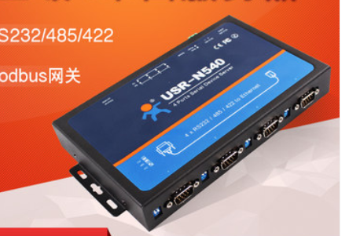
Board plan
Why need evaluation board?
1. Not all UARTs(only a few) pins can be routed out via LPCXpresso board. Not convenience to testing and evaluation, demonstration.
2. Easy to demonstrate, ready to use evaluation board, also can be used to build standalone hardware.

Slide 8

Board plan
LPC54018 TFBA180
Optional, misc. control
GPIO0-9
Micro B USB
USB HSD
UART0
UART1
…..
Debug
interface
Colored LED for each UART TX/RX
SPI FLASH
Each UART include RTS CTS TX RX pins
UART9
UART baud rate support 4800-19200
GPIO reserved for future usage.
LPC54018 use TFBA180 package.
LPC54018 is a flash less part. Need SPI FLASH to store firmware
Windows is not consider to be supported

