Slide 1
INSTALLING UBUNTU Ver-20.04

Slide 2

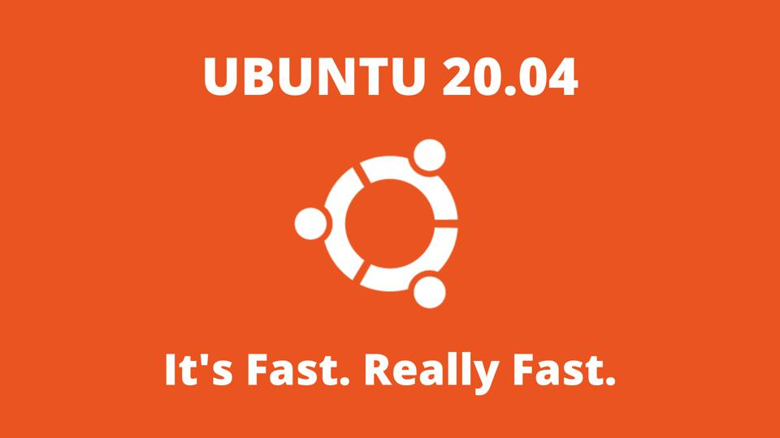
Prerequisites
System requirements (recommended):
2 GHz dual-core processor
4GB memory
25GB available disk space for storage (less if installing the minimal version)
DVD drive or USB port
At least a 4GB USB drive
Note: It is advised to take a full system backup before proceeding with the installation as faulty installation can lead to loss/corruption of data

Slide 3
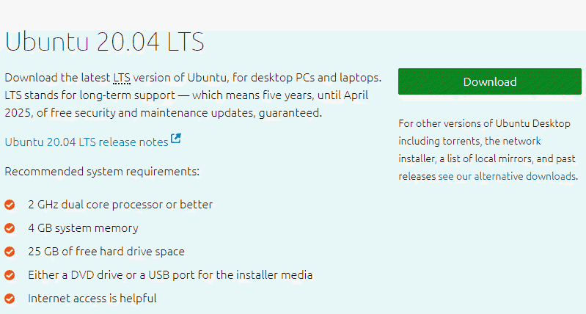
Step 1: Download the Installation Media
1. In a web browser, visit the Ubuntu download page and pick a version suitable for your machine. The most popular versions include:
Ubuntu Desktop
Ubuntu Server
Ubuntu Derivatives
2. Once you find the version you need, click the green Download button. You’ll be taken to a thank-you page, and your download should start. (We will download and install Ubuntu 20.04 for desktops.)
The download is an .iso file. You can use it to create a bootable USB drive.
3. Save the file to a location of your choice.

Slide 4
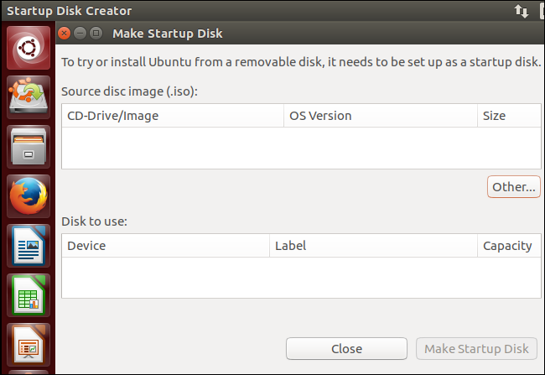
Step 2: Create Bootable USB
You will need a USB drive with 4GB or more. This process will delete all data on the USB drive. Make sure to backup any existing data on the USB drive.
Option 1: Create a Bootable USB Drive on Ubuntu
Use the Create startup disk tool:
Open a search dialog, and type create startup.
If it’s not installed, the Software Center will offer the option to install it – choose the option for USB drive, then open the utility.
In the top pane, click Other, then browse and select the Ubuntu 20.04 .iso file you downloaded.
In the bottom pane, select your USB drive.
Click Make startup disk.

Slide 5
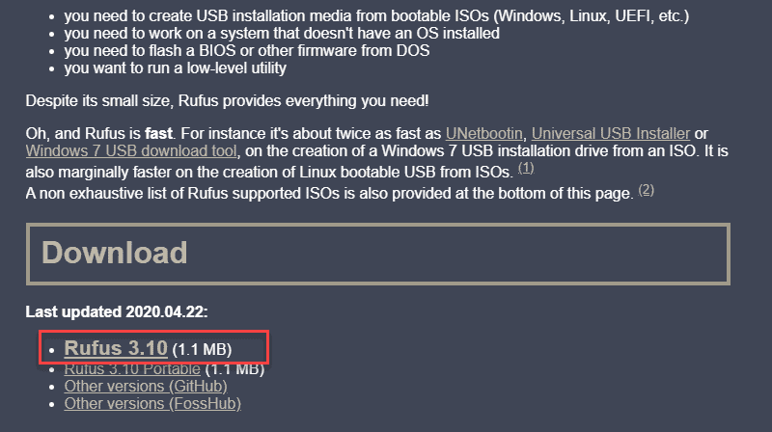
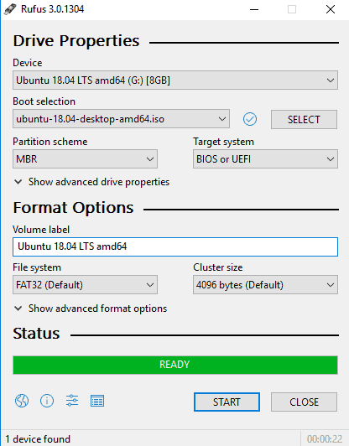
Option 2: Create Bootable USB Drive on Windows
You’ll need to install a third-party utility called Rufus to create a USB bootable drive.
Download the Rufus utility. Scroll down to the download section and click the link to download the latest version of Rufus.
2. Run the file once downloaded.
3. A pop-up dialog opens. You will be prompted whether you want to check for online updates. Select No.
4. The Rufus utility launches. Plug in the USB drive – you should see the drive pop up in the device field.
Set the USB as the device you wish to write to.
In the Boot Selection drop-down, click Disk or ISO Image.
Click the Select button to the right.
Browse and select the .iso Ubuntu file you downloaded earlier.
5. Click Start.

Slide 6
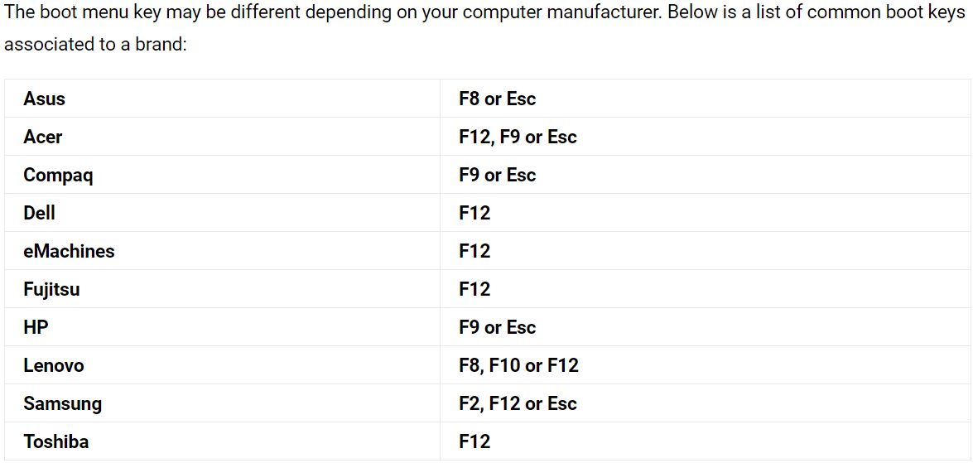
Step 3: Boot up Ubuntu from USB
1. Turn off your system. Make sure you remove all other USB devices, such as printers, memory cards, etc.
2. Insert the Ubuntu USB drive into the system and turn on your machine.
There are two possible scenarios:
The computer boots the USB drive automatically.
You need to manually configure USB booting in the Boot Menu or BIOS/UEFI.
3. To manually configure the boot order, tap the boot menu key about once or twice per second as soon as the computer powers on.
4. Once you see your boot menu, use the arrows to pick the Ubuntu media to boot from. For a DVD, the entry will usually have DVD or Optical in the name. USB is usually labeled USB.
Your system should start loading the Ubuntu live disc menu.
Note: If you are experiencing issues when booting the USB from the boot menu, try to boot the USB from BIOS/UEFI.

Slide 7
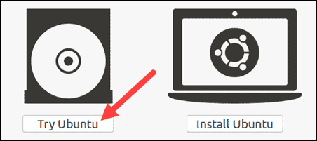
Step 4: Run Ubuntu
You can test Ubuntu 20.04 before you commit to installing it.
The .iso includes a live mode that only runs in memory.
Launch this mode by clicking Try Ubuntu.

Slide 8
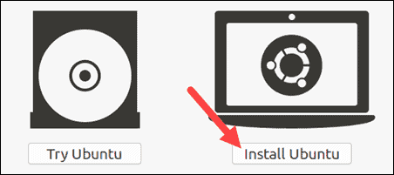
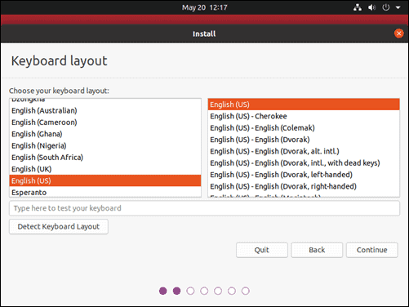
Step 5: Install Ubuntu 20.04 LTS Desktop
To begin the installation, click Install Ubuntu.
Choose Keyboard Layout
By default, the system will select English and English.
If you have a non-standard keyboard, you can select it in the list.
Alternately, click Detect Keyboard Layout and the system will automatically choose your keyboard.
If you need to test your keyboard, use the labeled field.
When you’re ready, click Continue.

Slide 9
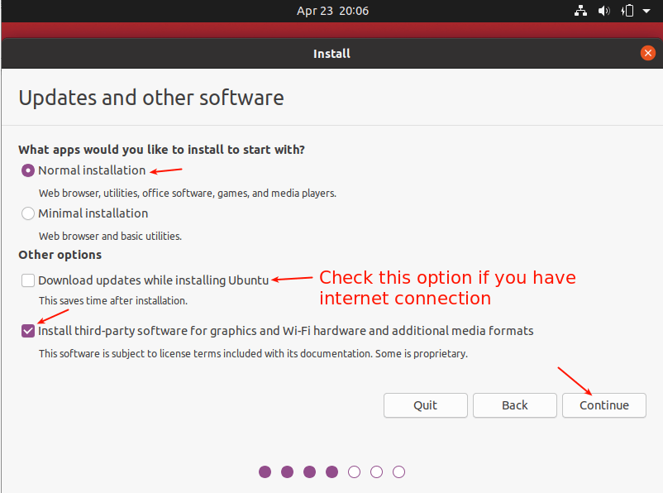
Choose Starting Applications
Normal Installation(Recommended) – This is the full Ubuntu Desktop experience, with office software, games, and media players.
Minimal Installation – Choose this to save disk space, especially if you won’t be using media players or productivity software.
You’ll also be asked to confirm other options:
Download updates while installing Ubuntu – This does the work of downloading large package files during the installation. Once the installation finishes, the packages will be ready to apply as updates.
Install third-party software for graphics and Wi-Fi hardware and additional media formats – Some hardware, like graphics cards and wi-fi cards, do not have open-source driver support. Also, some media formats, such as .wmv, do not fall under the GPL license. If you need support for these, you’ll need to agree to additional terms of use.

Slide 10
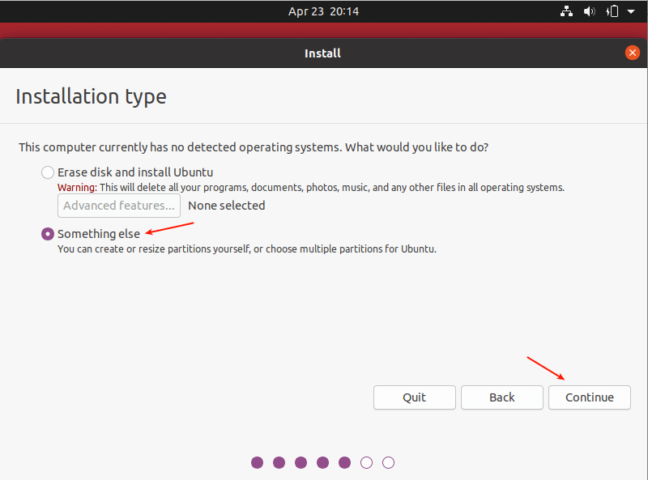
Disk Partitioning
Next, you’ll be presented with an Installation Type dialog.
Scenario 1: Keep only ubuntu ver 20 on hard disk:
You can wipe the hard drive clean prior to installing Ubuntu by clicking Erase disk and install Ubuntu. If you go this route, skip ahead to the next step.
Advanced users may want to edit Advanced Features.
Scenario 2: Using an Unpartitioned Harddrive (without an OS installed)
For this scenario, you need to set up partitions manually so choose Something else and click Continue.

Slide 11
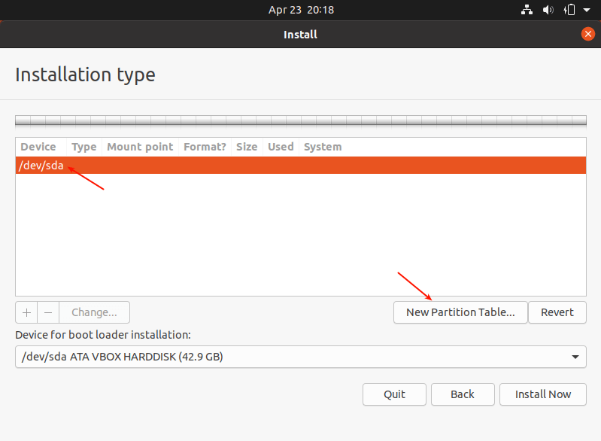
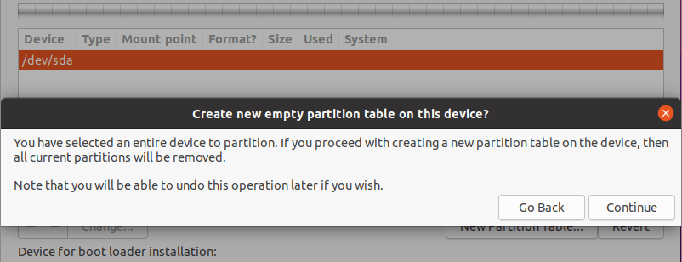
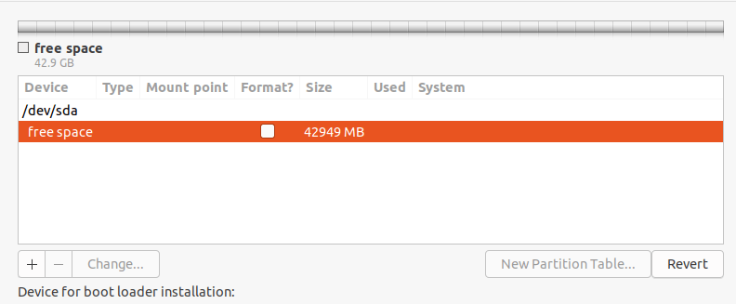
Scenario 2 continued…
Now you need to partition your hard drive for the installation. Simply select/click on the unpartitioned storage device from the list of available storage devices. Then click New Partition Table.
Note that the installer will auto-select the device on which the boot-loader will be installed as shown in the following screenshot.
Next, click Continue from the pop-up window to create an empty partition table on the device
Now you should be able to see the free space created equivalent to the capacity of the hard drive. Double click on the free space to create a partition as described next.

Slide 12
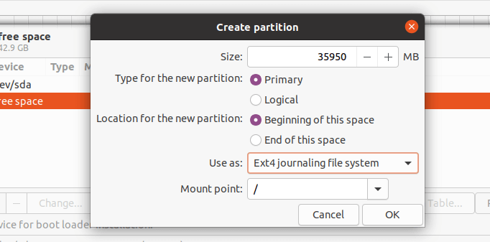
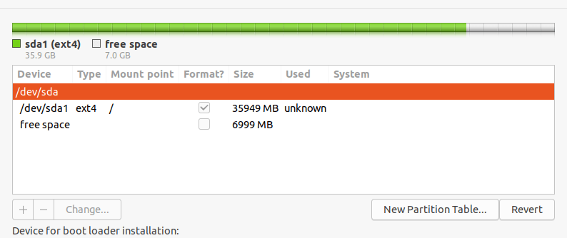
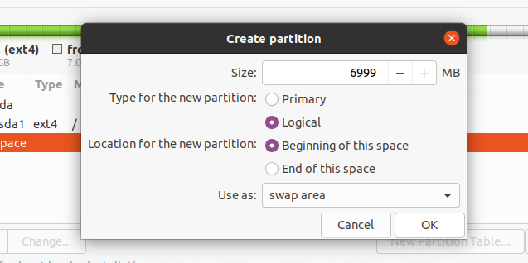
Scenario 2 continued…
To create a root(/) partition (where the base system files will be installed), enter the size of the new partition out of the total free space. Then set the file system type to EXT4 and the mount point to / from the drop-down list.
Now the new partition should appear in the list of partition as shown in the next screenshot.
Next, you need to create a swap partition/area. Double click on the current free space to create a new partition to be used as swap area. Then enter the swap partition size and set swap area as shown in the following screenshot.

Slide 13
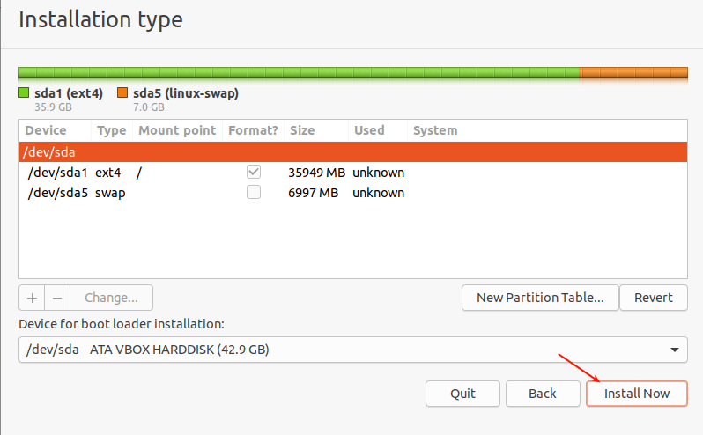
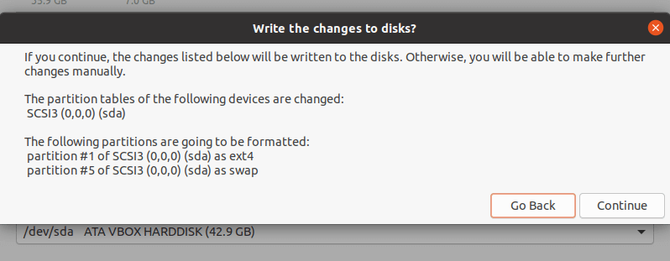
Scenario 2 continued…
At this point, you should see two partitions created, the root partition and the swap partition. Next, click Install Now
You will be prompted to permit the installer to write the recent changes concerning partitioning to disk. Click Continue to proceed.

Slide 14
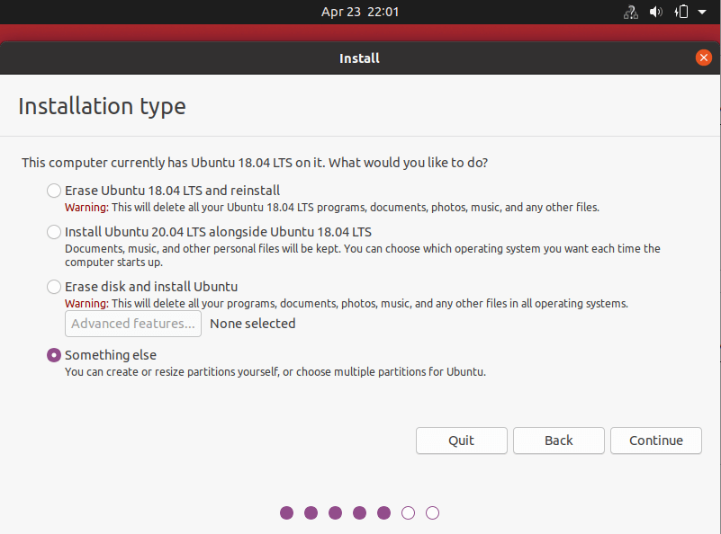
Scenario 3: Using an Already Partitioned Harddrive (with an existing OS installed)
Option 1: Direct installation
Select option Install Ubuntu 20.4 alongside xxxxxx. This will enable the system to have more than one OS on it, thoe all system settings will be done automatically
Option 2:
For this scenario, you will use the existing partitions, choose Something else and click Continue.

Slide 15
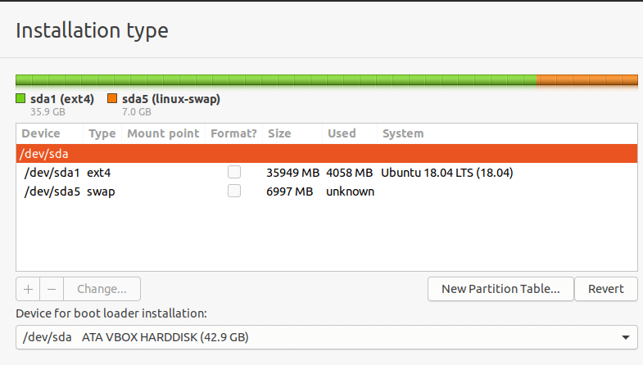
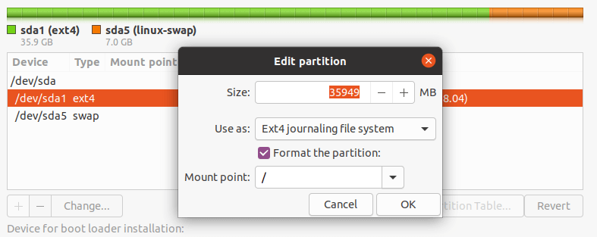
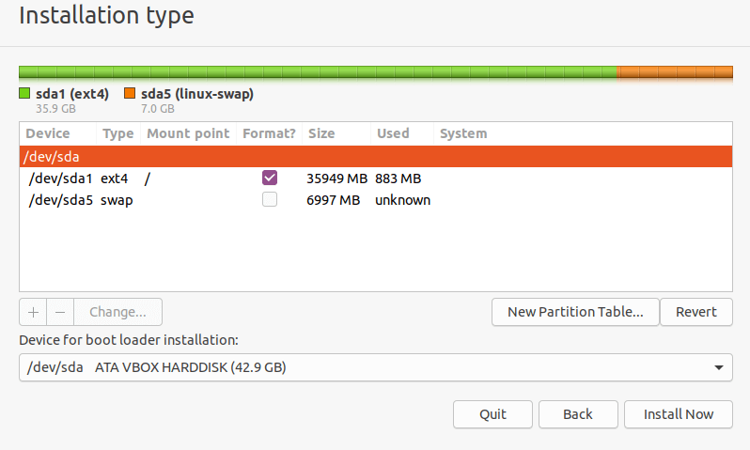
Scenario 3 Continued…
Then you should see your existing partitions for example, as shown in the following screenshot. Double click on the partition with the previous OS installation, Ubuntu 18.04 in our case.
Next, edit the partition and set the file system size, file system type to Ext4, and then check the format option and set the mount point to root(/).
Accept the changes in the hard drive partition table, in the next pop-up window by clicking Continue.
Now you should have a root and swap partition as shown in the following screenshot. Note that the swap partition will be auto-detected by the installer. So click Install Now to proceed.

Slide 16
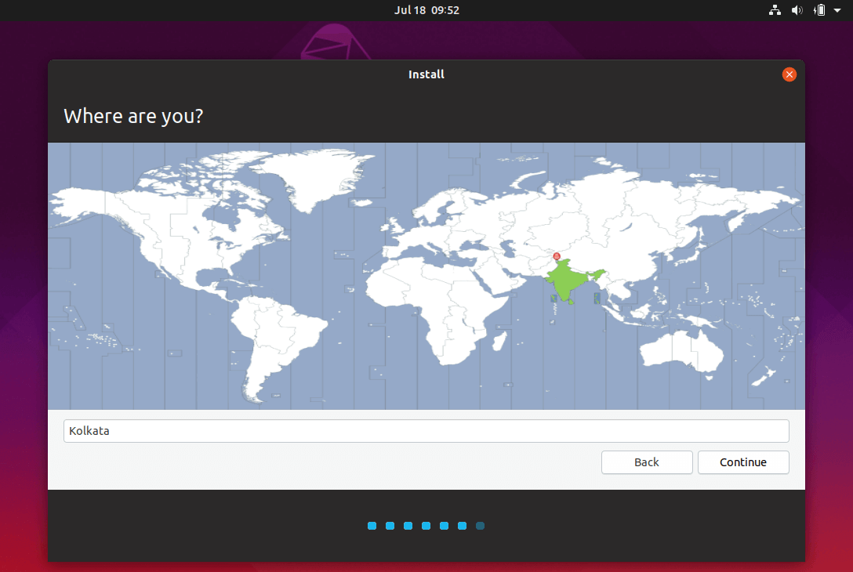
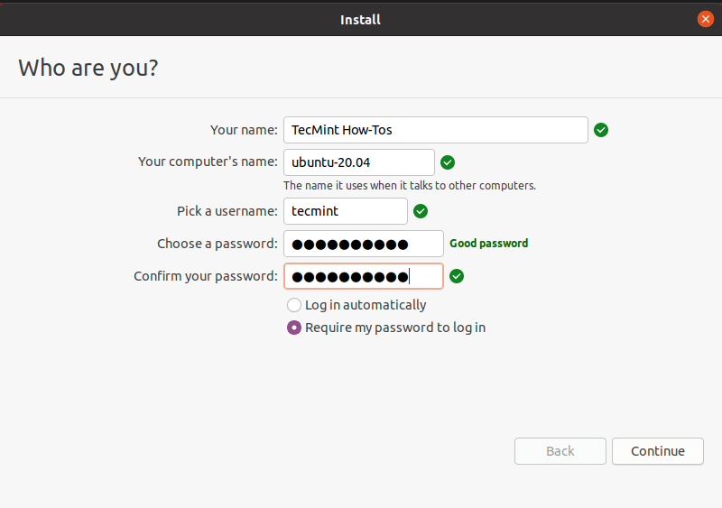
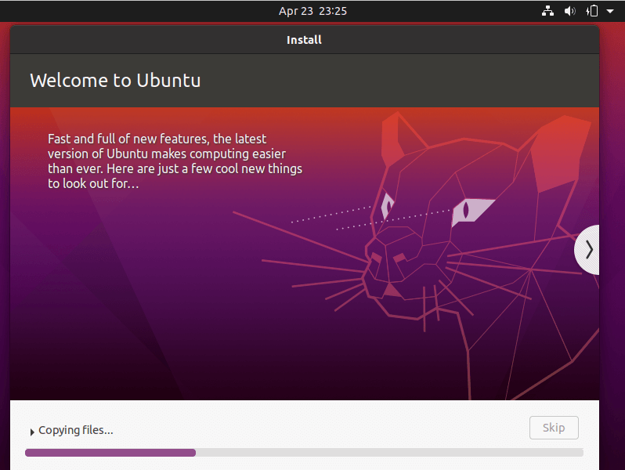
Installation Continued…
Next, select your location and click Continue.
Then provide your user details for system account creation. Enter your full name, computer name and username, and a strong, secure password as shown in the following screenshot. Then click Continue.
Now the actual base system installation will begin as shown in the screenshot. Wait for it to finish.

Slide 17
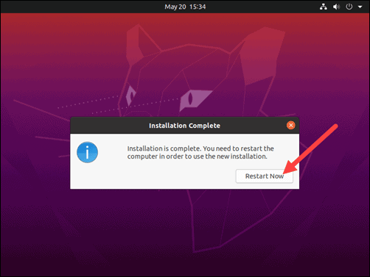
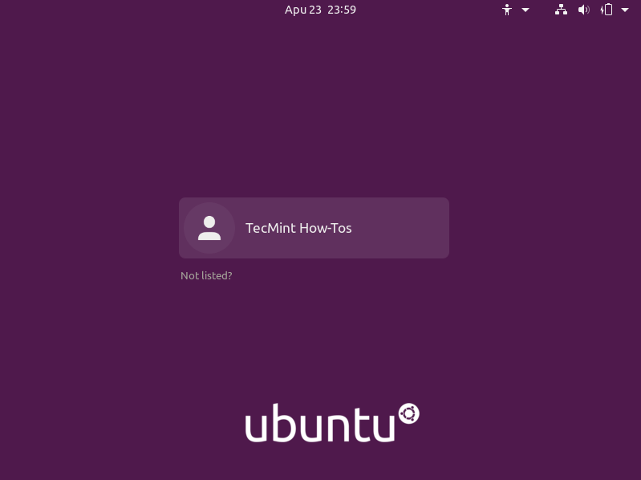
Installation Continued…
Once the system installation is complete, reboot your system by clicking Restart Now. Remember to remove the installation media, otherwise, the system will still boot from it.
The system should boot into your fresh install of Ubuntu 20.04.

Slide 18

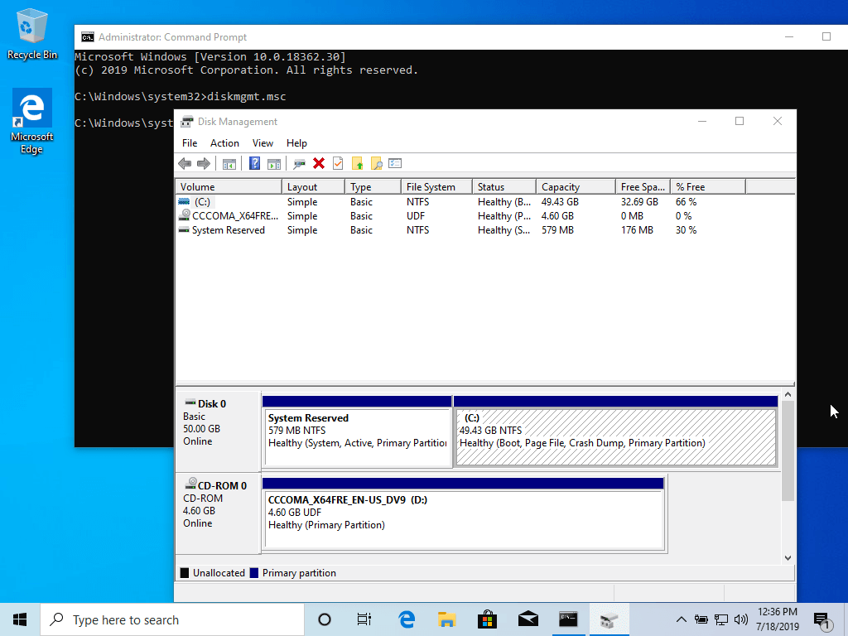
How to Install Ubuntu Alongside With Windows 10 or 8 in Dual-Boot
Step 1: Prepare Windows Machine for Dual-Boot
1. The first thing you need to take care of is to create free space on the computer hard disk in case the system is installed on a single partition.
Log in to your Windows machine with an administrative account and right-click on the Start Menu -> Command Prompt (Admin) in order to enter Windows Command-Line.
Once in CLI, type diskmgmt.msc on prompt and the Disk Management utility should open. From here, right-click on C: the partition and select Shrink Volume in order to resize the partition.

Slide 19
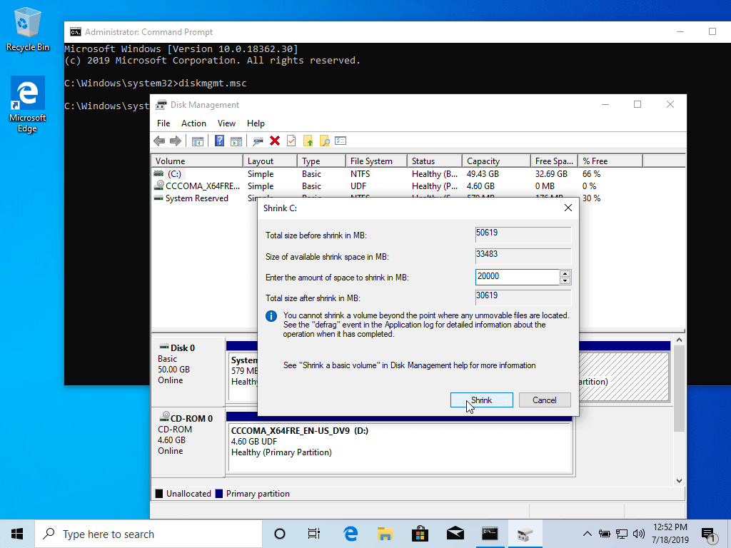

How to Install Ubuntu Alongside With Windows 10 or 8 in Dual-Boot Continued…
On Shrink C: enter a value on space to shrink in MB (use at least 20000 MB depending on the C: partition size) and hit Shrink to start partition resize as illustrated below (the value of space shrink from below image is lower and only used for demonstration purposes).
Once space has been resized you will see a new unallocated space on the hard drive. Leave it as default and reboot the computer in order to proceed with the Ubuntu installation.

Slide 20
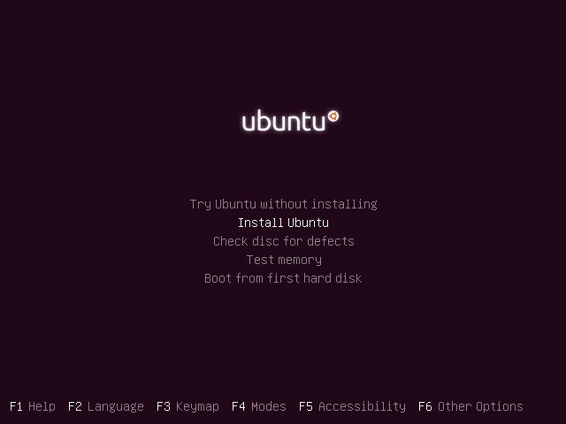
How to Install Ubuntu Alongside With Windows 10 or 8 in Dual-Boot CONTINUED...
Step 2: Install Ubuntu with Windows Dual-Boot
Go the download link from the topic description and grab Ubuntu Desktop 20.04 ISO image.
Burn the image to a DVD or create a bootable USB stick using a utility such as Universal USB Installer (BIOS compatible) or Rufus (UEFI compatible).
Place the USB stick or DVD in the appropriate drive, reboot the machine and instruct the BIOS/UEFI to boot-up from the DVD/USB by pressing a special function key (usually F12, F10 or F2 depending on the vendor specifications).
Once the media boot-up a new grub screen should appear on your monitor. From the menu select Install Ubuntu and hit Enter to continue.

Slide 21
How to Install Ubuntu Alongside With Windows 10 or 8 in Dual-Boot CONTINUED...
Step 2: Install Ubuntu with Windows Dual-Boot
4. Go the download link from the topic description and grab Ubuntu Desktop 20.04 ISO image.
Burn the image to a DVD or create a bootable USB stick using a utility such as Universal USB Installer (BIOS compatible) or Rufus (UEFI compatible).
Place the USB stick or DVD in the appropriate drive, reboot the machine and instruct the BIOS/UEFI to boot-up from the DVD/USB by pressing a special function key (usually F12, F10 or F2 depending on the vendor specifications).
Once the media boot-up a new grub screen should appear on your monitor. From the menu select Install Ubuntu and hit Enter to continue.

Slide 22
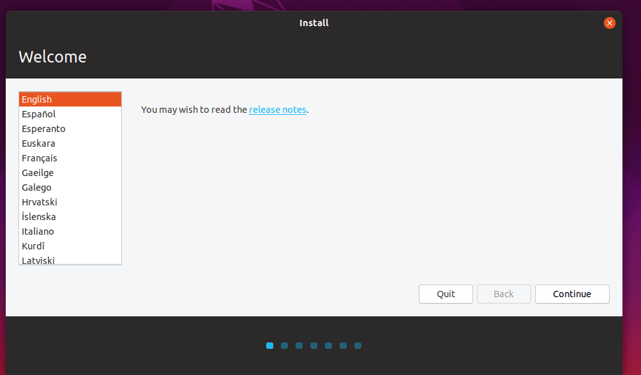
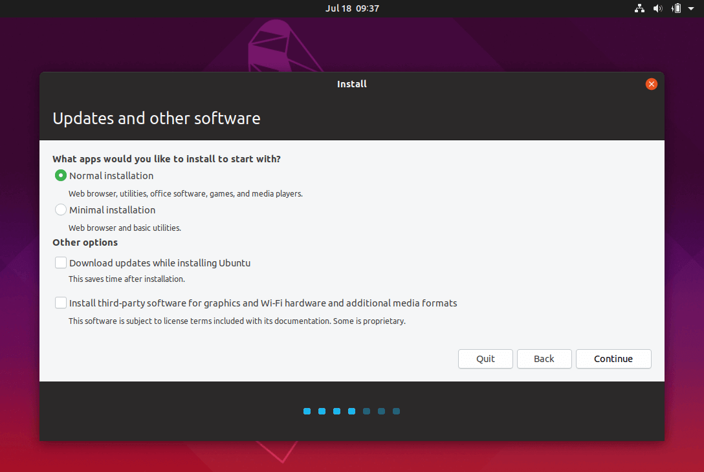
How to Install Ubuntu Alongside With Windows 10 or 8 in Dual-Boot CONTINUED...
5. After the boot media finishes loading into RAM you will end-up with a completely functional Ubuntu system running in live-mode.
On the Launcher hit on the second icon from top, Install Ubuntu 20.04 LTS, and the installer utility will start.
Choose the language you wish to perform the installation and click on the Continue button to proceed further.
6. Next, choose the first option “Normal Installation” and hit on the Continue button again.

Slide 23
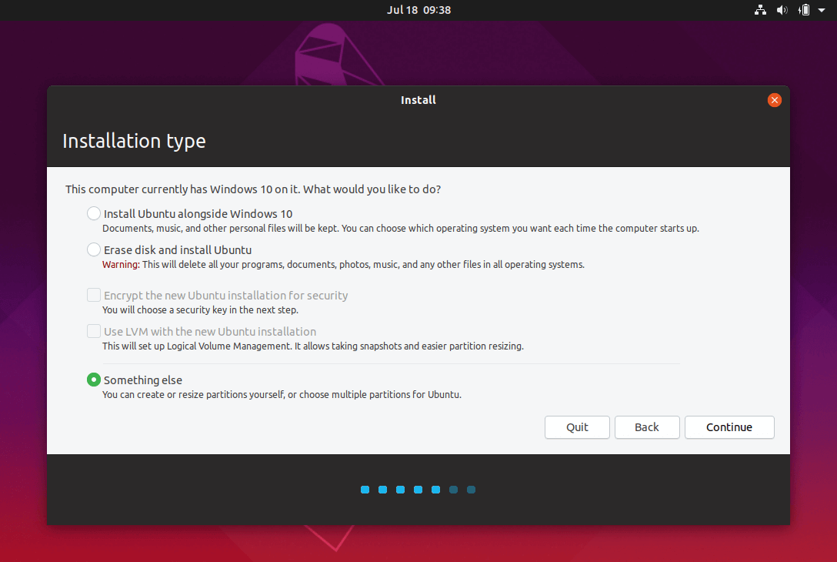
How to Install Ubuntu Alongside With Windows 10 or 8 in Dual-Boot CONTINUED...
7. Now it’s time to select an Installation Type.
You can choose to Install Ubuntu alongside Windows Boot Manager, an option that will automatically take care of all the partition steps.
Use this option if you don’t require a personalized partition scheme. In case you want a custom partition layout, check the Something else option and hit on the Continue button to proceed further.
The option Erase disk and install Ubuntu should be avoided on dual-boot because is potentially dangerous and will wipe out your disk.

Slide 24
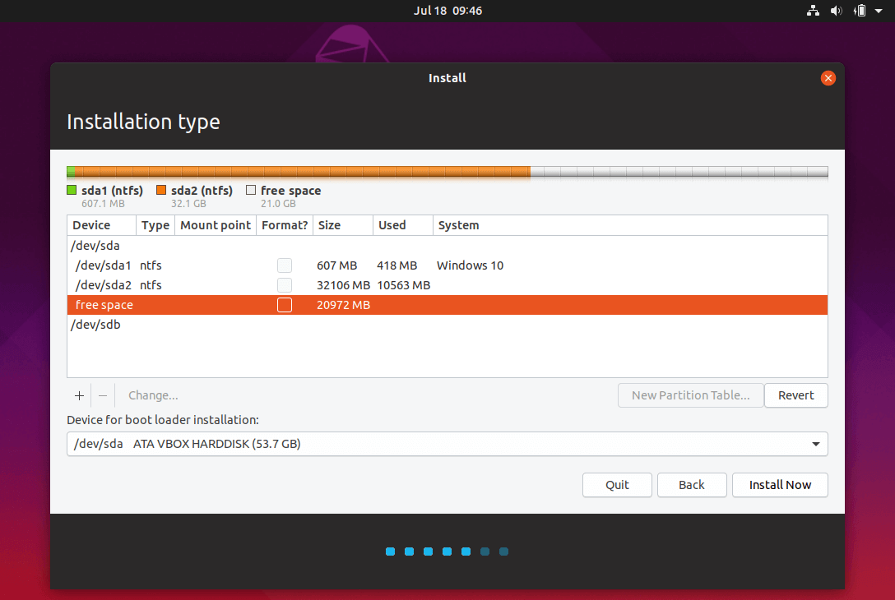
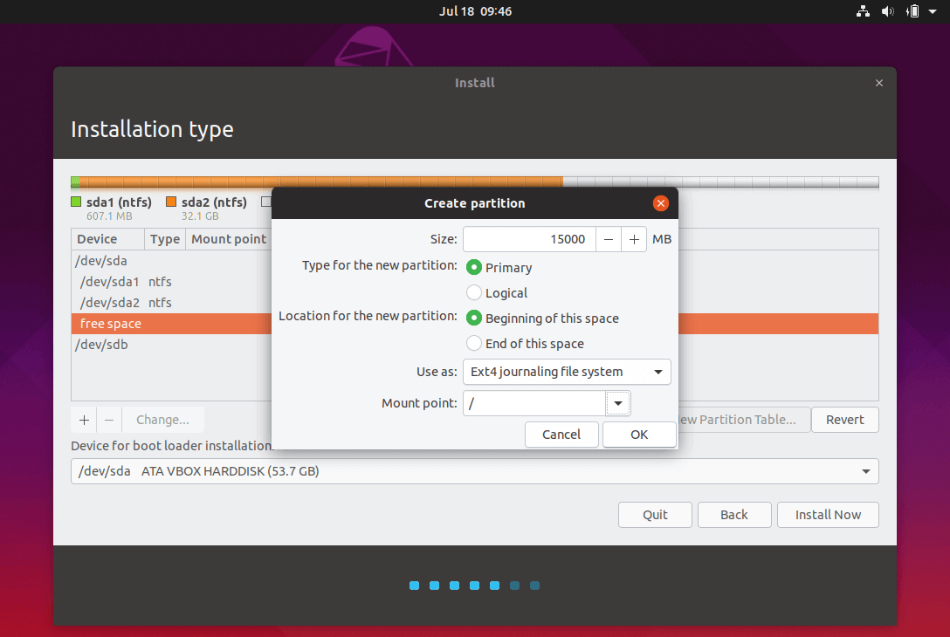
How to Install Ubuntu Alongside With Windows 10 or 8 in Dual-Boot CONTINUED...
8. On this step, we’ll create our custom partition layout for Ubuntu. This guide will recommend that you create two partitions, one for root and the other for home accounts data and no partition for swap (use a swap partition only if you have limited RAM resources or you use a fast SSD).
To create the first partition, the root partition, select the free space (the shrinking space from Windows created earlier) and hit on the + icon below.
On partition settings use the following configurations and hit OK to apply changes:
Size = at least 20000 MB
Type for the new partition = Primary
Location for the new partition = Beginning
Use as = EXT4 journaling file system
Mount point = /

Slide 25
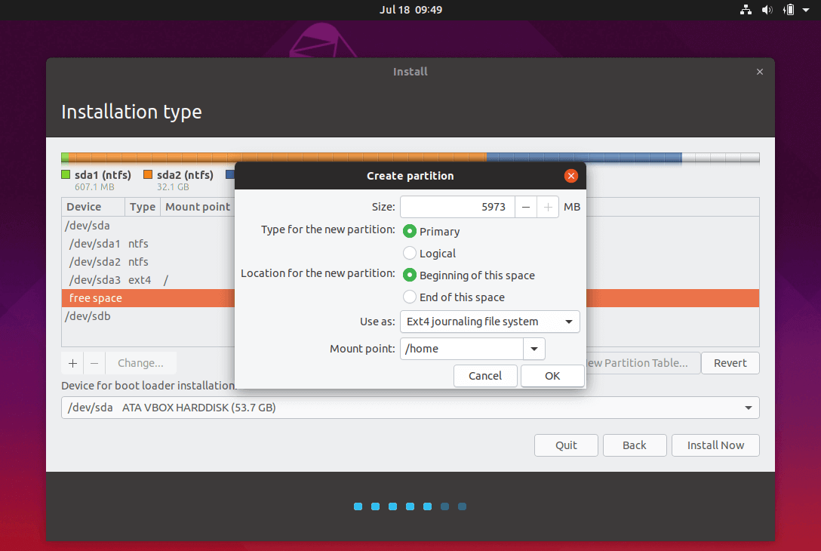
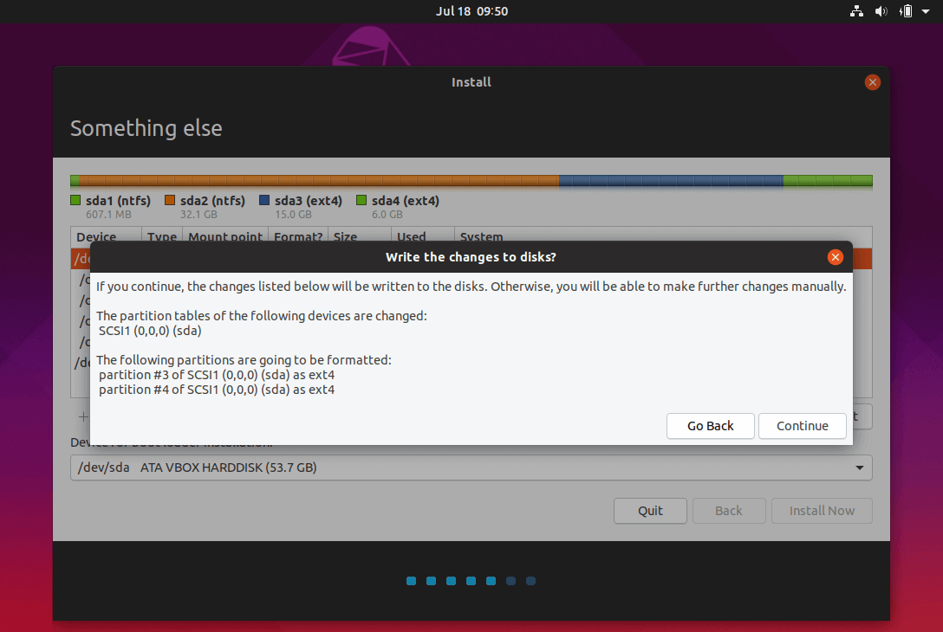
How to Install Ubuntu Alongside With Windows 10 or 8 in Dual-Boot CONTINUED...
Create the home partition using the same steps as above. Use all the available free space left for the home partition size. The partition settings should look like this:
Size = all remaining free space
Type for the new partition = Primary
Location for the new partition = Beginning
Use as = EXT4 journaling file system
Mount point = /home
9. When finished, hit the Install Now button in order to apply changes to disk and start the installation process.
A pop-up window should appear to inform you about swap space. Ignore the alert by pressing on the Continue button.
Next, a new pop-up window will ask you if you agree with committing changes to disk.
Hit Continue to write changes to disk and the installation process will now start.

Slide 26
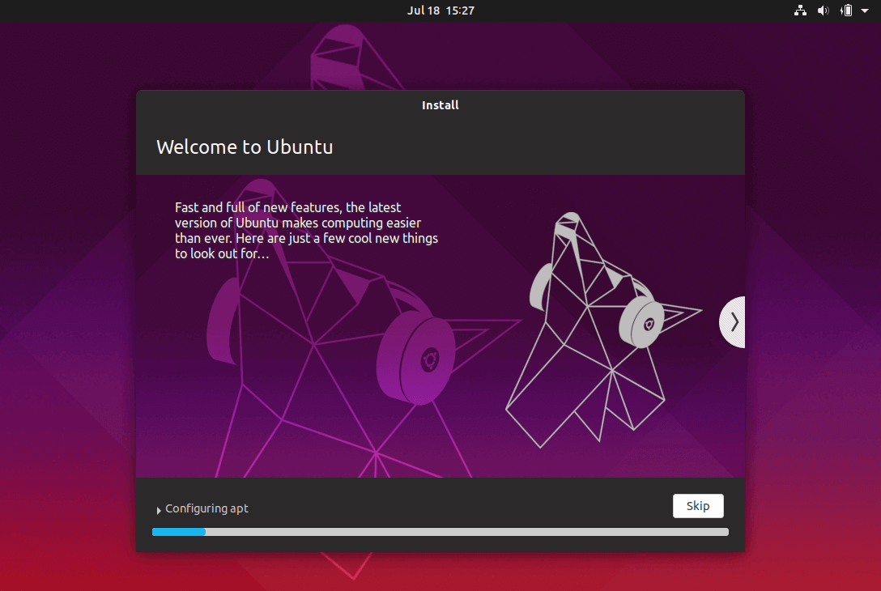
How to Install Ubuntu Alongside With Windows 10 or 8 in Dual-Boot CONTINUED...
10. On the next screen adjust your machine physical location by selecting a city nearby from the map. When done hit Continue to move ahead.
11. Pick up a username and password for your administrative sudo account, enter a descriptive name for your computer and hit Continue to finalize the installation.
These are all the settings required for customizing the Ubuntu installation. From here on the installation process will run automatically until it reaches the end.

Slide 27
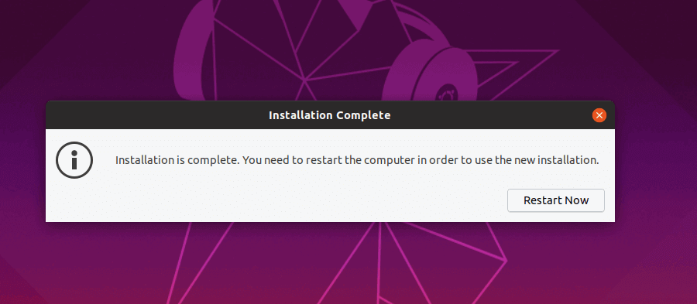
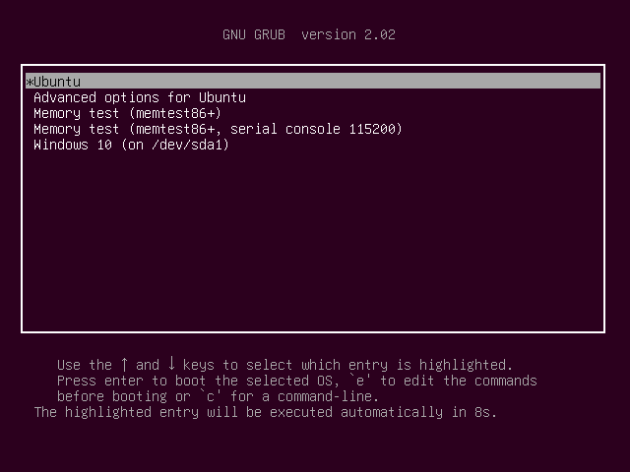
How to Install Ubuntu Alongside With Windows 10 or 8 in Dual-Boot CONTINUED...
12. After the installation process reaches its end hit on the Restart Now button in order to complete the installation.
The machine will reboot into the Grub menu, where for ten seconds, you will be presented to choose what OS you wish to use further: Ubuntu 20.04 or Microsoft Windows.
Ubuntu is designated as default OS to boot from. Thus, just press Enter key or wait for those 10 seconds timeout to drain.

Slide 28
Thank you

