Slide 1
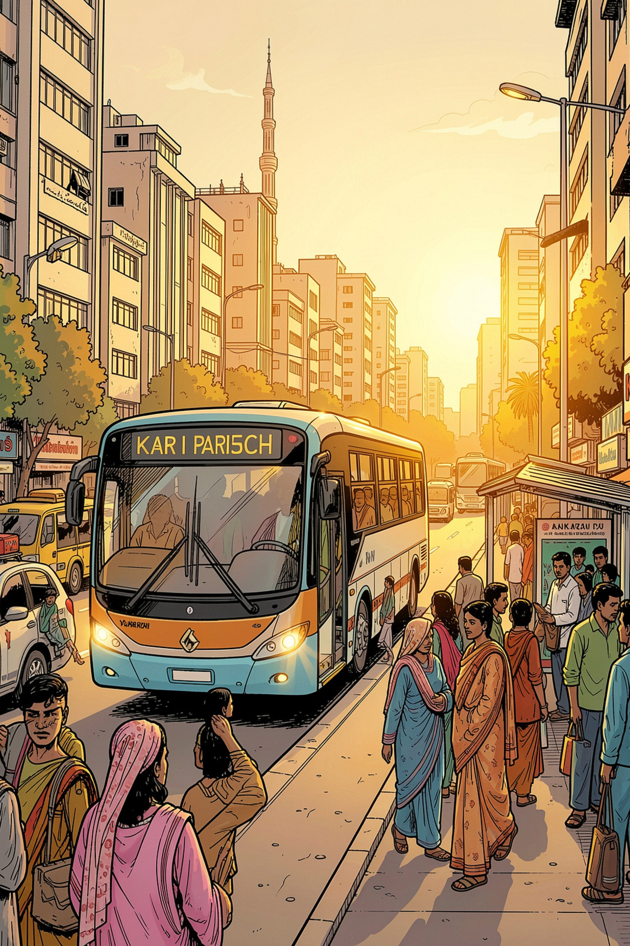
Raasta – Smart Bus Route Finder
A web-based platform that transforms Karachi's complex bus network into simple, step-by-step journeys — for everyone who needs to get from A to B.
WEB DEVELOPMENT PROJECT
KARACHI, PAKISTAN

Slide 2
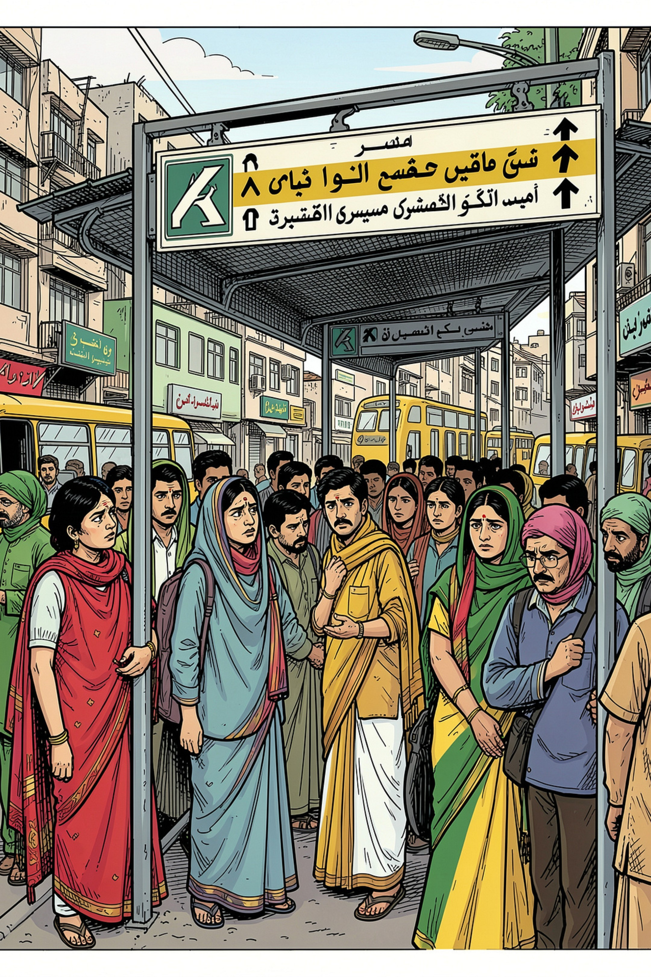
The Problem Raasta Solves
Most people in Karachi know where they want to go — but not how to get there by bus.
Which bus?
Bus numbers and route names are unfamiliar to most riders.
Where to board?
Nearest stops are rarely obvious or well-signposted.
Need to change?
Multi-bus journeys are confusing without clear guidance.
Which roads?
Riders don't know which streets their bus travels.

Slide 3
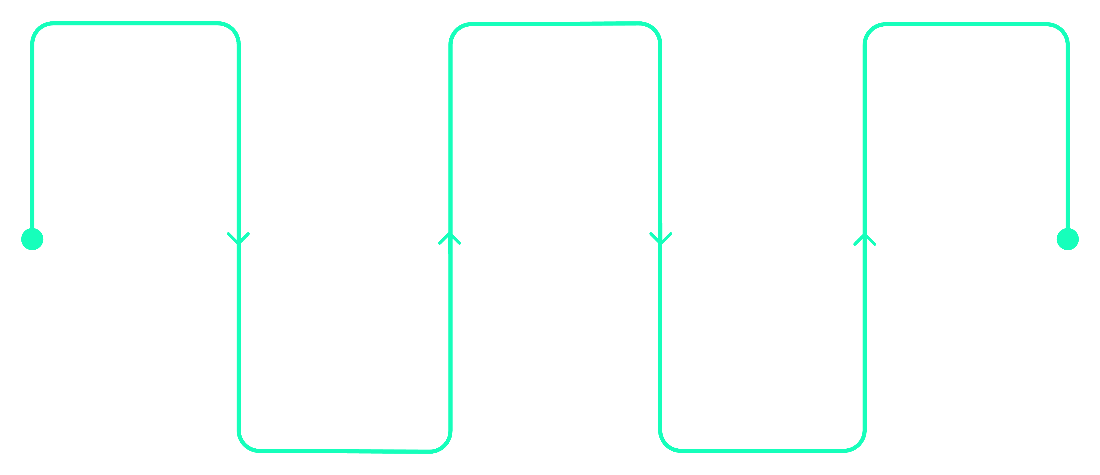
How a Journey Looks in Raasta
Example: Gulshan-e-Iqbal → Saddar
Start
Continue
Arrive
Gulshan-e-Iqbal, walk to stop
Pass Civic Centre on Route A
Take Route B to Saddar destination
Change
Bus A
Swap at interchange to Route B
Board Route A via NIPA, Hasan Square
Raasta breaks every journey into clear, numbered steps — telling you exactly where to walk, which bus to take, where to change, and when you've arrived.

Slide 4
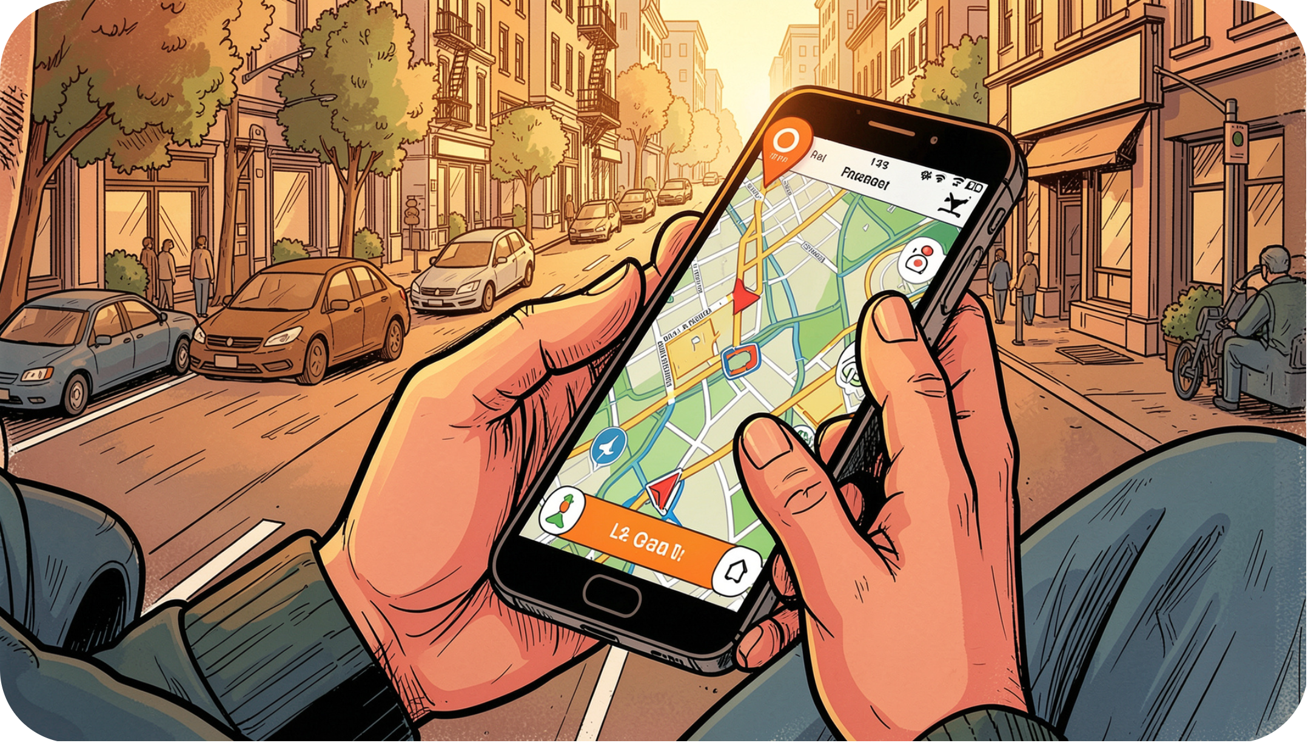

THE CORE CONCEPT
"Tell us where you want to go, and we explain how to get there."
Raasta is not just another route listing website. It is a plain-language navigation assistant for public transport — designed for people who have never memorized a bus number in their lives.
No route knowledge required. Just enter your destination.

Slide 5
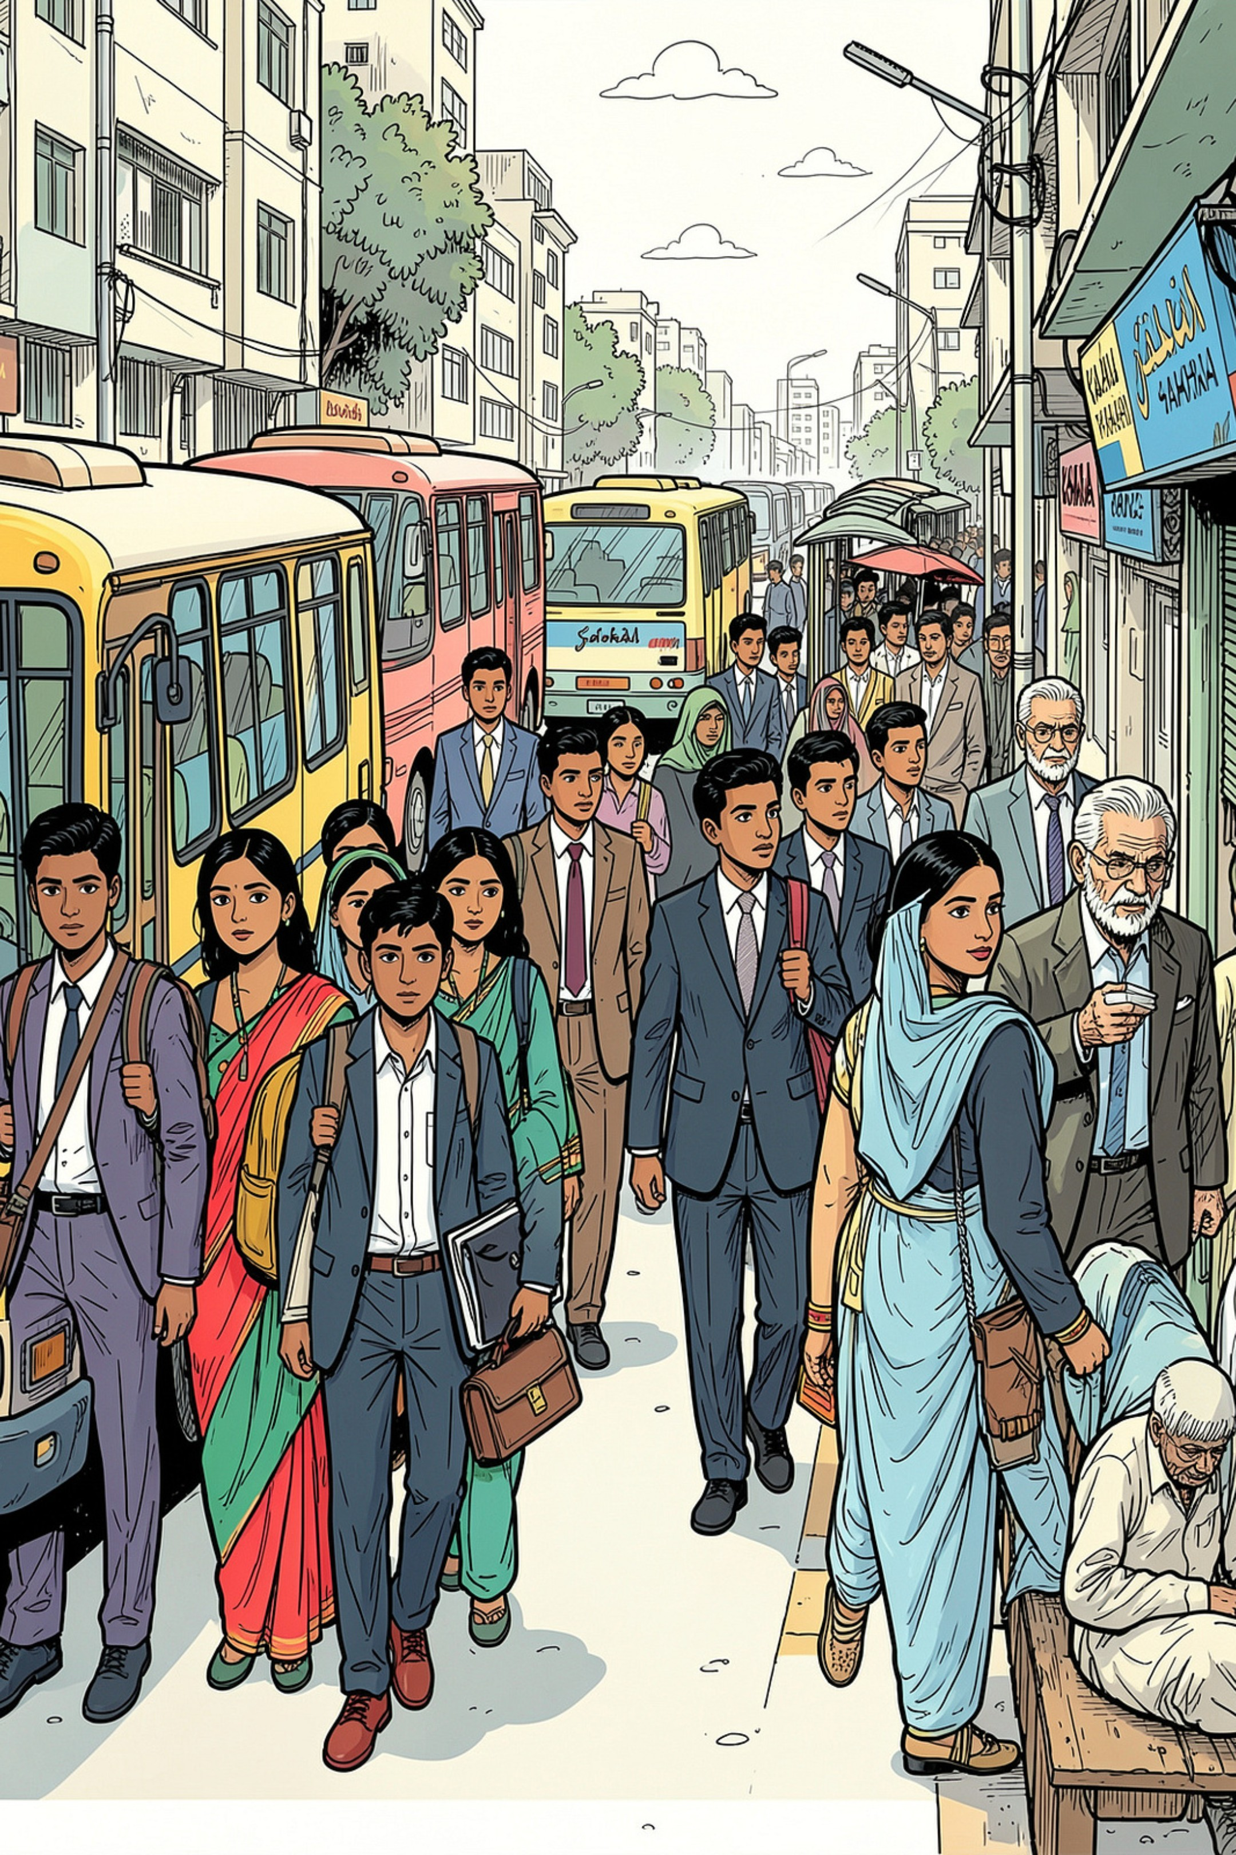




Who Raasta Is Built For
Students
Navigating between campuses, hostels, and homes across the city.
Daily Commuters
Workers who need reliable, repeatable routes every weekday.
New Residents & Visitors
People unfamiliar with Karachi's bus network who need clear guidance.
Frequent Public Transport Users
Anyone who relies on buses and wants smarter, faster journey planning.

Slide 6


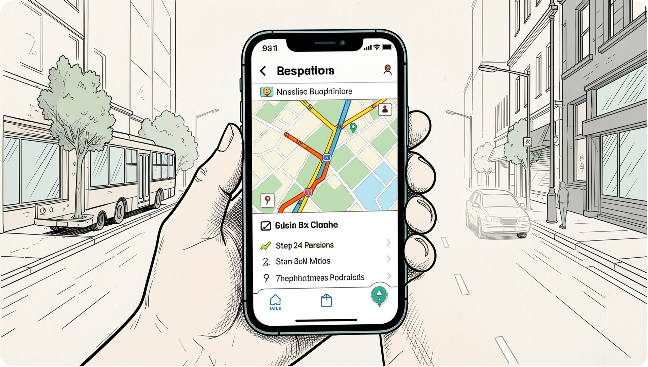


Core Features
Destination Search
From → To search with landmark support.
Step-by-Step Instructions
Walk, board, change, and arrive — all explained clearly.
Route Comparison
See multiple options and pick the simplest journey.
Interactive Map
Visualize your route with roads and stops highlighted.
Bilingual Support
Fully available in English and Urdu.
Community Updates
Users can suggest route and stop changes.
Mobile-Friendly
Responsive design for on-the-go use.

Slide 7
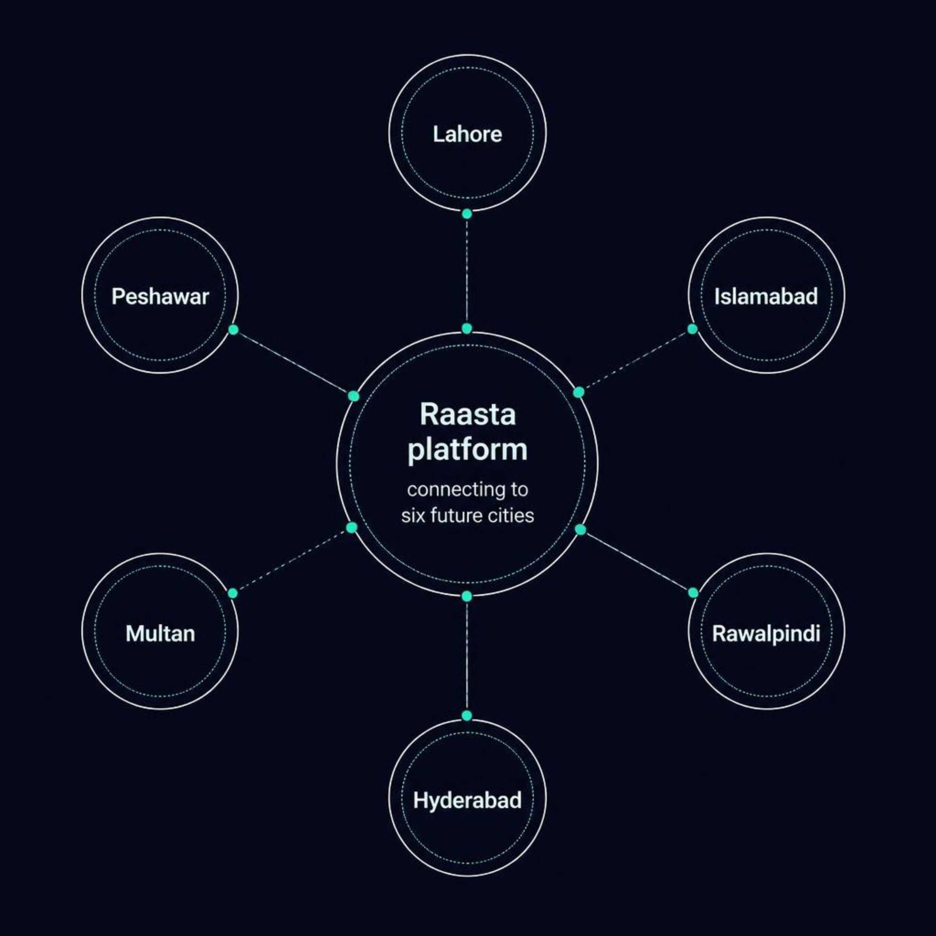

Built for Karachi, Designed for Pakistan
Raasta launches in Karachi — but the architecture is city-independent from day one, ready to scale nationwide.
A Scalable Foundation
Each city's data — routes, stops, roads, and coordinates — is stored in an identical structure, making expansion as simple as adding a new city record.
Future cities are added without rewriting the platform — only the data layer expands.

Slide 8




Technology Stack
Frontend
Backend
Next.js
React
Material UI (MUI)
Node.js
Express.js
Database
Maps
MongoDB
OpenStreetMap
Compatible mapping services
A modern, JavaScript-first stack chosen for speed, flexibility, and strong community support — ideal for a responsive, map-heavy navigation platform.

Slide 9
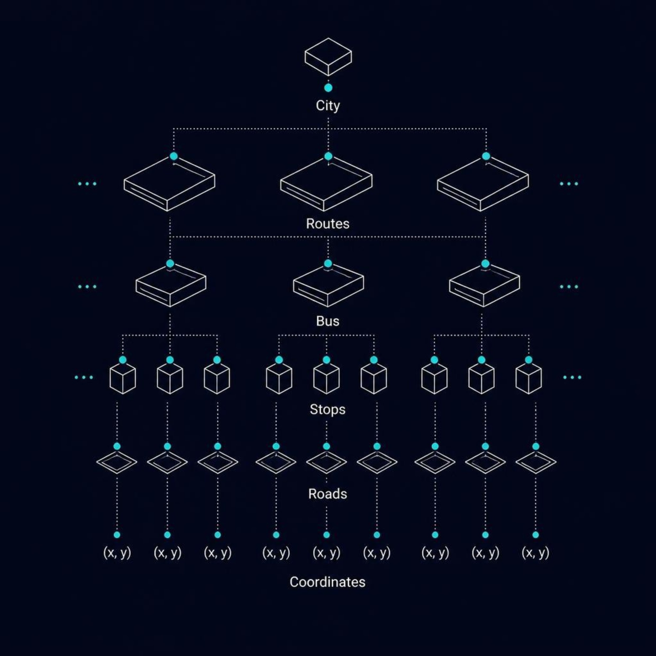
Database Structure
Data is organized in a clean, nested hierarchy — making it straightforward to add new cities without restructuring the entire system.
Why This Structure Works
Each level is self-contained and repeatable. Adding Lahore or Islamabad means inserting a new City record — all routes, stops, and coordinates follow the same schema.
City
Routes → Bus → Stops
Roads → Coordinates
Top-level container for all data.
Linked journey data per city.
Precise location data for mapping.

Slide 10
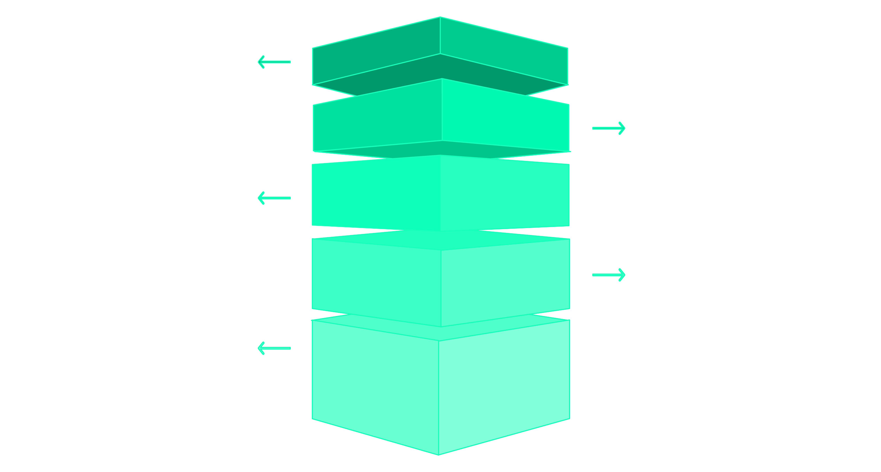
System Architecture
User Frontend
Next.js/React handles UI and interactions.
API Layer
Express.js processes requests and business logic.
Database
MongoDB stores routes and stop data.
Mapping Service
OpenStreetMap provides live map tiles and routing.
Live Flow
User actions propagate through API to map.
A clean separation of concerns — the frontend handles the user experience, the API manages logic, and the database stores all route and location data. The map service renders journeys visually.
🚀 Launch
🌍 Expand
🤝 Improve
Karachi bus routes live on the web
Scale to Lahore, Islamabad & beyond
Community-driven updates keep data fresh

