Slide 1


Slide 2
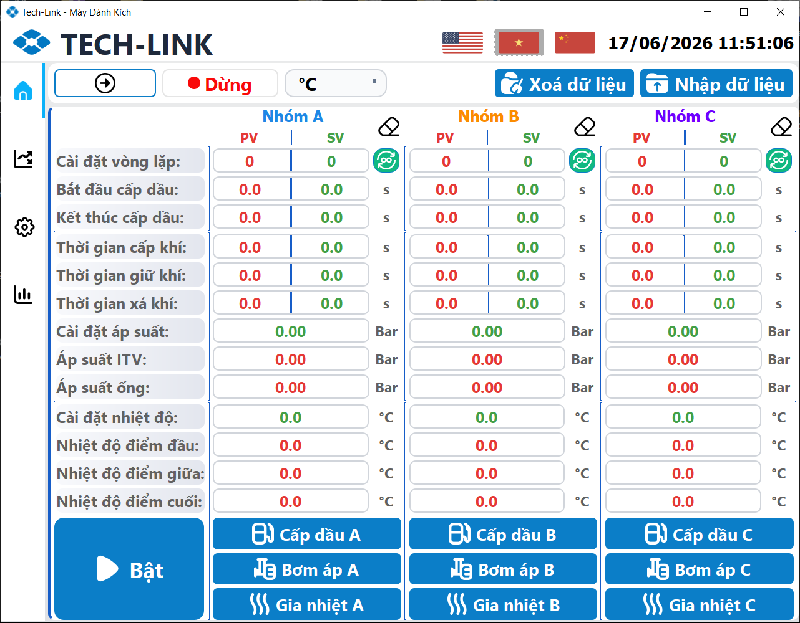

Slide 3
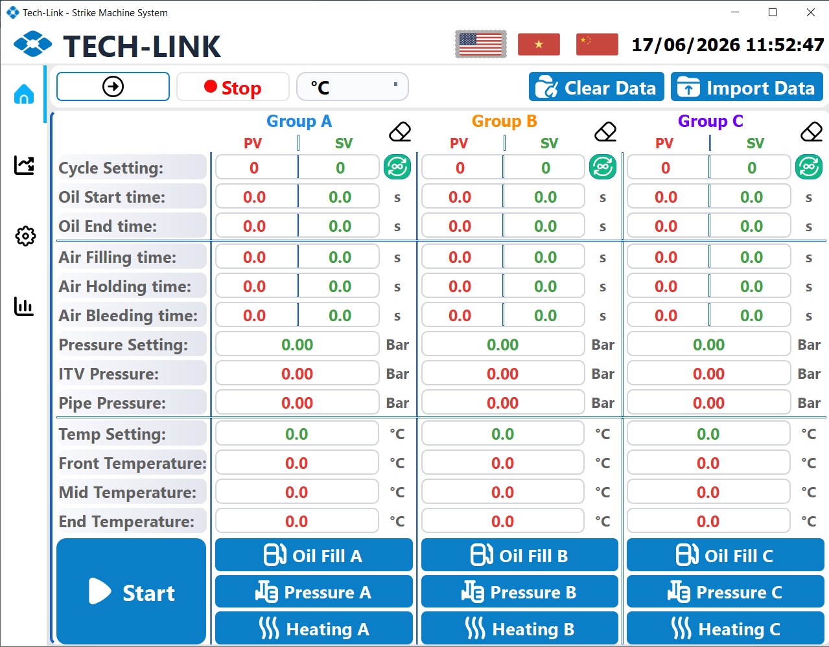
Next Page
Indicator
Unit Selection
Language Button
Clear/Get Data Button
Clear Group Data
Auto/Repeat Cycle Button
Value Area
Menu
Data Name
Button Area

Slide 4
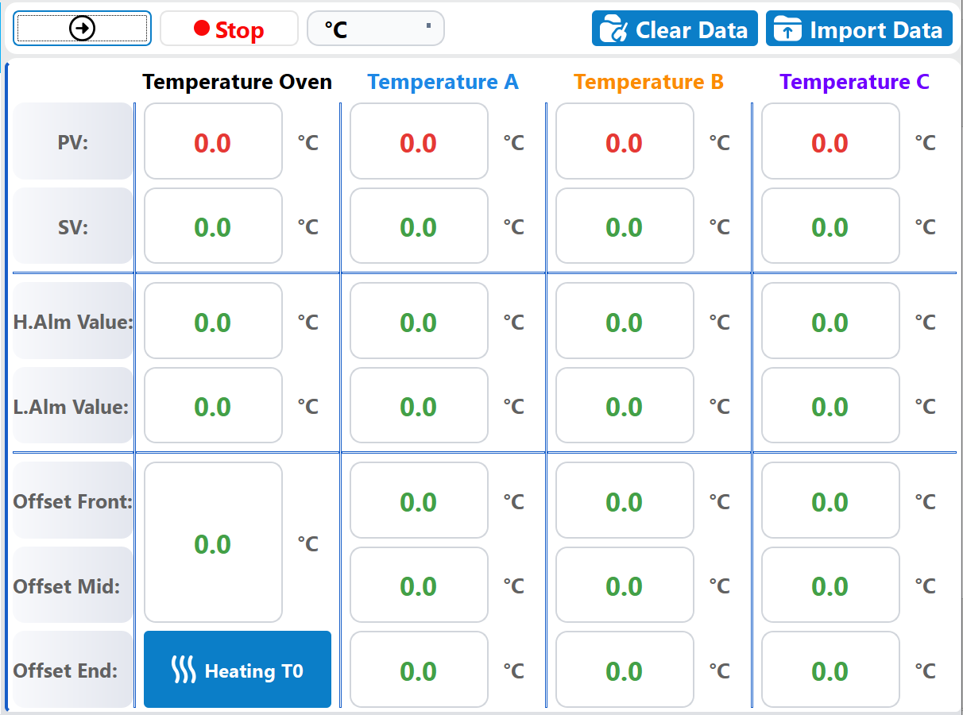
Current/Set Value
Alarm Value
Offset Value
Oven Heating Button

Slide 5
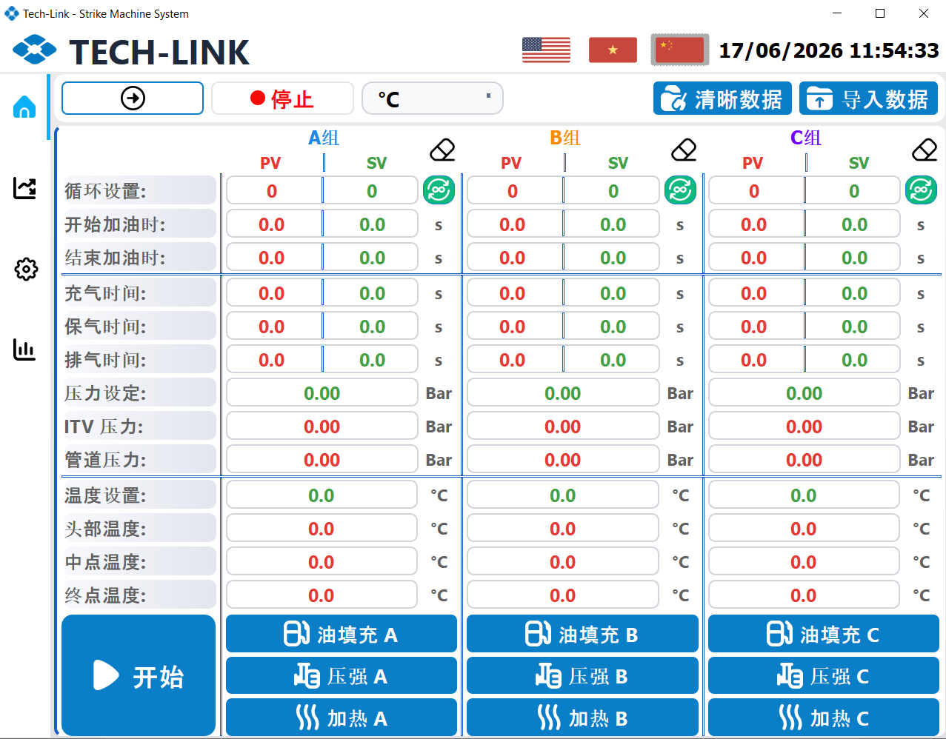

Slide 6
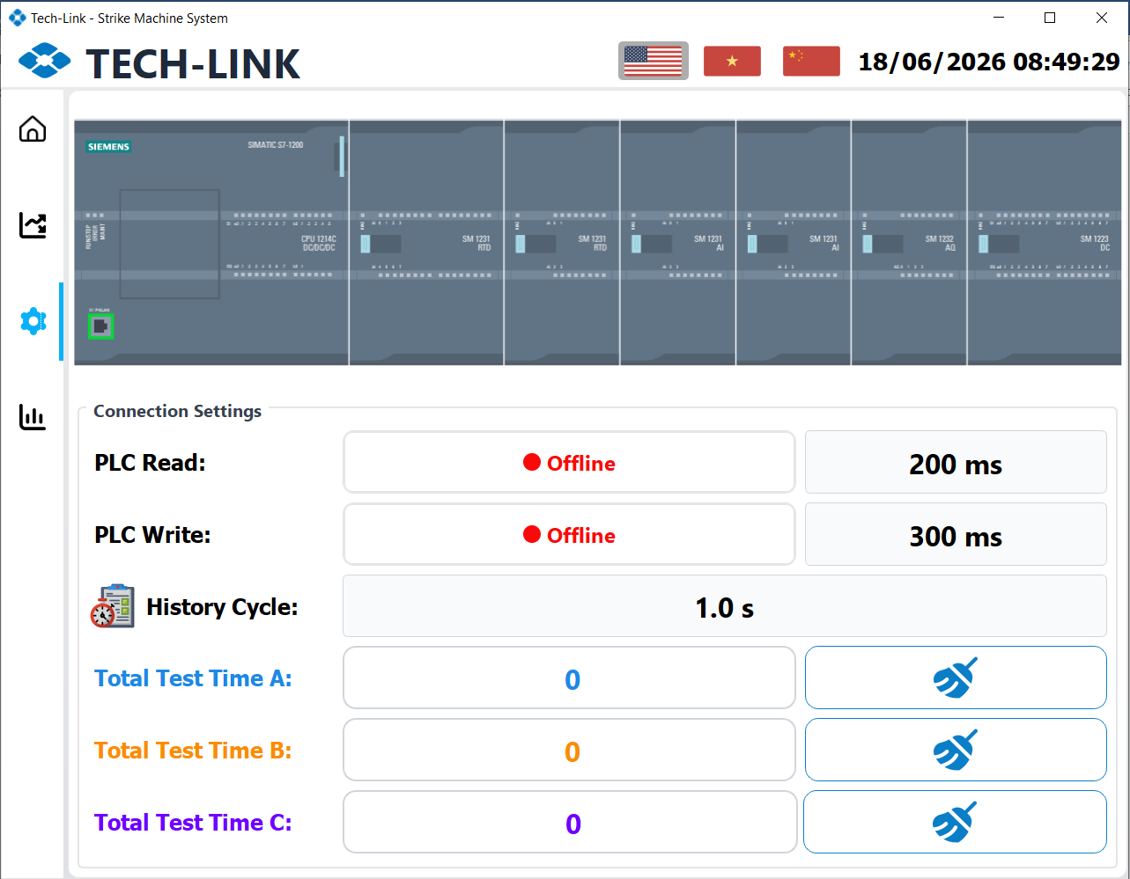
Reading Status
Writing Status
History Write Speed
Total Cycle Group A
Total Cycle Group B
Total Cycle Group C

Slide 7
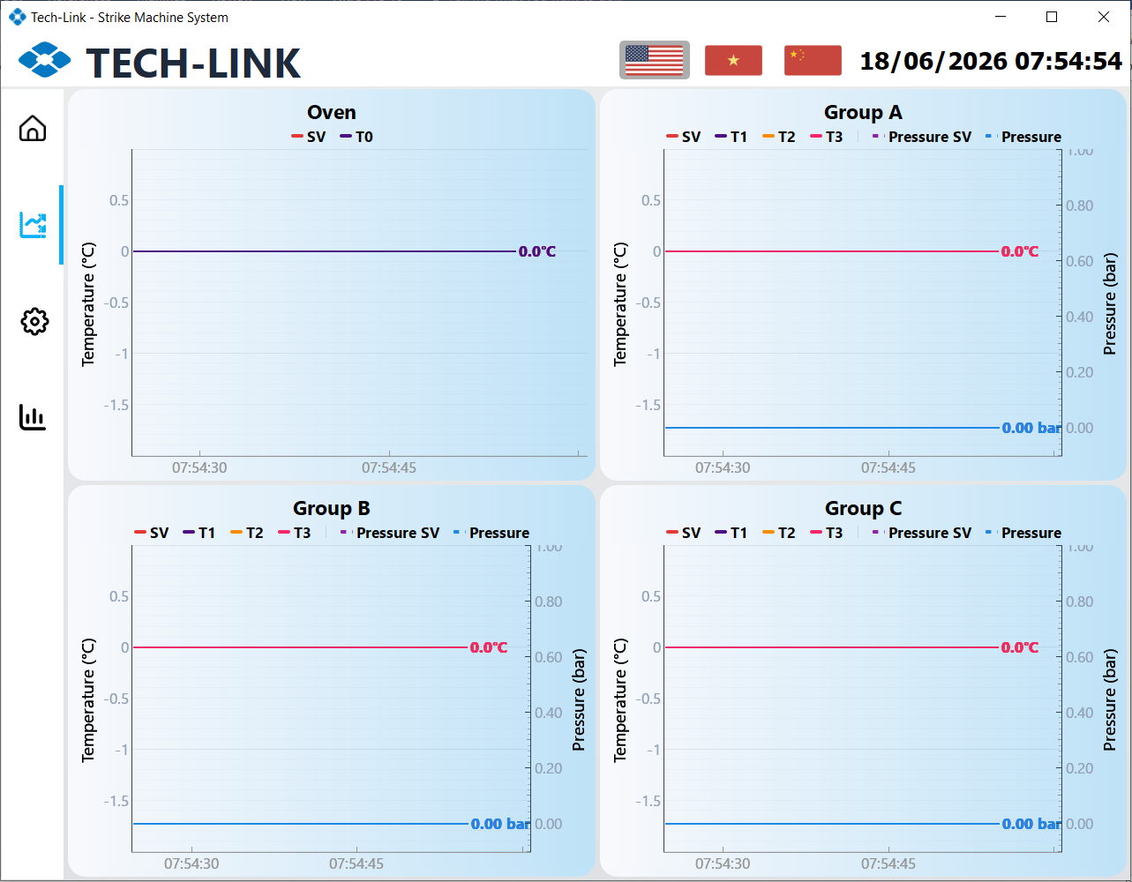

Slide 8
