Slide 1


Slide 2
Purpose
Promotes community while giving one’s desired privacy
Inspires continuous healthy habits
Ability to reach out to peers and medical professionals
Notes:
What really stuck with us was the statement “there are more interesting things about me than my disease”
Well we want to make it easier to manage your disease so that you can focus and continue developing the things that are unique about yourself
We made it easy to find people and events by implementing Google Maps and adding filters to select information most pertinent to you at the moment
Through reminders, community badges, and facilitating appointment making, we empower our users to continuously make healthy choices
And we enabled these young adults to take charge of their life by simplifying the means by which they connect to their community of peers and medical professionals

Slide 3
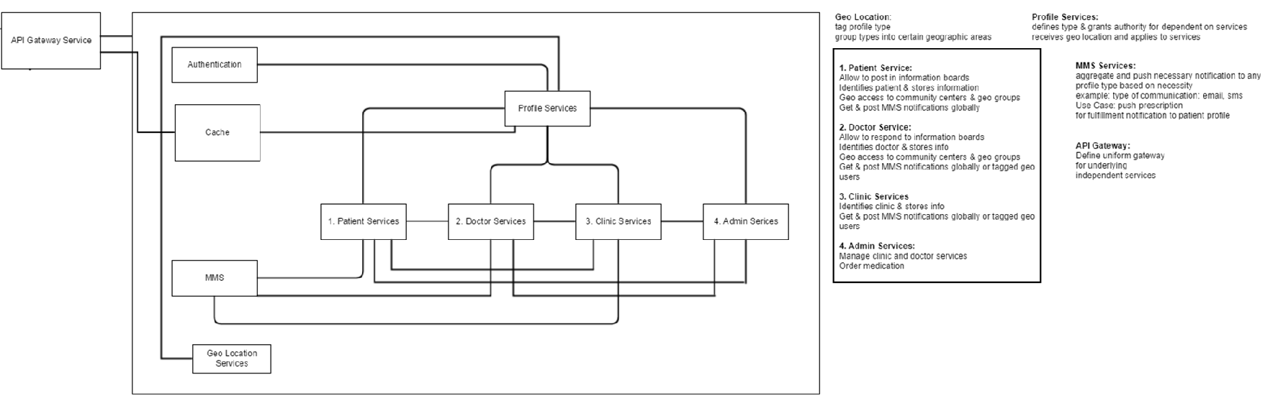
Planning
Notes:
We broke our plans down into comprehensible chunks that will be easy for others with some skill to understand and make their own
After authentication, we enable profile services specifically to the type of user which changes their accessibility to certain functionality
All services have the ability to send some kind of message and all but the admin include a geo loction service as well

Slide 4
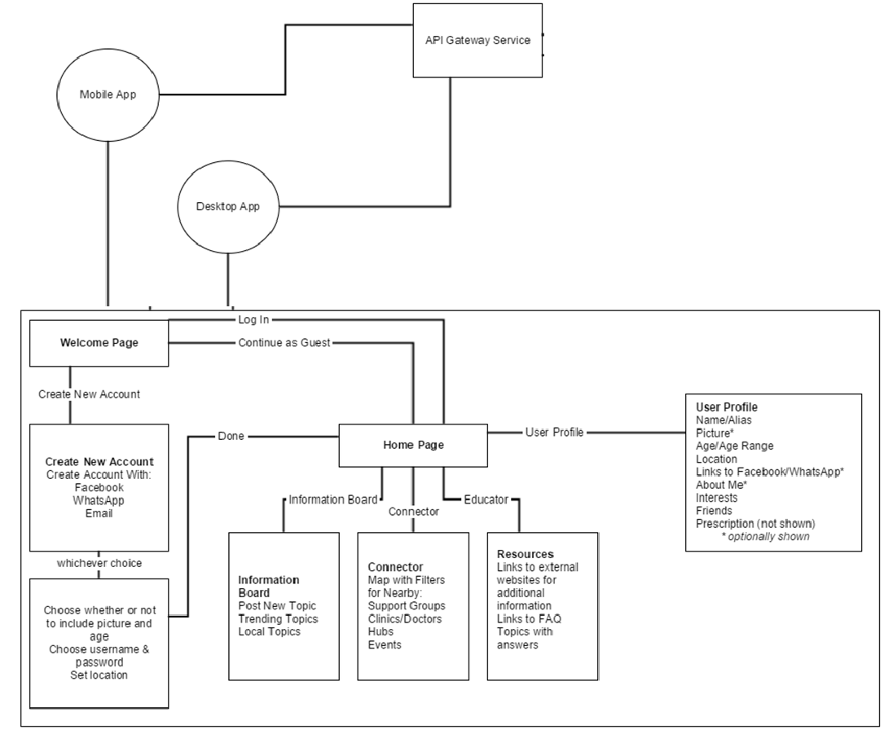
Planning cont.
Notes:
We also went ahead and broke down each page into it’s simplest form so that new programmers could discern each page’s purpose and from there add more functionality if needed, or keep it basic because this form is still completely comprehensive

Slide 5
