Slide 1
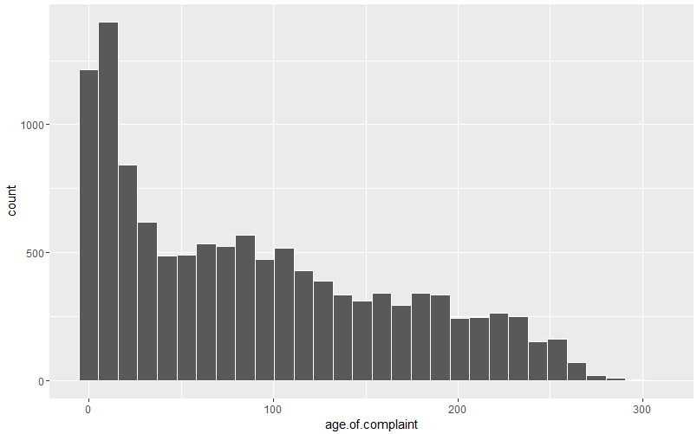
Analysis of active B complaints and backlog – Targeting Backlog
Objective: Develop a strategy to address B complaint backlog, while maintaining adequate service level on new B complaints – making a best effort to stay below or near the CPR target of 40 days (average) to respond.
Count | Bucket | Frequency | Percent Dist
1 | (0,10] | 1879 | 15.94%
2 | (10,20] | 985 | 8.36%
3 | (20,30] | 750 | 6.36%
4 | (30,40] | 488 | 4.14%
5 | (40,50] | 454 | 3.85%
6 | (50,60] | 489 | 4.15%
7 | (60,70] | 526 | 4.46%
8 | (70,80] | 485 | 4.12%
9 | (80,90] | 527 | 4.47%
10 | (90,100] | 473 | 4.01%
11 | (100,110] | 458 | 3.89%
12 | (110,120] | 449 | 3.81%
13 | (120,130] | 348 | 2.95%
14 | (130,140] | 335 | 2.84%
15 | (140,150] | 285 | 2.42%
16 | (150,160] | 354 | 3.00%
17 | (160,170] | 270 | 2.29%
18 | (170,180] | 291 | 2.47%
19 | (180,190] | 336 | 2.85%
20 | (190,200] | 289 | 2.45%
21 | (200,210] | 223 | 1.89%
22 | (210,220] | 229 | 1.94%
23 | (220,230] | 256 | 2.17%
24 | (230,240] | 204 | 1.73%
25 | (240,250] | 162 | 1.37%
26 | (250,260] | 145 | 1.23%
27 | (260,270] | 60 | 0.51%
28 | (270,280] | 17 | 0.14%
29 | (280,290] | 15 | 0.13%
30 | (290,300] | 2 | 0.02%
31 | (300,310] | 2 | 0.02%
 | TOTAL | 11786
Overall Stats on 6/26/16
Total of 11887 open B complaints
Average of 89.8 workdays open
Oldest complaint = 306.7 workdays

Slide 2
Analysis of active B complaints and backlog – Targeting Backlog
Methodology:
Redistribute total universe of b complaints into a smaller number of operational buckets.
Numerous bucketing scenarios were tested. Needed to strike a balance between total volume and mean workdays of each bucket while keeping a reasonable number of total buckets to simplify as an operational tool.
Assumptions based on annual averages
Approximately 5K new B complaints each month
Approximately 5K B complaints inspected each month
Run multiple scenarios to optimize – meet objective of targeting/addressing backlog while maintaining adequate service level.
Count | Buckets | Freq | Pct_Total | Mean Workdays
1 | (0,40] | 4102 | 34.8% | 13.80
2 | (40,100] | 2954 | 25.1% | 70.52
3 | (100,150] | 1875 | 15.9% | 122.31
4 | (150,200] | 1540 | 13.1% | 174.73
5 | (200,250] | 1074 | 9.1% | 223.49
6 | (250,310] | 241 | 2.0% | 260.65

Slide 3
Target Oldest B Complaints
 | Buckets | Freq | Mean | Pct from each bucket | # of Proposed Responses | Responses * Mean | Avg Time to Respond
1 | (0,40] | 4102 | 13.80 | 49% | 2000 | 27601.80 | 89.4
2 | (40,100] | 2954 | 70.52 | 34% | 1000 | 70521.97
3 | (100,150] | 1875 | 122.31 | 43% | 800 | 97850.40
4 | (150,200] | 1540 | 174.73 | 32% | 500 | 87367.45
5 | (200,250] | 1074 | 223.49 | 47% | 500 | 111746.70
6 | (250,310] | 241 | 260.65 | 83% | 200 | 52129.46
Total |  | 11786 |  |  | 5000 | 447217.78
Targeting oldest complaints results in a very high avg response time of 89.4 workdays.
Target Newest B Complaints
 | Buckets | Freq | Mean | Pct from each bucket | # of Proposed Responses | Responses * Mean | Avg Time to Respond
1 | (0,40] | 4102 | 13.80 | 73.1% | 3000 | 41402.7 | 36.5
2 | (40,100] | 2954 | 70.52 | 67.7% | 2000 | 141043.94
3 | (100,150] | 1875 | 122.31 | 0.0% | 0 | 0
4 | (150,200] | 1540 | 174.73 | 0.0% | 0 | 0
5 | (200,250] | 1074 | 223.49 | 0.0% | 0 | 0
6 | (250,310] | 241 | 260.65 | 0.0% | 0 | 0
Total |  | 11786 |  |  | 5000 | 182446.64
Targeting newest complaints results in an excellent service level but doesn’t address any of the older complaints
Address Both Old and New B Complaints
 | Buckets | Freq | Mean | Pct from each bucket | # of Proposed Responses | Responses * Mean | Avg Time to Respond
1 | (0,40] | 4102 | 13.80 | 79.2% | 3250 | 44852.925 | 47.5
2 | (40,100] | 2954 | 70.52 | 31.3% | 925 | 65232.82225
3 | (100,150] | 1875 | 122.31 | 26.7% | 500 | 61156.5
4 | (150,200] | 1540 | 174.73 | 9.7% | 150 | 26210.235
5 | (200,250] | 1074 | 223.49 | 14.0% | 150 | 33524.01
6 | (250,310] | 241 | 260.65 | 10.4% | 25 | 6516.1825
Total |  | 11786 |  |  | 5000 | 237492.6748
This is the optimal strategy to address a portion of the oldest complaints while keeping up with new volume and maintaining a reasonable avg response time of 47.5 days.

Slide 4
Future Projection – Need to investigate creating a more complex forecasting model, or just run current model each month.
Address Both Old and New B Complaints
 | Buckets | Freq | Mean | Pct from each bucket | # of Proposed Responses | Responses * Mean | Avg Time to Respond
1 | (0,40] | 4102 | 13.80 | 79.2% | 3250 | 44852.925 | 47.5
2 | (40,100] | 2954 | 70.52 | 31.3% | 925 | 65232.82225
3 | (100,150] | 1875 | 122.31 | 26.7% | 500 | 61156.5
4 | (150,200] | 1540 | 174.73 | 9.7% | 150 | 26210.235
5 | (200,250] | 1074 | 223.49 | 14.0% | 150 | 33524.01
6 | (250,310] | 241 | 260.65 | 10.4% | 25 | 6516.1825
Total |  |  |  |  | 5000 | 237492.6748
Projecting future months is a more complicated model due to movement of complaints to different buckets, and fluctuating total volume of responses and new complaints. Need to create a “variable rate” of responses per bucket for each month – otherwise the distribution will become skewed – see graphs below. There are a lot of unknowns and assumptions in this projection.
Sample Projection
Buckets | MAY | JUNE | JULY | AUG
(0,40] | 4102 | 5852 | 7352 | 8602
(40,100] | 2954 | 2029 | 1029 | 129
(100,150] | 1875 | 1375 | 1025 | 775
(150,200] | 1540 | 1390 | 1290 | 1240
(200,250] | 1074 | 924 | 899 | 874
(250,310] | 241 | 216 | 191 | 166
TOTAL | 11786 | 11786 | 11786 | 11786
Need to adjust % each month while keeping new complaints and responses constant at 5K.

