Slide 1

DOB UPDATE
Overview Presentation for
AIA New York
May 5, 2017

Slide 2
Building One City Commitments and Progress to Date
A 21st Century Department of Buildings
Progress to Date
100% of applications, reviews, payments and scheduling can be handled electronically | Development Inspections, Plumbing, Sprinkler, Standpipe and Facades launched in DOB NOW (approximately 300K filings)
100% of projects have a clear and transparent status | Transparent dashboards and notifications for stakeholders
Resources are targeted to the highest risk and highest priority work | 18 guidelines for plan examiners and applicants have been drafted to focus plan exam on high risk applications
Expeditors are no longer necessary for navigating City processes | Online inspection scheduling puts owners in the driver’s seat and requires them to authorize expeditors to act on inspection applications.
Integrity is high among all DOB staff and the risk of fraud is reduced by transparent processes | Risk Management team is fully staffed.
The building industry’s first ever Code of Conduct is in place and enforced with a firm zero-tolerance policy | Published first ever Industry Code of Conduct in July 2015. 11 revocations and suspensions in 2016.
Cycle times for major processes are best-in-class for major US cities | Hired 80% of Building One City FY 17 target, agency-wide; dramatic improvements in plan exam/inspection response times.
70% filings are self-certified, particularly low-risk filings | Pro-certification increased to 64.3% from 61% in 2015
Affordable Housing Unit is used to prioritize affordable housing filings | Affordable Housing Unit created. All inspector positions staffed.
Proactive enforcement will increase compliance with public safety | Sweep approach supported by Analytics and Data Science team.
Notes:
Williamsburg

Slide 3
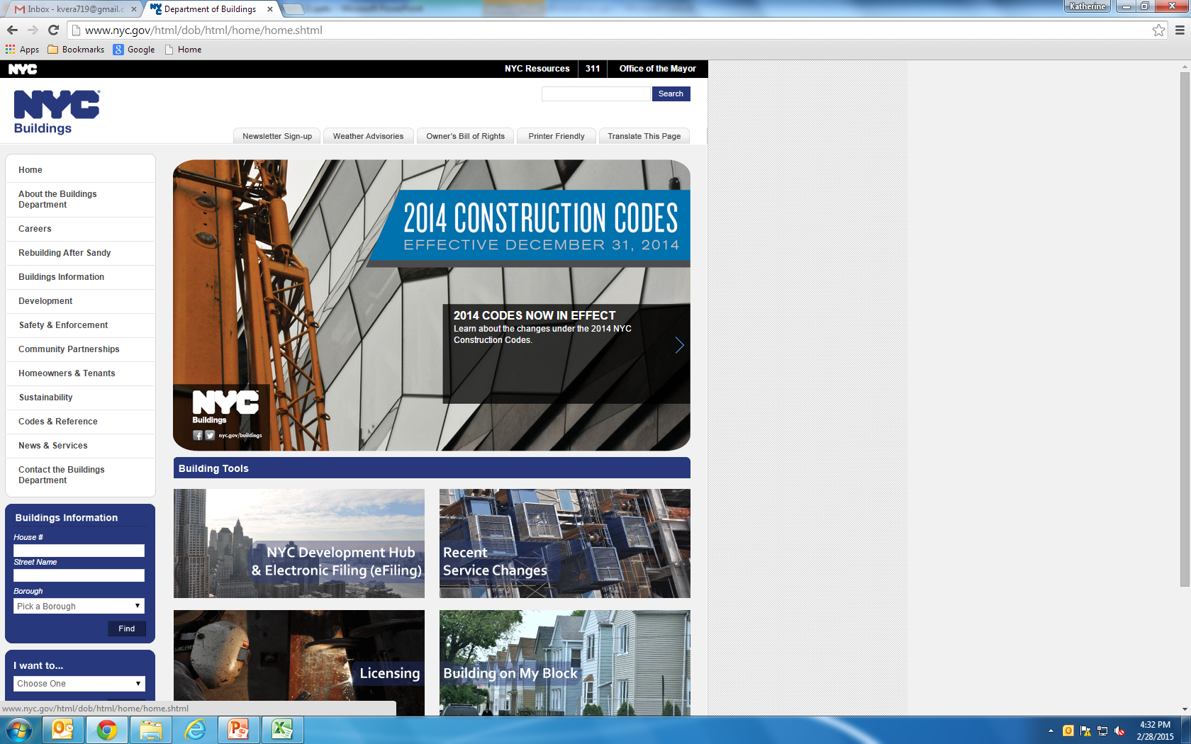
Service Level Statistics

Slide 4

DOB NOW Overview
DOB NOW is an interactive, web-based portal that will enable building owners, design professionals, filing representatives, and licensees to do all business with DOB online, including:
Submit applications
Make payments
Schedule appointments
Check the status of an application
Pull initial and renewal permits

Slide 5
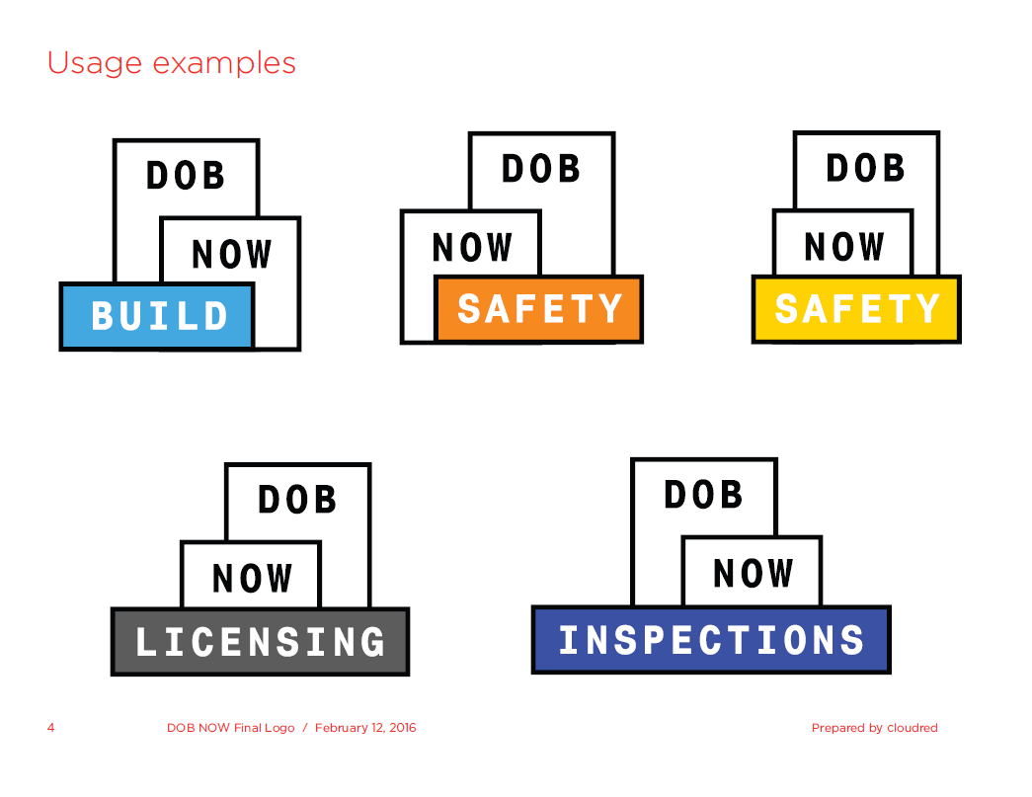
DOB NOW: Inspections Overview
DOB NOW: Inspections is the new name for Inspection Ready and continues to enable online:
Scheduling inspections
Tracking statuses
Notifications

Slide 6
DOB NOW: Build Overview
DOB NOW: Build enables:
Job filings
Permits
Post Approval Amendments (PAA)
Corrections
Withdrawals
Superseding
After Hour Variances (AHV)
Letters of Completion
Certificate of Occupancy – coming soon

Slide 7
DOB NOW: Licensing Overview
DOB NOW: Licensing enables:
Exam filing
Issuance and renewal

Slide 8
DOB NOW: Safety Overview
DOB NOW: Safety enables:
Initial and amended compliance filings
Extension requests

Slide 9
Impact to Customers
Better Customer Service | Customers are able to submit DOB NOW: Build job filings and DOB NOW: Safety compliance filings online for work types live in DOB NOW, which is more convenient than having to travel to a DOB office.
Increased Access to Information | Customers can view real-time information on job filings and compliance filings for work types live in DOB NOW in one place online: the DOB NOW Public Portal.
Greater Transparency | DOB NOW will make construction in the city more transparent for residents and building owners.
Improved Processing | Moving from paper-based to digital makes it easier for DOB to review applications and process them.

Slide 10
DOB NOW Live & Upcoming Releases
Module | Filings | Target Go Live
DOB NOW: Public Portal | Already live DOB NOW filings | Already Live!
DOB NOW: Build Job Filings | Plumbing and Sprinkler | Already Live!
 | Standpipe | Already Live!
 | Antenna | Fall 2017
 | Curb Cut | Fall 2017
 | Boiler | Fall 2017
 | Fuel Burning | Fall 2017
 | Fuel Storage | Fall 2017
 | Elevator | Fall 2017
DOB NOW: Safety Compliance Filings | Façade | Already Live!
 | Boiler | Fall 2017

Slide 11
DOB NOW Resources
Register for Building News for the latest information on DOB NOW
FAQs: for more information, look at the DOB NOW: Build and DOB NOW: Safety FAQs available on the DOB website

Slide 12
Risk Model – Construction Projects
Risk Model and Construction Project Types
Established 6 categories – from New Buildings to Demolition
Project Types: 55 distinct projects; each assessed/ranked by risk
Develop and Publish Project Guidelines
Draft Outline: Internal Team of Technical staff from central/borough offices outline detailed project requirements
Industry Review: Collaborate with industry to review and finalize the guidelines
Web Posting: Publish the guidelines on DOB Web site with links to referenced zoning/code/regulations
Draft Guidelines: Completed for 38 projects
Industry Review: 22 Projects – Plumbing/Sprinkler/Standpipe, an additional 8 are under review
In Progress: 8 Projects drafts by end of July

Slide 13
Project Guidelines
KEY GOALS AND OBJECTIVES
Provide detailed end-to-end project guidelines to the industry for use by:
Property Owners
Design Professionals
Contractors
Special Inspection Agencies
DOB Standards:
Establish standards for DOB plan reviews to focus on critical items identified based on a project’s risk assessment
Staff Training:
Train ACPE / Plan Examiners on DOB Standards
Ensure that reviews across offices follow citywide standards of Plan Exam protocols

