Slide 1


Download the slides at:
https://github.com/NYCDotNetDevs/Slides

Slide 2
Introductions
Co-Organizers
Brian Jablonsky
Erik Noren

Slide 3
News
Follow us on Twitter: @NYCDotNetDevs
.NET 5.0 GA – https://bit.ly/3ppn8Ji
EF Core 5.0 GA – https://bit.ly/2IyQjZD
ASP.NET Core 5.0 GA – https://bit.ly/2IwxbLN
Visual Studio 2019 v16.8 – https://bit.ly/35nJ6UP
C# 9 – https://bit.ly/3pl4vGd
F# 5 – https://bit.ly/3kuszTs
PowerShell 7.1 – https://bit.ly/3kjR6us

Slide 4
Other NYC Meetings
TBA – NY Pluralsight Study Group “TBD” (https://www.meetup.com/NYPluralsightStudy/)
TBA – NYC Mobile .NET “TBD” (https://www.meetup.com/nycmobiledev/)
Wednesday, December 9th – NYC PowerShell Meetup “Make PowerShell A Real Solution in 5 Steps” (https://www.meetup.com/NycPowershellMeetup/)

Slide 5
.NET Conf 2020
Virtual – Tuesday, November 10th – Thursday, November 12th
https://www.dotnetconf.net/
.NET 5 Launch!
Replay the 3-day event:
Day 1: https://www.youtube.com/watch?v=mS6ykjdOVRg
Day 2/3: https://www.youtube.com/watch?v=Uq4qyHi3sYM

Slide 6
Granite State Code Camp
Virtual – Saturday, November 14th
https://www.granitestatecodecamp.org/
Free!
Tons of great talks all day!

Slide 7
Announcements
Upcoming meetings
Thursday, December 10th – TBA
Call for presentations!
Have an idea/topic for a presentation?
Want to give a presentation?
Contact Erik (erik@nycdotnetdevs.com) or Brian (brian@nycdotnetdevs.com), or tweet @NYCDotNetDevs

Slide 8
Announcements
Join us on Slack!
Join the .NET Core Slack group
Already 6,800+ members including many core team members
http://tattoocoder.com/aspnet-slack-sign-up/
Join the #nyc-dotnet-developers channel

Slide 9
Announcements
Twitter
Got a blog post or article on .NET you’d like retweeted?
Have a .NET job opportunity you’re looking to fill?
Got something .NET related?
Follow us on twitter, email us (brian@nycdotnetdevs.com or erik@nycdotnetdevs.com) or DM us on Twitter (@NYCDotNetDevs) with your tweet, and we’ll retweet it!

Slide 10

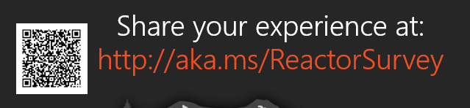
Sponsors
Microsoft Reactor http://microsoftreactor.com
Microsoft Reactors are developer community hubs providing technical events, community networking, and collaboration. They are graciously sponsoring our group in 2019 by providing our meeting space and food! Please fill out the survey at the end of the meeting!

Slide 11

Sponsors
PostSharp http://www.postsharp.net/
PostSharp is a compiler extension that adds support for patterns to C# and VB. If you’re tired of writing repetitive code, you may want to check it out. It can help you add logging, caching or INotifyPropertyChanged to your codebase without boilerplate, or solve multithreading issues.

Slide 12

Sponsors
RevDeBug https://revdebug.com
RevDeBug allows you to inspect past application state and performance profile, even directly from production environments. Trace the root cause of bugs in a matter of seconds, saving your developers' time and sanity.

Slide 13


Sponsors
JetBrains https://jetbrains.com
For over 15 years, JetBrains has strived to make the strongest, most effective developer tools on earth. By automating routine checks and corrections, JetBrains tools speed up production, freeing developers to grow, discover and create.

Slide 14
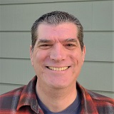
Jeremy Clark
http://www.jeremybytes.com/
Microsoft MVP
Authored numerous Pluralsight courses
Plays the banjo

Slide 15

Reactor NYC
@MSFTReactor
#ReactorNYC
How was your Meeting?

Slide 16

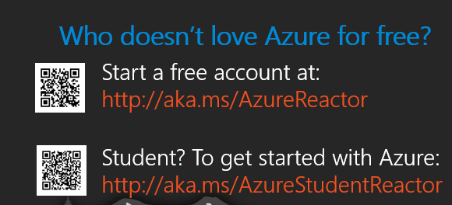

Reactor NYC
@MSFTReactor
#ReactorNYC

