Slide 1


Download the slides at:
https://github.com/NYCDotNetDevs/Slides

Slide 2
Introductions
Co-Organizers
Brian Jablonsky
Erik Noren

Slide 3
News
Follow us on Twitter: @NYCDotNetDevs
.NET 5.0 Preview 2 – https://bit.ly/3fLzerg
EF Core 5.0 Preview 3 – https://bit.ly/360ykmc
ASP.NET Core 5.0 Preview 3 – https://bit.ly/3bsOypf
Blazor WebAssembly 3.2.0 RC – https://bit.ly/3buiOQR

Slide 4
Other NYC Meetings
TBA – NY Pluralsight Study Group “TBD” (https://www.meetup.com/NYPluralsightStudy/)
Thursday, May 28th – NYC Mobile .NET “Microsoft Build 2020 Recap” (https://www.meetup.com/nycmobiledev/)
TBA – New York ALT.NET Software Development Group “TBD” (https://www.meetup.com/nyaltnet/)
Wednesday, June 10th – NYC PowerShell Meetup “Shell of an Idea: Exploring the Origins of PowerShell” (https://www.meetup.com/NycPowershellMeetup/)

Slide 5
//Build
Tuesday, May 19th – Wednesday, May 20th
Completely free!
Completely online!
https://mybuild.microsoft.com/

Slide 6
Microsoft Build 2020 Recap
Thursday, May 28th
6:30PM
Joint meetup with NYC Mobile .NET
https://www.meetup.com/NYC-NET-Developers/events/270655634/

Slide 7
Announcements
Upcoming meetings
Thursday, June 11th – [VIRUTAL] “TBA”
Thursday, July 9th – TBA
Thursday, August 13th – TBA
Thursday, September 10th – TBA
Thursday, October 1st – “Hacktoberfest.NET”
Call for presentations!
Have an idea/topic for a presentation?
Want to give a presentation?
Contact Erik (erik@nycdotnetdevs.com) or Brian (brian@nycdotnetdevs.com), or tweet @NYCDotNetDevs

Slide 8
Announcements
.NET Happy Hour – ON HOLD
An event happening around NYC offering members an open discussion with other developers about anything and everything over drinks and snacks.

Slide 9
Announcements
Community Service Hackathon – ON HOLD
We’ve been in discussion with the Teaching Artist Project Cohort (TAP Cohort) to develop an interactive platform to serve teaching artists working in public schools and higher education
Announcement for a planning session meeting and a Hackathon coming soon!
Great way to give back to non-profits in NYC-area
Play with new technology
Looks great on your GitHub account/resume

Slide 10
Announcements
Join us on Slack!
Join the .NET Core Slack group
Already 6,800+ members including many core team members
http://tattoocoder.com/aspnet-slack-sign-up/
Join the #nyc-dotnet-developers channel

Slide 11
Announcements
Twitter
Got a blog post or article on .NET you’d like retweeted?
Have a .NET job opportunity you’re looking to fill?
Got something .NET related?
Follow us on twitter, email us (brian@nycdotnetdevs.com or erik@nycdotnetdevs.com) or DM us on Twitter (@NYCDotNetDevs) with your tweet, and we’ll retweet it!

Slide 12
Announcements
.NET Survey
We’ll be sending out a survey shortly to help us understand what you want out of the user group!

Slide 13

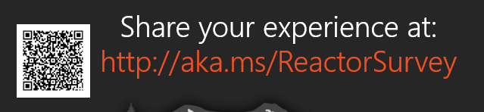
Sponsors
Microsoft Reactor http://microsoftreactor.com
Microsoft Reactors are developer community hubs providing technical events, community networking, and collaboration. They are graciously sponsoring our group in 2019 by providing our meeting space and food! Please fill out the survey at the end of the meeting!

Slide 14

Sponsors
PostSharp http://www.postsharp.net/
PostSharp is a compiler extension that adds support for patterns to C# and VB. If you’re tired of writing repetitive code, you may want to check it out. It can help you add logging, caching or INotifyPropertyChanged to your codebase without boilerplate, or solve multithreading issues.

Slide 15

Sponsors
RevDeBug https://revdebug.com
RevDeBug allows you to inspect past application state and performance profile, even directly from production environments. Trace the root cause of bugs in a matter of seconds, saving your developers' time and sanity.

Slide 16


Sponsors
JetBrains https://jetbrains.com
For over 15 years, JetBrains has strived to make the strongest, most effective developer tools on earth. By automating routine checks and corrections, JetBrains tools speed up production, freeing developers to grow, discover and create.

Slide 17

Sponsors
Secure Code Warrior https://securecodewarrior.com/
Secure Code Warrior® is the secure coding company. We have developed an online secure coding platform that helps developers to think and act with a security mindset every day. Companies can then scale their secure coding excellence as coders and development teams build and verify their software security skills, gain real-time advice, and monitor skills development.

Slide 18

Sean Varga
https://securecodewarrior.com/
Secure Code Warrior

Slide 19

Reactor NYC
@MSFTReactor
#ReactorNYC
How was your Meeting?

Slide 20

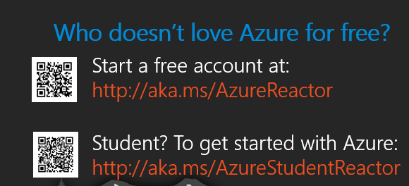

Reactor NYC
@MSFTReactor
#ReactorNYC

