Slide 1


Download the slides at:
https://github.com/NYCDotNetDevs/Slides

Slide 2
Introductions
Co-Organizers
Brian Jablonsky
Erik Noren

Slide 3
News
Follow us on Twitter: @NYCDotNetDevs
.NET 5.0 Preview 6 – https://bit.ly/2ChOn4u
EF Core 5.0 Preview 6 – https://bit.ly/2ZiPPN7
ASP.NET Core 5.0 Preview 6 – https://bit.ly/2ZYkqyi
dotnet-monitor – https://bit.ly/323j5t0
TypeScript 4.0 Beta - https://bit.ly/38G0CDO
Windows Terminal Preview 1.1 - https://bit.ly/3iOk71S

Slide 4
Other NYC Meetings
TBA – NY Pluralsight Study Group “TBD” (https://www.meetup.com/NYPluralsightStudy/)
Thursday, August 20th – NYC Mobile .NET “TBD” (https://www.meetup.com/nycmobiledev/)
Wednesday, August 12th – NYC PowerShell Meetup “Powershell - Data without a Database” (https://www.meetup.com/NycPowershellMeetup/)

Slide 5
Announcements
Upcoming meetings
Thursday, August 13th – TBA
Thursday, September 10th – TBA
Thursday, October 1st – “Hacktoberfest.NET”
Call for presentations!
Have an idea/topic for a presentation?
Want to give a presentation?
Contact Erik (erik@nycdotnetdevs.com) or Brian (brian@nycdotnetdevs.com), or tweet @NYCDotNetDevs

Slide 6
Announcements
Join us on Slack!
Join the .NET Core Slack group
Already 6,800+ members including many core team members
http://tattoocoder.com/aspnet-slack-sign-up/
Join the #nyc-dotnet-developers channel

Slide 7
Announcements
Twitter
Got a blog post or article on .NET you’d like retweeted?
Have a .NET job opportunity you’re looking to fill?
Got something .NET related?
Follow us on twitter, email us (brian@nycdotnetdevs.com or erik@nycdotnetdevs.com) or DM us on Twitter (@NYCDotNetDevs) with your tweet, and we’ll retweet it!

Slide 8


Sponsors
Microsoft Reactor http://microsoftreactor.com
Microsoft Reactors are developer community hubs providing technical events, community networking, and collaboration. They are graciously sponsoring our group in 2019 by providing our meeting space and food! Please fill out the survey at the end of the meeting!

Slide 9

Sponsors
PostSharp http://www.postsharp.net/
PostSharp is a compiler extension that adds support for patterns to C# and VB. If you’re tired of writing repetitive code, you may want to check it out. It can help you add logging, caching or INotifyPropertyChanged to your codebase without boilerplate, or solve multithreading issues.

Slide 10

Sponsors
RevDeBug https://revdebug.com
RevDeBug allows you to inspect past application state and performance profile, even directly from production environments. Trace the root cause of bugs in a matter of seconds, saving your developers' time and sanity.

Slide 11


Sponsors
JetBrains https://jetbrains.com
For over 15 years, JetBrains has strived to make the strongest, most effective developer tools on earth. By automating routine checks and corrections, JetBrains tools speed up production, freeing developers to grow, discover and create.

Slide 12

Cameron Presley
https://blog.thesoftwarementor.com/
Microsoft MVP
Directory of Speaker Relations for CodeStock
Organizer of Lambda Squared

Slide 13

Reactor NYC
@MSFTReactor
#ReactorNYC
How was your Meeting?

Slide 14

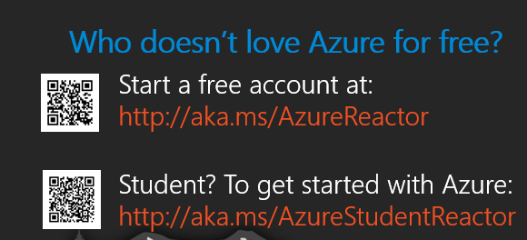

Reactor NYC
@MSFTReactor
#ReactorNYC

