Slide 1


Download the slides at:
https://github.com/NYCDotNetDevs/Slides

Slide 2
Introductions
Co-Organizers
Who’s new?
Brian Jablonsky
Erik Noren

Slide 3
News
Follow us on Twitter: @NYCDotNetDevs
.NET Core 2.2 EOL 12/23/2019 – https://bit.ly/39WHyBu
ASP.NET Core 3.1 – https://bit.ly/304YEZz
.NET Core 3.1 – https://bit.ly/2s9JR37
EF Core 3.1 – https://bit.ly/2FCm8M0
Visual Studio 2019 for Mac 8.4 – https://bit.ly/2NbdsAB

Slide 4
Other NYC Meetings
TBA – NY Pluralsight Study Group “TBD” (https://www.meetup.com/NYPluralsightStudy/)
Tuesday, February 18th – NYC Mobile .NET “TBD” (https://www.meetup.com/nycmobiledev/)
Wednesday, January 22nd – New York ALT.NET Software Development Group “TBD” (https://www.meetup.com/nyaltnet/)
TBA – NYC PowerShell Meetup “TBD” (https://www.meetup.com/NycPowershellMeetup/)

Slide 5
.NET Conf - "Focus on Blazor"
Free – Virtual event
January 14, 2020
https://focus.dotnetconf.net/

Slide 6
Announcements
Upcoming meetings
Tuesday, February 11th – “Carl Franklin’s Blazor Road Show”
Thursday, March 12th – “TBA”
Thursday, April 9th
Thursday, May 14th
Thursday, June 11th
Call for presentations!
Have an idea/topic for a presentation?
Want to give a presentation?
Contact Erik (erik@nycdotnetdevs.com) or Brian (brian@nycdotnetdevs.com), or tweet @NYCDotNetDevs

Slide 7
Announcements
Moved NYC .NET Devs GitHub Slide Repo
https://github.com/NYCDotNetDevs/Slides

Slide 8
Announcements
NYC .NET Developer Member Survey
Watch out for a survey coming in the next few weeks to voice your opinions about the user group. Help us figure out what matters most to you (what topics you’re interested in, what kind of events you want to see, sponsorships, etc).

Slide 9
Announcements
.NET Happy Hour
An event happening around NYC offering members an open discussion with other developers about anything and everything over drinks and snacks.
Planning regular Happy Hours for 2020 – looking for venues and sponsorship!

Slide 10
Announcements
Community Service Hackathon
We’ve been in discussion with the Teaching Artist Project Cohort (TAP Cohort) to develop an interactive platform to serve teaching artists working in public schools and higher education
Announcement for a planning session meeting and a Hackathon coming soon!
Great way to give back to non-profits in NYC-area
Play with new technology
Looks great on your GitHub account/resume

Slide 11
Announcements
Join us on Slack!
Join the .NET Core Slack group
Already 6,800+ members including many core team members
http://tattoocoder.com/aspnet-slack-sign-up/
Join the #nyc-dotnet-developers channel

Slide 12
Announcements
Twitter
Got a blog post or article on .NET you’d like retweeted?
Have a .NET job opportunity you’re looking to fill?
Got something .NET related?
Follow us on twitter, email us (brian@nycdotnetdevs.com or erik@nycdotnetdevs.com) or DM us on Twitter (@NYCDotNetDevs) with your tweet, and we’ll retweet it!

Slide 13
Job Announcements
Looking for a job?
Looking to hire a developer?

Slide 14

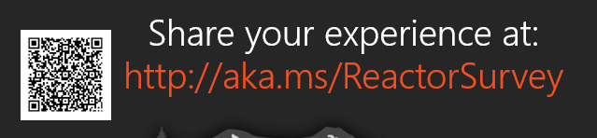
Sponsors
Microsoft Reactor http://microsoftreactor.com
Microsoft Reactors are developer community hubs providing technical events, community networking, and collaboration. They are graciously sponsoring our group in 2019 by providing our meeting space and food! Please fill out the survey at the end of the meeting!

Slide 15

Sponsors
PostSharp http://www.postsharp.net/
Members get a 10% discount on PostSharp licenses (both personal and company orders)
PostSharp is a compiler extension that adds support for patterns to C# and VB. If you’re tired of writing repetitive code, you may want to check it out. It can help you add logging, caching or INotifyPropertyChanged to your codebase without boilerplate, or solve multithreading issues. Customers ranging from Microsoft to Bank of America typically achieve a 15% code reduction thanks to PostSharp.

Slide 16

Sponsors
RevDeBug https://revdebug.com
RevDeBug allows you to inspect past application state and performance profile, even directly from production environments. Trace the root cause of bugs in a matter of seconds, saving your developers' time and sanity.

Slide 17


Sponsors
JetBrains https://jetbrains.com
For over 15 years, JetBrains has strived to make the strongest, most effective developer tools on earth. By automating routine checks and corrections, JetBrains tools speed up production, freeing developers to grow, discover and create.

Slide 18

Oren Novotny
https://twitter.com/onovotny
Executive Director of the .NET Foundation
Senior Program Manager of .NET Team at Microsoft

Slide 19

Reactor NYC
@MSFTReactor
#ReactorNYC
How was your Meeting?

Slide 20

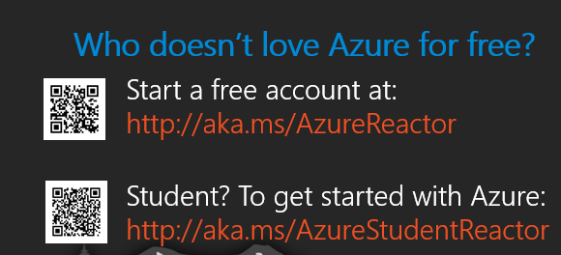

Reactor NYC
@MSFTReactor
#ReactorNYC

