Slide 1
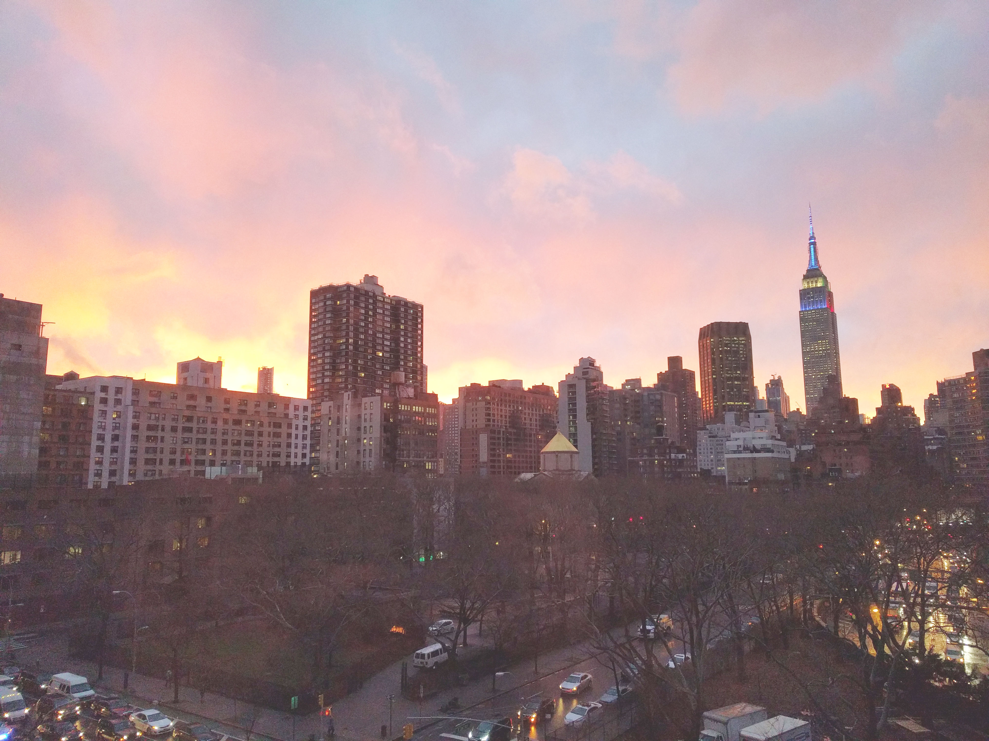

Download the slides at:
https://github.com/NYCDotNetDevs/Slides

Slide 2
Introductions
Co-Organizers
Brian Jablonsky
Erik Noren

Slide 3
News
Follow us on Twitter: @NYCDotNetDevs
.NET 5.0 Preview 2 – https://bit.ly/2xZ8jab
EF Core 5.0 Preview 2 – https://bit.ly/3e5CP2y
ASP.NET Core 5.0 Preview 2 – https://bit.ly/2VfH3w3
F# 5 Preview 1 – https://bit.ly/2Vga62j
.NET Core Uninstall Tool – https://bit.ly/2JT9GcZ
Blazor WebAssembly 3.2.0 Preview 3 – https://bit.ly/3chycAX

Slide 4
Other NYC Meetings
TBA – NY Pluralsight Study Group “TBD” (https://www.meetup.com/NYPluralsightStudy/)
Thursday, May 28th – NYC Mobile .NET “TBD” (https://www.meetup.com/nycmobiledev/)
TBA – New York ALT.NET Software Development Group “TBD” (https://www.meetup.com/nyaltnet/)
Thursday, April 16th – NYC PowerShell Meetup “Skill Up Your PowerShell Using Jupyter Notebooks w/ .NET Core” (https://www.meetup.com/NycPowershellMeetup/)

Slide 5
Announcements
Upcoming meetings
  Thursday, May 14th – TBA – Most likely a virtual event
  Thursday, June 11th – “Implementing Security in ASP.NET Core: Claims, Design Patterns, and Policies”
  Thursday, July 9th – TBA
  Thursday, August 13th – TBA
  Thursday, September 10th – TBA
  Thursday, October 1st – “Hacktoberfest.NET”
Call for presentations!
  Have an idea/topic for a presentation?
  Want to give a presentation?
  Contact Erik (erik@nycdotnetdevs.com) or Brian (brian@nycdotnetdevs.com), or tweet @NYCDotNetDevs

Slide 6
Announcements
.NET Happy Hour – ON HOLD
  An event happening around NYC offering members an open discussion with other developers about anything and everything over drinks and snacks.

Slide 7
Announcements
Community Service Hackathon – ON HOLD
  We’ve been in discussion with the Teaching Artist Project Cohort (TAP Cohort) to develop an interactive platform to serve teaching artists working in public schools and higher education
  Announcement for a planning session meeting and a Hackathon coming soon!
  Great way to give back to non-profits in NYC-area
  Play with new technology
  Looks great on your GitHub account/resume

Slide 8
Announcements
Join us on Slack!
Join the .NET Core Slack group
  Already 6,800+ members including many core team members
  http://tattoocoder.com/aspnet-slack-sign-up/
  Join the #nyc-dotnet-developers channel

Slide 9
Announcements
Twitter
  Got a blog post or article on .NET you’d like retweeted?
  Have a .NET job opportunity you’re looking to fill?
  Got something .NET related?
  Follow us on twitter, email us (brian@nycdotnetdevs.com or erik@nycdotnetdevs.com) or DM us on Twitter (@NYCDotNetDevs) with your tweet, and we’ll retweet it!

Slide 10


Sponsors
Microsoft Reactor
http://microsoftreactor.com
Microsoft Reactors are developer community hubs providing technical events, community networking, and collaboration. They are graciously sponsoring our group in 2019 by providing our meeting space and food! Please fill out the survey at the end of the meeting!

Slide 11

Sponsors
PostSharp
http://www.postsharp.net/
PostSharp is a compiler extension that adds support for patterns to C# and VB. If you’re tired of writing repetitive code, you may want to check it out. It can help you add logging, caching or INotifyPropertyChanged to your codebase without boilerplate, or solve multithreading issues.

Slide 12

Sponsors
RevDeBug
https://revdebug.com
RevDeBug allows you to inspect past application state and performance profile, even directly from production environments. Trace the root cause of bugs in a matter of seconds, saving your developers' time and sanity.

Slide 13


Sponsors
JetBrains
https://jetbrains.com
For over 15 years, JetBrains has strived to make the strongest, most effective developer tools on earth. By automating routine checks and corrections, JetBrains tools speed up production, freeing developers to grow, discover and create.

Slide 14
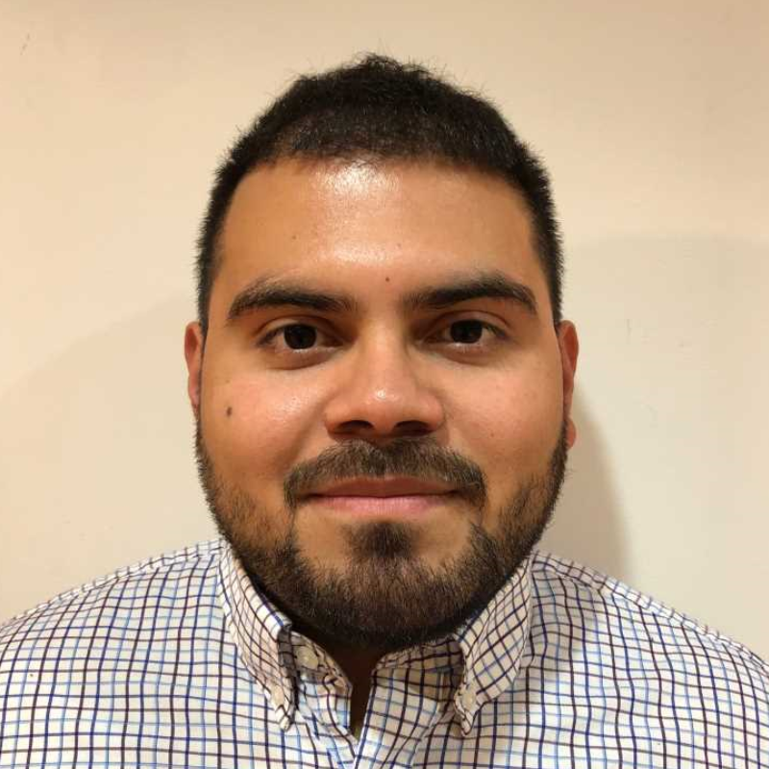
Luis Quintanilla
https://twitter.com/ljquintanilla
Content Developer - Microsoft
Focusing on AI and ML

Slide 15

Reactor NYC
@MSFTReactor
#ReactorNYC
How was your Meeting?

Slide 16

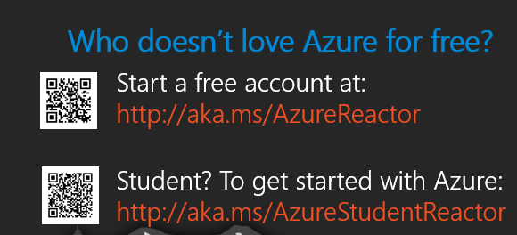

Reactor NYC
@MSFTReactor
#ReactorNYC

