Slide 1
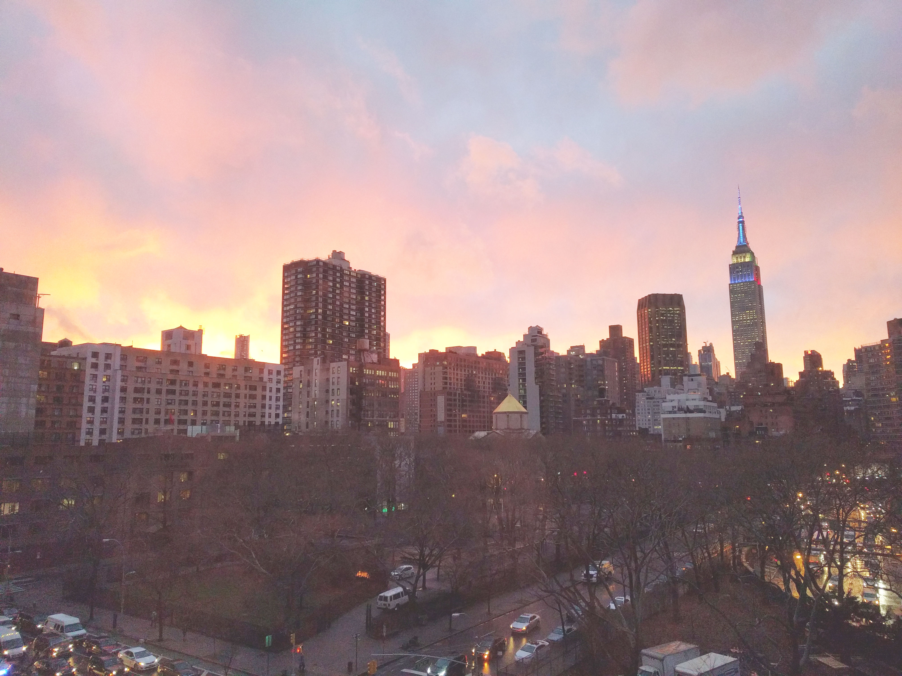

Slide 2
Introductions
Co-Organizers
Interested in becoming a co-organizer? Let me know!
Brian Jablonsky

Slide 3
News
Follow us on Twitter: @NYCDotNetDevs
BUILD 2024 Announcements - https://bit.ly/3wXVLyt
.NET Aspire GA - https://bit.ly/3RtOnSL
VS 2022 17.10 GA - https://bit.ly/455DnR6

Slide 4
Other NYC Meetings
Friday, May 31st – NYC PowerShell Meetup “Release Party - OpenAI meets PowerShell” (https://www.meetup.com/NycPowershellMeetup/)
Thursday, June 20th – NYC AI/LLM/ChatGPT Developers Meetup “GenAI, LLMs and ML” (https://www.meetup.com/nyc-llm-talks/)

Slide 5
.NET Virtual User Group
https://dotnetfoundation.org/community/virtual-user-group
Attend another .NET User Group virtually!
Constantly adding new user group meetings
Replay some of the meetings you might have missed

Slide 6
Upcoming Meetings
Thursday, June TBD – TBA
July – NO MEETING
Thursday, August TBD – TBA
Thursday, September TBD – TBA
Thursday, October TBD – TBA
Thursday, November TBD – “.NET Conf 2024/.NET 9 Release”
Thursday, December TBD – TBA

Slide 7
Announcements
Call for presentations!
Have an idea/topic for a presentation?
Want to give a presentation?
Brian (brian@nycdotnetdevs.com), or tweet @NYCDotNetDevs

Slide 8
Announcements
State of User Group Survey
We’ll be sending out a survey via Meetup to gauge your interest in what you want to see from the user group
Submit your survey anonymously, or add an email address and be entered to win some prizes

Slide 9

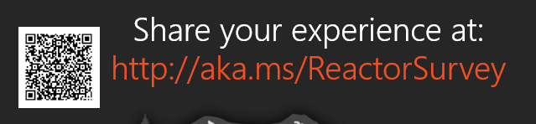
Sponsors
Microsoft Reactor http://microsoftreactor.com
Microsoft Reactors are developer community hubs providing technical events, community networking, and collaboration. They are graciously sponsoring our group in 2019 by providing our meeting space and food! Please fill out the survey at the end of the meeting!

Slide 10

Reactor NYC
@MSFTReactor
#ReactorNYC
How was your Meeting?

Slide 11
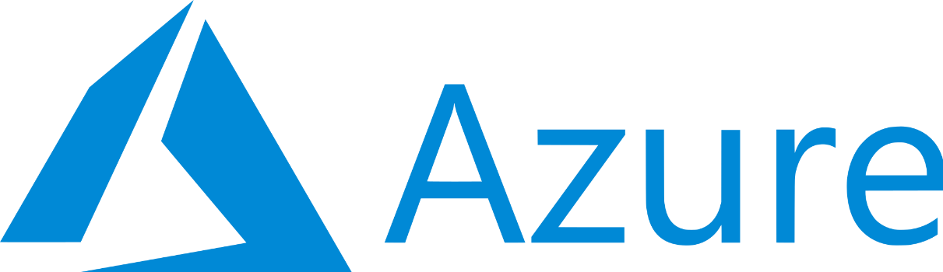
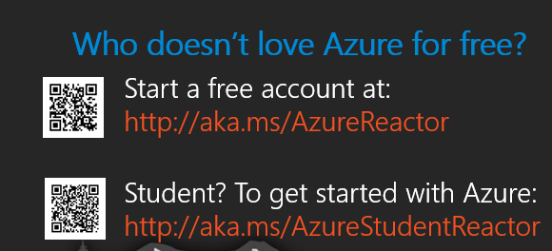

Reactor NYC
@MSFTReactor
#ReactorNYC

