Slide 1
PowerShell Core 6.2 and Beyond
Jeffrey Snover
Microsoft Technical Fellow

Slide 2
Agenda
Investing ahead of conventional wisdom
PowerShell Core 6.2
Demo (Experimental Features)
Look back at PowerShell Core so far
PowerShell 6.3
Support Lifecycle
Windows PowerShell
Call to Action
My New Role

Slide 3
Investing ahead of conventional wisdom
Satya’s “welcome to the room” conversation
PowerShell Core
.NET Core V1
NanoServer
Open Source & Linux
AZ CLI
CloudShell
Stuff we’ll talk about tonight
Our “sacred vow” is at the center of every large decision we make
It might take a few years for you to see it

Slide 4
PowerShell Core 6.2
GA’d
Primarily an engineering system release i.e. “sharpening the tools”
With additional work for stability, bug fixes, and security
PowerShell Team has been automating build/test/release
Moved all of CI and release testing to Azure DevOps
Added “experimental feature” feature

Slide 5
Experimental Features

Slide 6
PowerShell Core 6: What were our goals?
Ubiquitous
Cloud-ready
Community-focused

Slide 7
Ubiquity: How have we done?
Ship on all the platforms
Windows downlevel to 7 and Server 2008R2
macOS 10.12+
Linux: Ubuntu, Debian, CentOS, RHEL, openSUSE, Fedora, Arch, Kali, Alpine
Other architectures: ARM32/64 on Windows and Raspbian Linux
All the package formats
Docker containers, Snap package, .NET global tool
Portable
All you have to do is xcopy!

Slide 8
PowerShell Startups

Slide 9
Cloud-ready: How have we done?
Adopted and/or supported by all major cloud vendors
Azure, AWS, GCP, VMware
Major improvements to Web/REST cmdlets
Significant performance improvements
PowerShell for AutoRest beta
Proof points
Azure Cloud Shell
Azure Functions
Azure Pipelines
AppVeyor CI

Slide 10
Community: How have we done?
PowerShell open-source repository
Holding steady with ~50% PRs coming from the community
5-10 members are heavy contributors in both PRs and issues
87 external contributors opened PRs into PowerShell in the last 30 days
Repo maintainers from the community
PowerShell: @iSazonov, @vors
PSScriptAnalzyer: @bergmeister
VSCode-PowerShell: @rkeithhill, @seeminglyscience, @pcgeek86
DSCResources: @PlagueHO, @johlju, @bgelens, @ld0614
Still working through our backlog of RFCs
1.5 hour weekly meeting with Committee

Slide 11
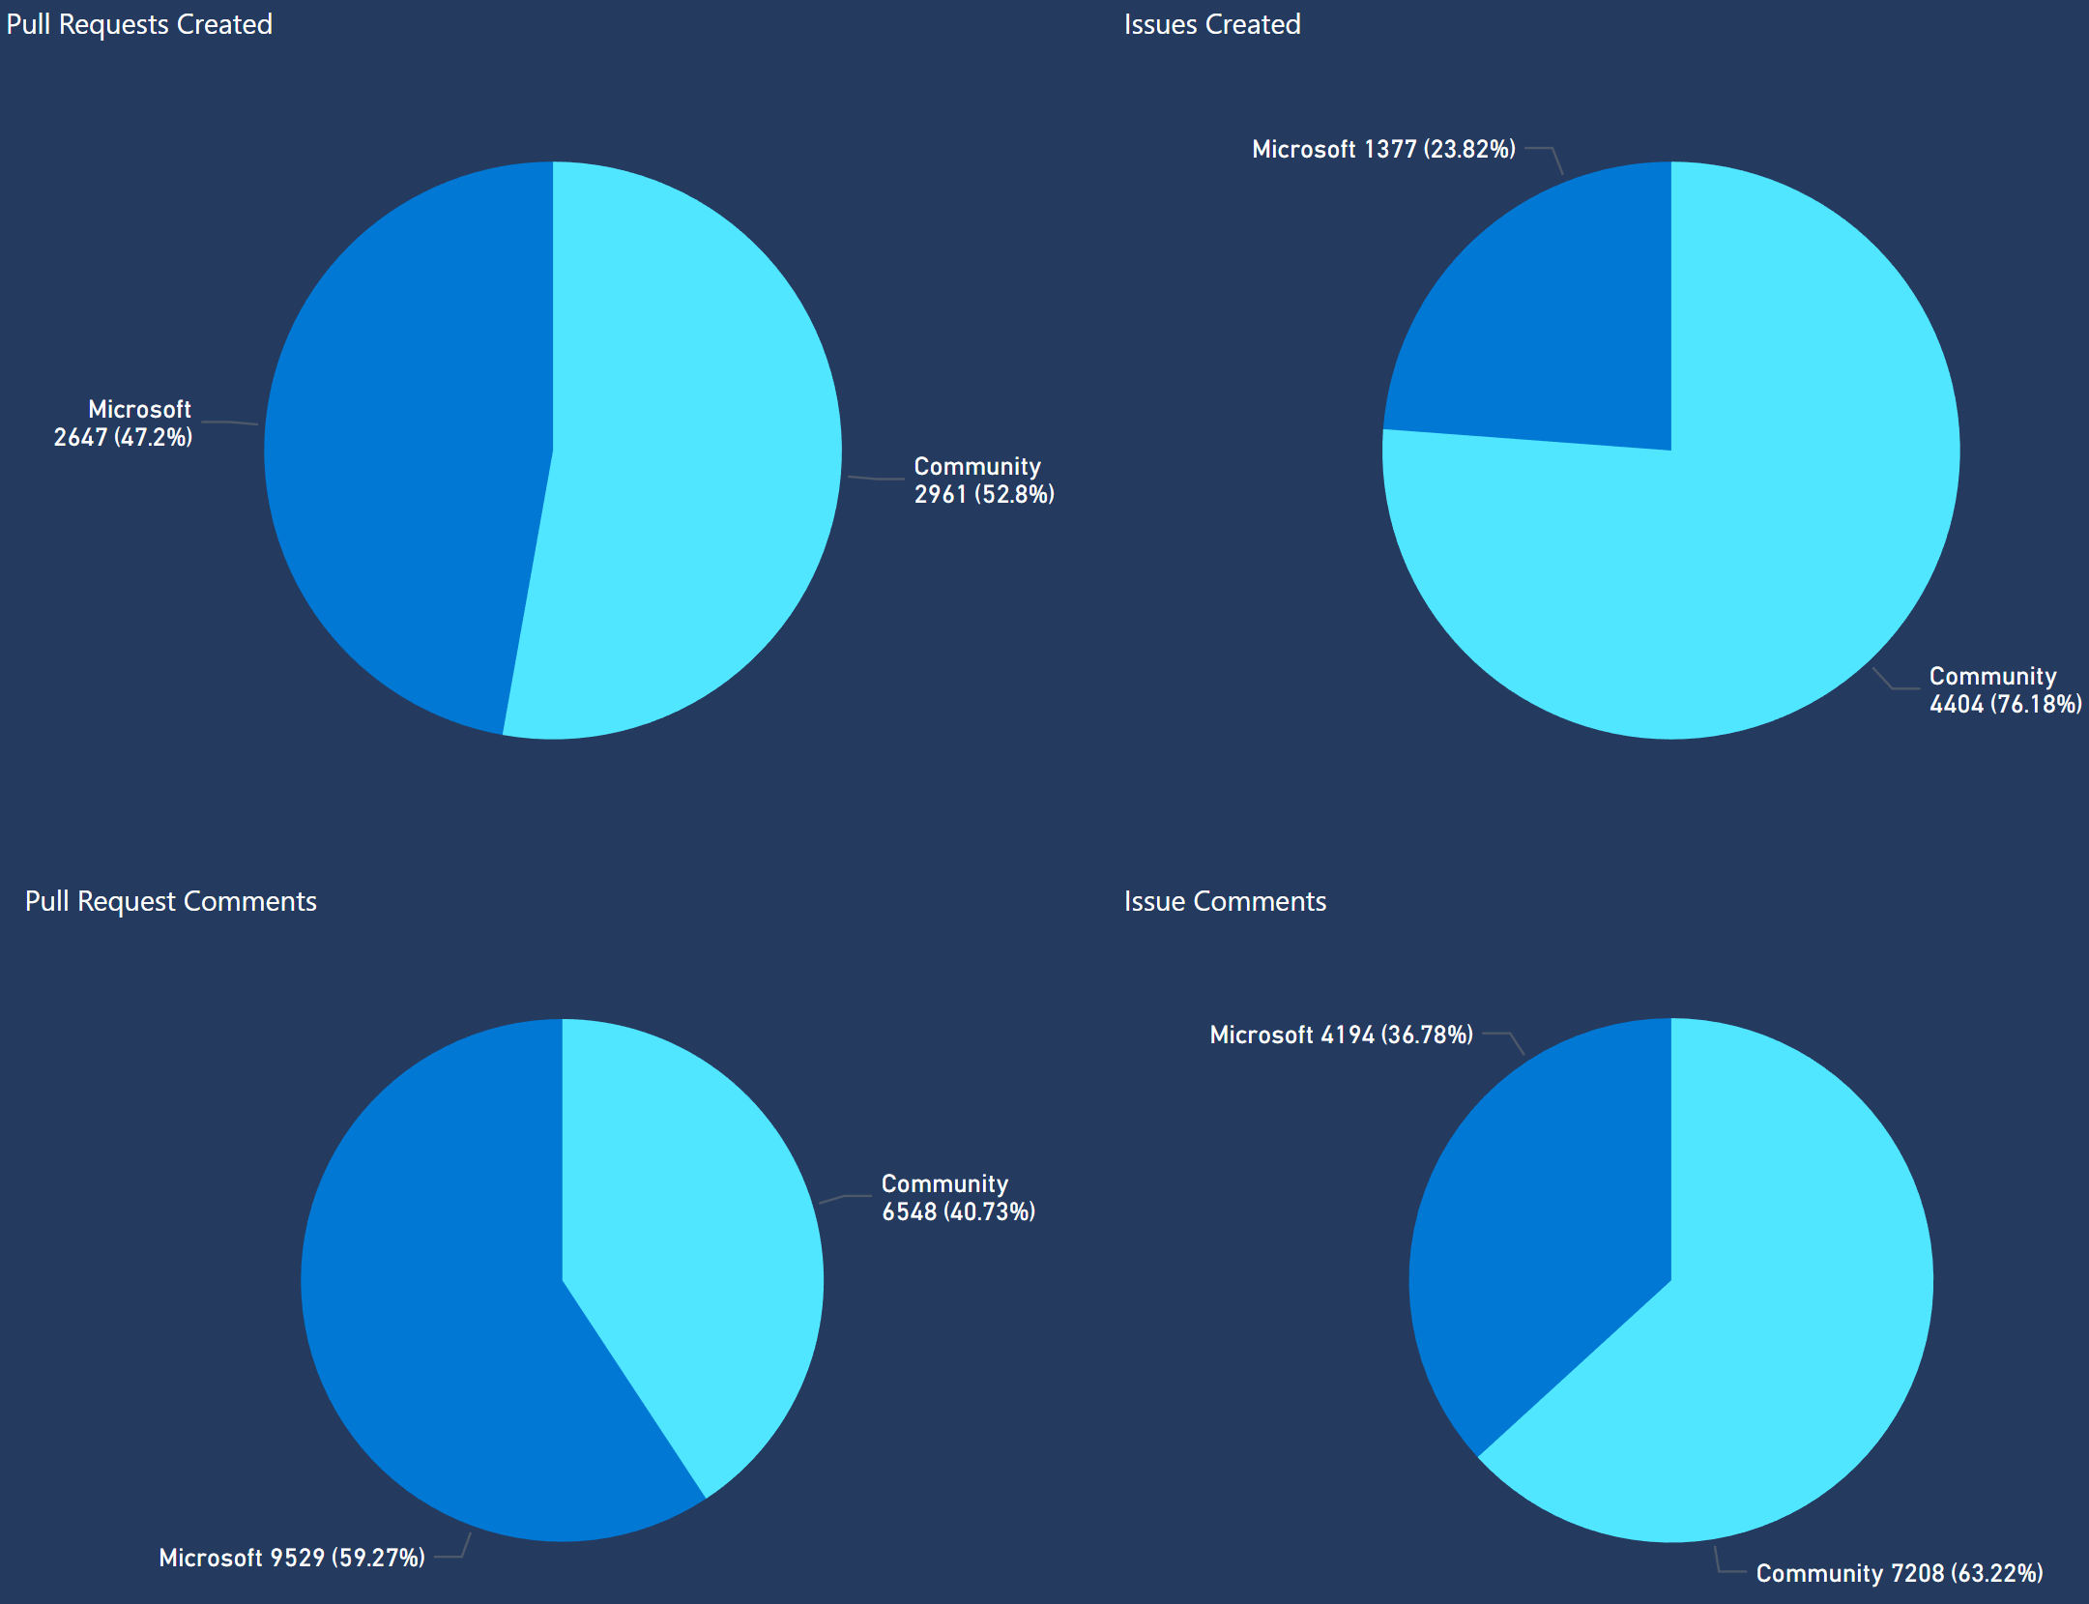
Community in the PowerShell Repository

Slide 12
How can we do better?
Ubiquity
Are there some platforms we’re missing?
What’s keeping you from adopting today?
Cloud-ready
Performance needs to improve more
Working with Azure PowerShell on asynchronous deployments
Community
Desire to record/transcribe committee meetings
Anything else?

Slide 13
What’s next: PowerShell
6.3
7.0
Based on .NET Core 3.0
Gives us WinForms and WPF on Windows
Estimates that we will reach ~90% module compatibility with built-in Windows modules
Support lifecycle will snap to .NET
Will very likely ship in Windows
Blocked on an LTS release of .NET Core 3.x
Will likely start as an optional feature
Will also likely drop “Core” from the marketing name
Why 7.0 instead of 6.3?

Slide 14
.NET Core Support Lifecycle
Version | Original Release Date | Latest Patch Version | Patch Release Date | Support Level | End of Support
.NET Core 2.2 | December 4, 2018 | 2.2.2 | February 12, 2019 | Current
.NET Core 2.1 | May 30, 2018 | 2.1.8 | February 12, 2019 | LTS | At least three years from LTS declaration (August 21, 2018)
.NET Core 2.1 RC1 | May 8, 2018 | n/a | n/a | n/a | June 30, 2018
.NET Core 2.0 | August 14, 2017 | 2.0.9 | July 10, 2018 | EOL | October 1, 2018
.NET Core 1.1 | November 16, 2016 | 1.1.11 | February 12, 2019 | Maintenance | June 27 2019
.NET Core 1.0 | June 27, 2016 | 1.0.14 | February 12, 2019 | Maintenance | June 27 2019
.NET Core 1.0.0 RC2 | May 16, 2016 | n/a | n/a | EOL | September 27, 2016
.NET Core 1.0.0 RC1 | February 15, 2016 | n/a | n/a | EOL | July 16, 2016

Slide 15
Windows PowerShell
No plans for major feature work
Some changes have been made for accessibility
UserVoice
If issues are still relevant to Core, please submit them as GitHub Issues
May go read-only in the future
ISE won’t work against Core
Investing in Visual Studio Code

Slide 16
Call to action
Update to the latest release of PowerShell
Talk to us!
Tell us how you’re using PowerShell Core
If you’re not using PowerShell Core today, why not?
Join our Community Calls at aka.ms/PSCommunityCall
If you haven’t already, check out our contribution guide
Check out our other open-source projects
PowerShell-RFC for design and planning documents
VS Code extension and PowerShell Editor Services
PSScriptAnalyzer

Slide 17
My New Role
Architect for the Office 365 Intelligent Substrate
Building a platform to enable an AI ecosystem on top of O365
Most important new technology on our most important asset

Slide 18
Questions

