Slide 1


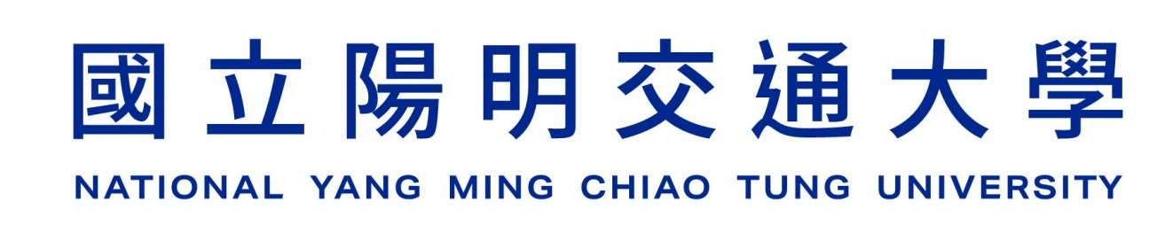
NVIDIA Sionna: An Open-Source Library for 6G Physical-Layer Research
2025/3/14
Presenter：Chia-Chuan Chiu
Adviser：Li-Chun Wang
Class GitHub: https://github.com/s87315teve/sionna_introduction
NVIDIA website: https://developer.nvidia.com/sionna
Sionna official tutorial: https://nvlabs.github.io/sionna/index.html
Sionna GitHub: https://github.com/NVlabs/sionna

Slide 2
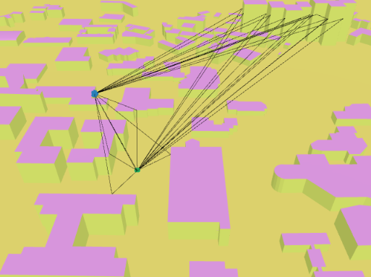
What is Sionna?
Open-source Wireless Communication Simulation Framework
Built upon TensorFlow, designed for developing, analyzing, and validating wireless communication algorithms
Particularly suited for research and development in modern wireless standards such as 5G/6G

Slide 3
Key Features of Sionna
Modular & Flexible Design
Modular architecture that can be easily customized or extended.
Allows quick prototyping of complex communication systems.
Integration with Deep Learning
Parameters are constructed using TensorFlow
High Computational Efficiency
Accelerated by GPU computing

Slide 4
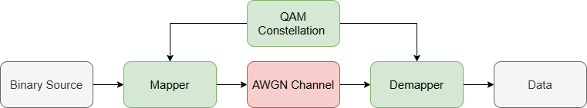
Key Features of Sionna
Modular & Flexible Design
Modular architecture that can be easily customized or extended.
Allows quick prototyping of complex communication systems.
Integration with Deep Learning
Parameters are constructed using TensorFlow
High Computational Efficiency
Accelerated by GPU computing

Slide 5
Key Features of Sionna
Modular & Flexible Design
Modular architecture that can be easily customized or extended.
Allows quick prototyping of complex communication systems.
Integration with Machine Learning
Parameters are constructed using TensorFlow
Users can easily implement machine learning models.
High Computational Efficiency
Accelerated by GPU computing

Slide 6
Key Features of Sionna
Modular & Flexible Design
Modular architecture that can be easily customized or extended.
Allows quick prototyping of complex communication systems.
Integration with Machine Learning
Parameters are constructed using TensorFlow
Users can easily implement machine learning models.
High Computational Efficiency
Accelerated by GPU computing
Change to AI model
AI model

Slide 7
Key Features of Sionna
Modular & Flexible Design
Modular architecture that can be easily customized or extended.
Allows quick prototyping of complex communication systems.
Integration with Machine Learning
Parameters are constructed using TensorFlow
Users can easily implement machine learning models.
High Computational Efficiency
Accelerated by GPU computing

Slide 8
Basic usage of Sionna

Slide 9
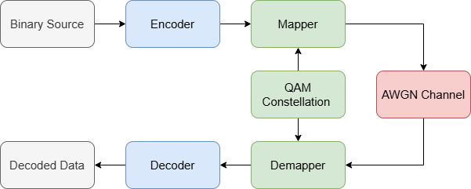
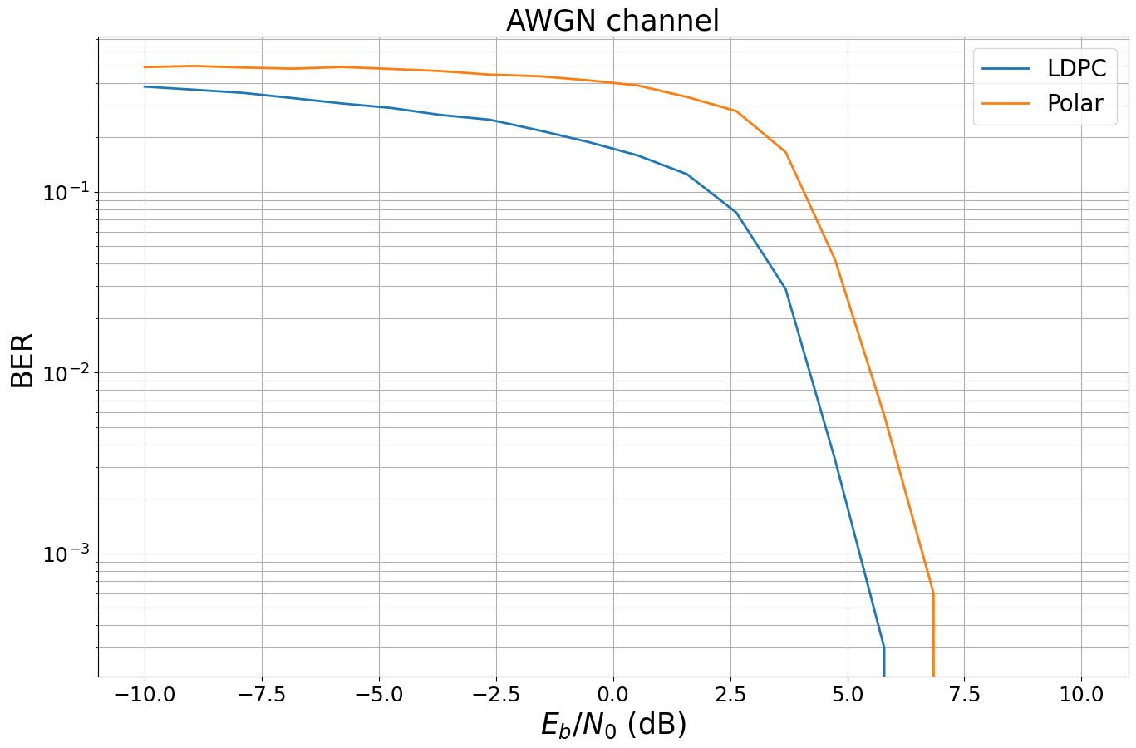
Case 1 : Link-level simulation
Channel coding comparison: LDPC vs Polar

Slide 10
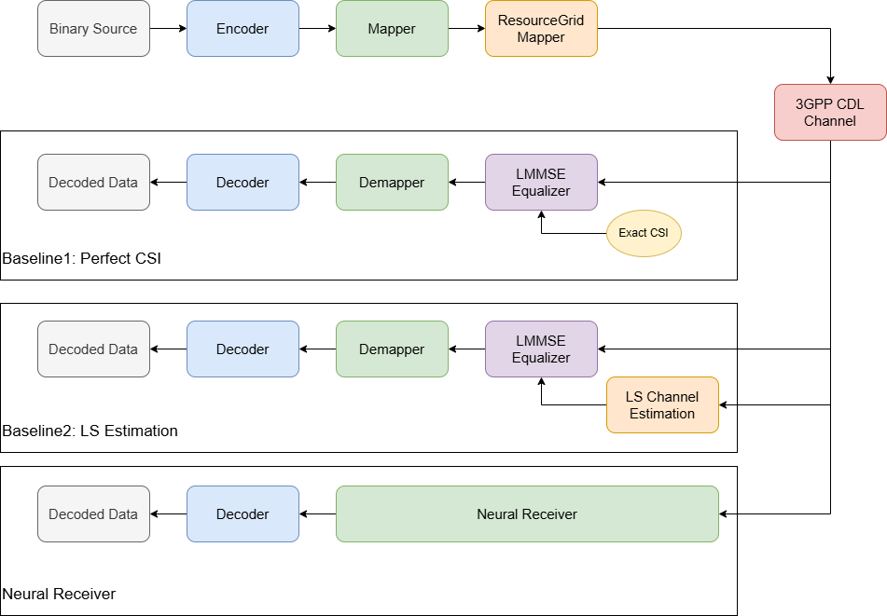
Case 2 : Neural receiver

Slide 11
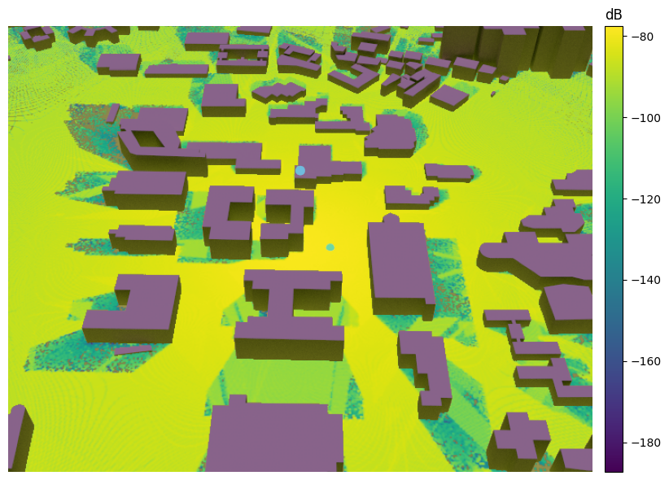
Case 3 : Ray tracing
Ray tracing simulation in NYCU campus

