Slide 1


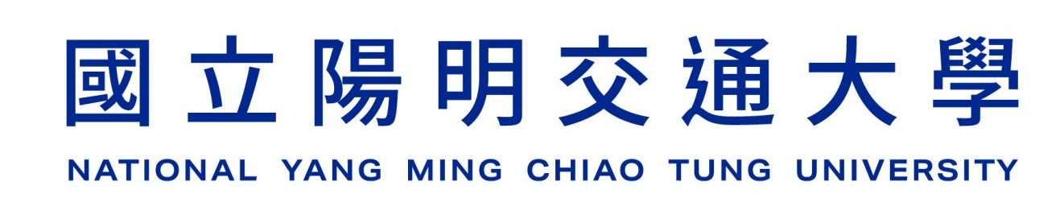
Sionna介紹
2025/?/?
Presenter：Chia-Chuan Chiu
Adviser：Li-Chun Wang
NVIDIA website: https://developer.nvidia.com/sionna
Sionna tutorial: https://nvlabs.github.io/sionna/index.html
Sionna GitHub: https://github.com/NVlabs/sionna

Slide 2
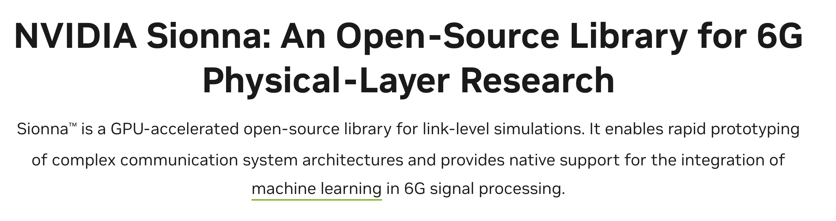
What is Sionna?

Slide 3
Benefits of Sionna
Native AI support
Open-Source

Slide 4
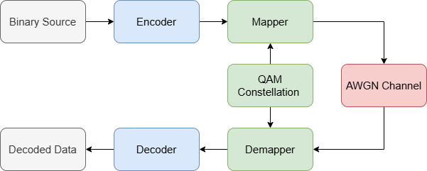
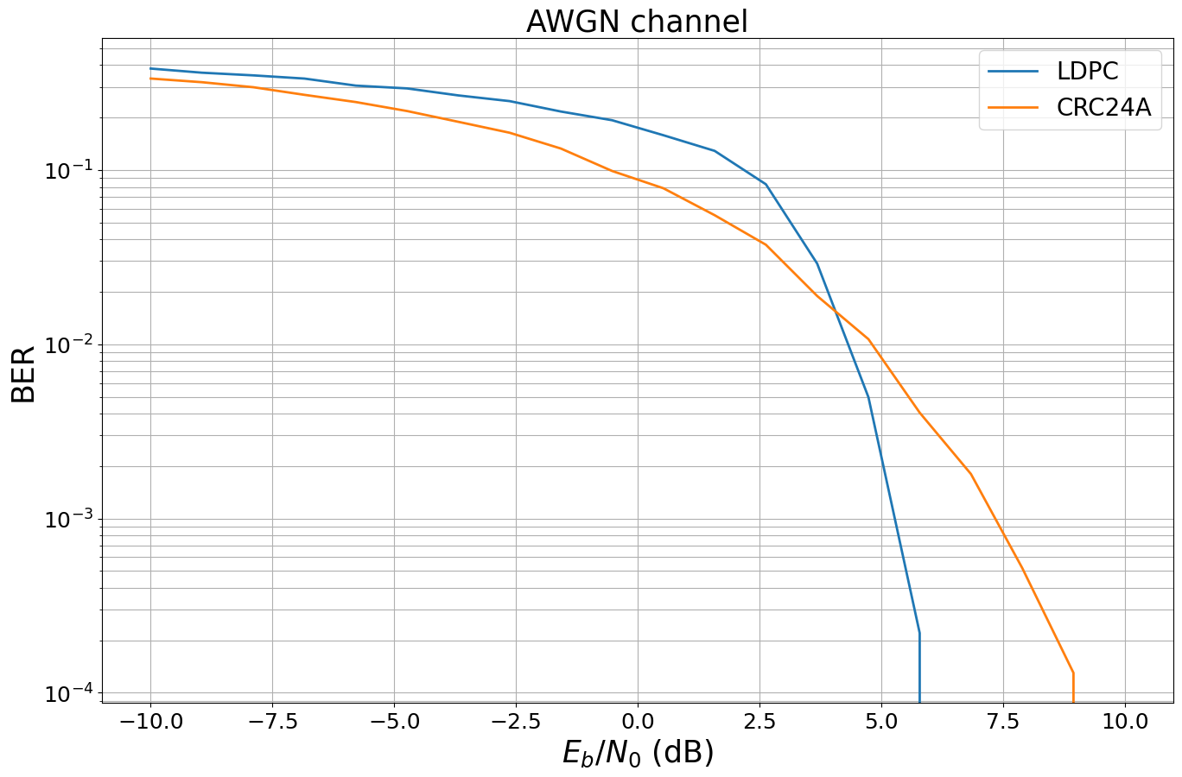
Case 1 : Link-level simulation

Slide 5
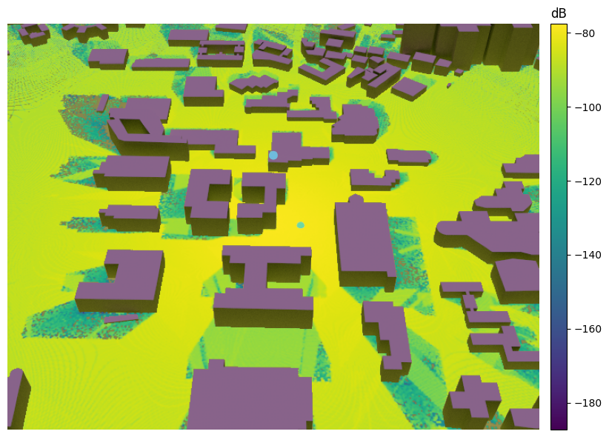
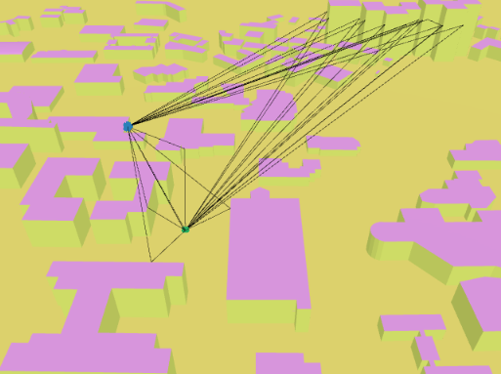
Case 2 : Ray tracing

Slide 6
Case 3 : Neural receiver

