Slide 1
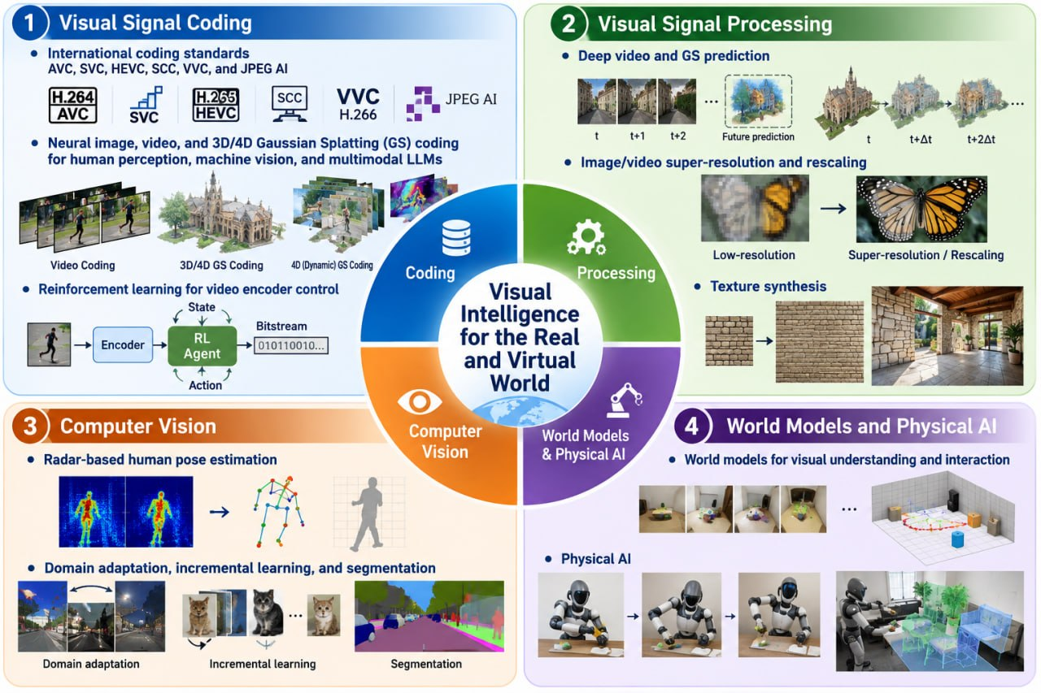
Research Topics

Slide 2

Research Collaborators

Slide 3











Job Opportunities

Slide 4

Welcome to Join Us!

