Slide 1
Multimedia Architecture and Processing Laboratory (MAPL)
Dr. Wen-Hsiao Peng
wpeng@cs.nctu.edu.tw
https://mapl.cs.nycu.edu.tw
Computer Science Department
National Yang Ming Chiao Tung Univ. (NYCU), Taiwan
September 19, 2024

Slide 2

About Me
Director, Institute of Data Science, NYCU, Taiwan
Director, Computer Vision Research Center, NYCU ’21-’24
Associate Director, Joint AI Research Labs, Univ. of Washington, USA and NYCU, Taiwan since ’21
Visiting Professor, IBM T. J. Watson Research, New York, USA, ’15-’16
Intern, Intel Microprocessor Research Lab, California, USA, ’00-’01
Delegate, ISO/IEC Moving Picture Experts Group (MPEG), ’04 – Pres.
Ph.D., Institutes of Electronics Engineering, NCTU, Taiwan, ’05
(Visit https://sites.google.com/g2.nctu.edu.tw/wpeng for more details)

Slide 3
Professional Activities in IEEE
Editor-in-Chief, the IEEE Journal on Emerging and Selected Topics in Circuits and Systems (JETCAS), ’24 – ’25
Chair, the IEEE CASS Visual Signal Processing and Communications (VSPC) Technical Committee, ’21 – ’22
Distinguished Lecturer, IEEE CASS, ’22 – ’23; APSIPA, ’17-’18
Associate Editor-in-Chief/SEB Member/Guest Editor, IEEE Journal on Emerging and Selected Topics in Circuits and Systems (JETCAS), ’16 – Pres.
(Senior) Associate Editor, IEEE Transactions on Circuits and Systems for Video Technology (TCSVT), ’19 – ’20
Guest Editor, IEEE Transactions on Circuits and Systems II (TCAS-II): Express Briefs, ’19
Senior Member of the IEEE since ’13
Area Chair/Technical Program Chair/Publication Chair/Track Chair/Session Chair for IEEE and APSIPA conferences

Slide 4

JETCAS

Slide 5




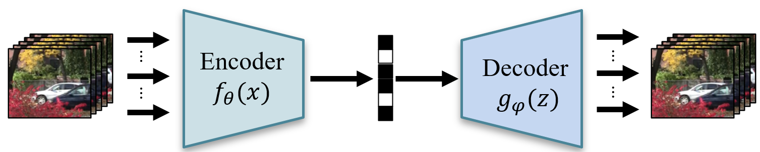




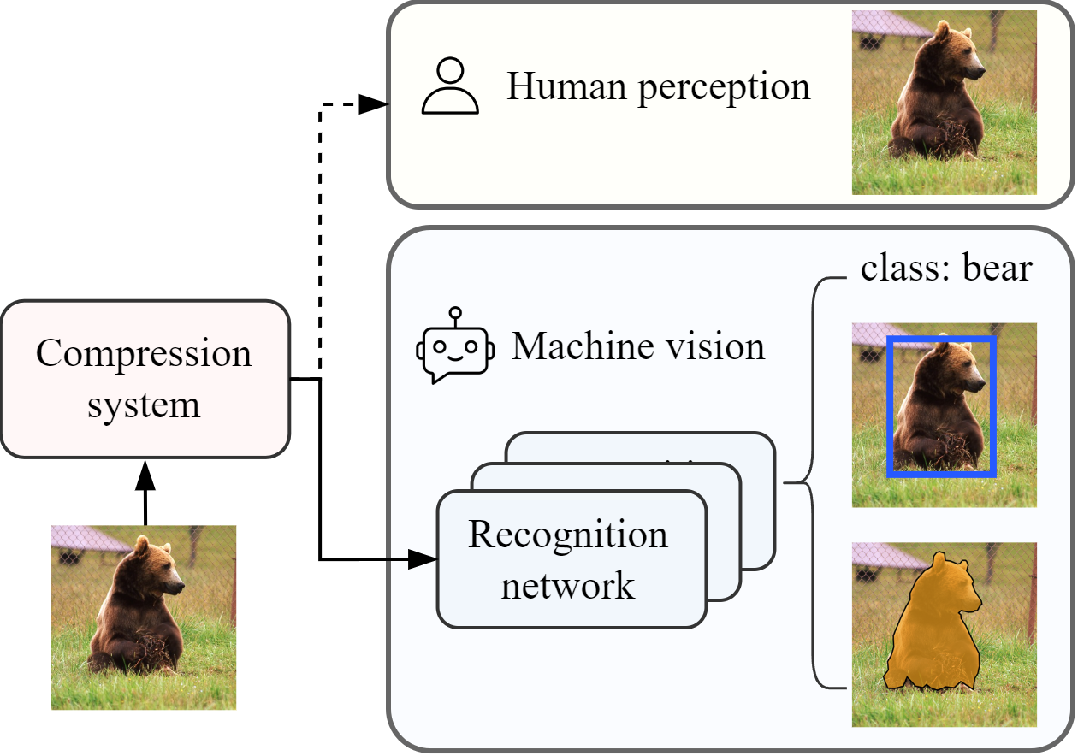



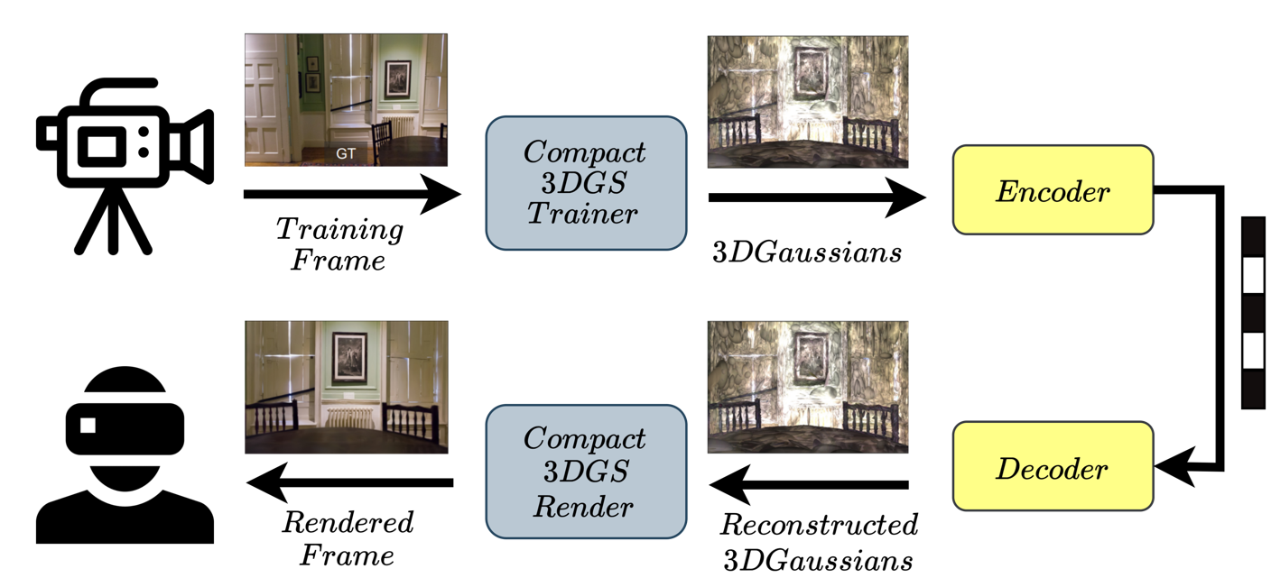


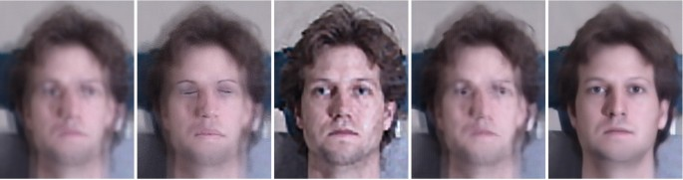
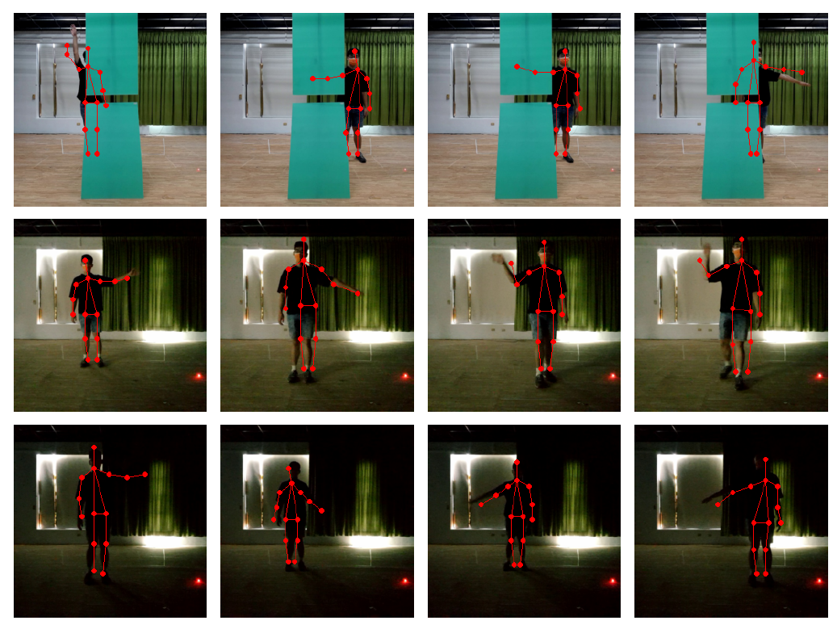
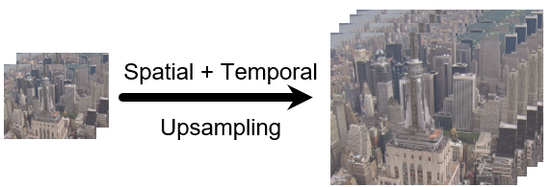
Visual Signal Representation, Processing and Understanding
Learned Image/Video Compression
Coding for Machine
3D View
Rendering & Coding
Learned
Compression
+
Signal Processing
Image/Video
Quality Enhancement
Radar-based
Human Pose Estimation
Notes:
This slide gives you a high-level idea of what my research group has been doing.
Our research touches upon several areas related to visual signal representation, processing and understanding.
For example, we invested a lot in end-to-end learned image/video coding for both 2-D and 3-D images and/or video.
More recently, we look into an interesting and emerging area known as image/video coding for machines.
In the past, image/video coding was designed primarily for human perception.
But, the industry is seeing a rising demand for image/video coding for machine perception.
They want to transmit images or video in a form suitable for various recognition or computer vision tasks.
We also have some works on using mmWave Radars for Human Pose Estimation.
This kind of technology allows human pose estimation to be done in adversarial environments, such as under low-light conditions.

Slide 6
Selected Publications
Learning-based Image and Video Compression
  Learning-based Image/Video Compression (OJCAS’21; ECCV’22; TCSVT’23; PCS’24, CVPR’23, TCSVT’24)
  Deep Learning-assisted Video Compression (DCC’21)
  Image/Video Coding for Machines (ICCV’23)
Visual Signal Processing and Computer Vision
  Continuous-scale Video Super-resolution (ICCV’23)
  Radar-based Human Pose Estimation (WACV’23, BMVC’24)
  Video Rescaling (CVPR’21)
  Reinforcement Learning-based Video Prediction (ICCV’19)
  Incremental Learning (ACCV’21)
  Weakly Supervised Semantic Segmentation (ICME’21)
  Domain Adaptation for Semantic Segmentation (CVPR’19)
Robotics
  Autonomous drone (VCIP’21)
Notes:
My main conferences are those popular conferences in the field of computer vision and signal processing, including CVPR, ICCV, ECCV.

Slide 7
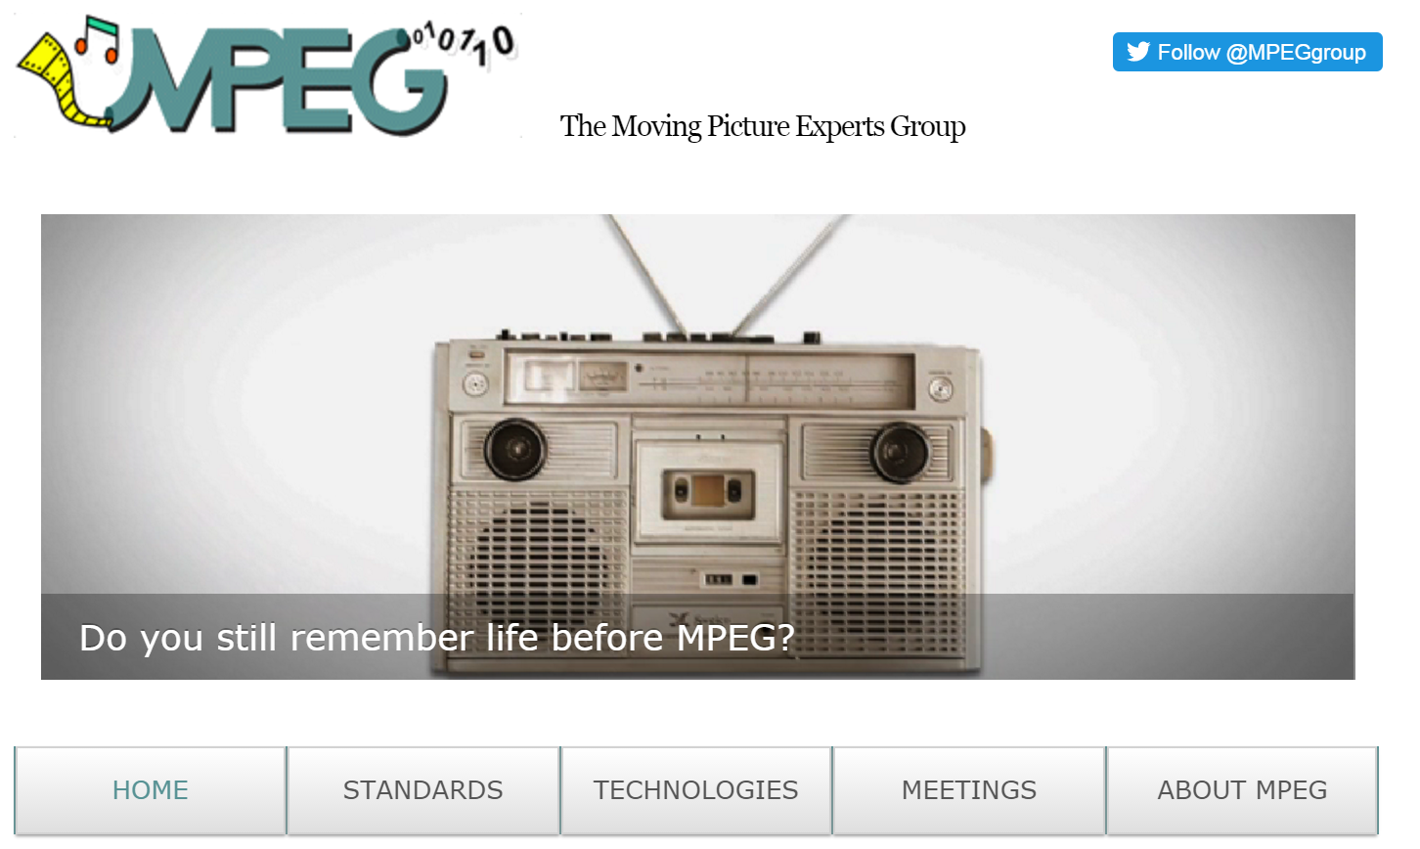
Active Contributor to ISO & ITU-T Video Standards
Notes:
Notably, our group used to be a main contributor to this ISO/IEC & ITU-T standards committee.
We have a number of technical proposals adopted into the international standards.

Slide 8
Our Collaborators
Academia
  Leibniz Universität Hannover, Germany
  University of Brescia, Italy
  Yokohama National University, Japan
  Federal University of Pelotas - UFPel, Brazil
  University of Washington, USA
  Poznan University of Technology, Poland
Industry
  MediaTek, Taiwan
  Qualcomm, USA
Notes:
Also, my research group has been working with people from around the world.
We publish papers together, apply for joint research projects, and send students to each other’s lab.

Slide 9
Student Internship
2024 Internship with University of Brescia, Italy
2024 Internship with Leibniz Universität Hannover, Germany
2020 Internship with University of Washington, USA
2019 Internship with Poznan University of Technology, Poland
2019 Internship with Max Planck Institute, Germany
2017 Student Exchange Program with RWTH Aachen University, Germany
2015 Internship with InterDigital, San Diego, USA
2014 Internship with INRIA, France
Notes:
Also, my research group has been working with people from around the world.
We publish papers together, apply for joint research projects, and send students to each other’s lab.

Slide 10
End-to-End Learned Image and Video Coding: Recent Advances and Beyond

Slide 11
Deep Compression Papers
Deep image/video compression is attracting attention
150+ papers on deep image compression since 2017
  Most adopt the autoencoder-based framework with hyperprior
40+ papers on deep video compression since 2019
  Potential techniques are still being researched
  Pixel/feature-domain residual and conditional coding are popular approaches
Notes:
End-to-end learned image and video compression is now a hot research area.
The first deep image compression paper appeared in 2017.
Since then, there have been about 150 papers published on this topic.
Most works adopt the autoeocoder-based framework with hyperprior.
In comparison, deep video compression is still being researched;
Up to now, there have been about 40 papers on deep video compression.
Pixel/feature-domain residual and conditional coding are popular approaches
These numbers are still growing fast.

Slide 12
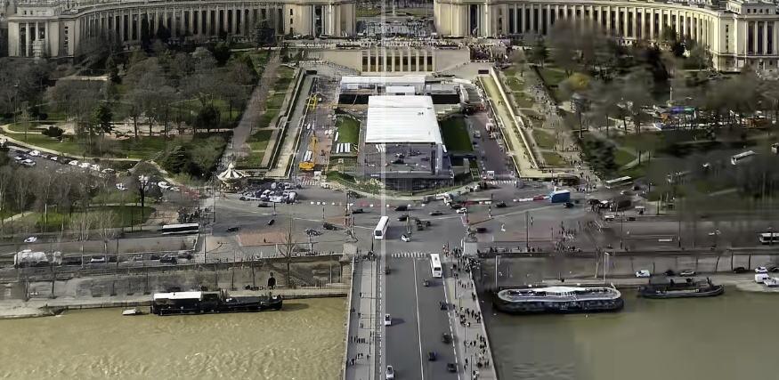
Neural Networks for Image Compression?
Neural networks are good at synthesizing image detail
Easily trained with any differentiable quality metric
Learned
BPG (HEVC Intra)
https://hific.github.io/
Source: Mentzer et al., “High-Fidelity Generative Image Compression (HIFIC),” NeurIPS 2020
Notes:
So, why should we use NN for compression?
I think this NeurIPS 2020 paper from Google gives a clear answer.
At the same bit rate, you can see that the learned codec preserve more image detail than the traditional codec.
We all know that neural networks are good at synthesizing image detail.
Moreover, they can be easily adapted to any differentiable quality metric.
As such, learned codecs can find applications in various domains.

Slide 13
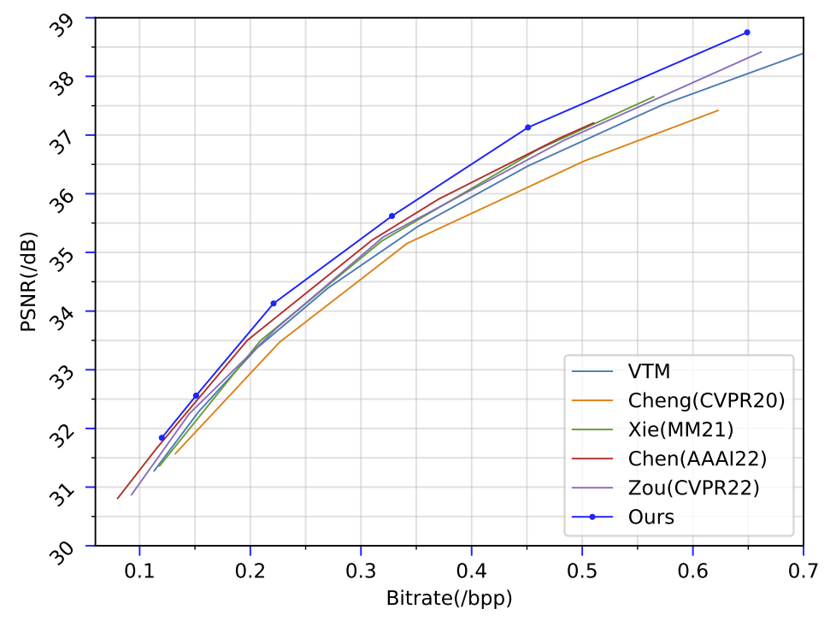
How Good is Learned Image Compression?
CLIC Professional Validation dataset
CVPR’23
VVC Intra (VTM)
Top performer (CVPR’23): 11% bit rate saving over VVC Intra
Source: Liu et al., “Learned Image Compression with Mixed Transformer-CNN Architectures,“ CVPR 2023
Notes:
This slide compares the rate-distortion performance of the learned codecs with VVC Intra, which is the best traditional codec.
The horizontal axis is bits-per-pixel, and the vertical axis is PSNR measured in the RGB domain.
We can see that the best learned codec now outperforms VVC Intra.
The bit rate saving relative to VVC Intra is about 11%.

Slide 14
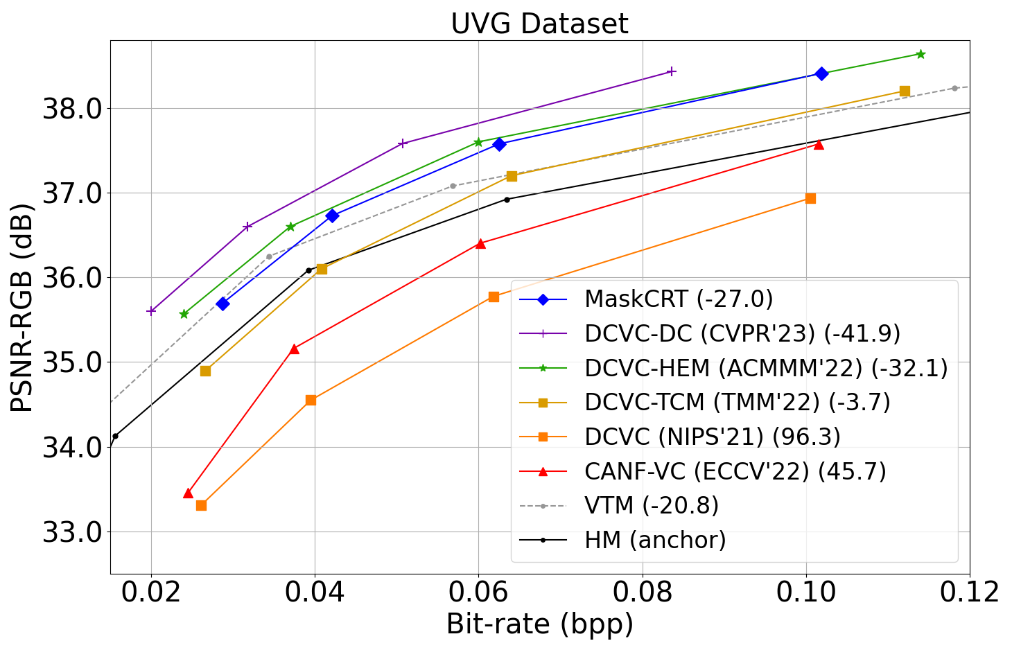
How Good is Learned Video Compression?
DCVC-DC (CVPR’23)
VVC (LDP)
< 2 years!
Intra Period = 32
Top performer (CVPR’23): 41.9% bit rate saving over HM LDP
Notes:
In the video domain, the progress of learned video codecs is also very remarkable.
In less than 2 years, the coding performance is improved considerably.
Here the black line corresponds to the rate-distortion performance of VVC.
Now, there are a number of learned codecs outperforming VVC in terms of PSNR-RGB.

Slide 15
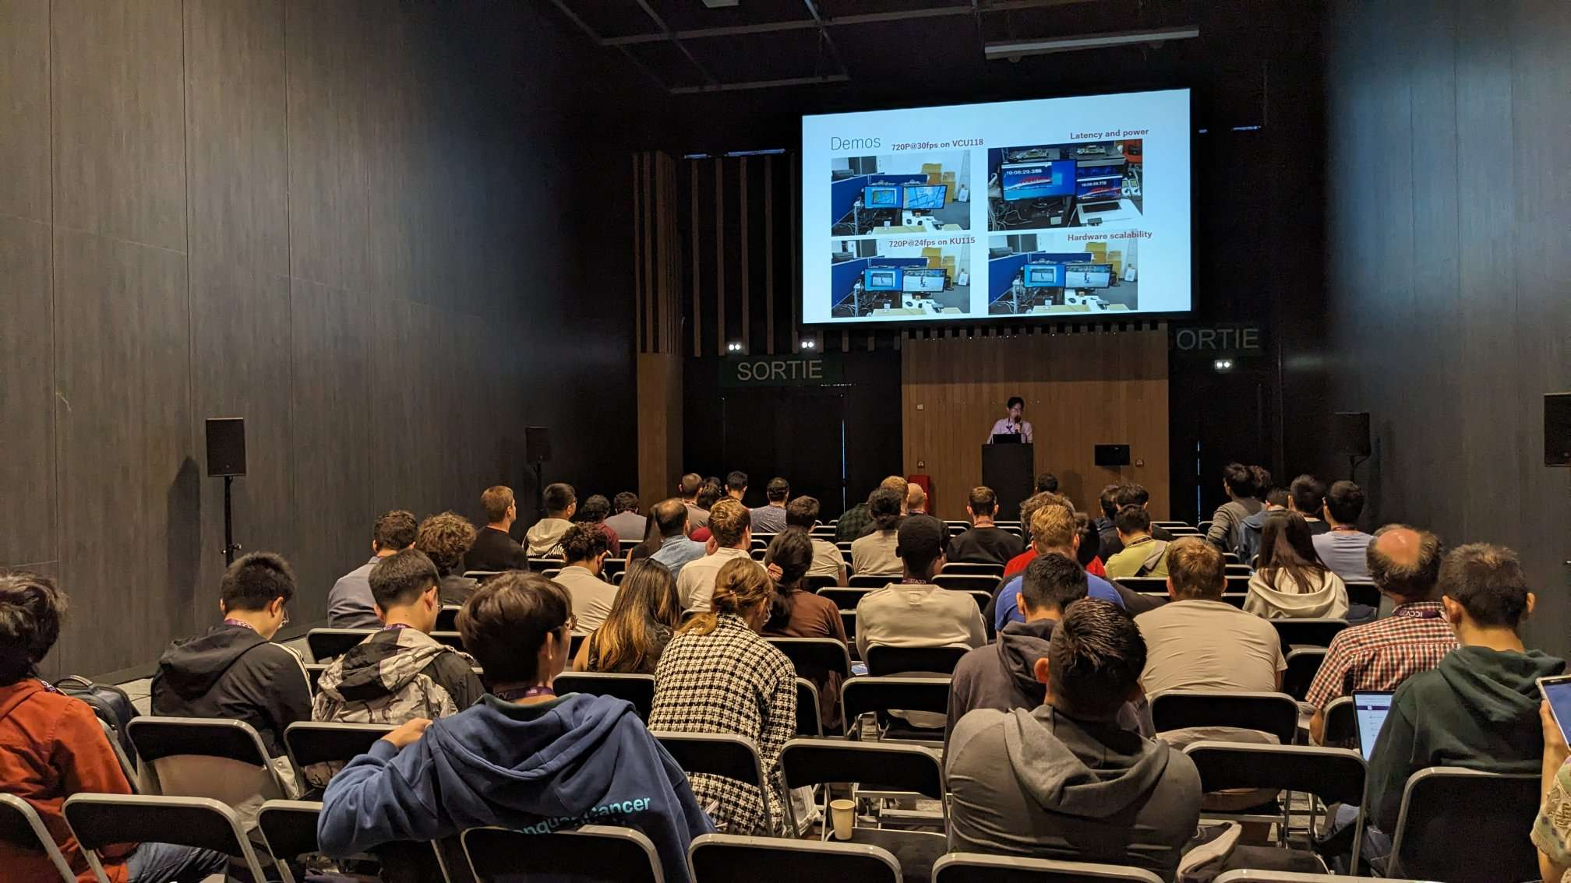
Tutorial on Learned Image/Video Coding at ICCV’23
https://nycu-mapl.github.io/ICCV2023_Learned_Image_and_Video_Compression_Tutorial/

Slide 16
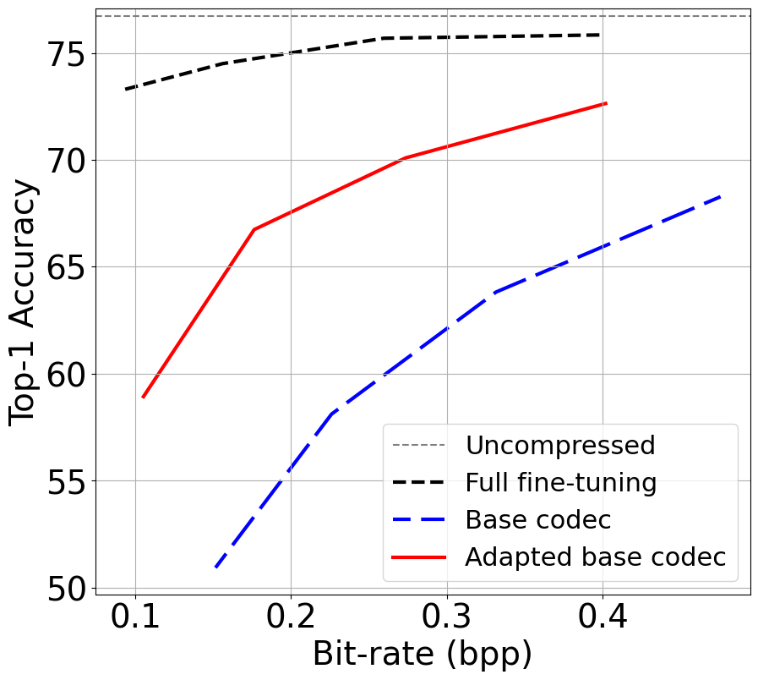
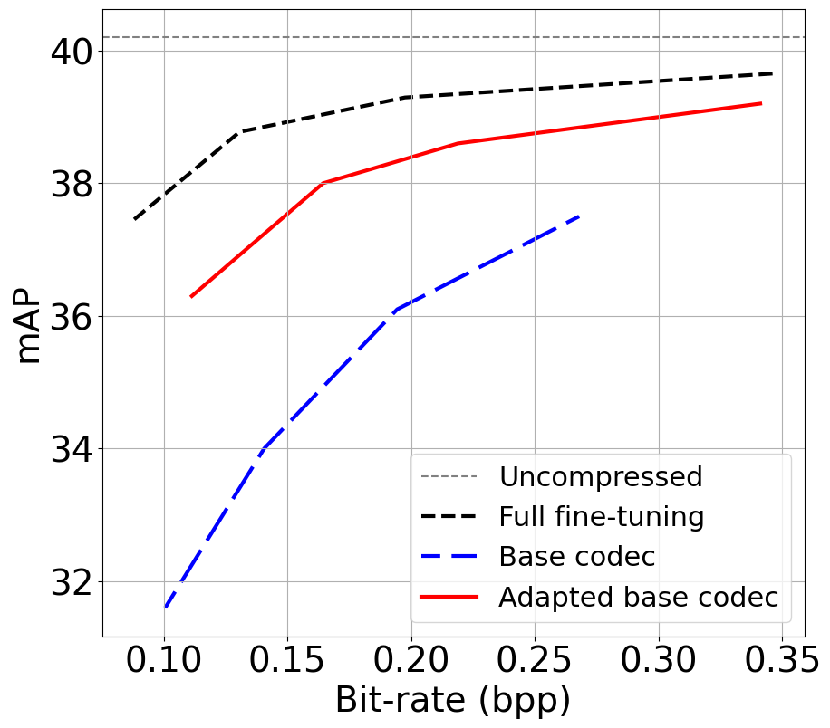
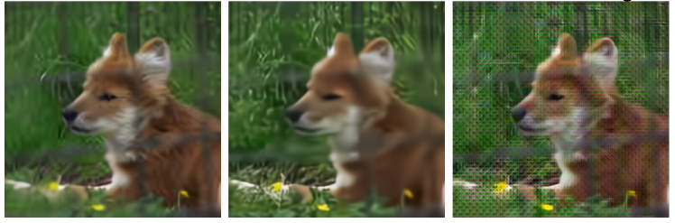
Image Coding for Machine Perception
Classification
Object Detection
Full finetuning
Full finetuning
Ours
Ours
Base (for human)
Base (for human)
Base codec (for human)
Ours (for machine)
Full finetuning (for machine)

Slide 17
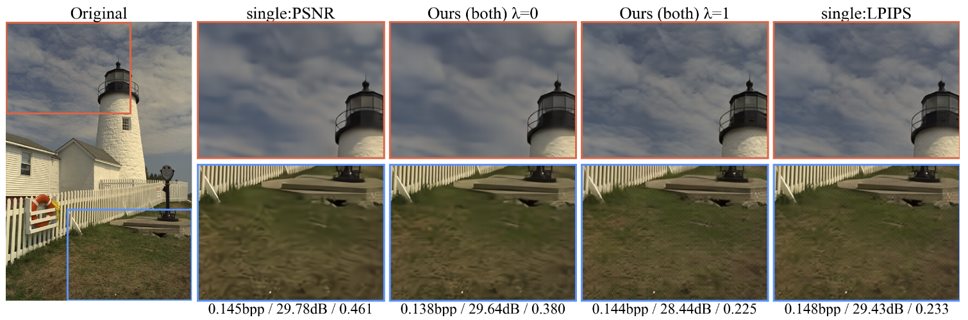
Image Coding with a Variable Quality Objective
PSNR
Variable Quality Objective (PSNR)
Variable Quality Objective (LPIPS)
LPIPS
Codecs trained for ONE quality metric
Codecs trained for MULTIPLE quality metrics
Notes:
Here is another example, which shows how flexible the learned codec can be.
This is our recent work, in which we train a codec that is able to optimize the quality of the decoded image according to different quality metrics.
Normally, people train separate models using different quality metrics, such as PSNR and LPIPS.
What is special about our work is that it is able to switch between different quality metrics using only one single network.

Slide 18
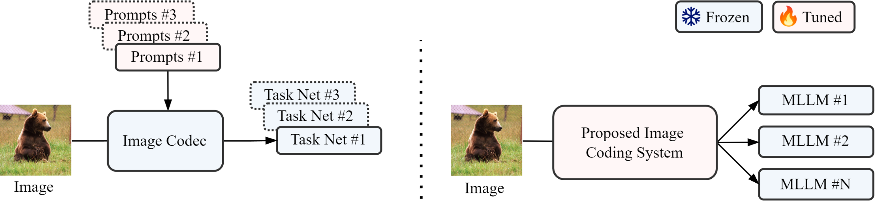
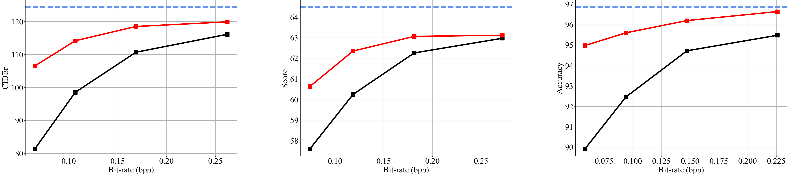
Learned Image Coding for Multimodal Large Language Models (MLLMs)
Captioning
VQA
Few-shot Classification
Notes:
End-to-end learned image and video compression is now a hot research area.
The first deep image compression paper appeared in 2017.
Since then, there have been about 150 papers published on this topic.
Most works adopt the autoeocoder-based framework with hyperprior.
In comparison, deep video compression is still being researched;
Up to now, there have been about 40 papers on deep video compression.
Pixel/feature-domain residual and conditional coding are popular approaches
These numbers are still growing fast.

Slide 19
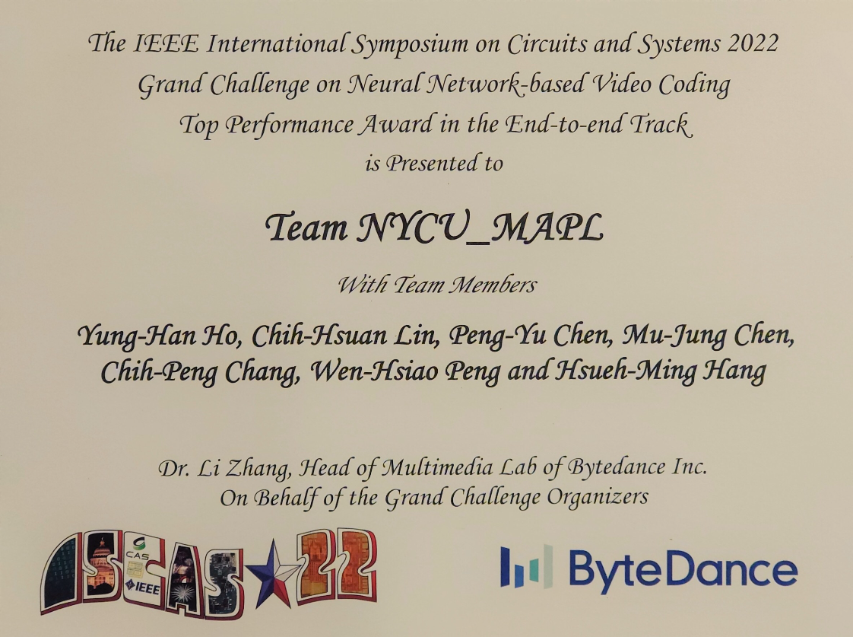
IEEE ISCAS’22 Grand Challenge
Notes:
This slide presents the RD performance of our video coding scheme.
You can see clearly that our scheme outperforms x265 by a significant margin.
Its superiority over the other SOTA baselines is also quite obvious.

Slide 20
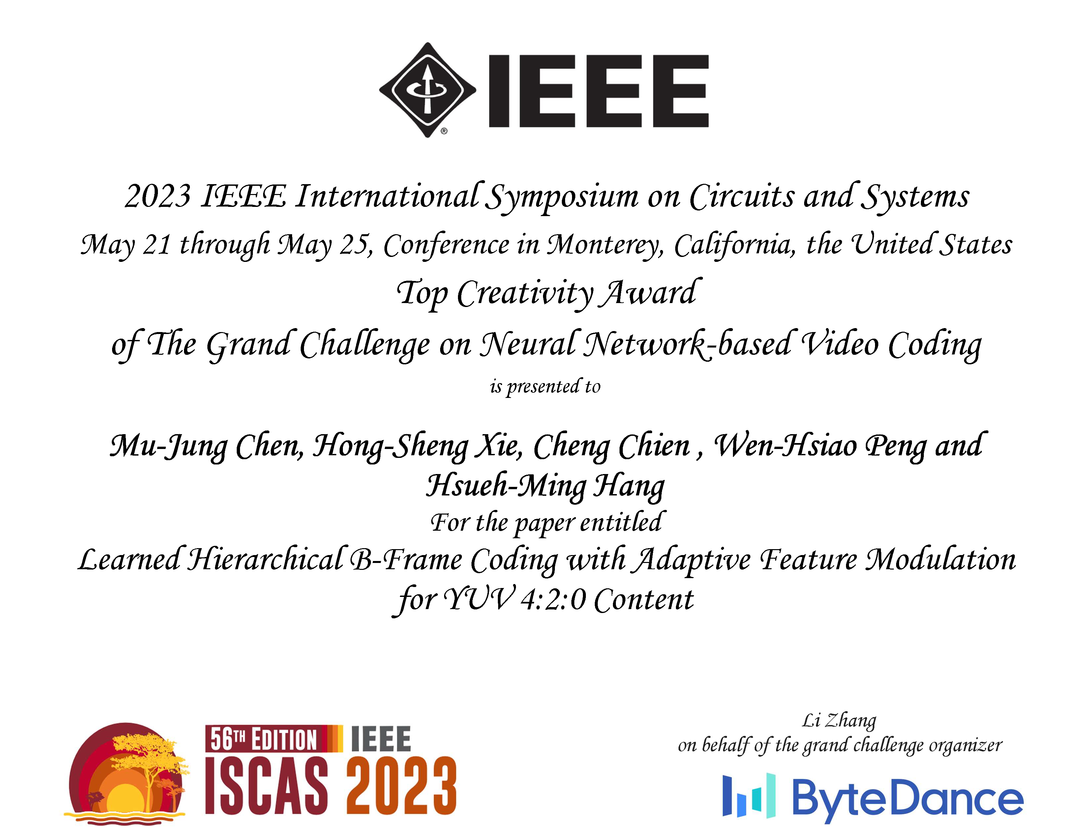
IEEE ISCAS’23 Grand Challenge
Notes:
This slide presents the RD performance of our video coding scheme.
You can see clearly that our scheme outperforms x265 by a significant margin.
Its superiority over the other SOTA baselines is also quite obvious.

Slide 21
Thank you for your attention

