Slide 1
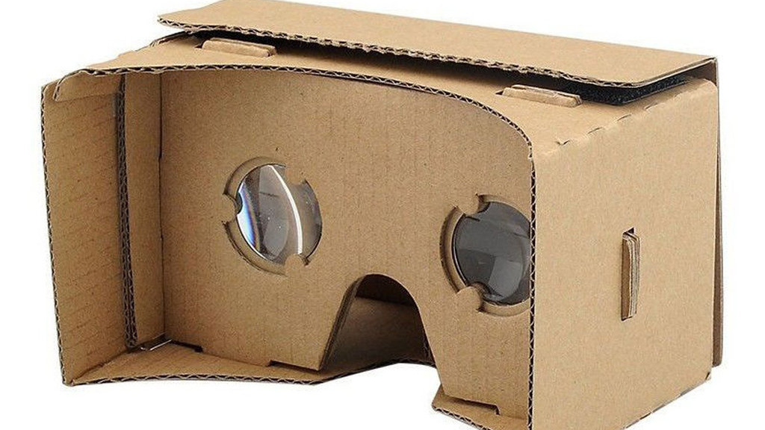
Input and Interaction Methods of Google Cardboard
Fall 2023 VR/AR Research Project

Slide 2
Different Inputs
Physical Devices
Another Phone
PS5 Controller
Mouse and Keyboard
Sensors
Non-Physical Devices
Voice Control
Gesture Control
Eye Gaze

Slide 3
Research on the Input Methods of Cardboard

Slide 4
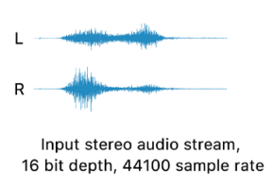
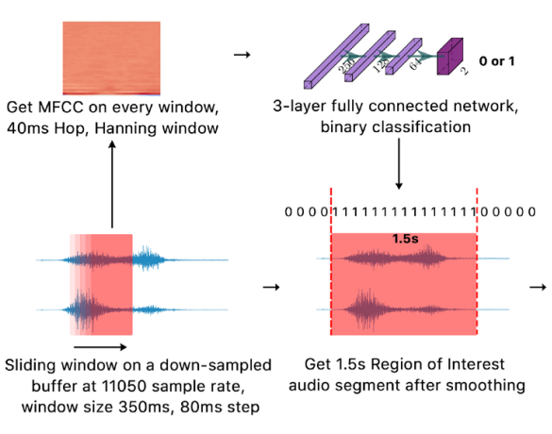
GestOnHMD
Step1: Gesture Detection Detect whether a gesture has been performed by the user on the surface
Sliding-window algorithm
Applied a 350ms sliding window with 80 steps on a down-sampled audio sample with a sample rate of 11050Hz
For each window, extract 20 MFCC features using a Hanning window in the hop size of 40ms
For each extracted MFCC feature, calculate its mean and standard deviation to form a 40-dimensional feature vector
For valid result, form a 1.5s audio segment for future classification
0: background noise
1: gesture performing

Slide 5
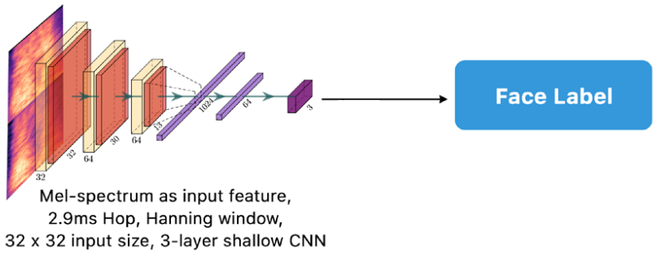
GestOnHMD
Step2: Surface Recognition
Extract the mel-spectrograms for both the left and the right channels separately, and concatenated them vertically into one image
Reshape the image to 32×32
Feeding into CNN do surface recognition

Slide 6
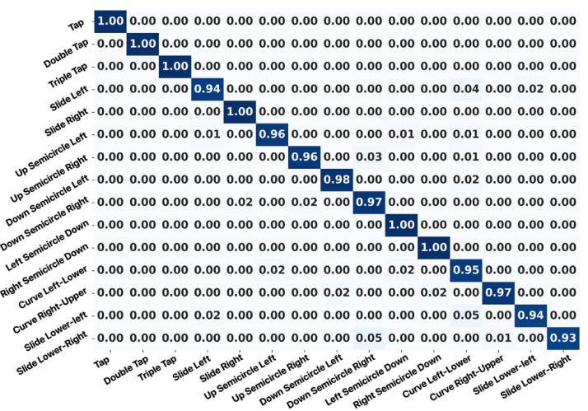
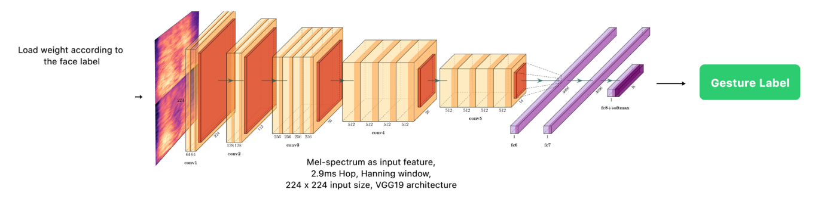
GestOnHMD
Step3: Gesture Classification
Data Augmentation
Noise Augmentation
Time Warping
Frequency Mask
Classification
Training: training on three surfaces as three different classification problems
Mono-channel acoustic signal for left-right surface (average data of two channel)
Multi-channel acoustic signal for front surface
224×224

