Slide 1

Traject-WiCSE Shadowing
Final Presentation
Spring 2022
Nayan Jain

Slide 2


Introduction
Year: 1st Year Graduate Student
Major: Computer Science
Project: Photo App for searching and filtering photos
Interests: Application Development and Deployment
Mentor: James Friedman

Slide 3
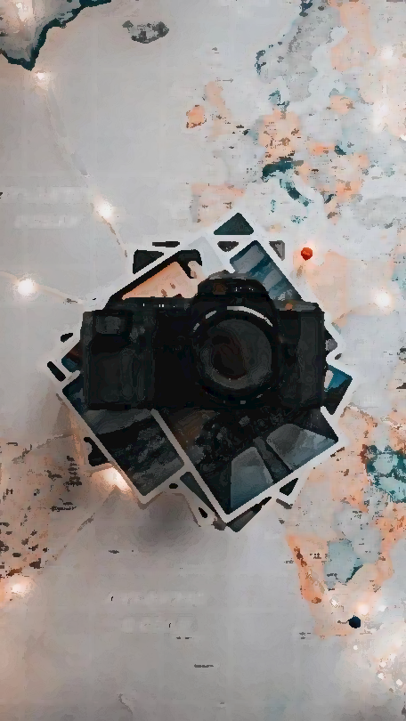




Project Overview
Objective
Upload images and sort them into albums. Allow user to search the images based on their tags or text or both.
Have the ability to sort these images based on the date uploaded and/or name.
Topics
Full-Stack Development
Image Processing
OCR
Technologies
Frontend: React JS
Backend: Python Flask
Database: MySQL, Elasticsearch
Storage: AWS S3
OCR: GCV
Auto Tagging: Imagga
Motivation
To have the ease of searching images based on the tags associated with them and the text they contain.

Slide 4

Accomplished since Midterm
Created functionality to upload text images and extract text from those images.
Created functionality to search images across all albums based on text or tags or both as well as confided to one album.
Created functionality to sort images inside an album based on the date they were uploaded or their name.

Slide 5
Accomplished since Midterm
Created functionality to edit the tags of an image.
Created functionality to delete an image.
Created functionality to auto-tag images if no tags are provided by the user.
Created APIs and databases for all the above tasks.

Slide 6
Challenges
Learning
Learning React JS from scratch, no prior experience with frontend frameworks.
Architecture
Deciding which databases and storage to choose.
Extracting
Finding a publicly available API to extract text from an image
Auto-Tagging Images
Finding a publicly available API to auto-tag images.

Slide 7

Future Plans
User Registration
Functionality to log in and register users.
Edit Images
Functionality to edit images during or after uploading them.
Search based on Color
Functionality to search images based on color.
Translate Images
Functionality to translate images to any preferred language.

Slide 8

Thank You

