Slide 1
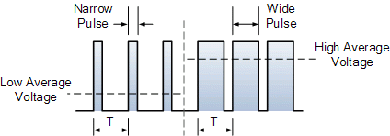
PWM

Slide 2
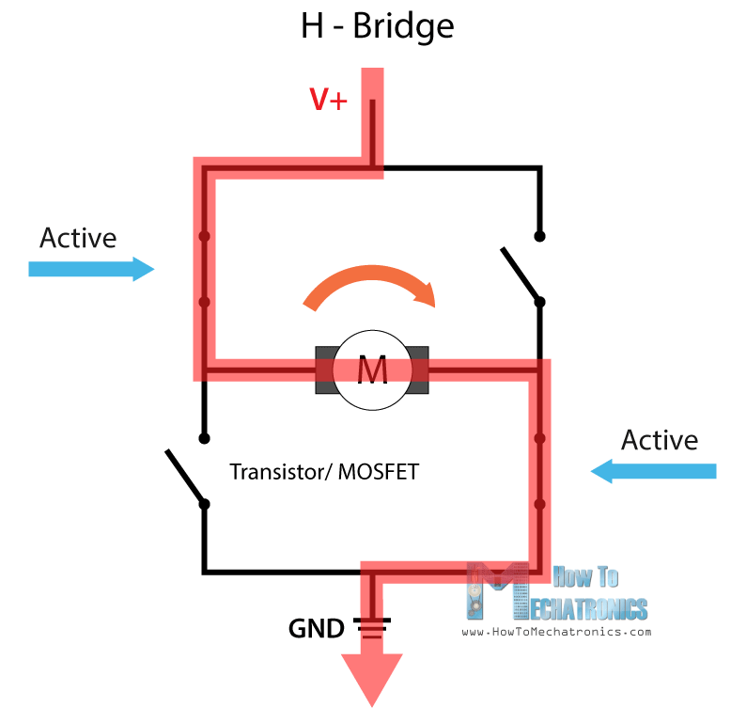
H bridge

Slide 3
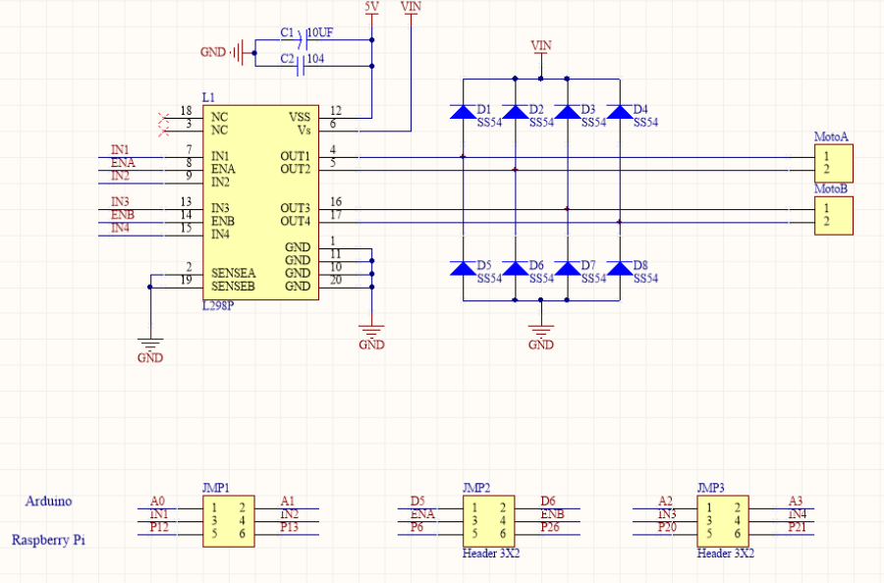

Slide 4
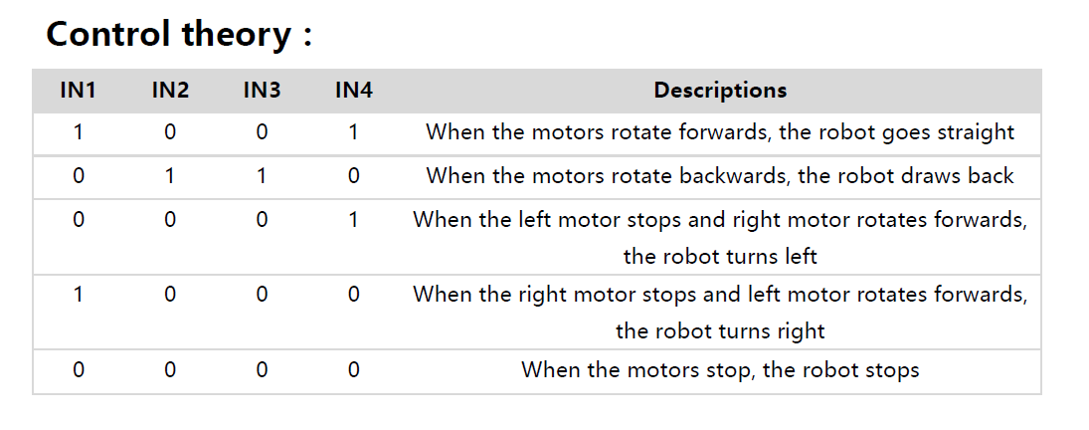

Slide 5
Alphabot base file
AlphatBot.py
def __init__(self,ain1=12,ain2=13,ena=6,bin1=20,bin2=21,enb=26)
def forward(self)
def stop(self):
def backward(self):
def left(self):
def right(self)
def setPWMA(self,value)
def setPWMB(self,value):
def setMotor(self, left, right):
AlphatBot2.py
def __init__(self,ain1=12,ain2=13,ena=6,bin1=20,bin2=21,enb=26)
def forward(self)
def stop(self):
def backward(self):
def left(self):
def right(self)
def setPWMA(self,value)
def setPWMB(self,value):
def setMotor(self, left, right):

Slide 6
Test motor
AlphaBot
Backup the original
cp ~/AlphaBot/AlphaBot.py AlphaBot_bk.py
Open the AlphaBot.py
Add the following code
if __name__=='__main__':
Ab = AlphaBot()
Ab.forward()
try:
while True:
time.sleep(1)
except KeyboardInterrupt:
GPIO.cleanup()
AlphaBot2
Open in IDLE to look at the program
Look for this part of the code
if __name__=='__main__':
Ab = AlphaBot()
Ab.forward()
try:
while True:
time.sleep(1)
except KeyboardInterrupt:
GPIO.cleanup()
Close the file and run the program
cd ~/AlphaBot2/python sudo python AlphaBot2.py

Slide 7
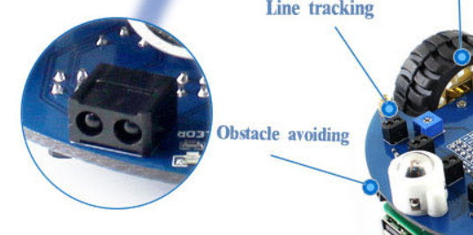
Infrared Obstacle detection Expectation result: When the left sensor detects the obstacle, the smart robot will turn to right. When the right sensor detects the obstacle, the smart robot will turn to left.
AlphaBot
AlphaBot2
When there is no obstacle ahead of the robot, the green LED on the robot is off.
When the obstacle is detected, the green LED will light up.

Slide 8
Infrared Obstacle detection Expectation result: When the left sensor detects the obstacle, the smart robot will turn to right. When the right sensor detects the obstacle, the smart robot will turn to left.
AlphaBot
import RPi.GPIO as GPIO
import time
from AlphaBot import AlphaBot
Ab = AlphaBot()
DR = 16
DL = 19
GPIO.setmode(GPIO.BCM)
GPIO.setwarnings(False)
GPIO.setup(DR,GPIO.IN,GPIO.PUD_UP)
GPIO.setup(DL,GPIO.IN,GPIO.PUD_UP)
AlphaBot2
import RPi.GPIO as GPIO
import time
from AlphaBot2 import AlphaBot2
Ab = AlphaBot2()
DR = 16
DL = 19
GPIO.setmode(GPIO.BCM)
GPIO.setwarnings(False)
GPIO.setup(DR,GPIO.IN,GPIO.PUD_UP)
GPIO.setup(DL,GPIO.IN,GPIO.PUD_UP)

Slide 9
Infrared Obstacle detection Expectation result: Read out the value of the 2 sensors
AlphaBot
try:
while True:
DR_status = GPIO.input(DR)
DL_status = GPIO.input(DL)
print(DR_status,DL_status)
except KeyboardInterrupt:
GPIO.cleanup()
AlphaBot2
try:
while True:
DR_status = GPIO.input(DR)
DL_status = GPIO.input(DL)
print(DR_status,DL_status)
except KeyboardInterrupt:
GPIO.cleanup()

Slide 10
Infrared Obstacle detection
Modify the program to add in the following states and behaviour
DL_status | DR_status | Remarks
0 | 0
0 | 1
1 | 0
1 | 1

Slide 11
Line Tracing

