Slide 1
MMD-GAN

Slide 2
Different Configurations to be Tried
Same batch, more samples
Add FC at the end of Encoder & beginning of Decoder

Slide 3
Parameters
Parameter | Value
Batch_size | 16
Number of samples | 2048
Lr (learning rate) | 5e-5
Number of epochs | 150
Optimizer | rmsprop
Dist_ae (reconstruction loss function for autoencoding) | L2
Gen_iterations_limit | 3
Diter_1 | 100
Giter_1 | 1
Diter_2 | 5
Giter_2 | 1
Sampled Cube Edge | 128
Test Cube Edge | 512
Parameter | Value
Nz (embedded space channels) | 256
Lambda_AE_X & Y | 8
Lambda_rg | 16
Sigma list | [1.0, 2.0, 4.0, 8.0, 16.0]
Minimum variance estimated | 1e-30
Left_clamp
Right_clamp
Redshift_raw_file | fields_z=0.0.hdf5
Redshift_file | minmax_scale_01_redshift0.h5
Inverse transform | minmax01
Slurm | 10003899
Notes:
Copy this slide for every different configuration

Slide 4
Architectures
Encoder
Decoder
(encoder): Encoder(
(conv1_encode): Conv3d(1, 4, kernel_size=(3, 3, 3), stride=(1, 1, 1))
(bn1_encode): BatchNorm3d(4, eps=1e-05, momentum=0.1, affine=True, track_running_stats=True)
(leakyrelu1): LeakyReLU(negative_slope=0.2, inplace)
(pool1_encode): AvgPool3d(kernel_size=2, stride=2, padding=0)
(conv2_encode): Conv3d(4, 24, kernel_size=(4, 4, 4), stride=(1, 1, 1))
(bn2_encode): BatchNorm3d(24, eps=1e-05, momentum=0.1, affine=True, track_running_stats=True)
(leakyrelu2): LeakyReLU(negative_slope=0.2, inplace)
(pool2_encode): AvgPool3d(kernel_size=2, stride=2, padding=0)
(conv3_encode): Conv3d(24, 48, kernel_size=(3, 3, 3), stride=(1, 1, 1))
(bn3_encode): BatchNorm3d(48, eps=1e-05, momentum=0.1, affine=True, track_running_stats=True)
(leakyrelu3): LeakyReLU(negative_slope=0.2, inplace)
(pool3_encode): AvgPool3d(kernel_size=2, stride=2, padding=0)
(conv4_encode): Conv3d(48, 64, kernel_size=(4, 4, 4), stride=(2, 2, 2))
(bn4_encode): BatchNorm3d(64, eps=1e-05, momentum=0.1, affine=True, track_running_stats=True)
(leakyrelu4): LeakyReLU(negative_slope=0.2, inplace)
(conv5_encode): Conv3d(64, 128, kernel_size=(3, 3, 3), stride=(1, 1, 1))
(bn5_encode): BatchNorm3d(128, eps=1e-05, momentum=0.1, affine=True, track_running_stats=True)
(leakyrelu5): LeakyReLU(negative_slope=0.2, inplace)
(conv6_encode): Conv3d(128, 256, kernel_size=(2, 2, 2), stride=(1, 1, 1))
(bn6_encode): BatchNorm3d(256, eps=1e-05, momentum=0.1, affine=True, track_running_stats=True)
(leakyrelu6): LeakyReLU(negative_slope=0.2, inplace)
(conv7_encode): Conv3d(256, 256, kernel_size=(2, 2, 2), stride=(1, 1, 1))
(bn7_encode): BatchNorm3d(256, eps=1e-05, momentum=0.1, affine=True, track_running_stats=True)
(leakyrelu7): LeakyReLU(negative_slope=0.2, inplace)
)
(decoder): Decoder(
(deconv1_decode): ConvTranspose3d(256, 256, kernel_size=(2, 2, 2), stride=(1, 1, 1))
(bn1_decode): BatchNorm3d(256, eps=1e-05, momentum=0.1, affine=True, track_running_stats=True)
(leakyrelu1): LeakyReLU(negative_slope=0.2, inplace)
(deconv2_decode): ConvTranspose3d(256, 128, kernel_size=(2, 2, 2), stride=(1, 1, 1))
(bn2_decode): BatchNorm3d(128, eps=1e-05, momentum=0.1, affine=True, track_running_stats=True)
(leakyrelu2): LeakyReLU(negative_slope=0.2, inplace)
(deconv3_decode): ConvTranspose3d(128, 64, kernel_size=(3, 3, 3), stride=(1, 1, 1))
(bn3_decode): BatchNorm3d(64, eps=1e-05, momentum=0.1, affine=True, track_running_stats=True)
(leakyrelu3): LeakyReLU(negative_slope=0.2, inplace)
(deconv4_decode): ConvTranspose3d(64, 48, kernel_size=(4, 4, 4), stride=(2, 2, 2))
(bn4_decode): BatchNorm3d(48, eps=1e-05, momentum=0.1, affine=True, track_running_stats=True)
(leakyrelu4): LeakyReLU(negative_slope=0.2, inplace)
(unpool1): Upsample(scale_factor=2, mode=nearest)
(deconv5_decode): ConvTranspose3d(48, 24, kernel_size=(3, 3, 3), stride=(1, 1, 1))
(bn5_decode): BatchNorm3d(24, eps=1e-05, momentum=0.1, affine=True, track_running_stats=True)
(leakyrelu5): LeakyReLU(negative_slope=0.2, inplace)
(unpool2): Upsample(scale_factor=2, mode=nearest)
(deconv6_decode): ConvTranspose3d(24, 4, kernel_size=(4, 4, 4), stride=(1, 1, 1))
(bn6_decode): BatchNorm3d(4, eps=1e-05, momentum=0.1, affine=True, track_running_stats=True)
(leakyrelu6): LeakyReLU(negative_slope=0.2, inplace)
(unpool3): Upsample(scale_factor=2, mode=nearest)
(deconv7_decode): ConvTranspose3d(4, 1, kernel_size=(3, 3, 3), stride=(1, 1, 1))
(bn7_decode): BatchNorm3d(1, eps=1e-05, momentum=0.1, affine=True, track_running_stats=True)
(relu7): ReLU(inplace)
)
Discriminator = Encoder + Decoder | Generator = Decoder
Notes:
Copy this slide for every different configuration

Slide 5
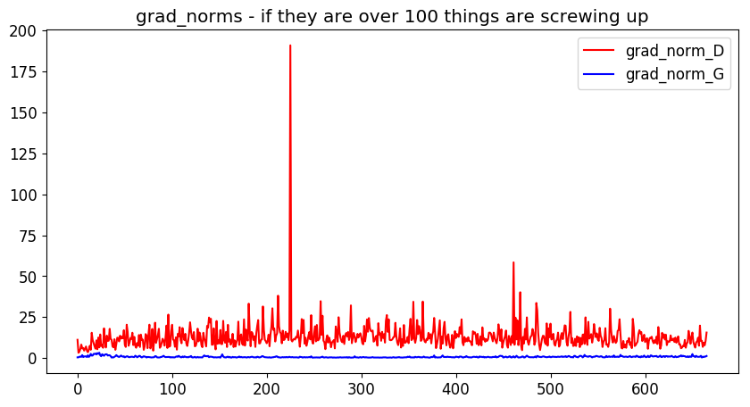
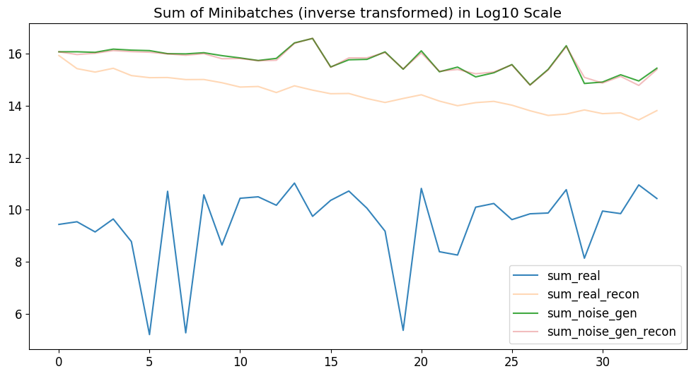
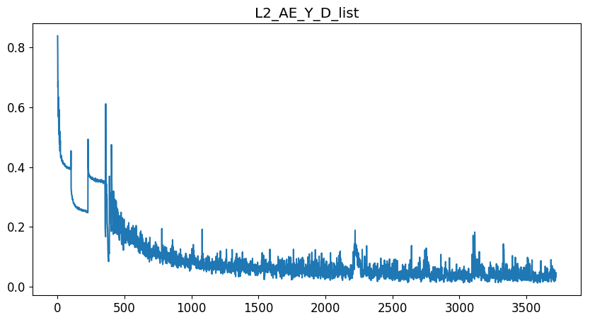
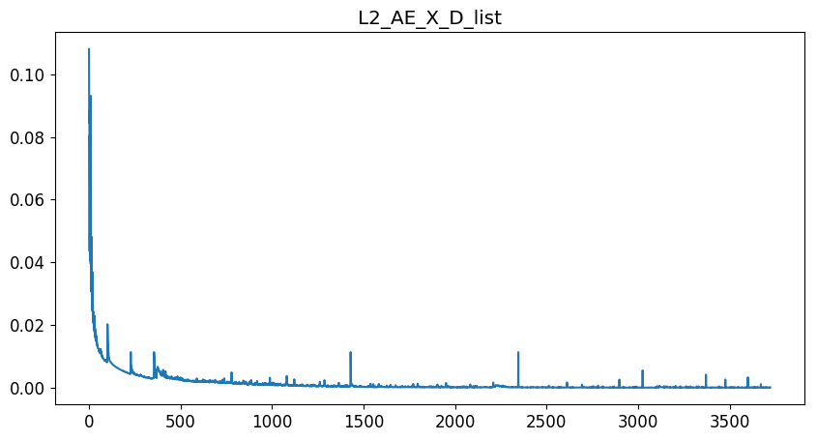
Plots - Training
Notes:
Copy this slide for every different configuration

Slide 6
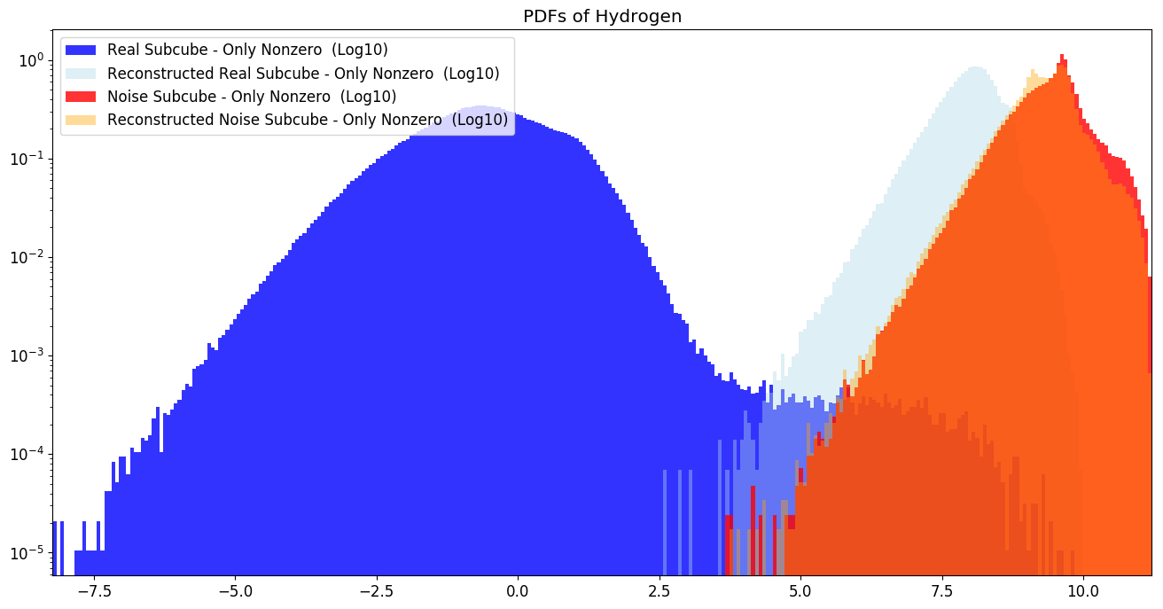
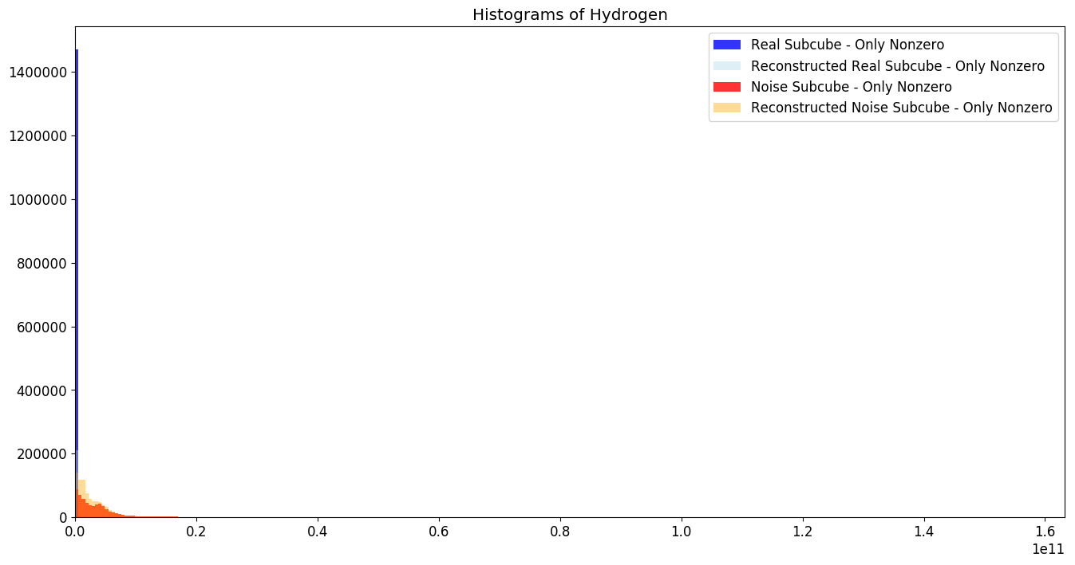
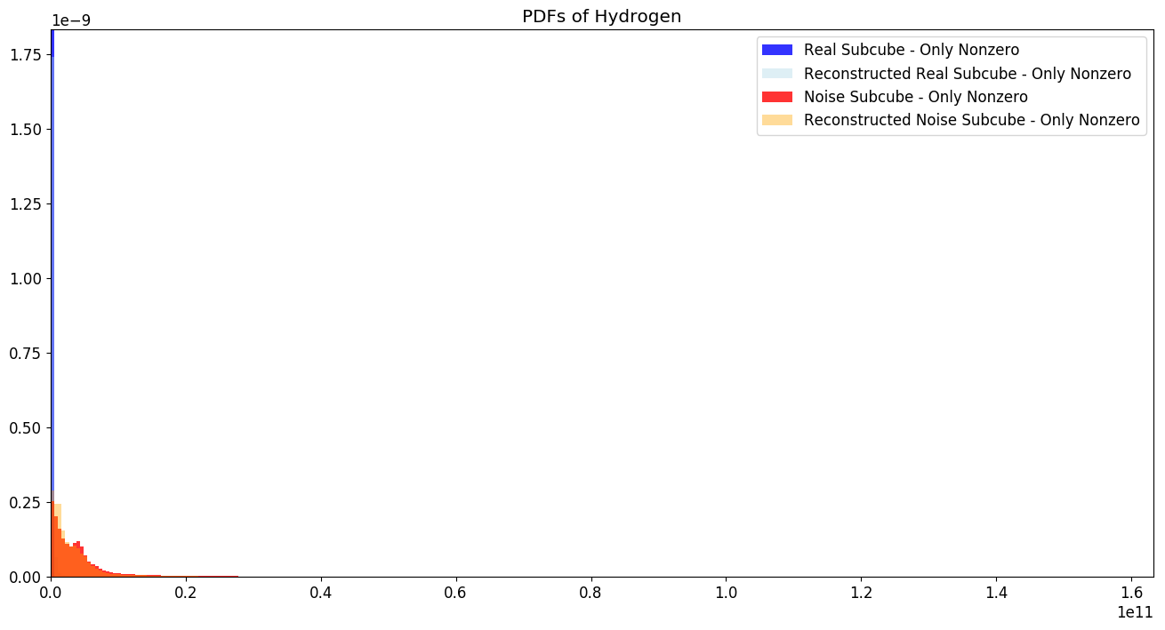
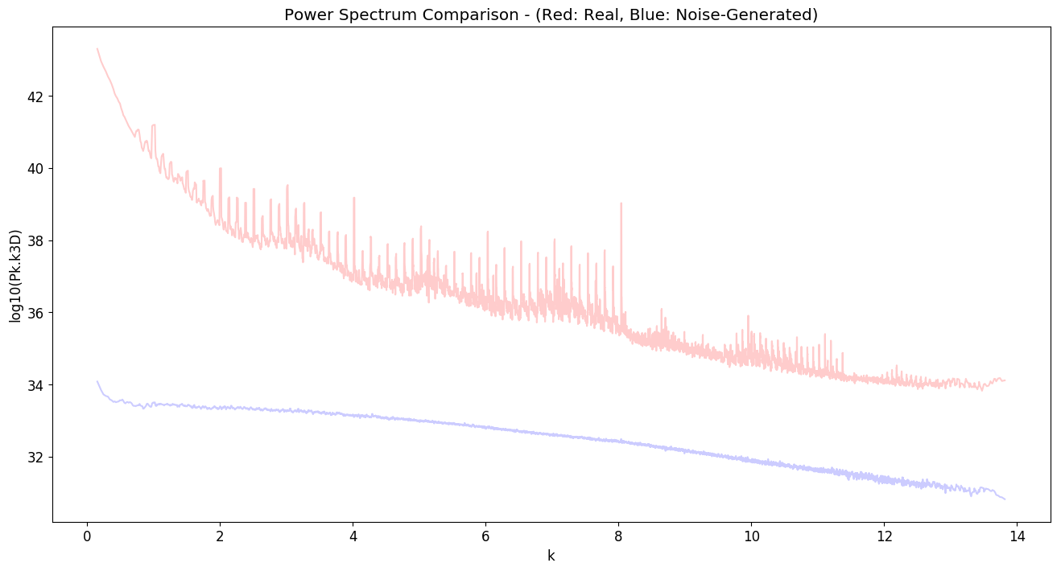
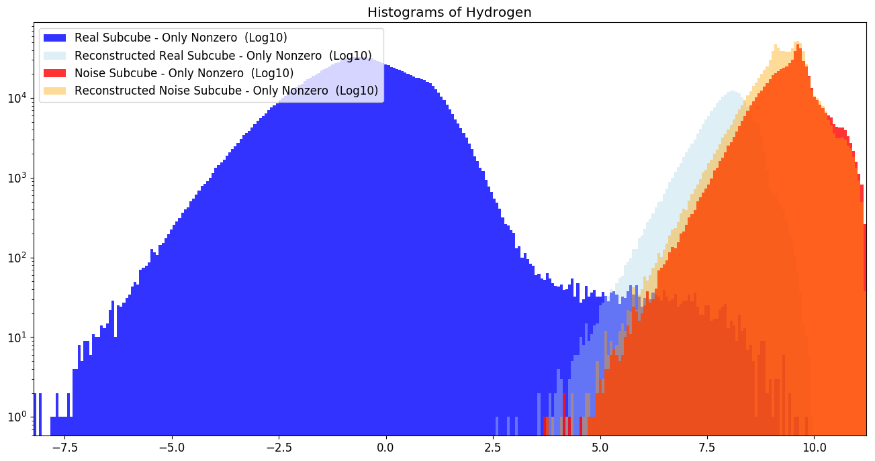
Plots – Matter Distributions
Notes:
Copy this slide for every different configuration

Slide 7
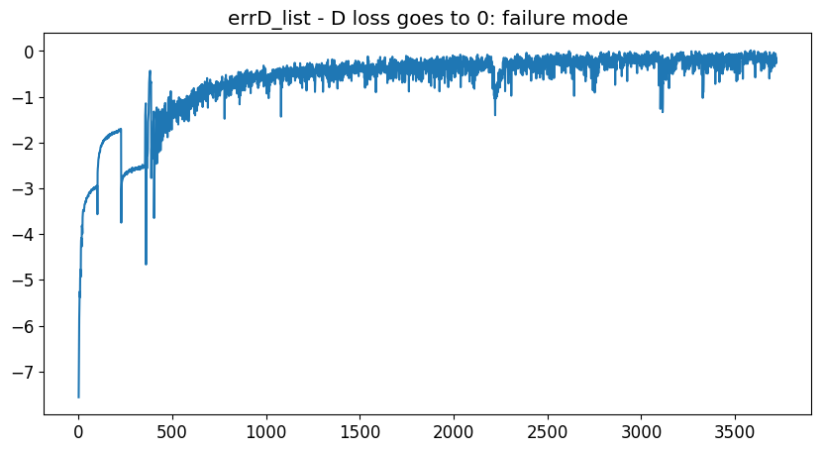
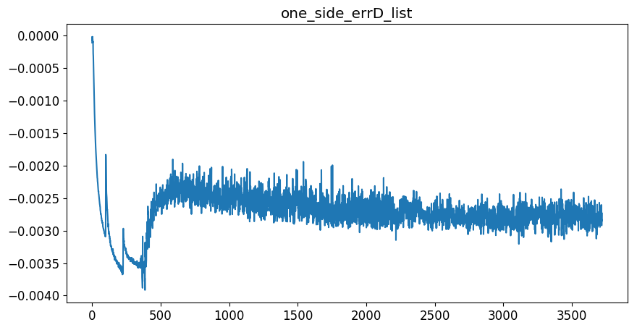
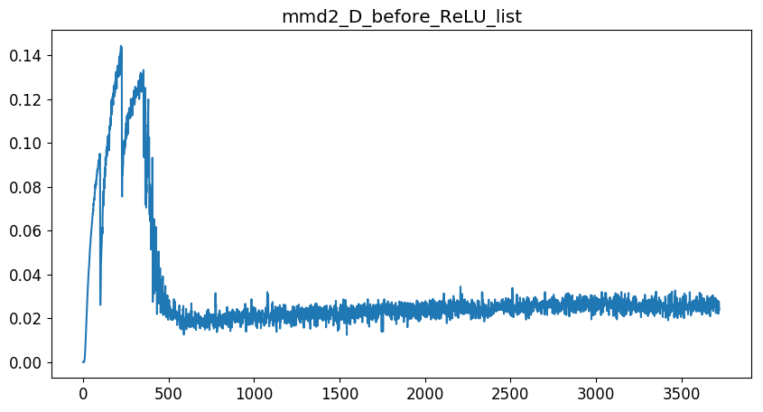

Plots - Discriminator
Notes:
Copy this slide for every different configuration

Slide 8
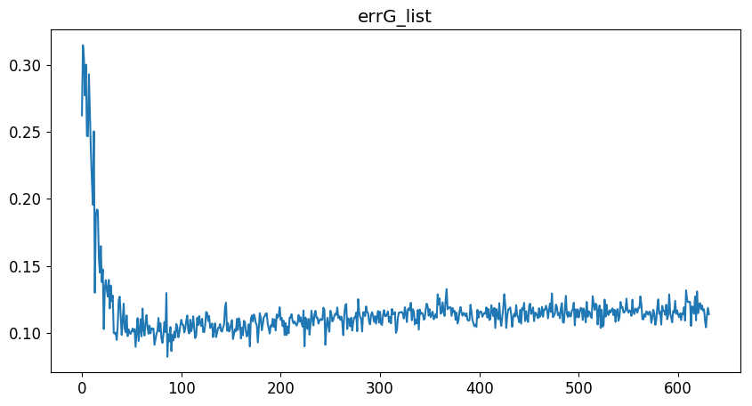
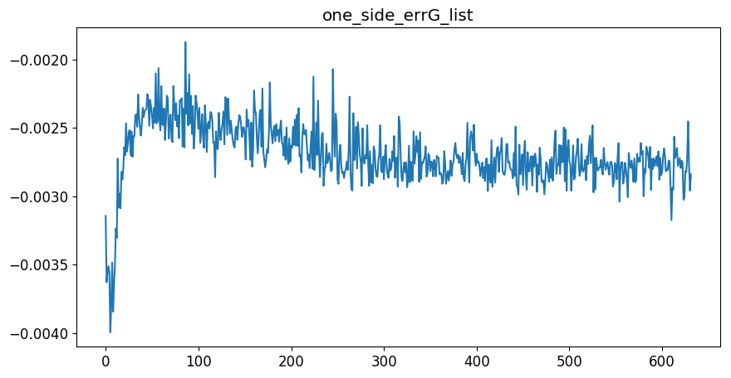
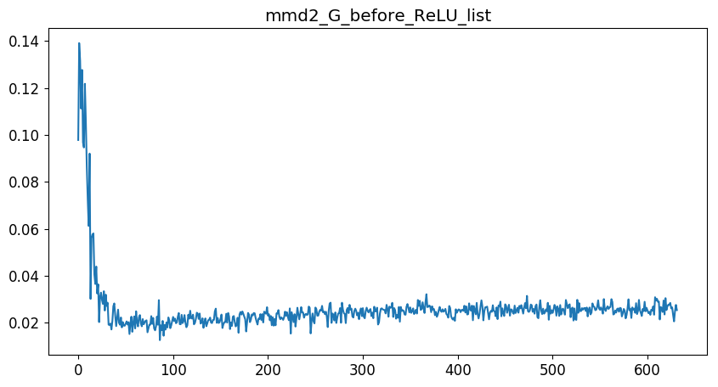
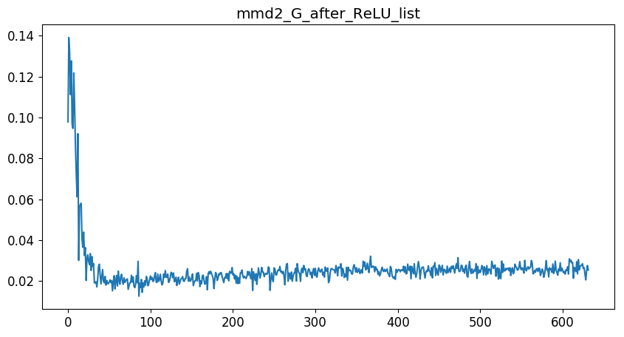
Plots - Generator
Notes:
Copy this slide for every different configuration

Slide 9
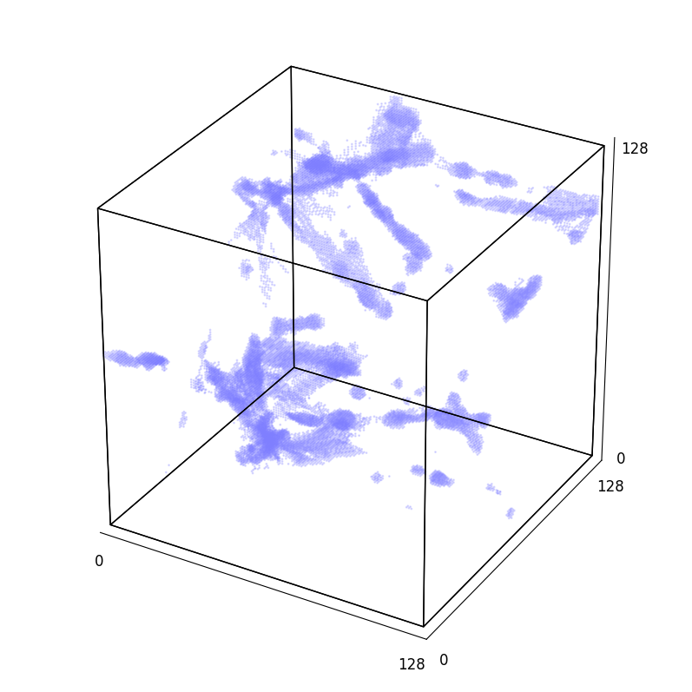
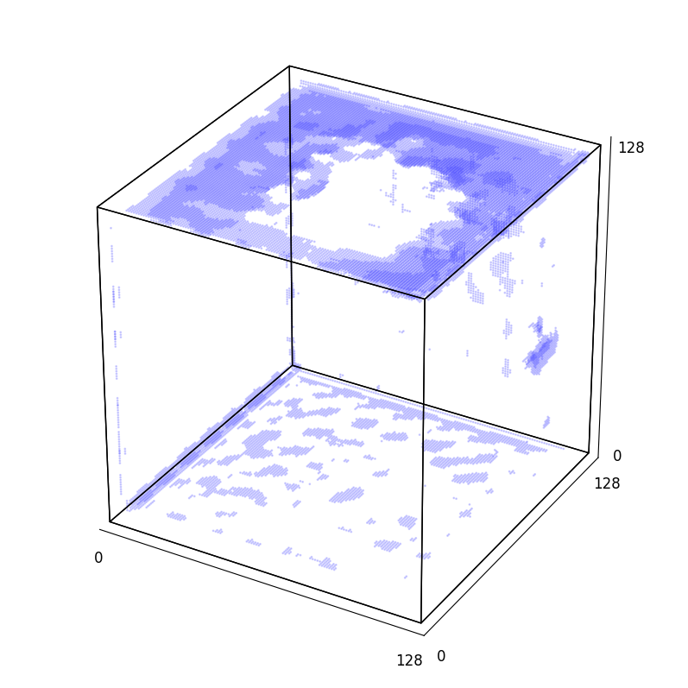
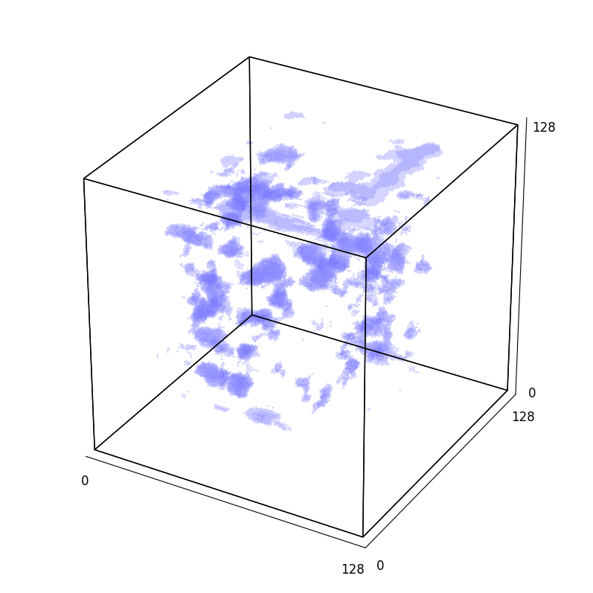
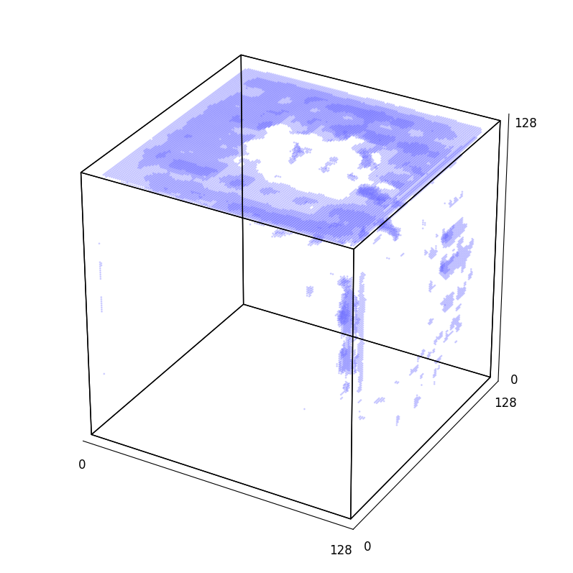
3D Plots of Real / Noise Input / AE Real / AE Noise

