Slide 1
Replicating IllustrisTNG one stride at a time...
Seda Bilaloglu, Asena Derin Cengiz, Atakan Okan, Juan Jose Zamudio

Slide 2
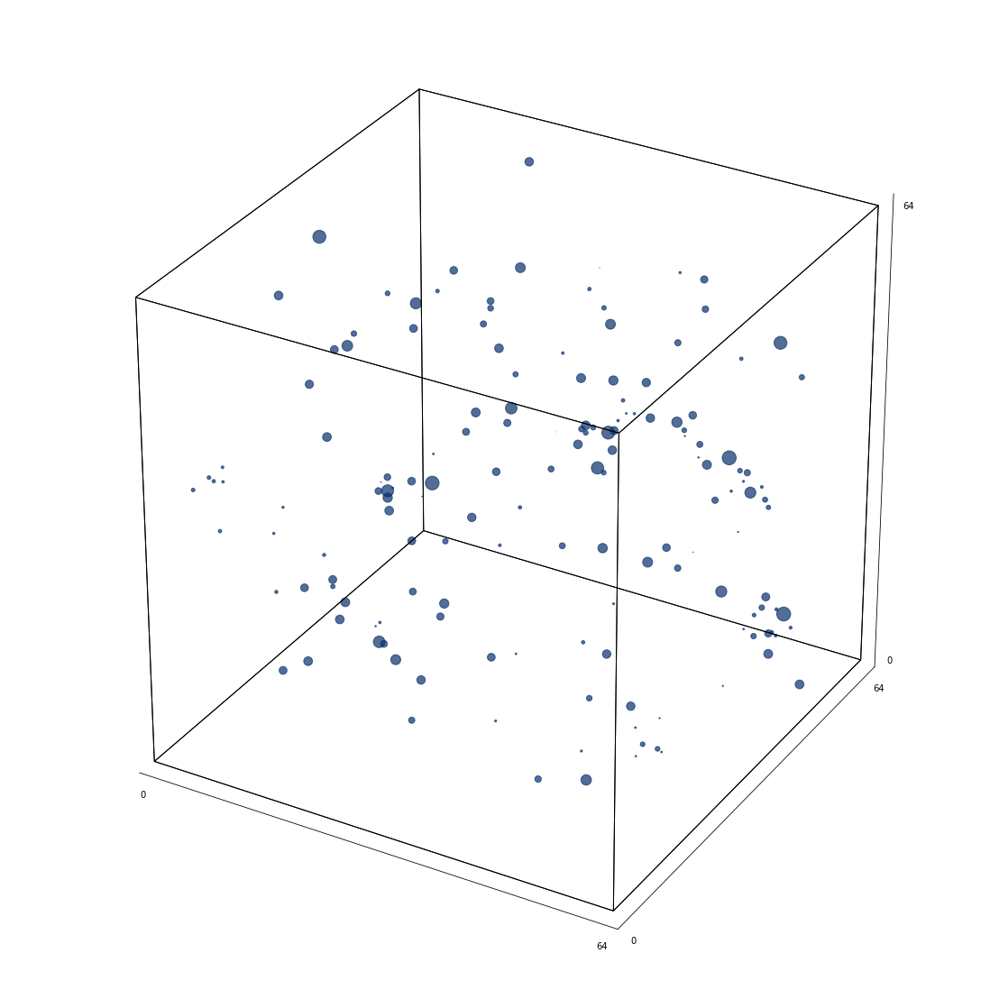
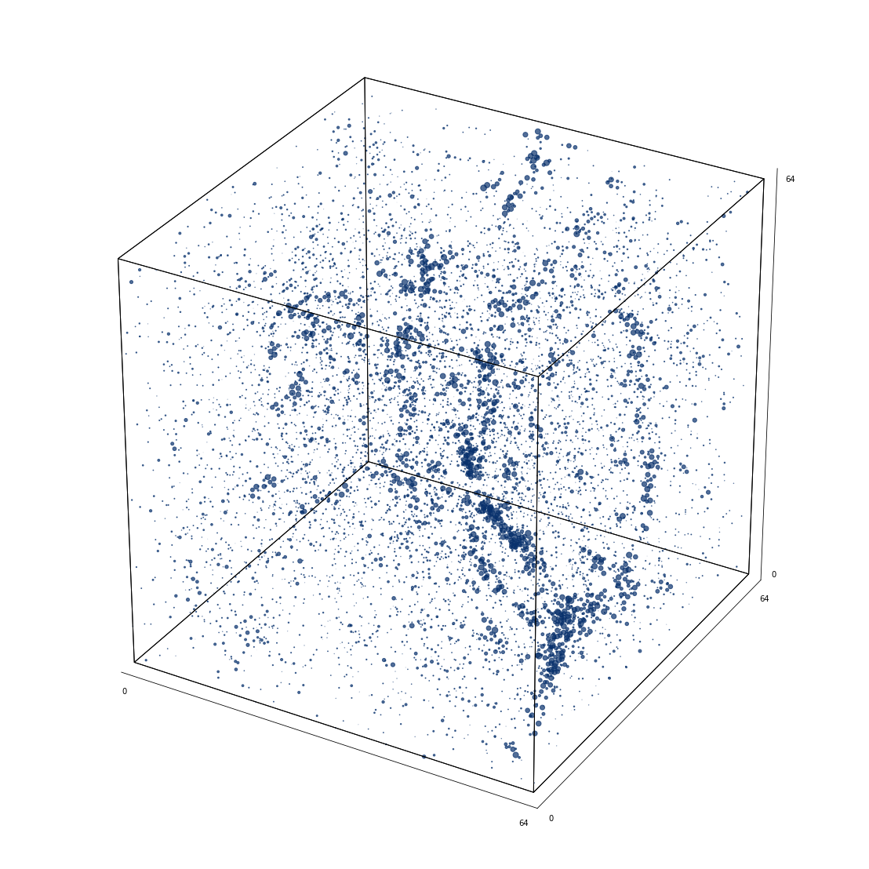
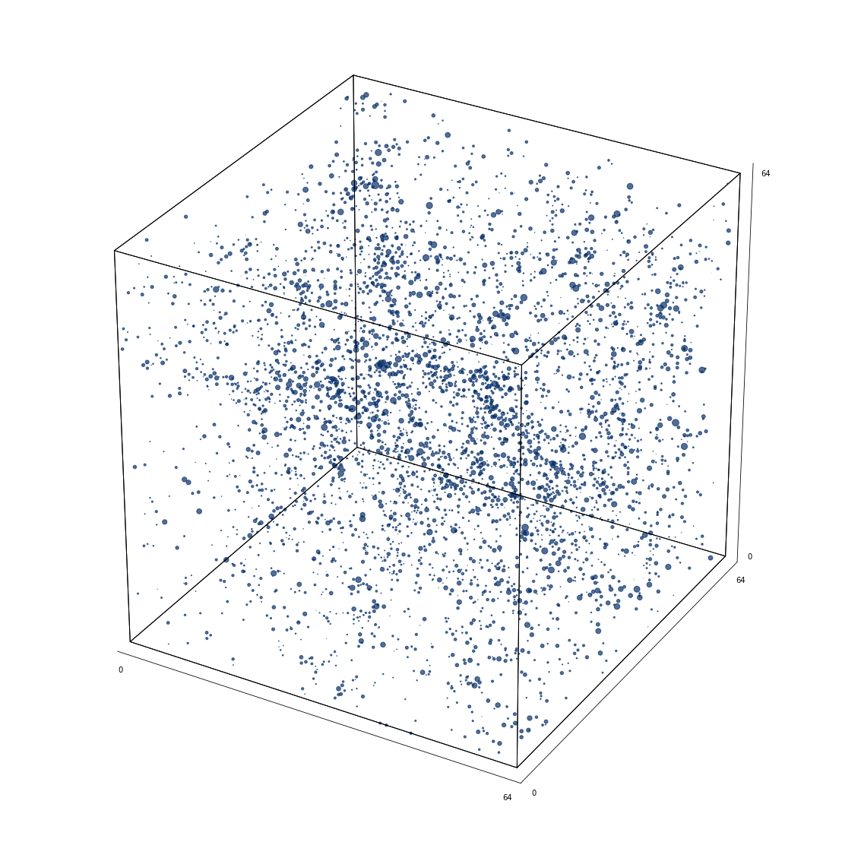
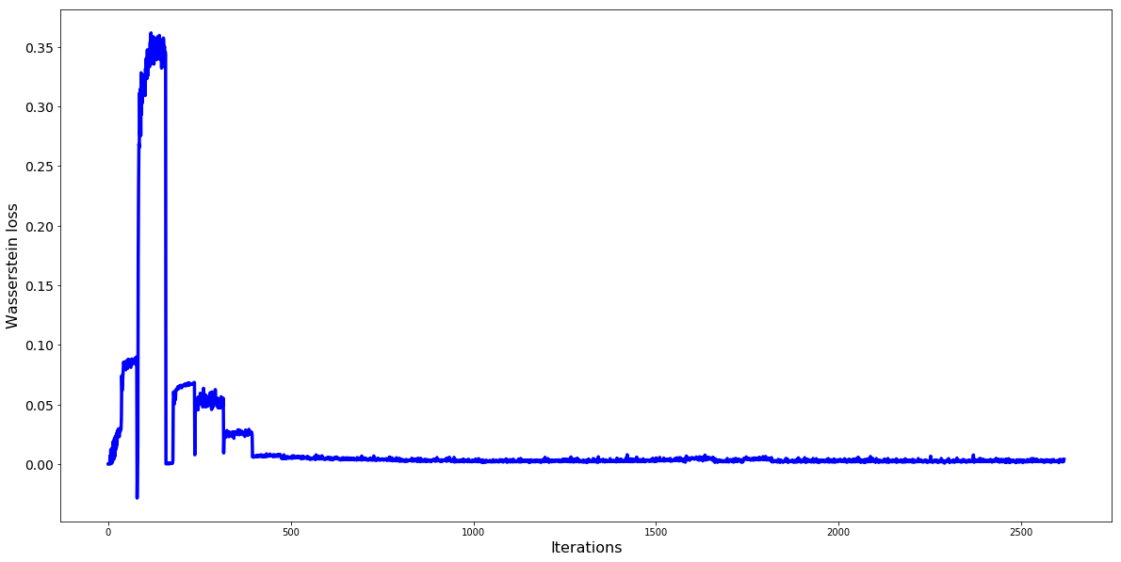
Wasserstein GAN
Right: 3D plots comparing noise-input generated cubes (sampled at epoch 20-30) vs sampled cubes from the real data
WGAN with Fully Connected layers
Data used Redshift = 5.0

Slide 3
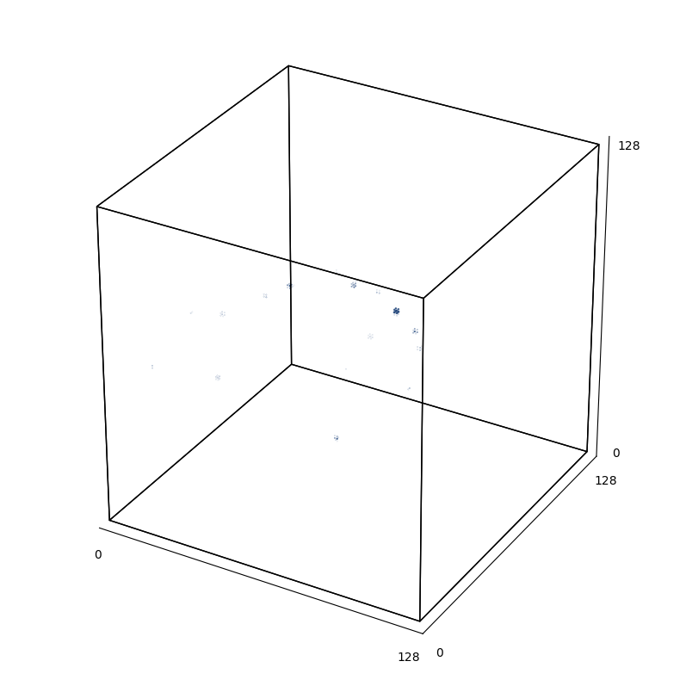
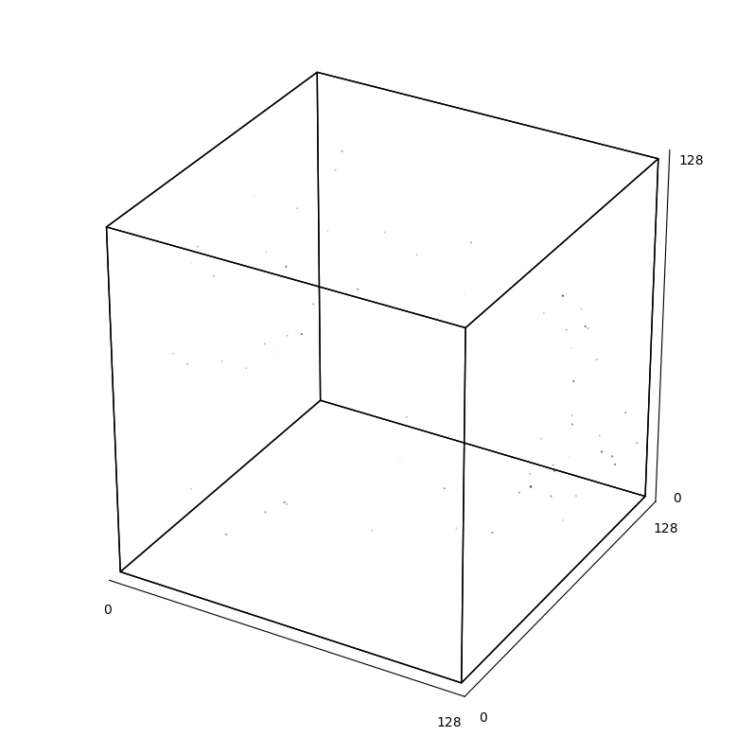
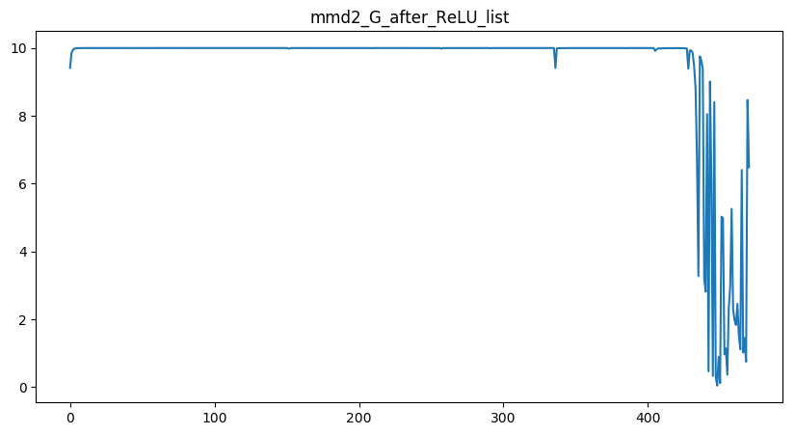
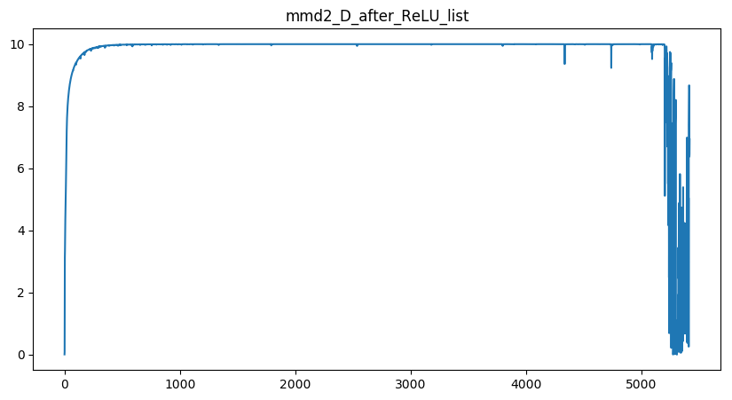
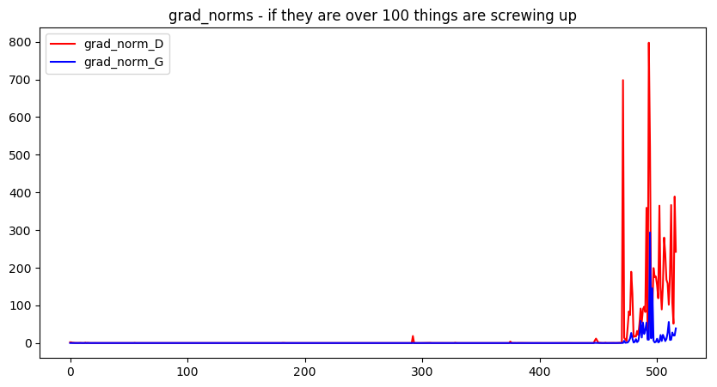
MMD-GAN
Using DCGAN architecture with 3D Conv and Deconv Layers
Discriminator:
Autoencoder like architecture where only the encoder is used for discriminative purposes
The decoder is trained as an autoencoder to speed up generator’s training
Generator:
Architecture same as the decoder part of the Discriminator
Training is not stable under hyperparameters given by the authors of the paper. Probably due to the sparsity of the hydrogen data vs. dense bedroom image data.
Gradients blowing up after ~40 epochs just when 3D plots seem to replicate better
Squint you eyes to see the hydrogen masses! (They are really really small.)
Next steps:
Repulsive Loss (1)
Different architectures
Ratio Matching MMD (2)
Where to use ReLU vs LeakyReLU?
Sampled Real Cube
Noise-Input Generated Cube
https://openreview.net/pdf?id=HygjqjR9Km
https://arxiv.org/pdf/1806.00101.pdf

Slide 4
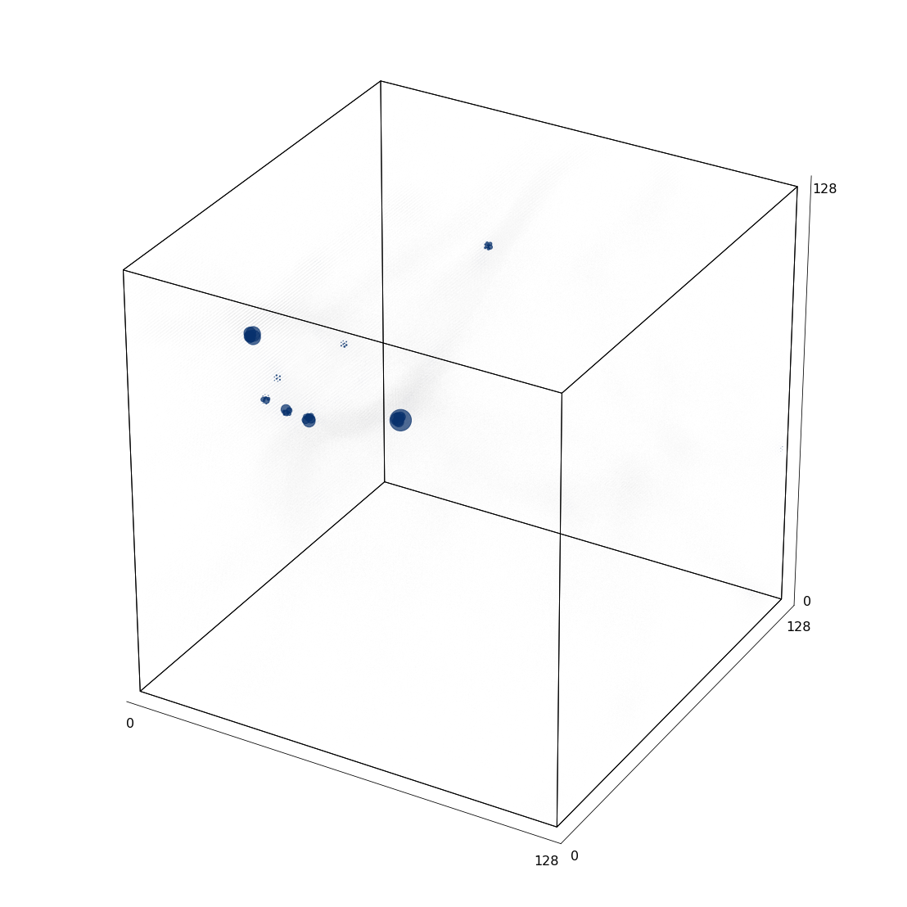
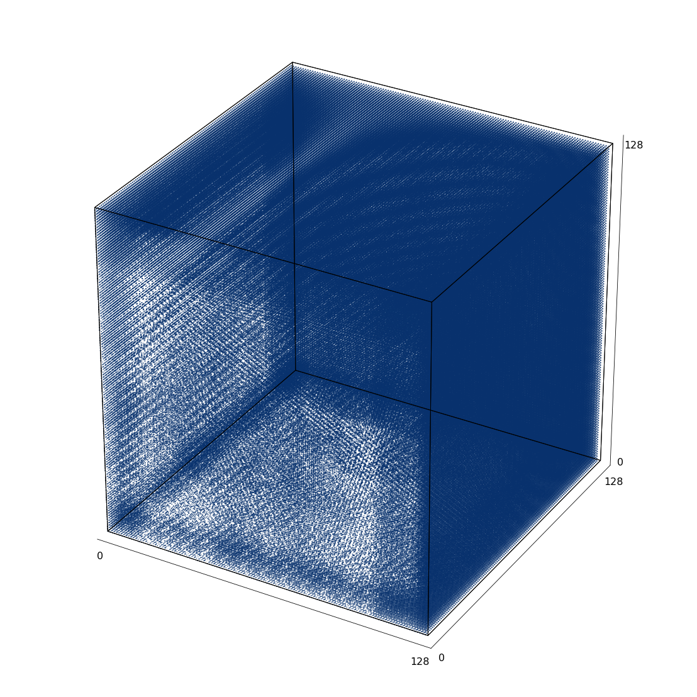
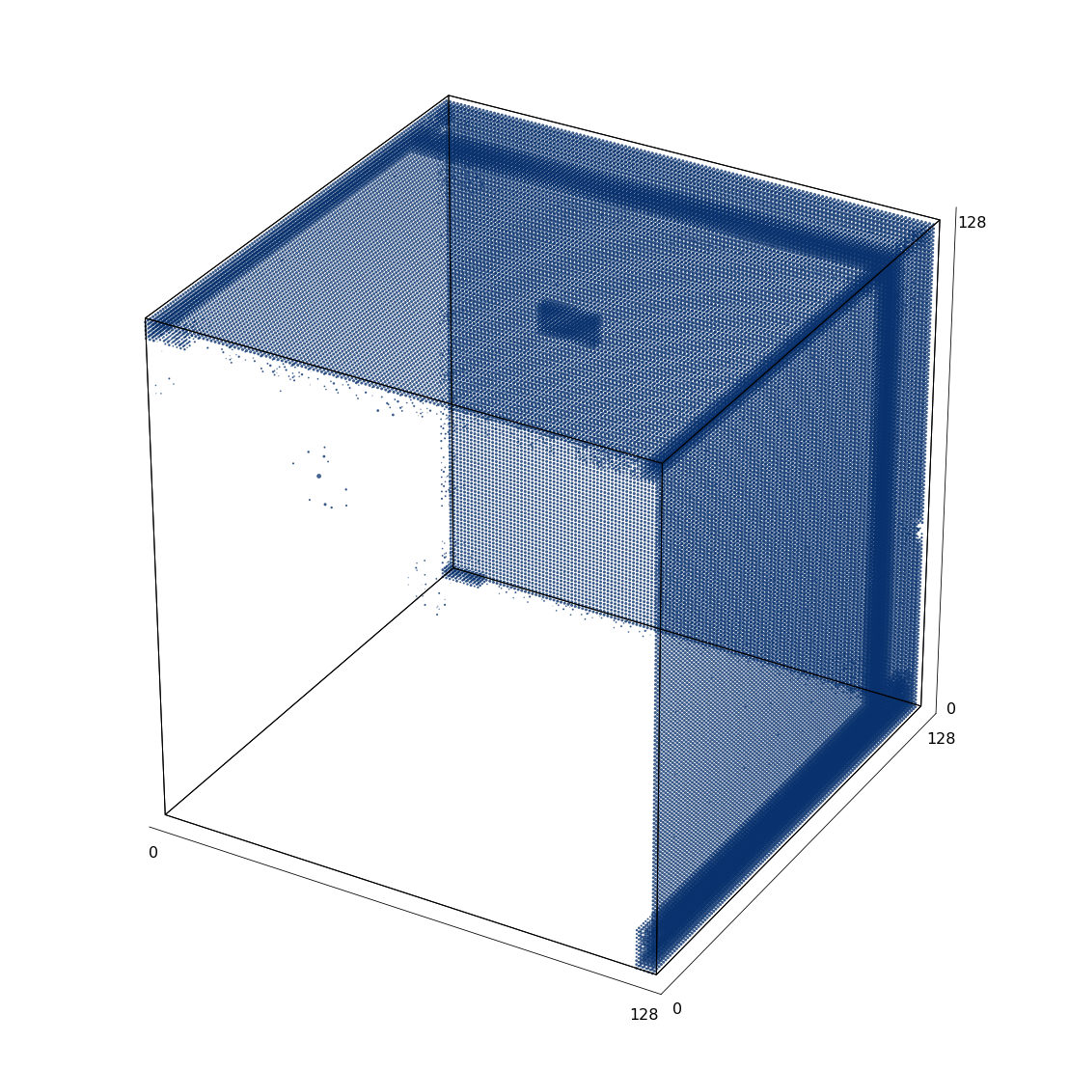
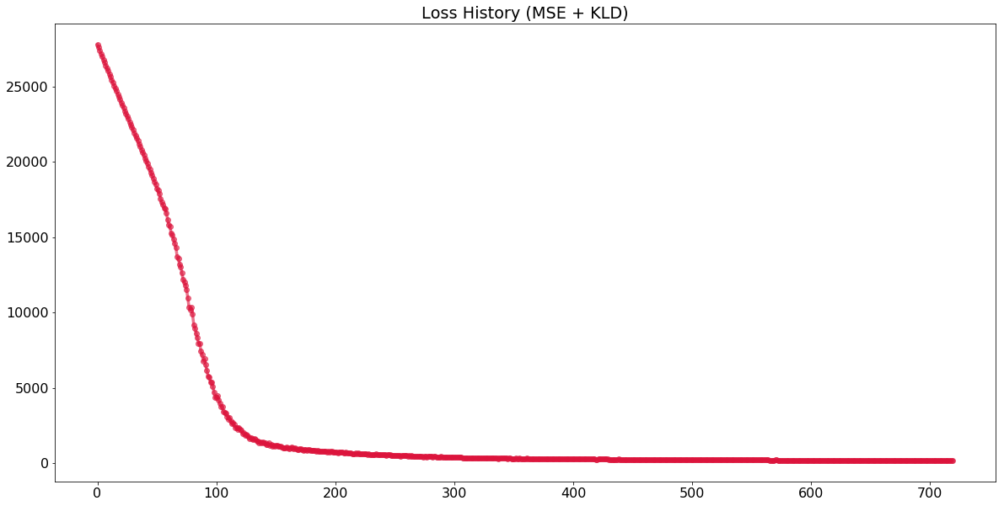
VAE
Right: 3D plots comparing noise-input generated cubes (sampled at epoch 20-30) vs sampled cubes from the real data
VAE with 3D Conv and 3D Deconv layers
very unstable loss (KLD + MSE) in reconstruction, but better loss decline in noise input
Left 3D Cube: Real Sampled Cube
Middle: Reconstructed Cube at Epoch 1 corresponding to the plotted real cube
Right: Reconstructed Cube at Epoch 55, corresponding to the plotted real cube
Below: Loss

