Slide 1
MMD-GAN

Slide 2
Different Configurations to be Tried
Same batch, more samples
Add FC at the end of Encoder & beginning of Decoder
Date | Batch size | Number of samples | Learning rate | Number of epochs | Optimizer | Dist_ae | Gen_iterations_limit | Diter_1 | Giter_1 | Diter_2 | Giter_2 | NZ – embedded space channels | Lambda_ae_x & lambda_ae_y | Lambda_rg | Sigma_list | Min_var_Est | Left_clamp, right_clamp | transformation | Encoder architecture | Decoder architecture | Decoder output | Slurm no & drive folder
11/13 | 16 | 2048 | 5e-5 | 150 | Rmsprop | L2 | 3 | 100 | 1 | 5 | 1 | 256 | 8 , 8 | 16 | 1,2,4,8,16 | 1e-30 | -0.01,0.01 | Standardize, no shift | All Conv avgpool | All deconv, upsample |  | 10003331 – drive_output_5
11/13 | 16 | 2048 | 5e-5 | 150 | Rmsprop | L2 | 3 | 100 | 1 | 5 | 1 | 256 | 8,8 | 16 | 1,2,4,8,16 | 1e-30 | -0.01,0.01 | Minmax01 | All conv avgpool | All deconv upsample |  | 10003899 – drive_output_6
11/13 | 16 | 8192 | 5e-5 | 150 | Rmsprop | L2 | 25 | 100 | 1 | 5 | 1 | 256 | 8,8 | 16 | 1,2,4,8,16 | 1e-30 | -0.01,0.01 | Minmax01 | All conv + avgpool | All deconv + upsample |  | 9974542 – drive_output_2
11/14 | 16 | 4096 | 1e-4 | 150 | Rmsprop | L2 | 25 | 100 | 1 | 5 | 1 | 256 | 8,8 | 16 | 1,2,4,8,16 | 1e-30 | -0.01,0.01 | Minmax01 | All conv, avgpool | All deconv + upsample |  | 10029805 – drive-output-1
11/14 | 16 | 4096 | 1e-4 | 150 | Rmsprop | L2 | 25 | 100 | 1 | 5 | 1 | 256 | 8,8 | 16 | 1,2,4,8,16 | 1e-30 | -0.01,0.01 | Minmax01 | All conv + avgpool | All deconv + upsample |  | 10029806 – drive-output-4
11/14 | 16 | 4096 | 1e-4 | 150 | Rmsprop | L2 | 25 | 100 | 1 | 5 | 1 | 256 | 8,8 | 16 | 1,2,4,8,16 | 1e-30 | -0.01,0.01 | Minmax01 | Allconv + avgpool | All deconv + upsample |  | 10029803 – drive-output-3
11/14 | 16 | 4096 | 1e-4 | 150 | Rmsprop | L2 | 25 | 100 | 1 | 5 | 1 | 256 | 8,8 | 16 | 1,2,4,8,16 | 1e-30 | -0.01,0.01 | Minmax01 | All conv + avgpool | All deconv + upsample |  | 10029804 – drive-output-2
11/14 | 16 | 2048 | 5e-5 | 150 | Rmsprop | L1 | 25 | 100 | 1 | 5 | 1 | 256 | 8,8 | 16 | 1,2,4,8,16 | 1e-30 | -0.01,0.01 | Minmax01 | All conv + avgpool | All deconv + upsample |  | 10029921 – drive-output-5
11/14 | 16 | 2048 | 5e-5 | 150 | Rmsprop | L1 | 25 | 100 | 1 | 5 | 1 | 256 | 8,8 | 16 | 1,2,4,8,16 | 1e-30 | -0.01,0.01 | Minmax01 | All conv + avgpool | All deconv + upsample |  | 10029924 – drive-output-6
 |  |  |  |  |  |  |  |  |  |  |  |  |  |  |  |  |  |  |  |  |  | 10076078 – drive-output-12
 |  |  |  |  |  |  |  |  |  |  |  |  |  |  |  |  |  |  |  |  |  | 10076063 – drive-output-11
 |  |  |  |  |  |  |  |  |  |  |  |  |  |  |  |  |  |  |  |  |  | 10076062 – drive-output-10

Slide 3
Date | Batch size | Number of samples | Learning rate | Number of epochs | Optimizer | Dist_ae | Gen_iterations_limit | Diter_1 | Giter_1 | Diter_2 | Giter_2 | NZ – embedded space channels | Lambda_ae_x & lambda_ae_y | Lambda_rg | Sigma_list | Min_var_Est | Left_clamp, right_clamp | transformation | Encoder architecture | Decoder architecture | Decoder output | Slurm no & drive folder
 |  |  |  |  |  |  |  |  |  |  |  |  |  |  |  |  |  |  |  |  |  | 10076061 – drive-output-9
 |  |  |  |  |  |  |  |  |  |  |  |  |  |  |  |  |  |  |  |  |  | 10076059 – drive-output-8
 |  |  |  |  |  |  |  |  |  |  |  |  |  |  |  |  |  |  |  |  |  | 10076048 – drive-output-7
 |  |  |  |  |  |  |  |  |  |  |  |  |  |  |  |  |  |  |  |  |  | 10076080 – drive-output-13
11/17 | 16 | 4096 | 5e-5 | 150 | Rmsprop | L2 | 25 | 100 | 1 | 5 | 1 | 32 | 8,8 | 16 | 1,2,4,8,16 | 1e-30 | -0.01,0.01 | 16th root | All conv + batchnorm | All deconv + bathcnorm | RELU | 10180233 – drive-output-28

Slide 4
Good Ones
Drive-output-23

Slide 5
Parameters
Parameter | Value
Batch_size | 16
Number of samples | 4096
Lr (learning rate) | 5e-5
Number of epochs | 150
Optimizer | rmsprop
Dist_ae (reconstruction loss function for autoencoding) | L1
Gen_iterations_limit | 25
Diter_1 | 100
Giter_1 | 1
Diter_2 | 5
Giter_2 | 1
Sampled Cube Edge | 128
Test Cube Edge | 512
Parameter | Value
Nz (embedded space channels) | 32
Lambda_AE_X & Y | 8
Lambda_rg | 16
Sigma list | [1.0, 2.0, 4.0, 8.0, 16.0]
Minimum variance estimated | 1e-30
Left_clamp | -0.01
Right_clamp | 0.01
Redshift_raw_file | fields_z=0.0.hdf5
Redshift_file | redshift0_4th_root.h5
Inverse transform | 4_root
Slurm | 10180061
Notes:
Copy this slide for every different configuration

Slide 6
Architectures – Changes in bold & italic
Encoder
Decoder
(encoder): Encoder(
(conv_net): Sequential(
(conv_1): Conv3d(1, 2, kernel_size=(4, 4, 4), stride=(2, 2, 2), padding=(1, 1, 1), bias=False)
(batchnorm_1): BatchNorm3d(2, eps=1e-05, momentum=0.1, affine=True, track_running_stats=True)
(leakyrelu_1): LeakyReLU(negative_slope=0.01, inplace)
(conv_2): Conv3d(2, 4, kernel_size=(4, 4, 4), stride=(2, 2, 2), padding=(1, 1, 1), bias=False)
(batchnorm_2): BatchNorm3d(4, eps=1e-05, momentum=0.1, affine=True, track_running_stats=True)
(leakyrelu_2): LeakyReLU(negative_slope=0.01, inplace)
(conv_3): Conv3d(4, 8, kernel_size=(4, 4, 4), stride=(2, 2, 2), padding=(1, 1, 1), bias=False)
(batchnorm_3): BatchNorm3d(8, eps=1e-05, momentum=0.1, affine=True, track_running_stats=True)
(leakyrelu_3): LeakyReLU(negative_slope=0.01, inplace)
(conv_4): Conv3d(8, 16, kernel_size=(4, 4, 4), stride=(2, 2, 2), padding=(1, 1, 1), bias=False)
)
)
(decoder): Decoder(
(deconv_net): Sequential(
(deconv_1): ConvTranspose3d(16, 8, kernel_size=(4, 4, 4), stride=(2, 2, 2), padding=(1, 1, 1), bias=False)
(batchnorm_1): BatchNorm3d(8, eps=1e-05, momentum=0.1, affine=True, track_running_stats=True)
(leakyrelu_1): LeakyReLU(negative_slope=0.01, inplace)
(deconv_2): ConvTranspose3d(8, 4, kernel_size=(4, 4, 4), stride=(2, 2, 2), padding=(1, 1, 1), bias=False)
(batchnorm_2): BatchNorm3d(4, eps=1e-05, momentum=0.1, affine=True, track_running_stats=True)
(leakyrelu_2): LeakyReLU(negative_slope=0.01, inplace)
(deconv_3): ConvTranspose3d(4, 2, kernel_size=(4, 4, 4), stride=(2, 2, 2), padding=(1, 1, 1), bias=False)
(batchnorm_3): BatchNorm3d(2, eps=1e-05, momentum=0.1, affine=True, track_running_stats=True)
(leakyrelu_3): LeakyReLU(negative_slope=0.01, inplace)
(conv_4): ConvTranspose3d(2, 1, kernel_size=(4, 4, 4), stride=(2, 2, 2), padding=(1, 1, 1), bias=False)
(relu_4): ReLU(inplace)
)
)
Discriminator = Encoder + Decoder | Generator = Decoder
Notes:
Copy this slide for every different configuration

Slide 7
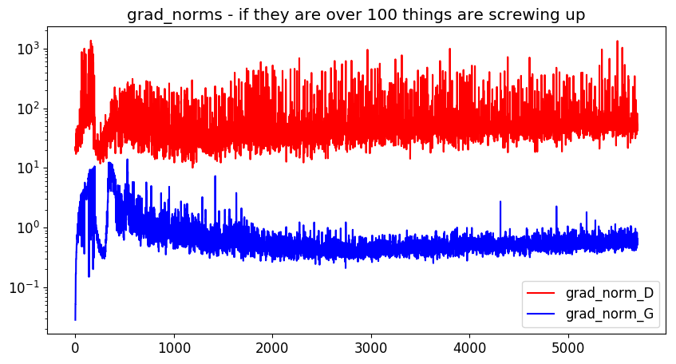
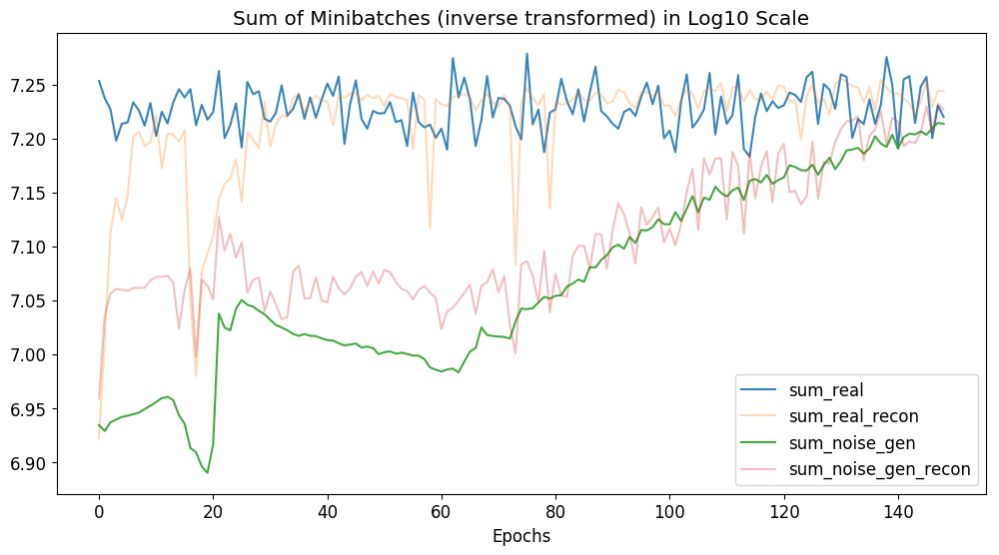
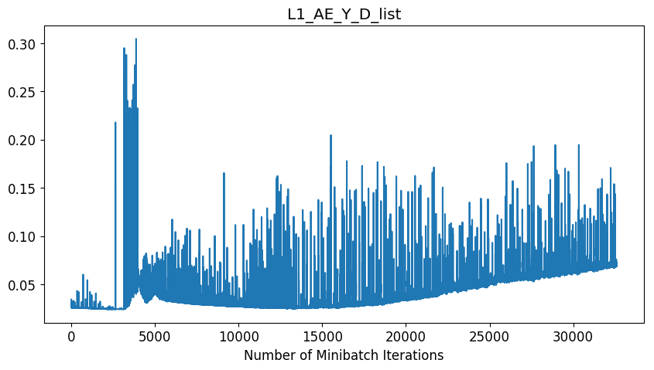
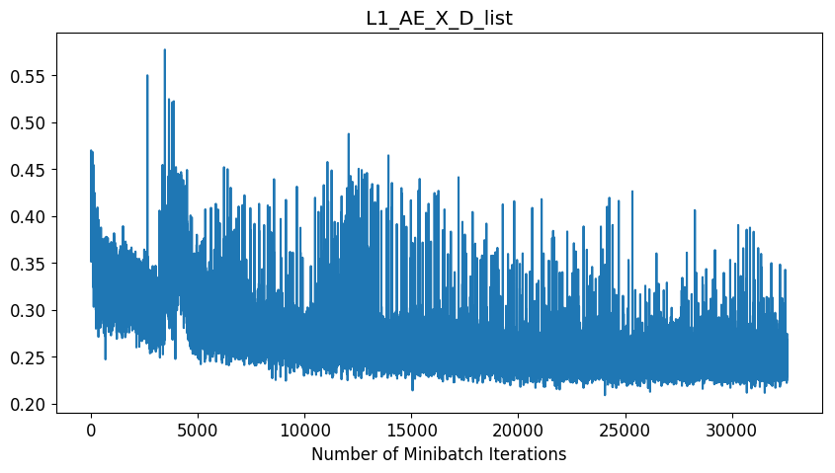
Plots - Training
Notes:
Copy this slide for every different configuration

Slide 8
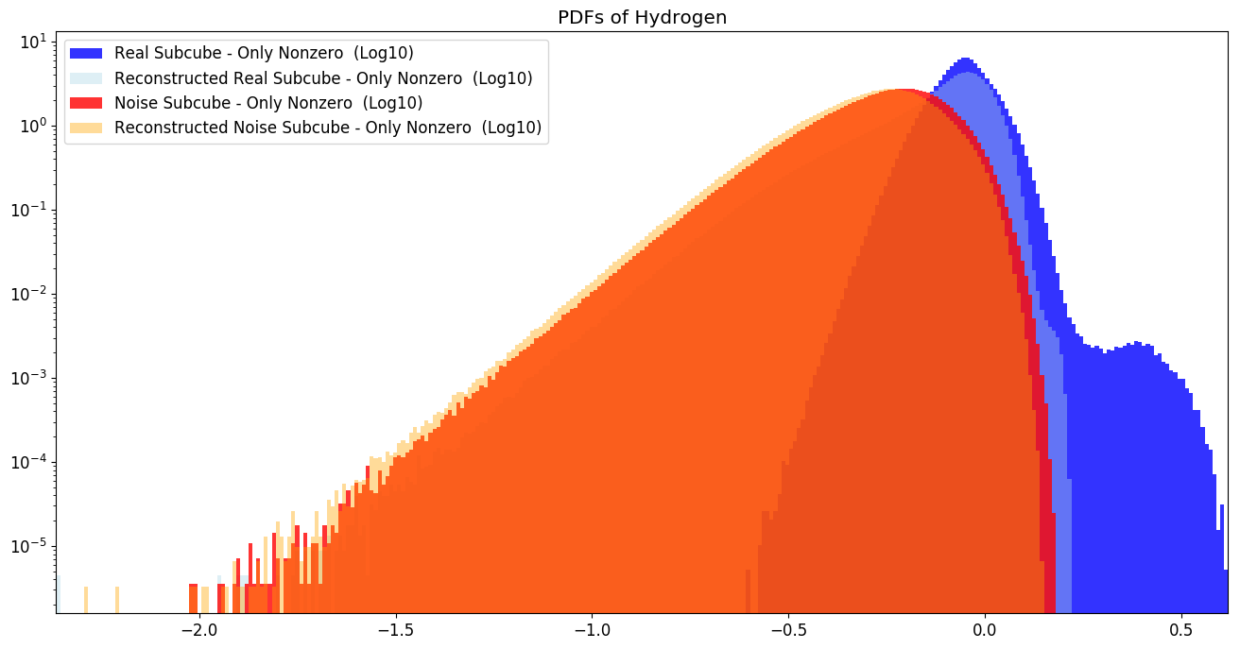
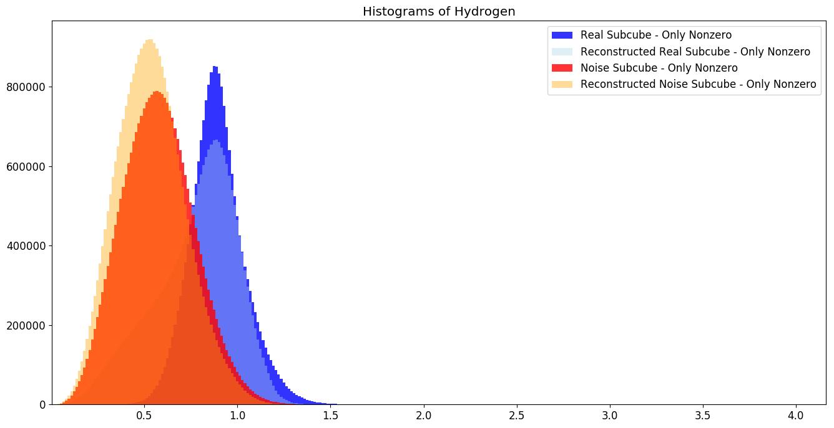
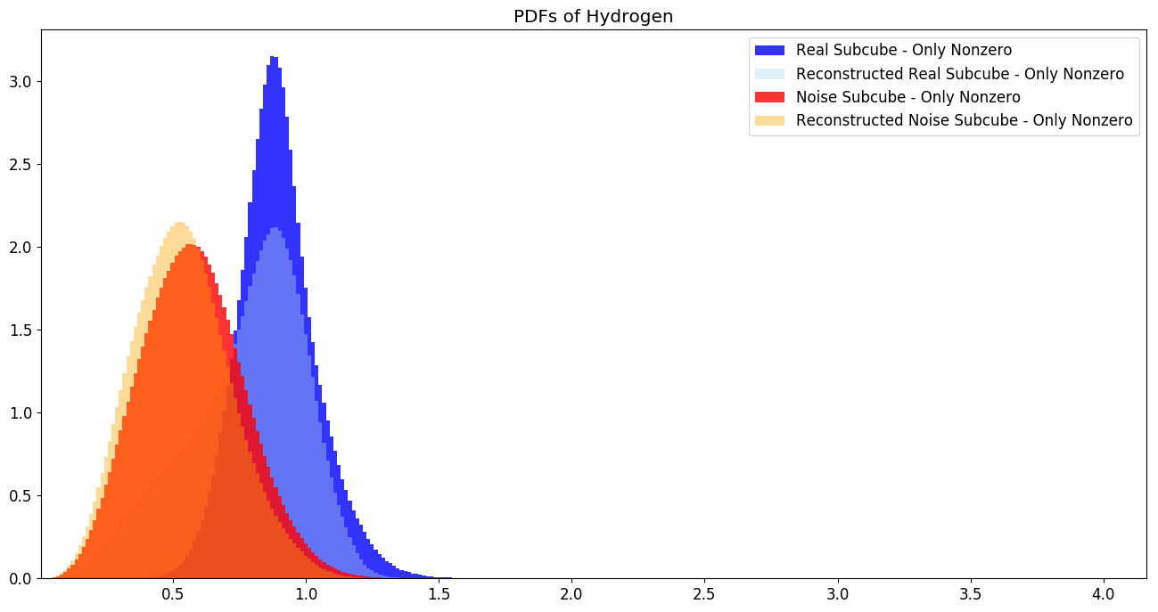
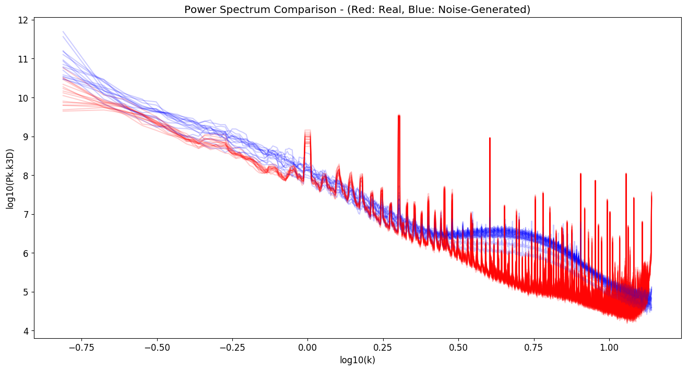
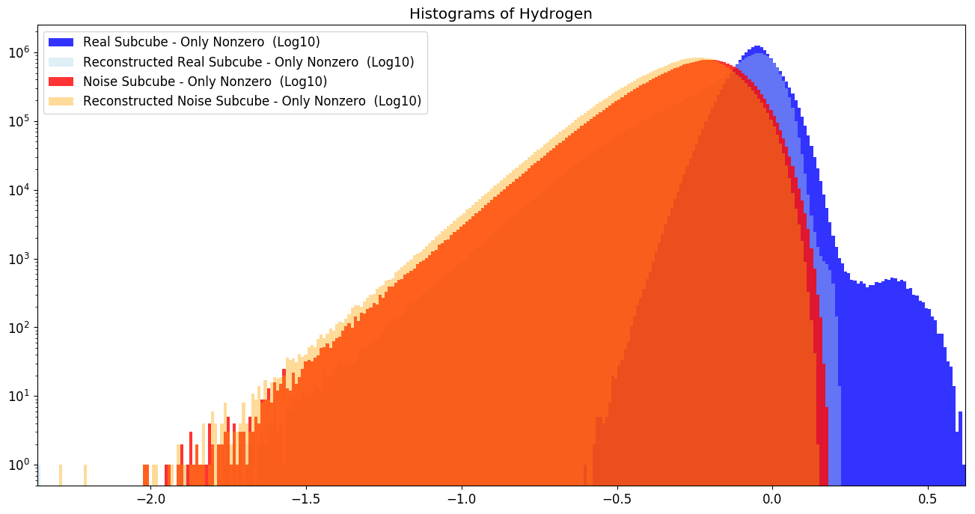
Plots – Matter Distributions
Notes:
Copy this slide for every different configuration

Slide 9
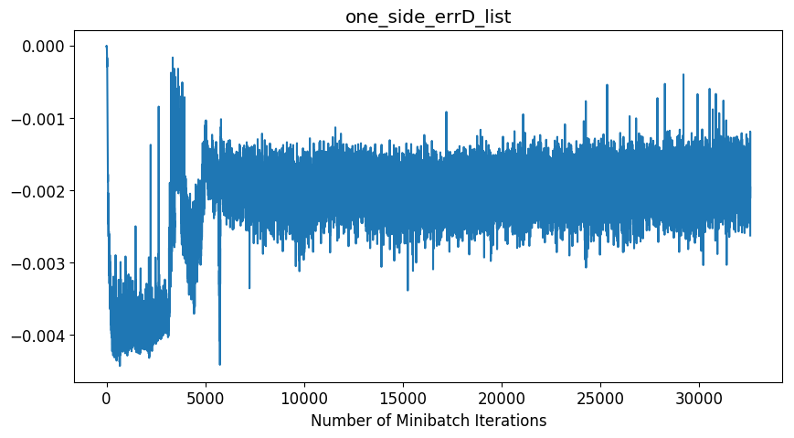
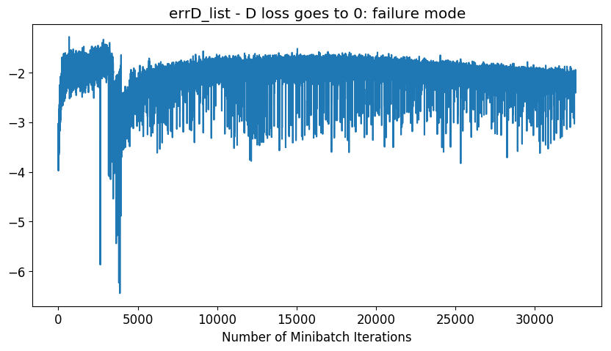
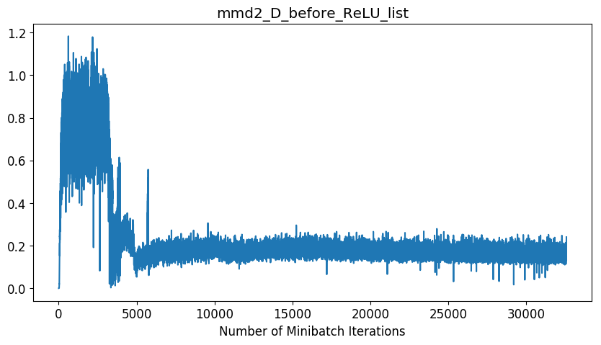

Plots - Discriminator
Notes:
Copy this slide for every different configuration

Slide 10
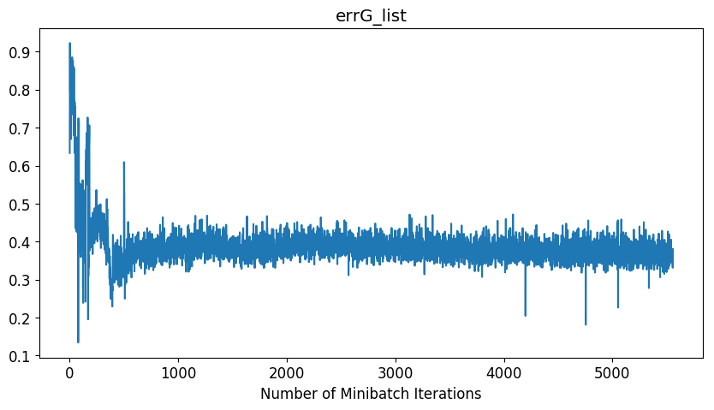
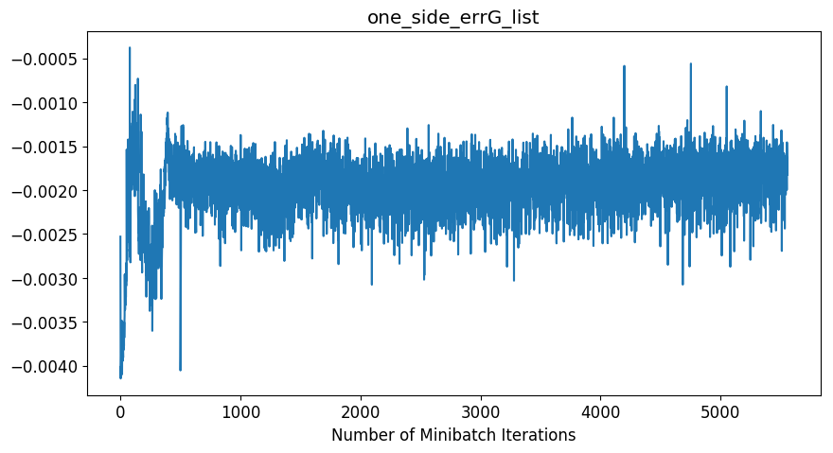
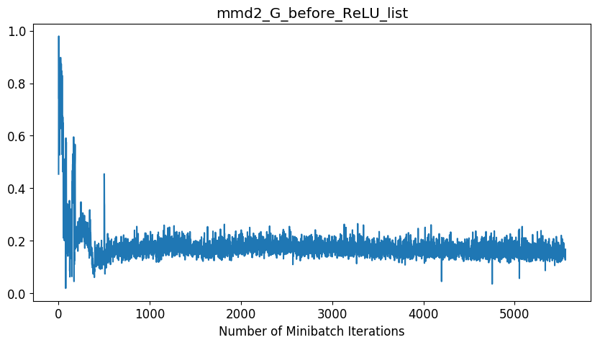

Plots - Generator
Notes:
Copy this slide for every different configuration

Slide 11
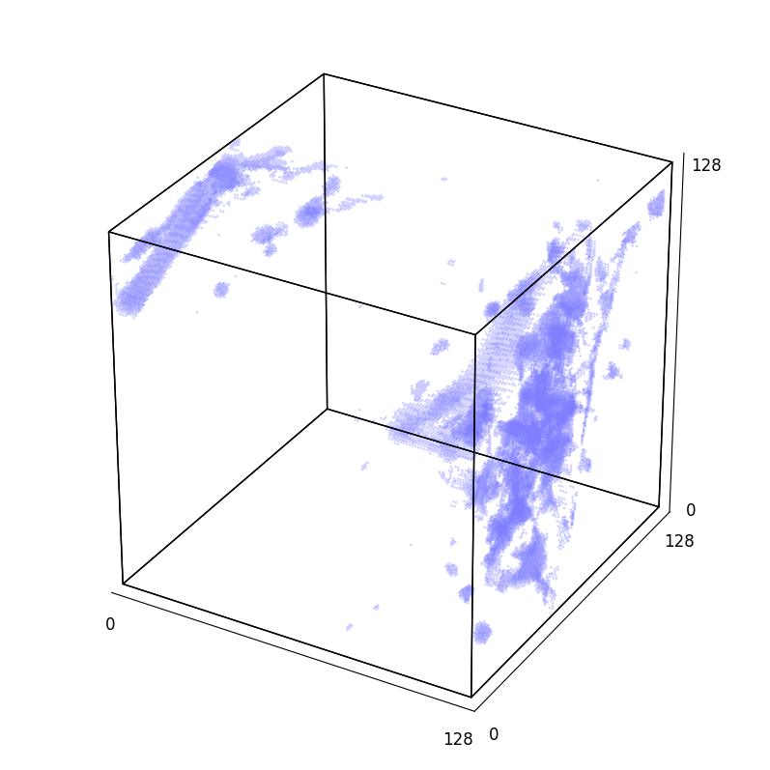
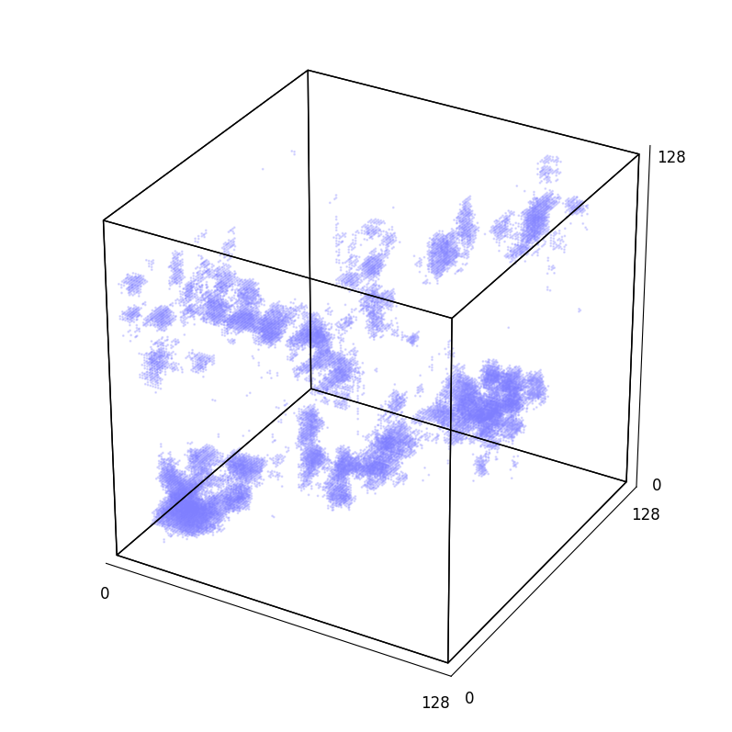
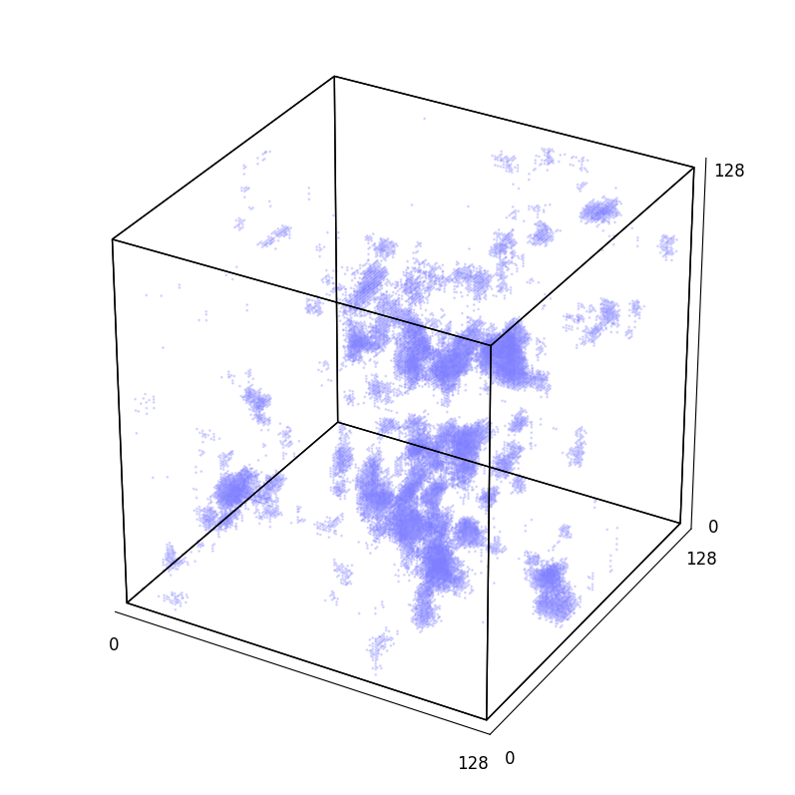
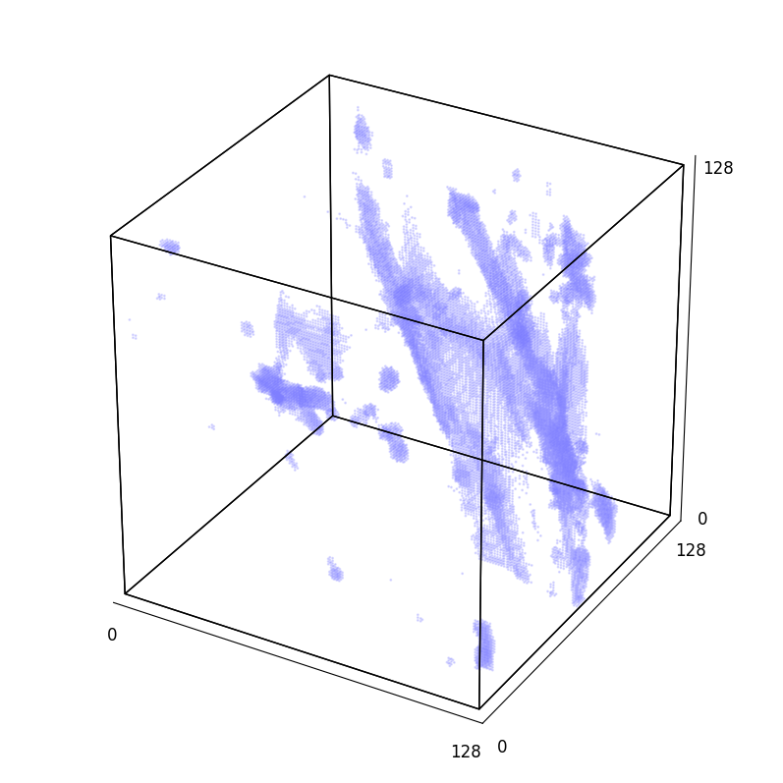
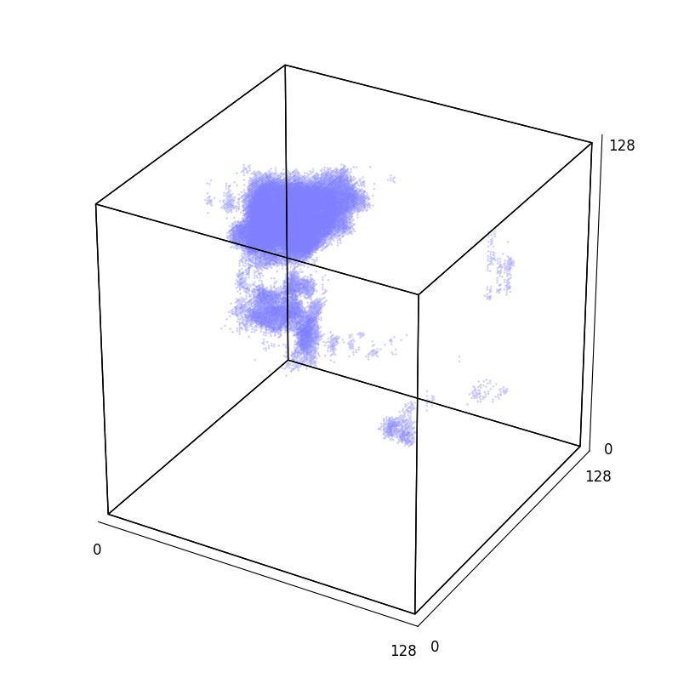
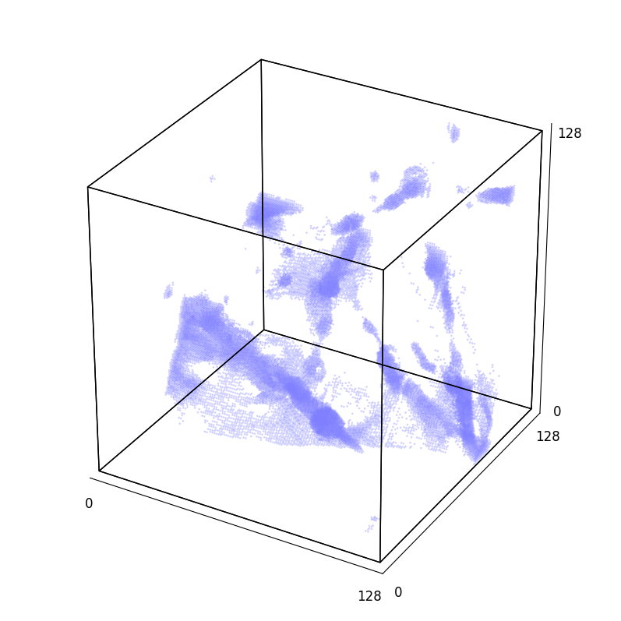
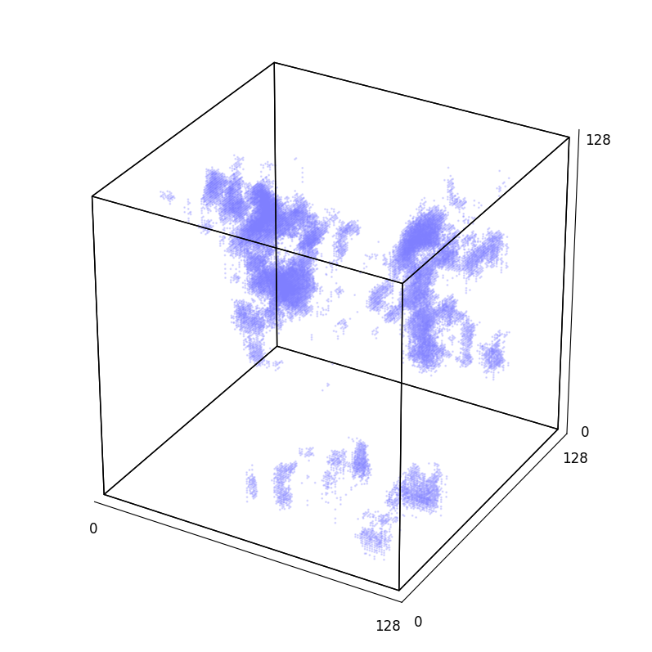
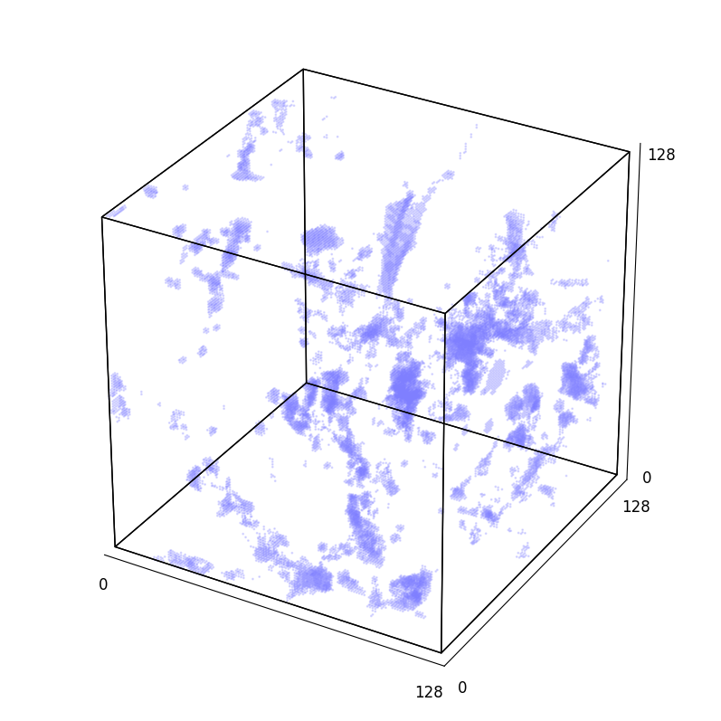
3D Plots of Real / Noise Input / AE Real / AE Noise
REAL
NOISE-INPUT GENERATED
Upper Left: Epoch 145, Upper Right: Epoch 140, Lower Left Epoch 135, Lower Right Epoch 130

Slide 12
Template

Slide 13
Parameters
Parameter | Value
Batch_size | 16
Number of samples | 2048
Lr (learning rate) | 5e-5
Number of epochs | 150
Optimizer | rmsprop
Dist_ae (reconstruction loss function for autoencoding) | L2
Gen_iterations_limit | 3
Diter_1 | 100
Giter_1 | 1
Diter_2 | 5
Giter_2 | 1
Sampled Cube Edge | 128
Test Cube Edge | 512
Parameter | Value
Nz (embedded space channels) | 256
Lambda_AE_X & Y | 8
Lambda_rg | 16
Sigma list | [1.0, 2.0, 4.0, 8.0, 16.0]
Minimum variance estimated | 1e-30
Left_clamp
Right_clamp
Redshift_raw_file | fields_z=0.0.hdf5
Redshift_file | minmax_scale_01_redshift0.h5
Inverse transform | minmax01
Slurm | 10003899
Notes:
Copy this slide for every different configuration

Slide 14
Architectures – Changes in bold & italic
Encoder
Decoder
(encoder): Encoder(
(conv1_encode): Conv3d(1, 4, kernel_size=(3, 3, 3), stride=(1, 1, 1))
(bn1_encode): BatchNorm3d(4, eps=1e-05, momentum=0.1, affine=True, track_running_stats=True)
(leakyrelu1): LeakyReLU(negative_slope=0.2, inplace)
(pool1_encode): AvgPool3d(kernel_size=2, stride=2, padding=0)
(conv2_encode): Conv3d(4, 24, kernel_size=(4, 4, 4), stride=(1, 1, 1))
(bn2_encode): BatchNorm3d(24, eps=1e-05, momentum=0.1, affine=True, track_running_stats=True)
(leakyrelu2): LeakyReLU(negative_slope=0.2, inplace)
(pool2_encode): AvgPool3d(kernel_size=2, stride=2, padding=0)
(conv3_encode): Conv3d(24, 48, kernel_size=(3, 3, 3), stride=(1, 1, 1))
(bn3_encode): BatchNorm3d(48, eps=1e-05, momentum=0.1, affine=True, track_running_stats=True)
(leakyrelu3): LeakyReLU(negative_slope=0.2, inplace)
(pool3_encode): AvgPool3d(kernel_size=2, stride=2, padding=0)
(conv4_encode): Conv3d(48, 64, kernel_size=(4, 4, 4), stride=(2, 2, 2))
(bn4_encode): BatchNorm3d(64, eps=1e-05, momentum=0.1, affine=True, track_running_stats=True)
(leakyrelu4): LeakyReLU(negative_slope=0.2, inplace)
(conv5_encode): Conv3d(64, 128, kernel_size=(3, 3, 3), stride=(1, 1, 1))
(bn5_encode): BatchNorm3d(128, eps=1e-05, momentum=0.1, affine=True, track_running_stats=True)
(leakyrelu5): LeakyReLU(negative_slope=0.2, inplace)
(conv6_encode): Conv3d(128, 256, kernel_size=(2, 2, 2), stride=(1, 1, 1))
(bn6_encode): BatchNorm3d(256, eps=1e-05, momentum=0.1, affine=True, track_running_stats=True)
(leakyrelu6): LeakyReLU(negative_slope=0.2, inplace)
(conv7_encode): Conv3d(256, 256, kernel_size=(2, 2, 2), stride=(1, 1, 1))
(bn7_encode): BatchNorm3d(256, eps=1e-05, momentum=0.1, affine=True, track_running_stats=True)
(leakyrelu7): LeakyReLU(negative_slope=0.2, inplace)
)
(decoder): Decoder(
(deconv1_decode): ConvTranspose3d(256, 256, kernel_size=(2, 2, 2), stride=(1, 1, 1))
(bn1_decode): BatchNorm3d(256, eps=1e-05, momentum=0.1, affine=True, track_running_stats=True)
(leakyrelu1): LeakyReLU(negative_slope=0.2, inplace)
(deconv2_decode): ConvTranspose3d(256, 128, kernel_size=(2, 2, 2), stride=(1, 1, 1))
(bn2_decode): BatchNorm3d(128, eps=1e-05, momentum=0.1, affine=True, track_running_stats=True)
(leakyrelu2): LeakyReLU(negative_slope=0.2, inplace)
(deconv3_decode): ConvTranspose3d(128, 64, kernel_size=(3, 3, 3), stride=(1, 1, 1))
(bn3_decode): BatchNorm3d(64, eps=1e-05, momentum=0.1, affine=True, track_running_stats=True)
(leakyrelu3): LeakyReLU(negative_slope=0.2, inplace)
(deconv4_decode): ConvTranspose3d(64, 48, kernel_size=(4, 4, 4), stride=(2, 2, 2))
(bn4_decode): BatchNorm3d(48, eps=1e-05, momentum=0.1, affine=True, track_running_stats=True)
(leakyrelu4): LeakyReLU(negative_slope=0.2, inplace)
(unpool1): Upsample(scale_factor=2, mode=nearest)
(deconv5_decode): ConvTranspose3d(48, 24, kernel_size=(3, 3, 3), stride=(1, 1, 1))
(bn5_decode): BatchNorm3d(24, eps=1e-05, momentum=0.1, affine=True, track_running_stats=True)
(leakyrelu5): LeakyReLU(negative_slope=0.2, inplace)
(unpool2): Upsample(scale_factor=2, mode=nearest)
(deconv6_decode): ConvTranspose3d(24, 4, kernel_size=(4, 4, 4), stride=(1, 1, 1))
(bn6_decode): BatchNorm3d(4, eps=1e-05, momentum=0.1, affine=True, track_running_stats=True)
(leakyrelu6): LeakyReLU(negative_slope=0.2, inplace)
(unpool3): Upsample(scale_factor=2, mode=nearest)
(deconv7_decode): ConvTranspose3d(4, 1, kernel_size=(3, 3, 3), stride=(1, 1, 1))
(bn7_decode): BatchNorm3d(1, eps=1e-05, momentum=0.1, affine=True, track_running_stats=True)
(relu7): ReLU(inplace)
)
Discriminator = Encoder + Decoder | Generator = Decoder
Notes:
Copy this slide for every different configuration

Slide 15
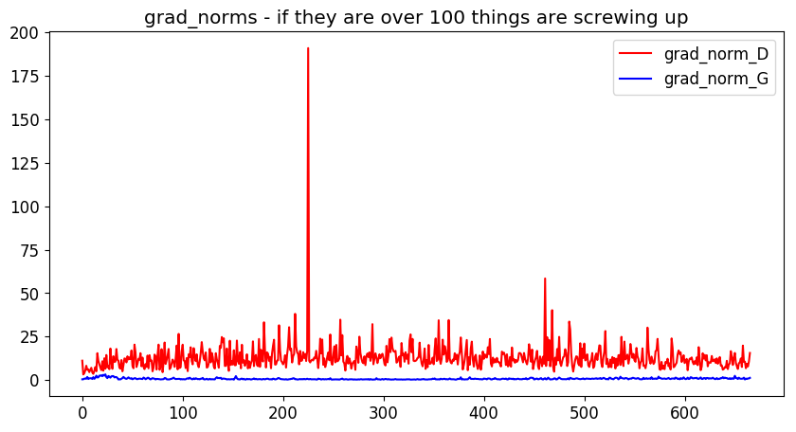
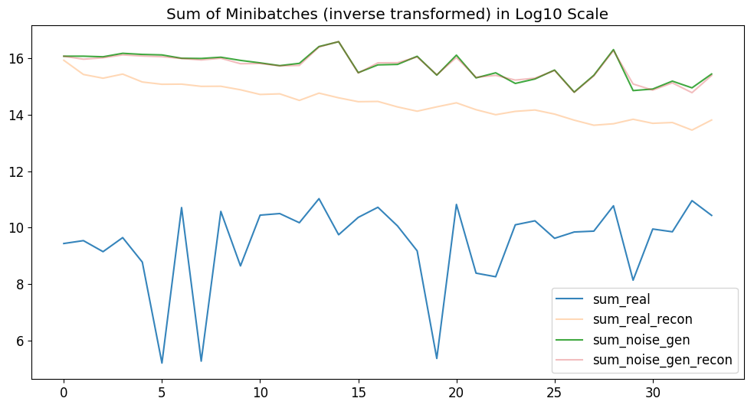
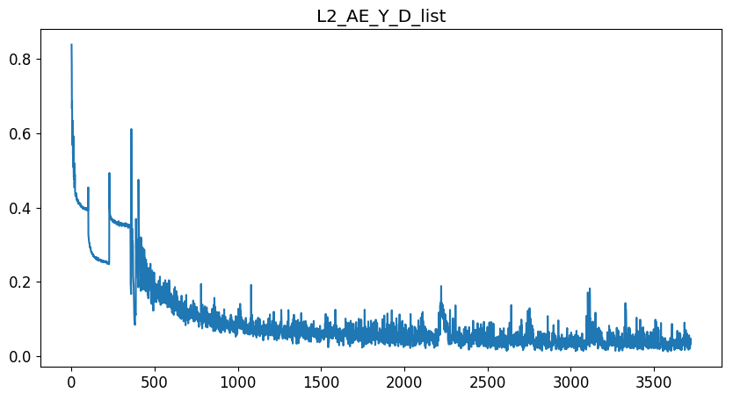
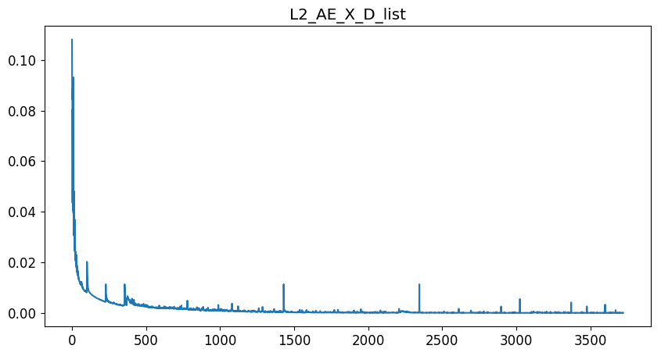
Plots - Training
Notes:
Copy this slide for every different configuration

Slide 16
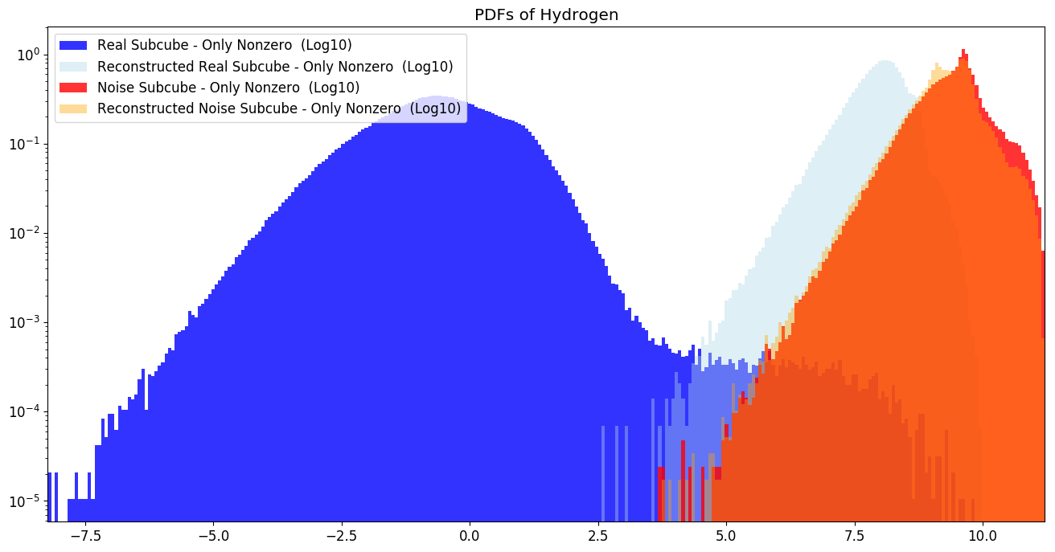
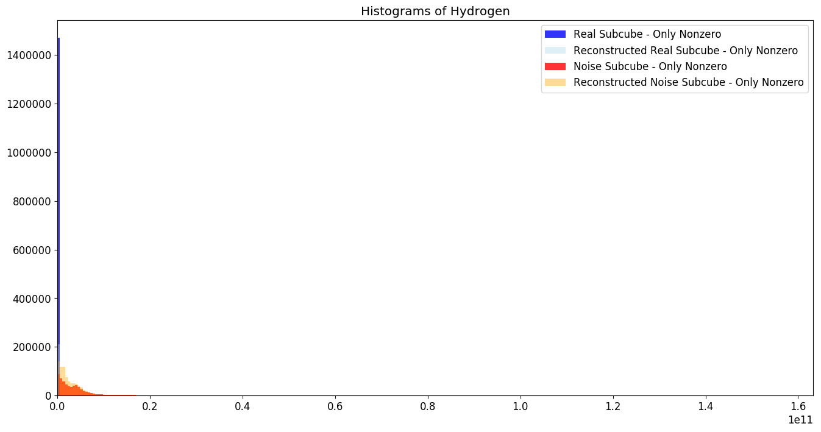
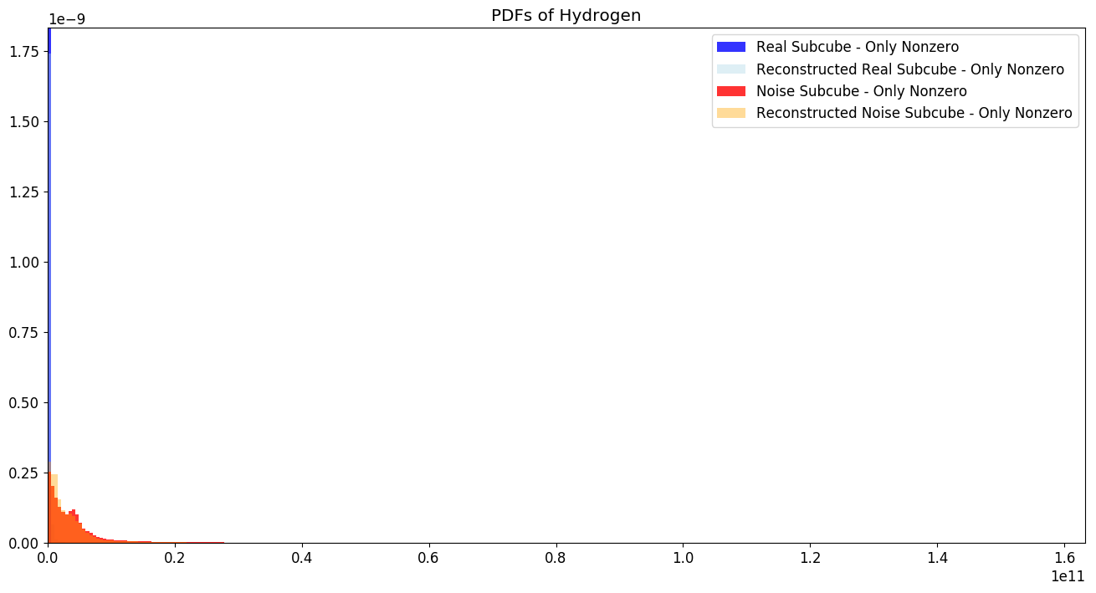
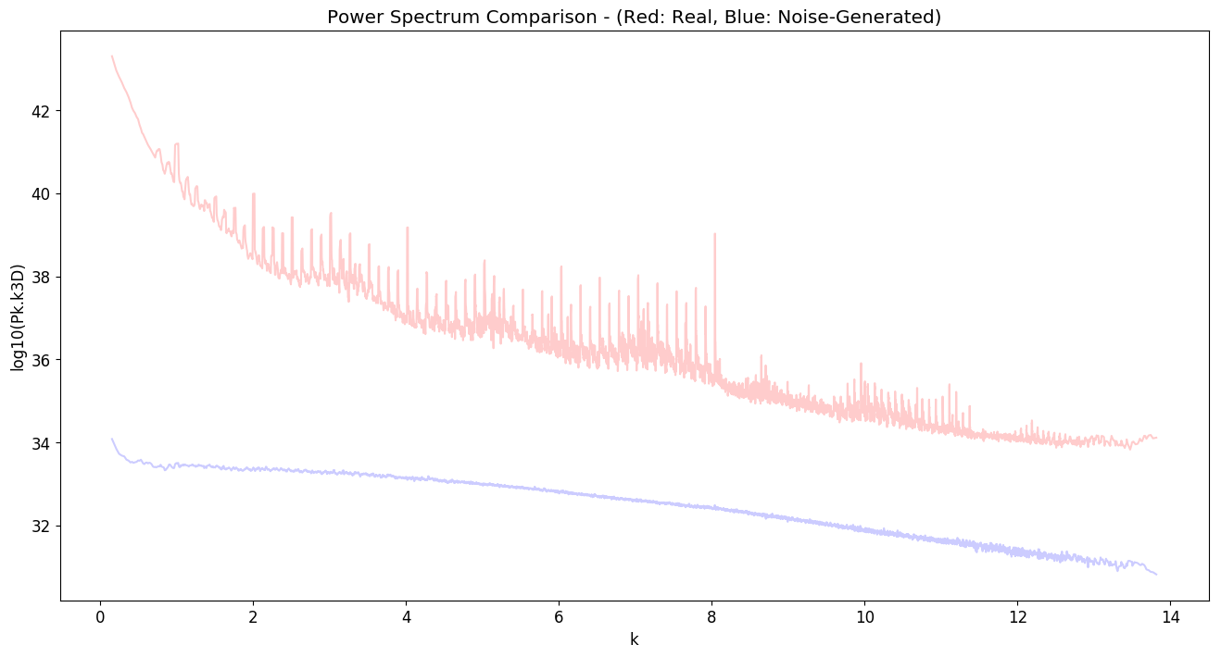
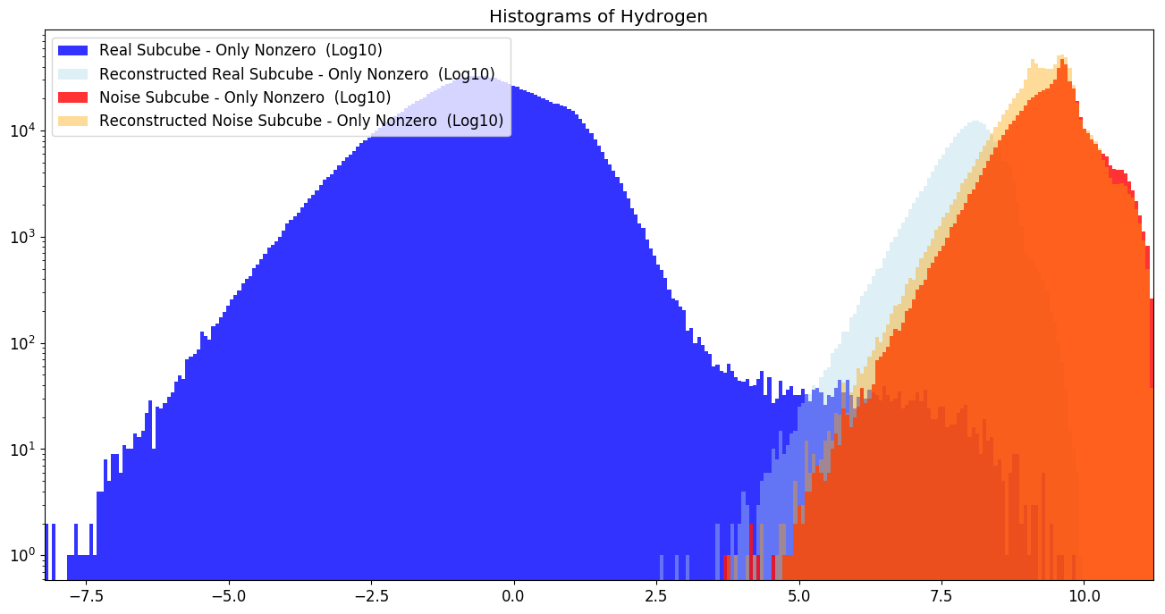
Plots – Matter Distributions
Notes:
Copy this slide for every different configuration

Slide 17
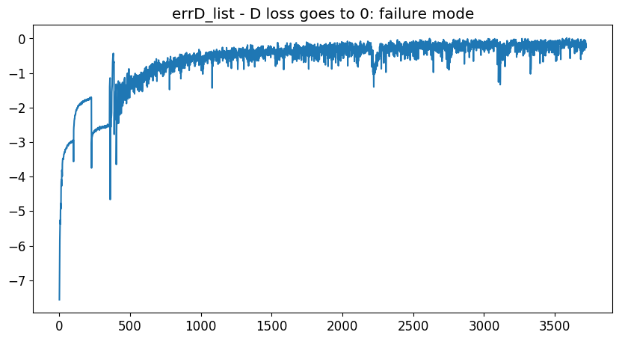
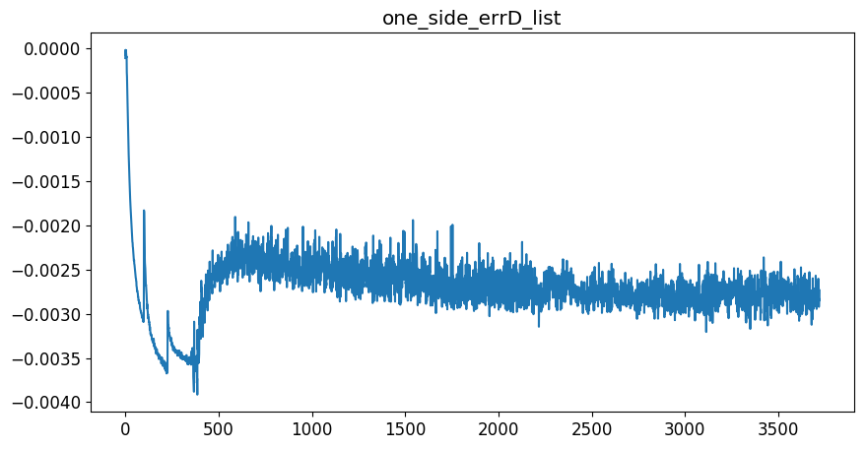
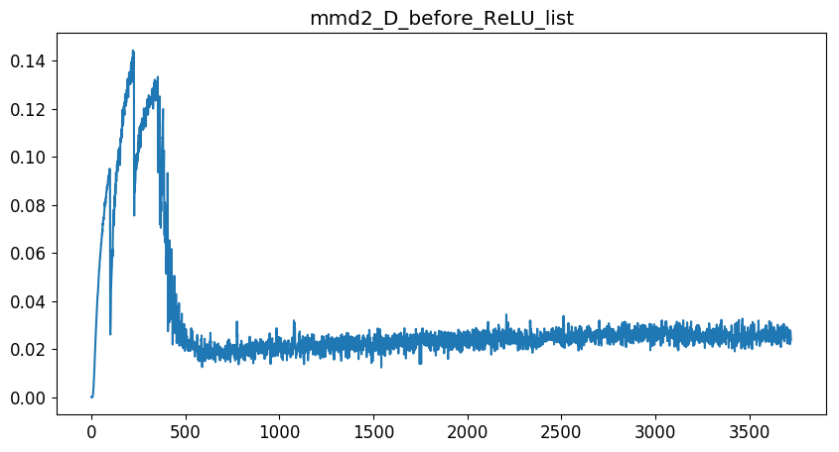

Plots - Discriminator
Notes:
Copy this slide for every different configuration

Slide 18
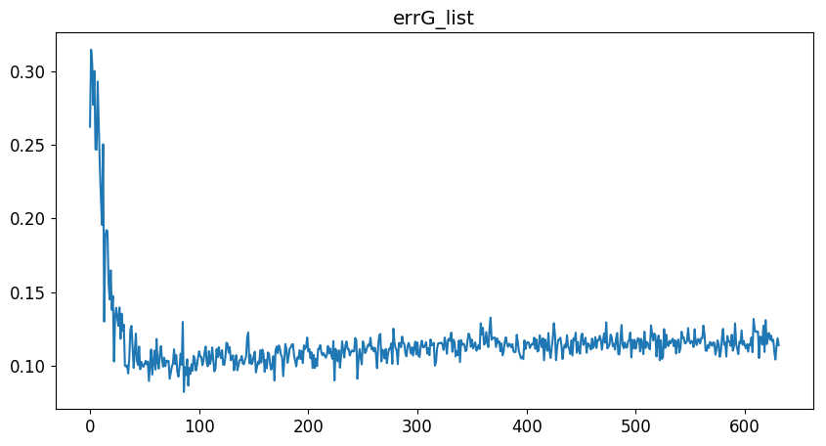
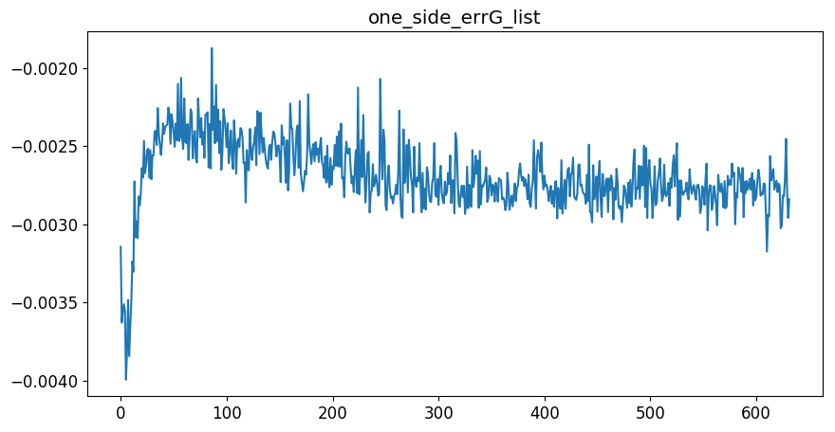
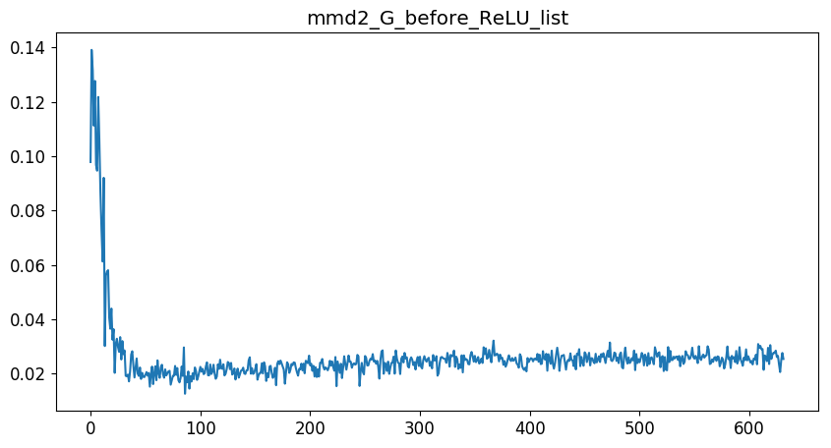
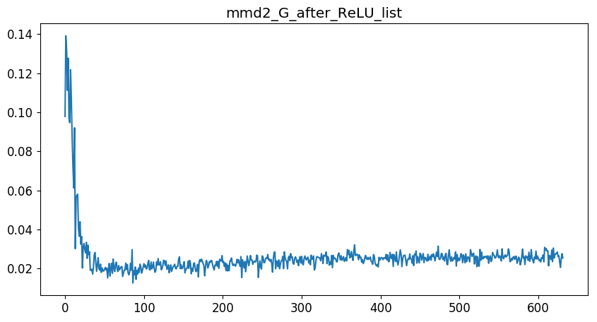
Plots - Generator
Notes:
Copy this slide for every different configuration

Slide 19
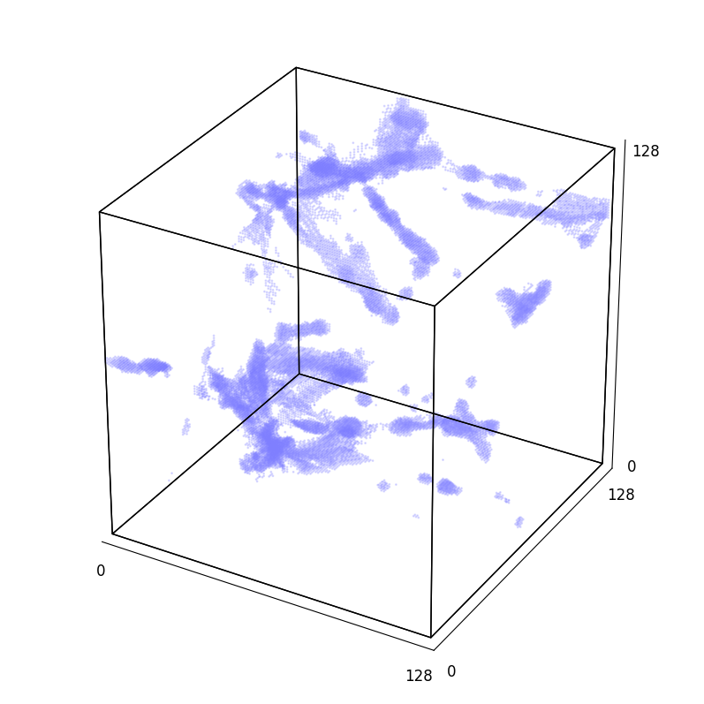
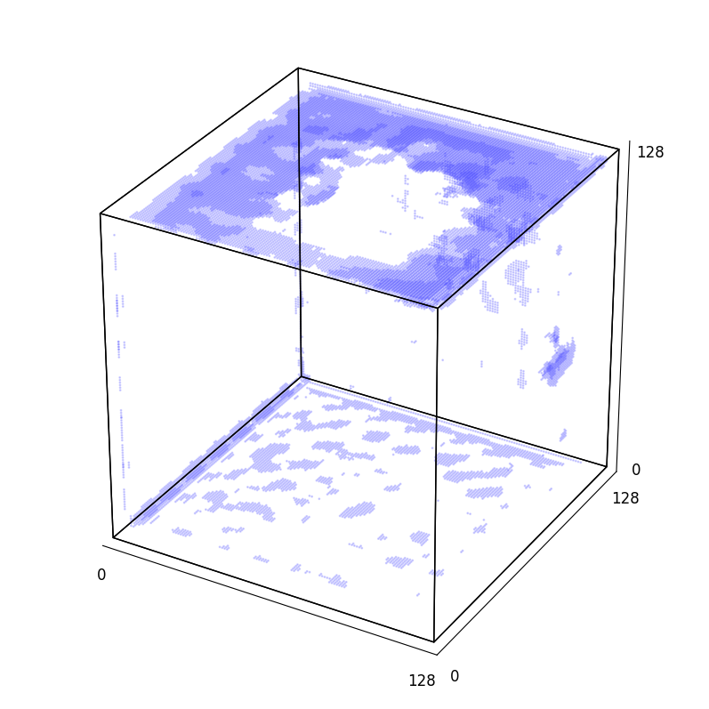
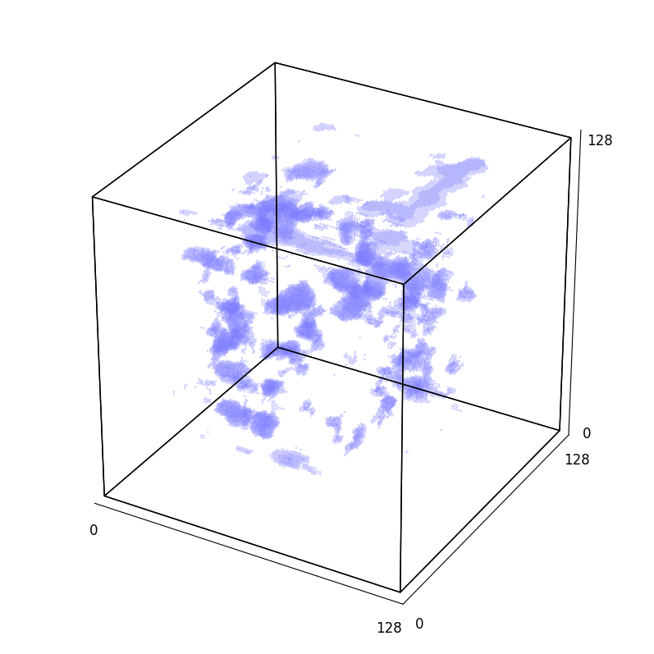
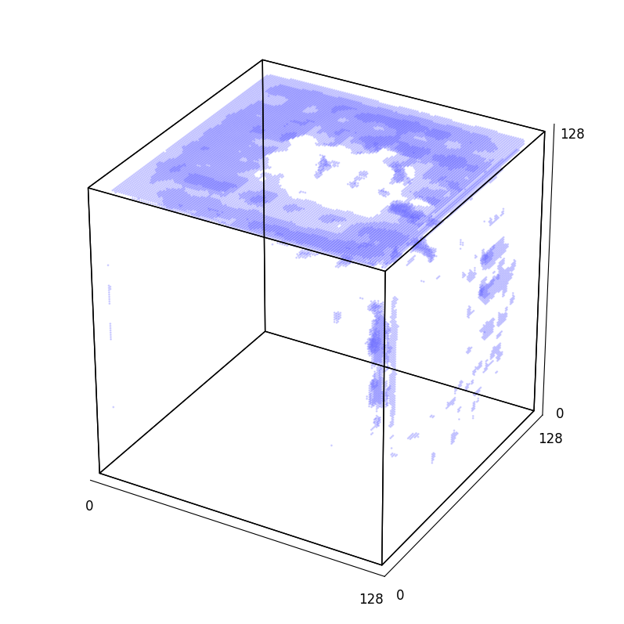
3D Plots of Real / Noise Input / AE Real / AE Noise

