Slide 1
ADDRESSING RECIDIVISM
INTERVENING TO REDUCE TECHNICAL VIOLATIONS AND IMPROVE OUTCOMES FOR EX-OFFENDERS
Preliminary Draft - Do Not Cite

Slide 2






PROJECT TEAM
EVAN
ABSHER
Kauffman Foundation
DANIELLE FULMER
City of South Bend
KATE PAWASARAT
City of Milwaukee
ERIC
ROCHE
City of Kansas City
NOLAN ZAROFF
City of Milwaukee
LI’L SEBASTIAN
Team Mascot
Applied Data Analytics | Team C2
Preliminary Draft - Do Not Cite

Slide 3
RESEARCH
QUESTION
What factors influence the likelihood that an individual will recidivate within two years for a technical parole or mandatory supervised release (MSR) violation?
Applied Data Analytics | Team C2
Preliminary Draft - Do Not Cite

Slide 4
PROJECT
GOALS
Understand the effect of relevant factors on recidivism
Develop a prioritization tool to identify those most likely to recidivate within 2 years for a technical or MSR violation
Applied Data Analytics | Team C2
Preliminary Draft - Do Not Cite

Slide 5
BACKGROUND:
WHY 2 YEARS?
Source: US Bureau of Justice Statistics, Recidivism rates of prisoners released in 2005 from prisons in 30 states * Here “recidivate” refers specifically to re-arrest, not necessarily re-incarceration
Applied Data Analytics | Team C2
Preliminary Draft - Do Not Cite
Notes:
Nearly ¾ of individuals who end up recidivating do so within 2 years of release.

Slide 6
BACKGROUND:
WHY TECHNICAL?
“…20 percent to 31 percent of all admissions to prison in Illinois over the past 10 state fiscal years have been for technical MSR violations…”
Source: Illinois Sentencing Policy Advisory Council, “Drivers of the Sentenced Population: MSR Violators” (Summer 2013)
Applied Data Analytics | Team C2
Preliminary Draft - Do Not Cite

Slide 7
BACKGROUND:
WHY TECHNICAL?
Policy solutions might be simpler and more politically feasible:
Is it as simple as better transit access?
More flexible parole officer check-ins?
Developing an achievable employment plan prior to exit?
Applied Data Analytics | Team C2
Preliminary Draft - Do Not Cite
Notes:
We also surmise that technical violations are “low-hanging fruit” – if we can identify those individuals most likely to return to prison on a technical violation, perhaps we can intervene in more simple ways to prevent recidivism than those with more complicated stories – and 20% - 30% of all admissions is a not-insignificant proportion of those returning to prison.

Slide 8
DESIGN & APPROACH
Use machine learning to predict recidivism risk
Target: individuals who exit prison between 2005 and 2013
Outcome variable: recidivism within 2 years for a technical or MSR violation
Applied Data Analytics | Team C2
Preliminary Draft - Do Not Cite

Slide 9
DESIGN & APPROACH
MACHINE LEARNING PROCESS
Prepare and explore data
Engineer features
Test models and select best
Evaluate results
Applied Data Analytics | Team C2
Preliminary Draft - Do Not Cite

Slide 10
RELEVANT
DATA SETS
Illinois Department of Corrections admissions data
Illinois Department of Corrections exit data
Illinois Department of Employment Security wage record data
Applied Data Analytics | Team C2
Preliminary Draft - Do Not Cite

Slide 11
EXIT POPULATION
CHARACTERISTICS
Applied Data Analytics | Team C2
Preliminary Draft - Do Not Cite

Slide 12
EXIT POPULATION
CHARACTERISTICS
Applied Data Analytics | Team C2
Preliminary Draft - Do Not Cite

Slide 13
EXIT POPULATION
CHARACTERISTICS
Applied Data Analytics | Team C2
Preliminary Draft - Do Not Cite
Notes:
Interesting to note that 26% of exiting individuals were admitted for a technical violation – we did not do an individual-level analysis, but what if we could isolate those with repeated technical violations and intervene?

Slide 14
EXIT POPULATION
CHARACTERISTICS
Average days in prison during most recent stay: 445
Average number of stays: 1.69 between 2013 and 2015
Average days out before return: 574
Applied Data Analytics | Team C2
Preliminary Draft - Do Not Cite

Slide 15
TARGET POPULATION
CHARACTERISTICS
Applied Data Analytics | Team C2
Preliminary Draft - Do Not Cite

Slide 16
MACHINE
LEARNING
What is machine learning?
A method in which a computer program learns from experience (data) with respect to a task and a performance measure
Source: Rayid Ghani presentation, 2017
Applied Data Analytics | Team C2
Preliminary Draft - Do Not Cite

Slide 17
MACHINE
LEARNING
Policy relevance:
Description
Detection
Prediction
Behavior change
Source: Rayid Ghani presentation, 2017
Applied Data Analytics | Team C2
Preliminary Draft - Do Not Cite

Slide 18
MACHINE
LEARNING
Magic Loop:
“Loops” data through series of machine learning models
Tests different parameters that can be adjusted for each model
Applied Data Analytics | Team C2
Preliminary Draft - Do Not Cite

Slide 19
MACHINE
LEARNING
Logistical Regression
Random Forest
Support Vector Machines
And others…
Machine Learning Methods Tried:
Decision Tree
Extra Trees
Gaussian Naive Bays
Gradient Boosting
K-Nearest Neighbor
Applied Data Analytics | Team C2
Preliminary Draft - Do Not Cite

Slide 20
MACHINE
LEARNING
Understanding Random Forests
Ensemble machine learning method
Best suited for classification problems
Constructs many decision trees and gives most predicted outcome overall
Assumes representative population sample
Applied Data Analytics | Team C2
Preliminary Draft - Do Not Cite

Slide 21
MACHINE
LEARNING
Understanding Random Forests
Number of features chosen at each “split” in the tree randomly selected
Creating many trees allows us to combine them into a model that is not over-fitted
Applied Data Analytics | Team C2
Preliminary Draft - Do Not Cite

Slide 22
MACHINE
LEARNING
Our Random Forest Model
Impute values for missing data
75 features included
Split into training and testing sets
Train model and apply to test data
Set threshold at 10% for evaluation
Applied Data Analytics | Team C2
Preliminary Draft - Do Not Cite
Notes:
[Maybe should discuss optimum level on precision / recall curve]

Slide 23
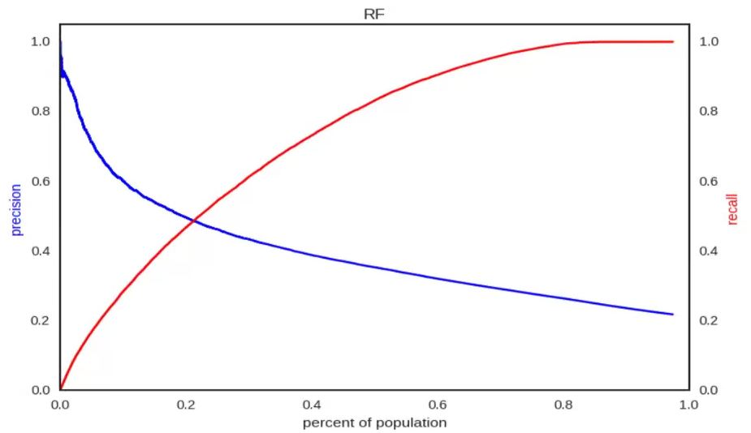
PRECISION/RECALL CURVES
AT VARYING POPULATIONS
Applied Data Analytics | Team C2
Preliminary Draft - Do Not Cite

Slide 24
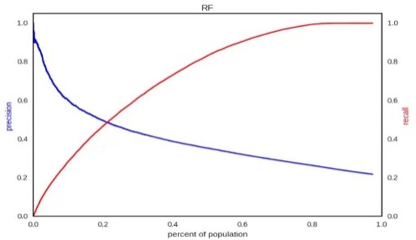
MODEL
RESULTS
Baseline: 21% of sample has a violation within 2 years of exit For the 10% riskiest population:
Accuracy: 81%
Precision: 0.61
Recall: 0.19
Applied Data Analytics | Team C2
Preliminary Draft - Do Not Cite
Notes:
“This means that if you look up the top 10% of the population by predicted risk score, 61% of them are going to have a technical parole violation and you'll capture 19% of all violators.”

Slide 25
MODEL
RESULTS
Employment plan
Habitual offender
Gang member
Drug use
Most important classifiers (in order)
Gender (male)
Marital status
Race/ethnicity
Veteran status
Sex offender status
Applied Data Analytics | Team C2
Preliminary Draft - Do Not Cite
Notes:
Feature importance ranking is similar to general recidivism predictors, but are stronger predictors for technical violators than for general recidivism.
This model used and found race to be predictive of technical parole violations. discussion is needed on how race plays into technical parole violations.

Slide 26
LIMITATIONS (OF THE TEAM)
Little or no prior knowledge of Illinois prison system
Little or no prior knowledge of machine learning method
Limited time to perform analysis
Possible changes in how variables are recorded / measured over study period
Applied Data Analytics | Team C2
Preliminary Draft - Do Not Cite

Slide 27
LIMITATIONS (OF OUR ASSUMPTIONS)
Every individual / story is unique
Even technical violations are complex
Don’t incorporate results of interventions already explored by IL DOC
Predictive model at exit cannot include subsequent relevant factors (e.g., successful employment after release)
Applied Data Analytics | Team C2
Preliminary Draft - Do Not Cite
Notes:
Initially we assumed that steady, gainful employment and access to transit would reduce the likelihood of an individual to recidivate due to a technical violation, but setting our model to predict at exit means we cannot include these factors. Additionally, every case is unique and what works for one individual may not work for another. Finally, our analysis did not include an analysis of previous efforts ILDOC has conducted related to technical violations.

Slide 28
LIMITATIONS (OF THE ANALYSIS)
Review from subject-matter expert
Clarify scope and impact of data entry errors, changes in variable coding over time or institution
Fine-tune model performance
Improve model based on specific intervention threshold, e.g., 5% most at-risk v. 20% most at-risk
Bias in the data (imputation, structural, etc.)
Applied Data Analytics | Team C2
Preliminary Draft - Do Not Cite

Slide 29
NEXT
STEPS
Effect of parole officer on parolee outcomes
Effect of transit availability and accessibility to jobs
Test model for collinearity, validate data using temporal methods, increase number of features
Applied Data Analytics | Team C2
Preliminary Draft - Do Not Cite
Notes:
A more complete analysis would consider the following factors…
Parole officer: need data from and about parole officers
Transit availability: need better data on where parolees are living

Slide 30
NEXT
STEPS
Source: Illinois Dept. of Corrections; Illinois Dept. of Employment Security
Applied Data Analytics | Team C2
Preliminary Draft - Do Not Cite
Notes:
We had hoped to study employment and recidivism more fully through our project. However, we were able to explore some basic information on the employment rates of our population of interest after their release from prison.
To better understand the relationship between recidivism and employment, we looked at employment rates for the 8 quarters following prison exits between 2005 and 2013. Individuals that recidivated for technical violations had only slightly higher employment rates compared to all individuals that recidivated within 2 years. Overall, employment rates for individuals that recidivated for technical violations ranged from 13% to 17% over the 2 years following their release.
Furthermore, although individuals that did not recidivate within 2 years have higher rates of employment, the employment rates remained below 30%.

Slide 31
NEXT
STEPS
Imprisoning someone is costly; reducing recidivism lowers costs
But targeting criminal violators is complex and politically sensitive
Intervening in technical violations could be more feasible, low-cost way of addressing incarceration rates
Applied Data Analytics | Team C2
Preliminary Draft - Do Not Cite
Notes:
Still, the results of our machine learning model suggests the following policy implications…

Slide 32
NEXT
STEPS
“[W]e’ve seen time and time again that mathematical models can sift through data to locate people who are likely to face great challenges, whether from crime, poverty, or education. It’s up to society whether to use that intelligence to reject and punish them – or to reach out to them with the resources they need.”
- Cathy O’Neil, Weapons of Math Destruction
Applied Data Analytics | Team C2
Preliminary Draft - Do Not Cite

Slide 33
QUESTIONS?
AND THANK YOU!
Applied Data Analytics | Team C2
Preliminary Draft - Do Not Cite

