Slide 1
ADRF demo
March 5, 2020

Slide 2
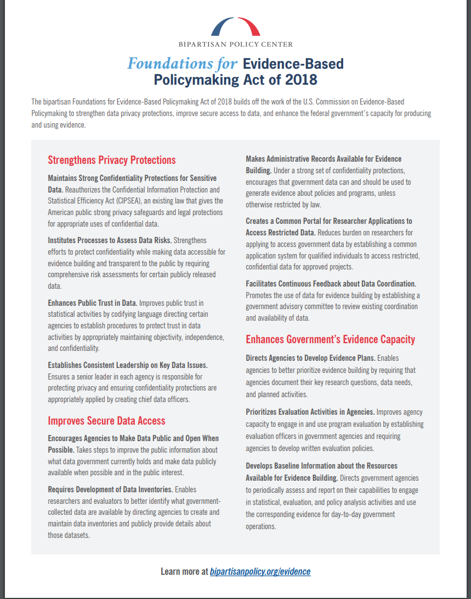
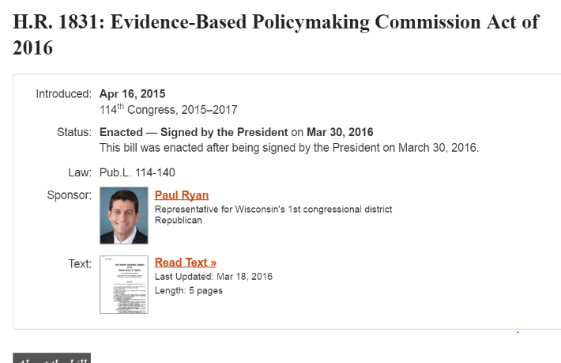
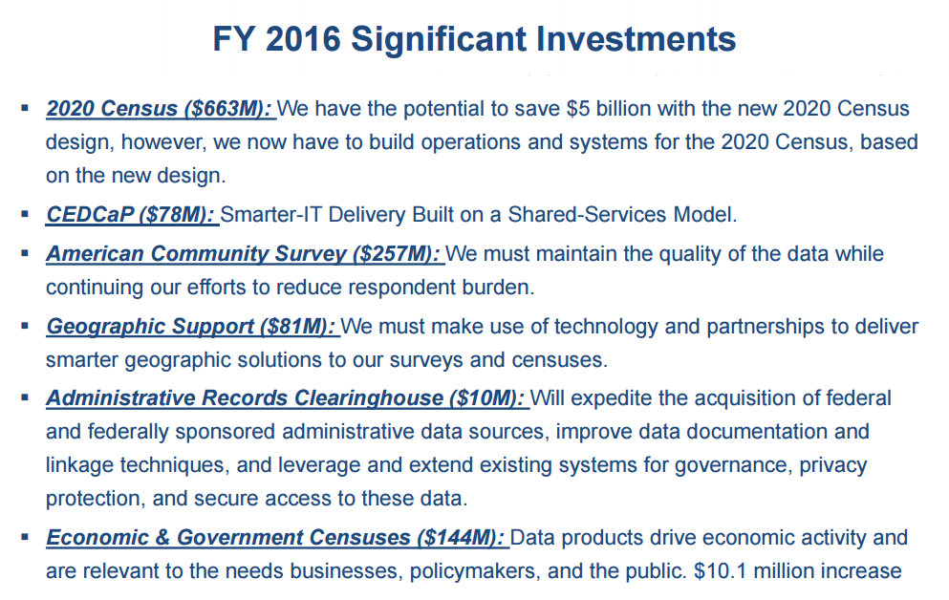
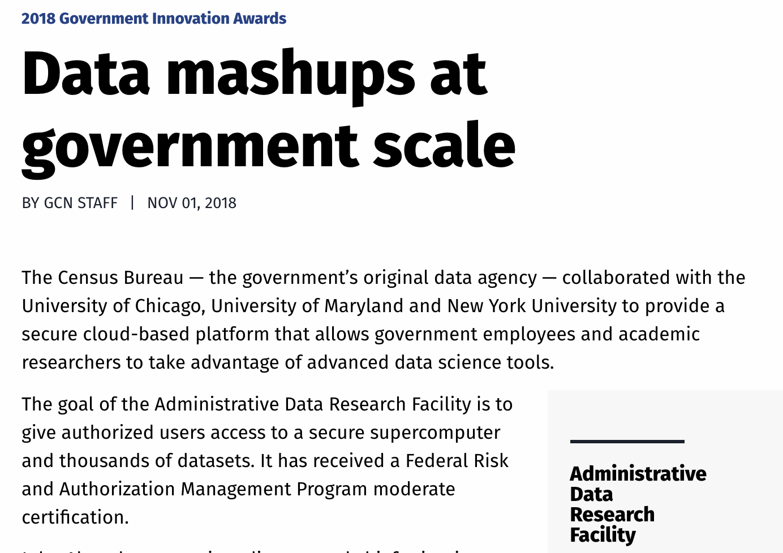
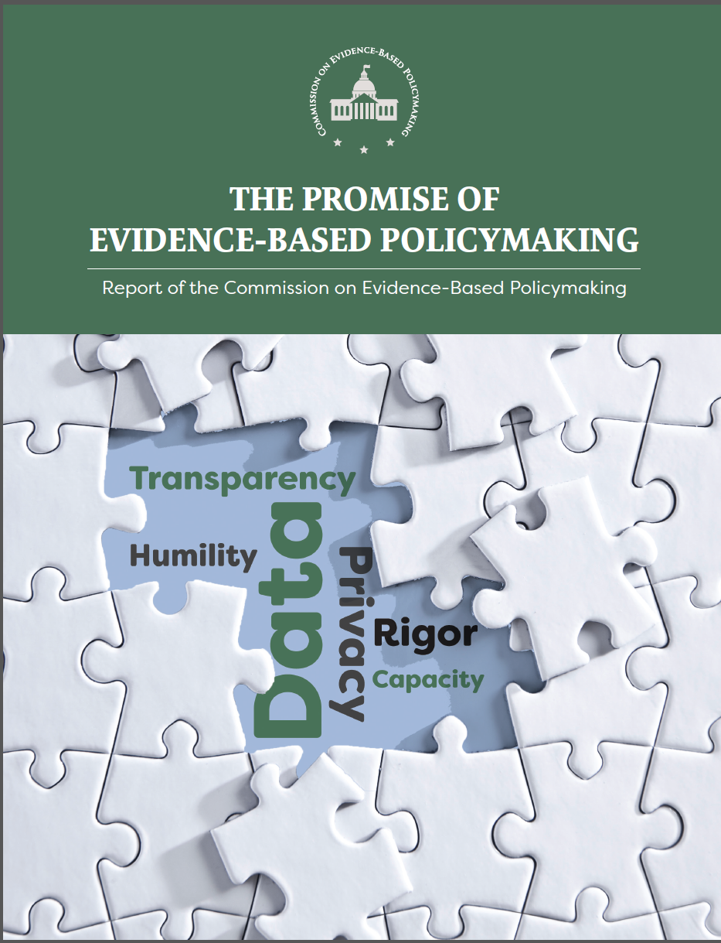
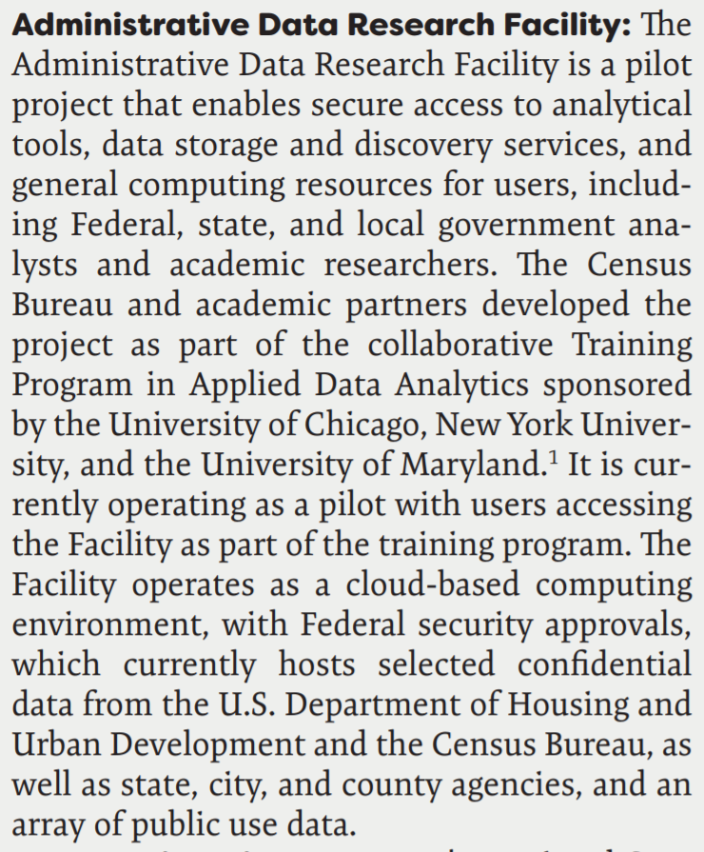
Background: Federal policy context

Slide 3
Approach: Five Safes
Safe Projects
Approved projects, consistent with agency mission
Safe People
Approved and trained researchers
Safe Settings
Secure environment, GovCloud, FedRamp Moderate
Safe Data
Deidentified Data
Safe Outputs
Disclosure reviews and export controls
= SAFE USE
https://en.wikipedia.org/wiki/Five_safes

Slide 4
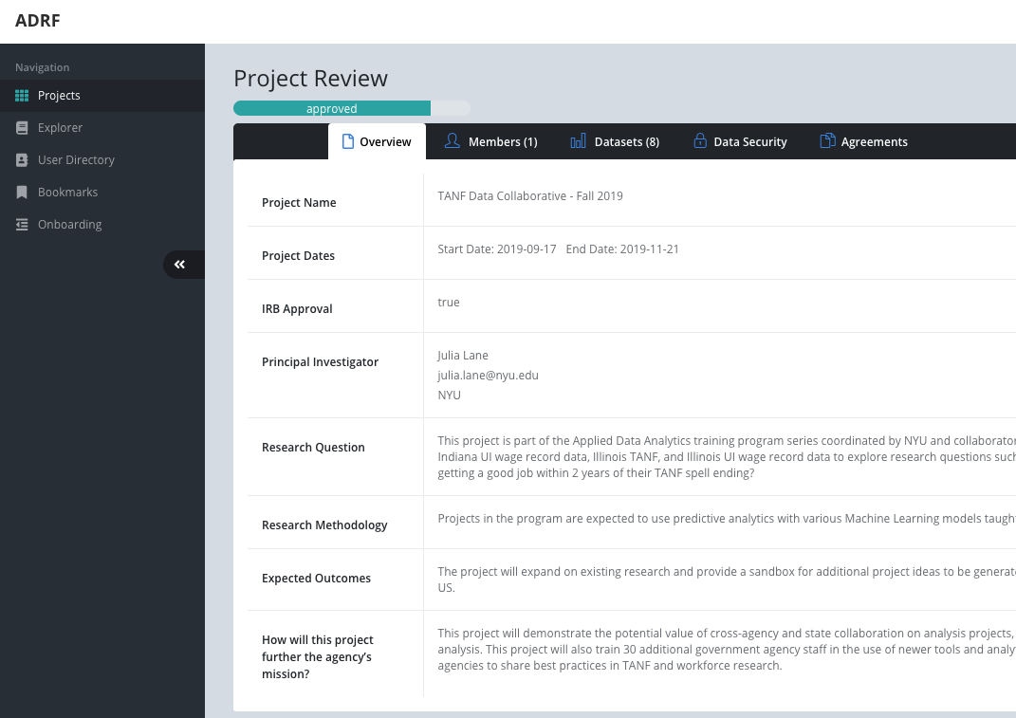
Safe Projects: all data access controlled on a project by project basis
Projects approved by Data Owner(s) via a Project Request
Project Requests include
Description including benefit to Data Owner(s)
Dataset(s)
People
Allows for dataset specific Non-Disclosure Agreements

Slide 5
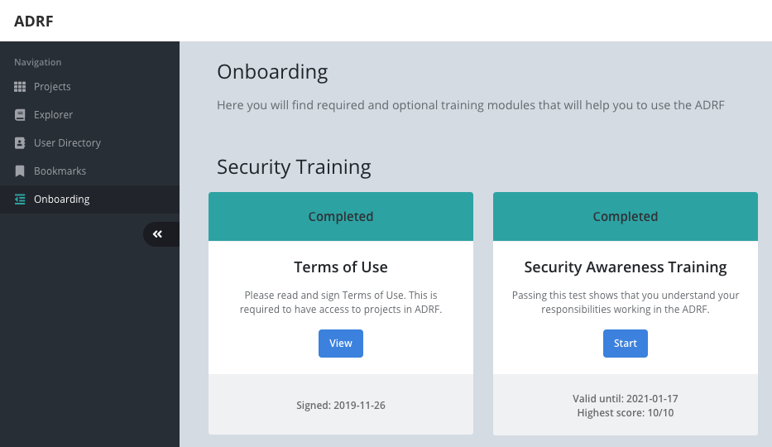
Safe People: only named users who have undergone Security training allowed access
ADRF onboarding
Security Awareness Training
Terms of Use

Slide 6
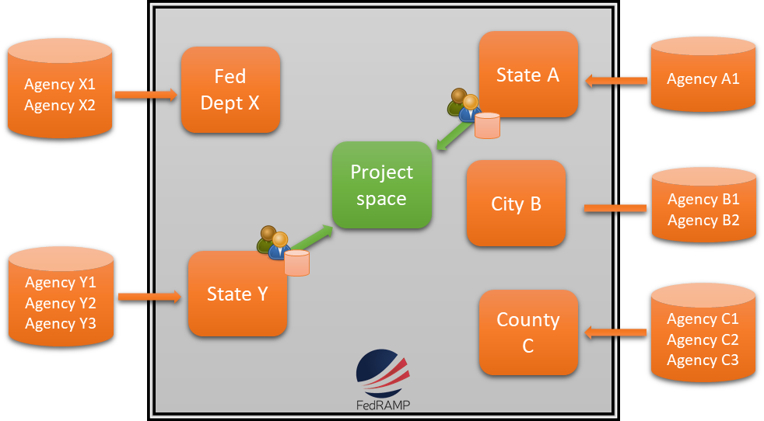
Safe Settings: FedRAMP Moderate with Census and USDA Authorization to Operate

Slide 7
Safe Data: only required information provided
Today: de-identified (hashed) PII
Future:
Tiered access
Flexibility to provide only subsets of data for use

Slide 8
Safe Outputs: nothing leaves without disclosure review
Data users request export
ADRF staff go through disclosure review
Option to include Data Owner specific criteria
Option for Data Owner to assign reviewer
Exports that pass are emailed to export requester

Slide 9
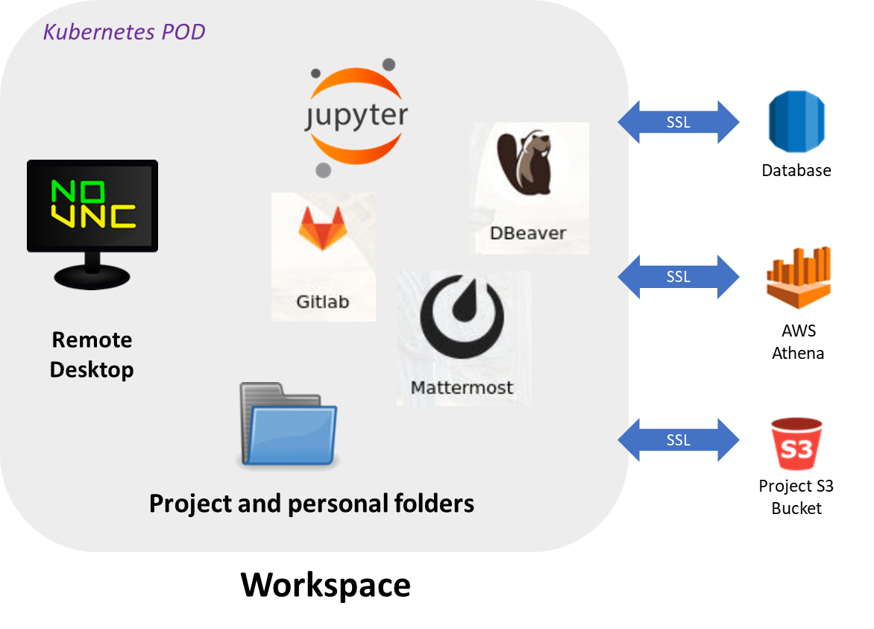
Use: secure, collaborative, scalable
Access: any modern web-browser
Collaborate: project level data storage, messaging, and code/scripts
Scale: big data tools and flexible compute configuration

Slide 10
LIVE DEMO

