Slide 1

Centralized and Decentralized Approaches to Student/Higher Education Data
Jason Owen-Smith
Executive Director, Institute for Research on Innovation & Science (IRIS)
Professor, Sociology
University of Michigan
iris.isr.umich.edu @IRIS_UMETRICS jdos@umich.edu

Slide 2
Roadmap
Who am I?
PSEO (Post-Secondary Employment Outcomes) Pilot Project
Data snippets
Costs and benefits of a different approaches

Slide 3
A Centralized approach, PSEO
Collaboration of U.S. Census Bureau (LEHD), IRIS, Universities & States
Two routes to get student data PIKed
State Education Offices work directly with Census (Colorado, UT-System)
Universities work through IRIS (Michigan, Wisconsin)
Benefits
Census – better educational attainment data for LEHD and related products
Universities – comprehensive outcome data for transparency and outreach
IRIS/Research Community – possible research dataset
Public – another source of data on career outcomes for all students (not just financial aid recipients)
States ????

Slide 4
Overall
47 campuses (four partners, 2 IRIS, 2 Census)
Mix of four year and two year (for State of Colorado)
Four “flagship” public campuses - UC-Boulder, UM-Ann Arbor, UW-Madison, UT-Austin
~2.5 million student records -- Associates, Bachelors, Masters, Professional, Doctorate
Formally private, noise infusion

Slide 5
Two tranches of data released
PSEO Earnings
National LEHD (U-I) earnings data by Degree Level, CIP Code
2016 $ (CPI-U)
3 Year Cohorts for Bachelor’s
5 Year Cohorts for Masters, Professional, Doctoral
Cell Counts, 25%, 50%, 75% at 1, 5, 10 years after graduation
PSEO Flow
Home State and Census Region Employment at 1, 5, 10 years
2 Digit NAICS of Employer at 1, 5, 10 years
By Degree Level, CIP Code

Slide 6
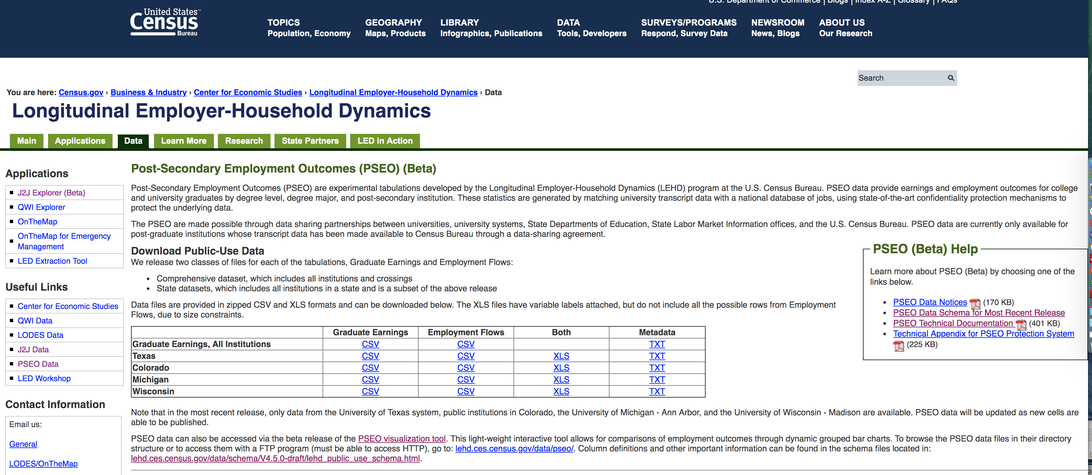
Both tranches are available with documentation
Andrew Foote, US Census Bureau, is the primary analyst

Slide 7
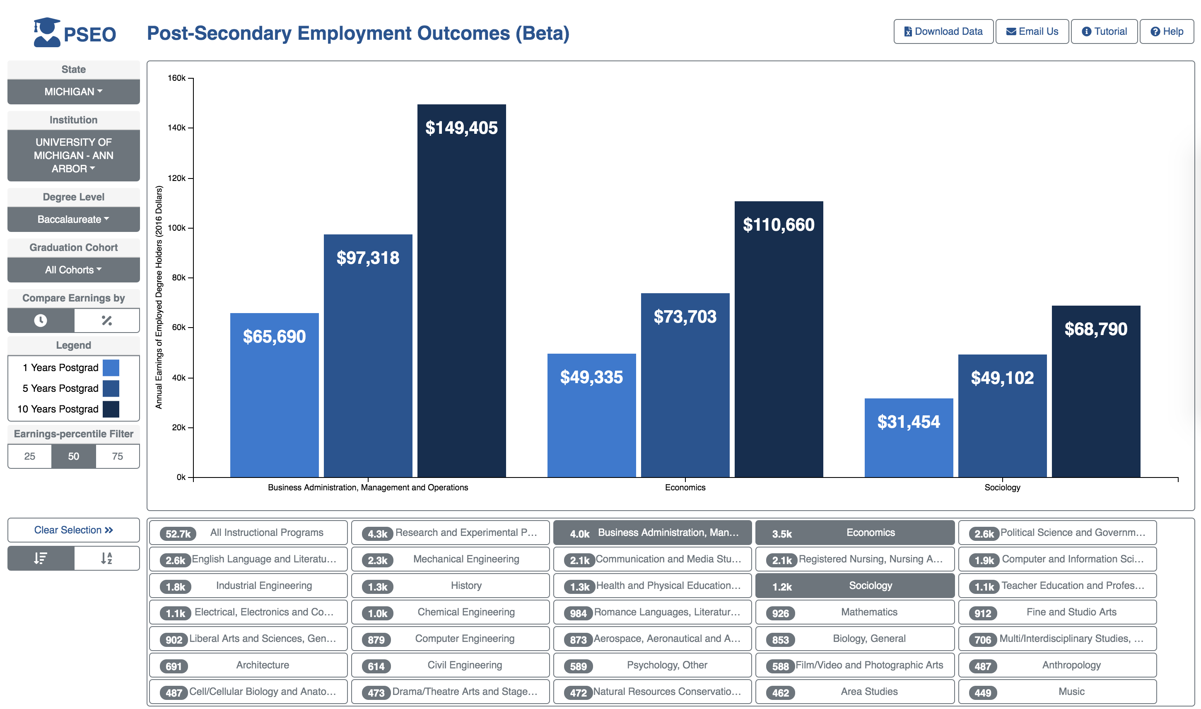
Some interesting tidbits
Census Bureau visualization tool
Median Earnings @ 1, 5, 10 years for BAs in Business, Econ, Sociology

Slide 9
Benefits of a Regional Collaborative Model
Build local and collaborative capability to use your data in useful, mission-driven ways
The people who know your data and needs best are directly engaged with the work
Control and transparency for data stewardship and use
Ability to define needs and restrictions
Technical and institutional mechanisms for data expansion and linkage
Visible methods and explicitly priorities
More nuanced approach to privacy/confidentiality
Stakeholder value and buy-in
Responsive to new situations and questions
Benefits of data integration within and across agencies and states
Multiple scales of analysis appropriate to your issues
Network models of organization are more nimble and innovative than large bureaucracies
You define, collaborate to do and directly benefit from the work

Slide 10
Costs of a Regional Collaborative Model
You define and collaborate to do the work

Slide 11
Questions?

